Slide 1
The Federal Court System
Chapter 18

Slide 2
The National Judiciary
Chapter 18 Section 1

Slide 3
Creation of a National Judiciary
Under the Articles of Confederation:
  Laws were interpreted and applied as each State saw fit
  Disputes between States and between person who lived in different States were decided, if at all, by the courts in one of the States involved
  Often, decisions by the courts in one State were ignored by the courts in other States

Slide 4
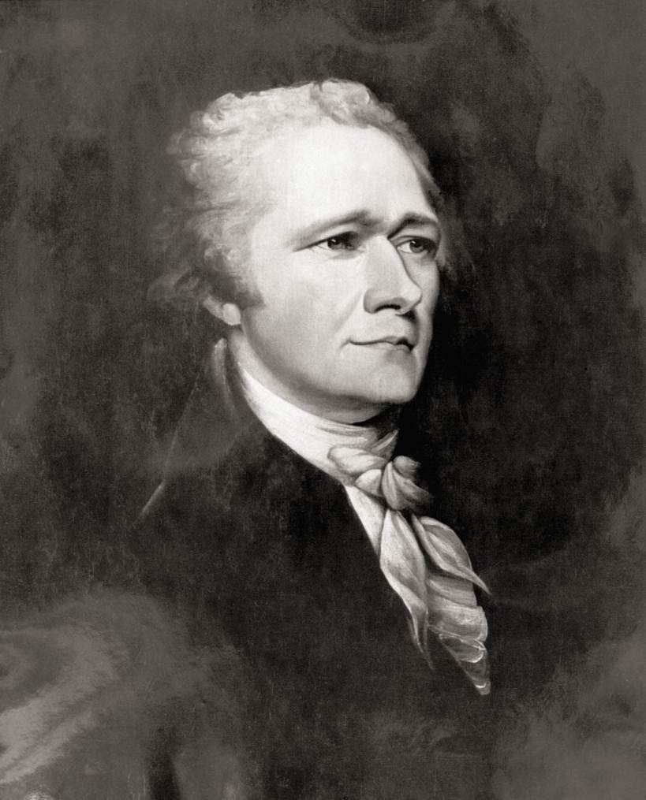
Creation of a National Judiciary
Alexander Hamilton argued the need for a national court system.
  Laws are dead without courts to interpret and define them
Constitution created a national judiciary under Article III

Slide 5
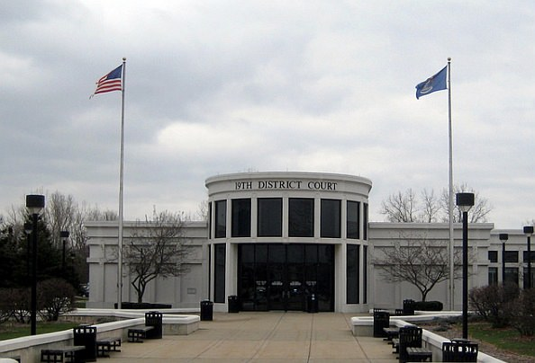
Dual Court system
Two separate court systems in America
  National judiciary spans the country with more than 120 courts
  Each of the fifty states has its own court system
    Number runs into the thousands
    State courts hear most of the cases in the country
Dearborn 19th District Court

Slide 6
Two kinds of federal Court
Constitutional Courts
Special Courts
Inferior courts that Congress has formed
Together with the Supreme Court the now include the courts of appeal, the district courts, and the U.S. court of International Trade
AKA regular courts or Article III courts
Do not exercise the broad “judicial Power of the United States”
Hear a much narrower range of cases
AKA the legislative courts

Slide 7
The Special Courts
The Court of Federal Claims | Composed of 16 judges, appointed by the president. Hears claims for damages against the government
The Territorial Courts | Courts in our nation’s territories
The District of Columbia Courts | Judicial system in our Nation’s capital (superior court and court of appeals)
The Court of Appeals for the Armed Forces | Military Courts for each branch of the nation’s armed forces (not a part of the federal court system)
Military Tribunals | Panels composed of American military personal that will hear trials against foreigners accused of committing acts of terror against the United States
The Court of Appeals for Veterans Claims | Power to hear appeals from the decisions of an administrative agency, Depart of Veterans Affairs Hears cases in which individuals claim that the VA has denied or mishandled claims for veterans benefits
The United States Tax Court | 19 Judges Hears civil but not criminal cases involving disputes over the application of the tax laws

Slide 8
Federal Court Jurisdiction
Jurisdiction
  The authority of a court to hear (to try and to decide) a case
  Federal Courts have jurisdiction over certain cases
  Article III, Section 2 of the Constitution provides that federal courts may hear a case because of either
    The subject matter
    Parties involved
  Cases that are not heard within the federal courts are within the jurisdiction of the States’ courts

Slide 9
Types of Jurisdiction
Exclusive Jurisdiction
  Cases that can only be heard in federal courts
    Ambassadors or other officials of foreign governments
    Person charged with federal crime (ex. Patent or copyright infringements)
Concurrent Jurisdiction
    May be tried in either a federal court or a State court
      Disputes involving citizens of different States

Slide 10
Type of Jurisdiction
Original Jurisdiction
  A court in which a case is heard first
Appellate Jurisdiction
  A court that hears a case on appeal from a lower court
  The appellate court may uphold or overrule, or in someway modify the decision appealed from the lower court
Parties involved in cases
Plaintiff: the person who files the suit
Defendant: the person against who made the complaint is made

Slide 11
Federal Judges
The President of the United States names federal judges
  The Senate, however, has to confirm the President’s nomination
The Constitution does not:
  Set an age limit for judges
  Set requirements for residence or citizenship
  Require that a judge have a professional background in law

Slide 12
Terms and Pay of Federal Judges
Appointed for life
  They serve until they resign, retire, or die in office
  Federal judges may be removed, however, through the impeachment process
    Only 15 judges have been impeached, with only 7 out of the 15 have been removed by the Senate

Slide 13
The inferior Courts
Chapter 18 section 2

Slide 14
What are the structure and Jurisdiction of the inferior courts?

Slide 15
Federal District Courts
The United States district courts are the federal trial courts
  667 federal judges handle more than 300,000 cases per year
District courts hear:
  Criminal cases (federal court)
    One in which the defendant is tried for committing some action that Congress has declared by law to be a federal crime
  Civil cases
    Noncriminal matter

Slide 16
The Court of appeals
Created by Congress in 1891
Established to relieve the Supreme Court of much of the burden of hearing appeals from the district courts
There are 13 federal courts of appeals in the United States

Slide 17
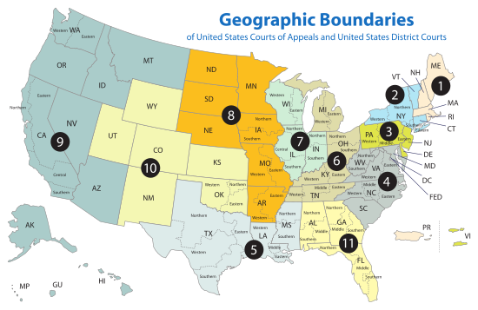
THE COURT OF APPEALS

Slide 18
The supreme court
Chapter 18 section 3

Slide 19
Judicial Review
Federal and State courts have extraordinary power to decide the constitutionality of an act of government, whether executive, legislative, or judicial
Ultimate power lays with the Supreme Court
Marbury v. Madison stated the following
  Constitution is the supreme law of the land
  All legislative acts and other actions of government are inferior to the supreme law and cannot be allowed to conflict with it
  Judges are sworn to enforce the provisions of the Constitution, and therefore must refuse to enforce any government action they find to be in conflict with it

Slide 20
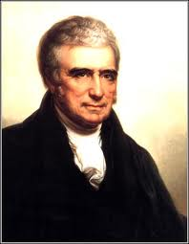
The Supreme Court
The Supreme Court is the only court specifically created by the United States Constitution.
The Court is made up of the Chief Justice of the United States and eight associate judges
Final authority in any case involving any question arising under the Constitution, an act of Congress, or a treaty of the United States
John Marshall from the first Supreme Court justice to increase the power of the Court

Slide 21
The Supreme Court
Article III of the Constitution
  Created the Supreme Court as one of the three branches
Is…
The last resort in all questions of federal law
The final authority in any case involving the Constitution, acts of Congress, and treaties with other nations
The decisions of the Supreme Court are binding on all lower courts
Nomination to the Supreme Court is a very high honor

Slide 22

Supreme Court Justices
Composed of Nine Justices:
  1 Chief Justice
  8 Associate Justices

Slide 23
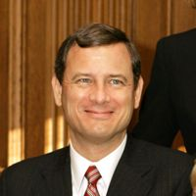
Chief Justice John Roberts

Slide 24
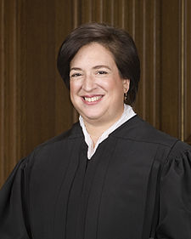
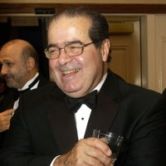
Supreme Court Justices
Elena Kagan
(newest member)
Antonin Scalia

Slide 25
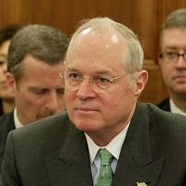
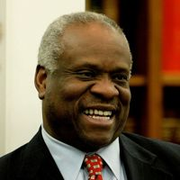
Supreme Court Justices
Anthony M. Kennedy
Clarence Thomas

Slide 26
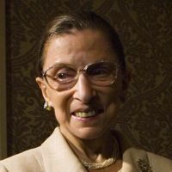
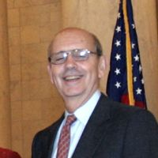
Supreme Court Justices
Ruth Bader Ginsburg
Stephen G. Breyer

Slide 27
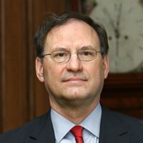
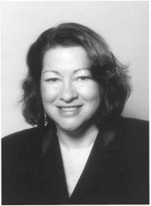
Supreme Court Justices
Samuel Alito, Jr.
Sonia Sotomayor

Slide 28
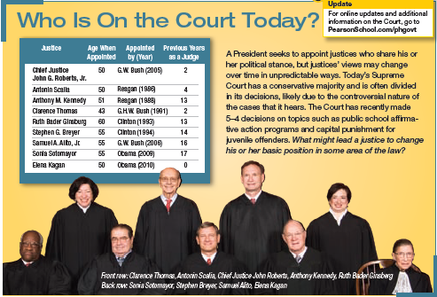

Slide 29
Duties of the Supreme Court
The main duty of the justices is to hear and rule on cases.
  Three decision making tasks:
  Decide which cases to hear from among the thousands appealed to the Court each year
  Decide the case itself
  Determine an explanation for the decision, called the Court’s opinion.

Slide 30
Duties of the Supreme Court
Chief Justice John Roberts has
several additional duties:
Presides over sessions and conferences at which cases are discussed
Carries out a leadership role in the court’s judicial work
Helps administer the federal court system

Slide 31
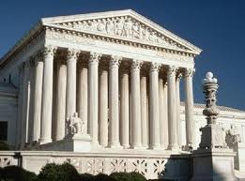
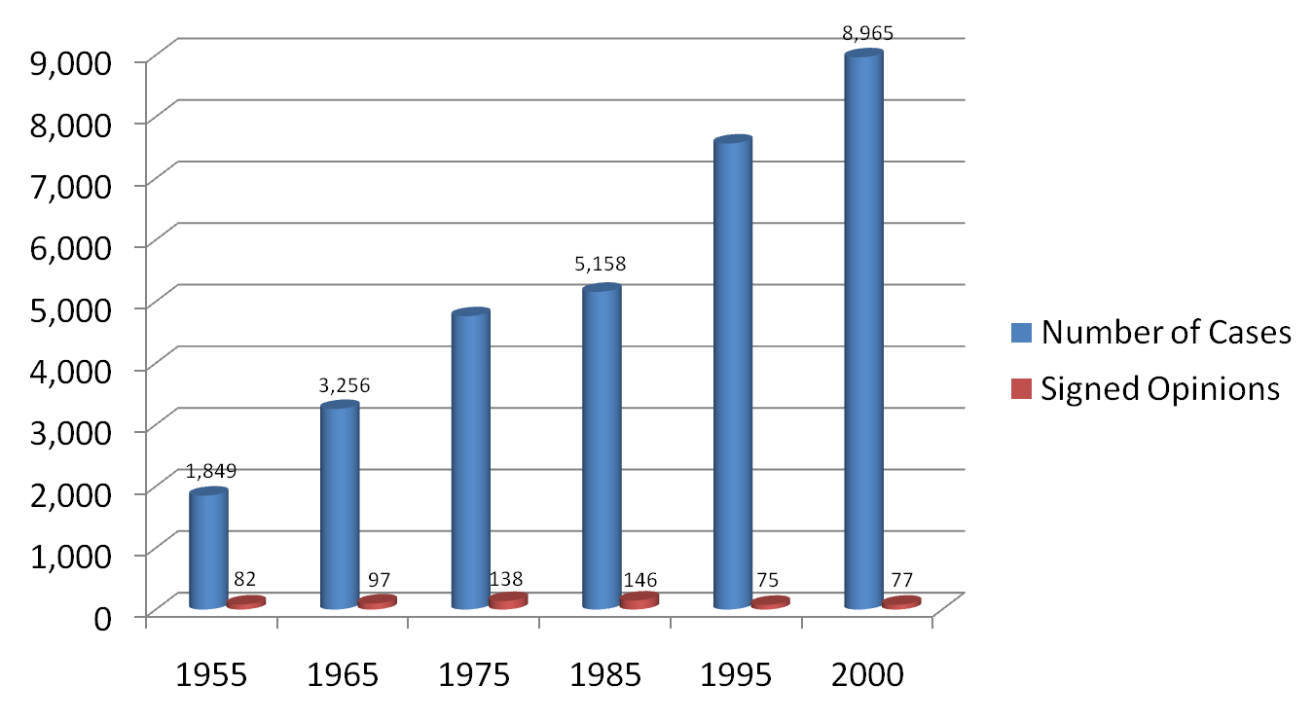
How the Supreme Court Operates
Only about 1% of cases sent to the Supreme Court are “heard” by the Court

Slide 32
The majority of cases that reach the Supreme Court are from appeals from lower court decisions.
How Cases Reach the Court
Writ of Certiorari | Main route to the Supreme Court Order from the Court to a lower court to send up the records Must argue either that the lower court made a legal error in handling the case or that the case raises a significant constitutional issue
On Appeal | The decision of a lower federal or state court has been requested to be reviewed Few cases actually arrive on appeal

Slide 33
Selecting Cases
Justices or clerks identify cases worthy of serious consideration
Chief Justice then puts them on the “discuss list” for all of the justices to consider
Court operates by the“rule of four”
  4/9 justices agree to accept the case, the Court will do so

Slide 34
How the Supreme Court Operates
Oral Argument
  sets a date on which that case will be heard
  Arguments are limited to 30 minutes
Briefs
  Briefs are written documents filed with the Court before oral arguments begin
The Court in Conference
  Justices meet Wednesday and Fridays (from October-July) to consider the cases in which they have heard oral arguments
  Chief Justice presides over the conference (speaks first and usually indicates how he intends to vote)
  Each associate judge will then summarize his/her views
    Presentations are made in order of seniority

Slide 35
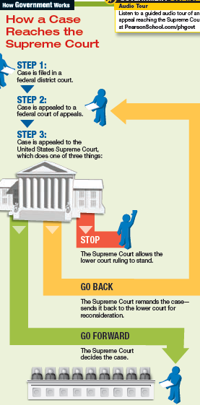

Slide 36
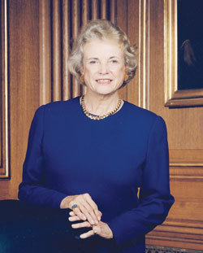
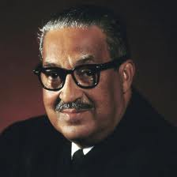
Historic Supreme Court Justices
Sandra Day O’Connor
Thurgood Marshall
First Female
Supreme Court Justice
First African American
Supreme Court Justice

Slide 37
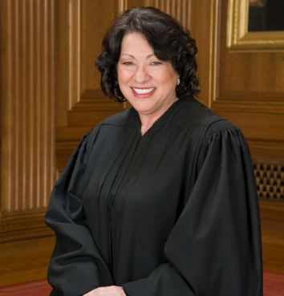
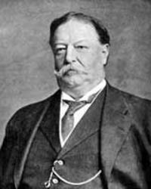
Historic Supreme Court Justices
Sonia Sotomayor
William H. Taft
First Hispanic
Supreme Court Justice
Only President to serve as a Supreme Court Justice

Slide 38
The court’s Opinions
Majority Opinion
  The courts opinion, announces the Court’s decision in a case and sets out the reasoning on which it is based
Precedents
  Examples to be followed in similar cases as they arise in the lower courts or reach the Supreme Court
Concurring opinion
  To add or emphasize a point that was not made in the majority opinion
Dissenting opinion
  Often written by those judges who do not agree with the majority decision

