Slide 1
The Federal Court System
Chapter 18-Streamlined Version

Slide 2
The National Judiciary
Chapter 18 Section 1

Slide 3
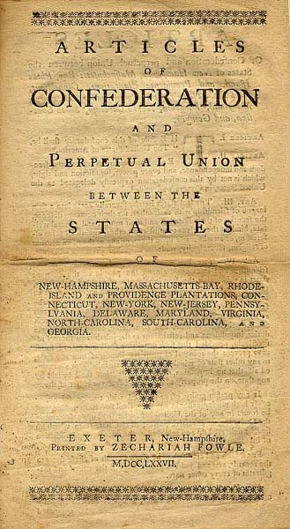
Creation of a National Judiciary
Under the Articles of Confederation:
  Laws were interpreted and applied as each State saw fit
  Disputes between States and between person who lived in different States were decided, if at all, by the courts in one of the States involved
  Often, decisions by the courts in one State were ignored by the courts in other States

Slide 4
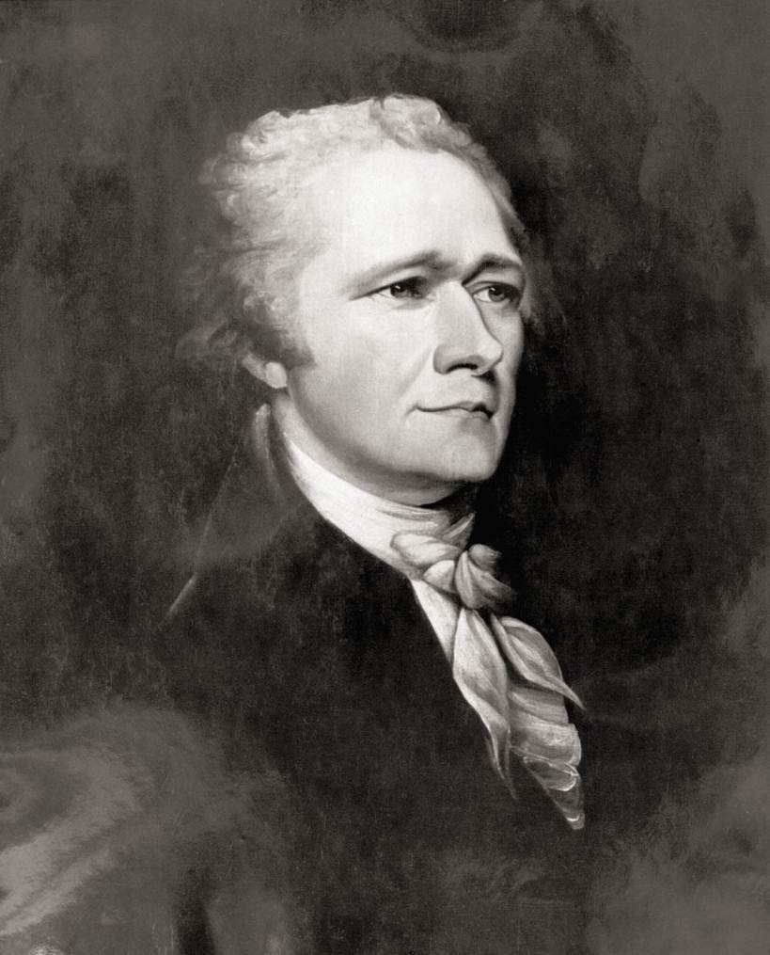
Creation of a National Judiciary
Alexander Hamilton argued the need for a national court system.
  Laws are dead without courts to interpret and define them
Constitution created a national judiciary under Article III

Slide 5
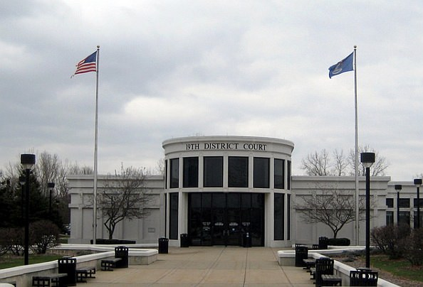
Dual Court system
There are two separate court systems in America
  National judiciary spans the country with more than one-hundred and twenty courts
  Each of the fifty states has its own court system
    Number runs into the thousands
      Broken into districts
    State courts hear most of the cases in the country
Dearborn 19th District Court

Slide 6
Two kinds of federal Court
Constitutional Courts
  Inferior courts that Congress has formed
  Together with the Supreme Court the now include the courts of appeal, the district courts, and the U.S. court of International Trade
    AKA regular courts or Article III courts
Special Courts
  Do not exercise the broad “judicial Power of the United States”
  Hear a much narrower range of cases
    AKA the legislative courts

Slide 7
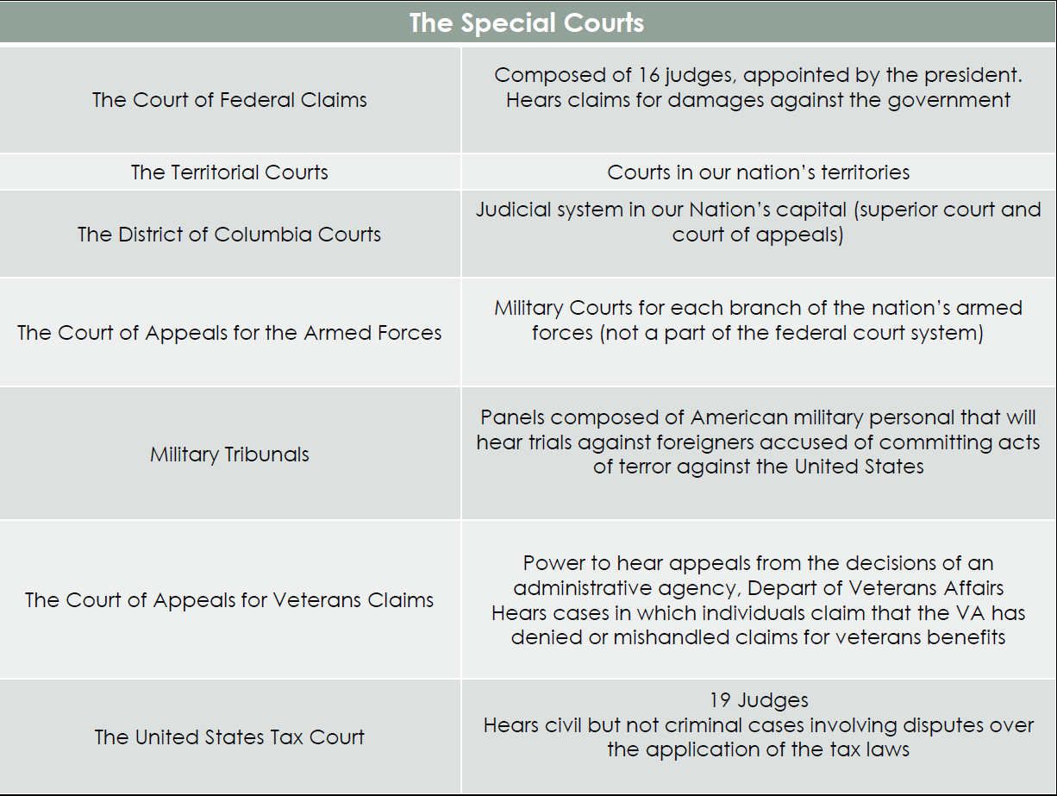

Slide 8
Federal Court Jurisdiction
Jurisdiction-
  The authority of a court to hear (to try and to decide) a case
  Federal Courts have jurisdiction over certain cases
  Article III, Section 2 of the Constitution provides that federal courts may hear a case because of either
    The subject matter
    Parties involved
  Cases that are not heard within the federal courts are within the jurisdiction of the States’ courts

Slide 9
Types of Jurisdiction
Exclusive Jurisdiction
  Cases that can only be heard in federal courts
    Ambassadors or other officials of foreign governments
    Person charged with federal crime (ex. Patent or copyright infringements)
Concurrent Jurisdiction
    May be tried in either a federal court or a State court
      Disputes involving citizens of different States

Slide 10
Type of Jurisdiction
Original Jurisdiction
  A court in which a case is heard first
Appellate Jurisdiction
  A court that hears a case on appeal from a lower court
  The appellate court may uphold or overrule, or in someway modify the decision appealed from the lower court
Parties involved in cases
Plaintiff: the person who files the suit
Defendant: the person against who made the complaint is made

Slide 11
The inferior Courts
Chapter 18 section 2

Slide 12
Federal District Courts
The United States district courts are the federal trial courts
  667 federal judges handle more than 300,000 cases per year
District courts hear:
  Criminal cases (federal court)
    One in which the defendant is tried for committing some action that Congress has declared by law to be a federal crime
  Civil cases
    Noncriminal matter

Slide 13
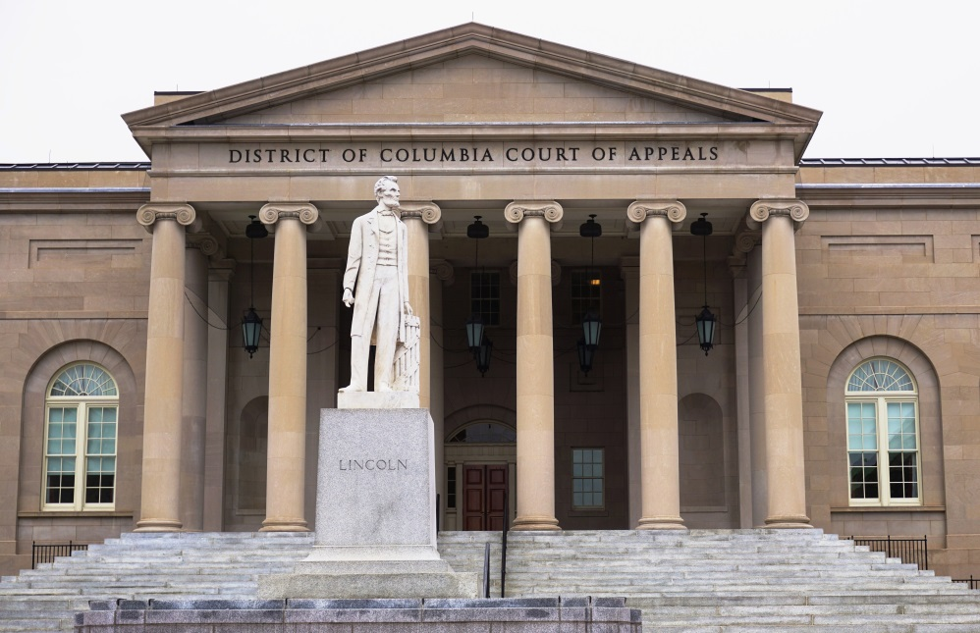
The Court of appeals
Created by Congress in 1891
Established to relieve the Supreme Court of much of the burden of hearing appeals from the district courts
There are 13 federal courts of appeals in the United States

Slide 14
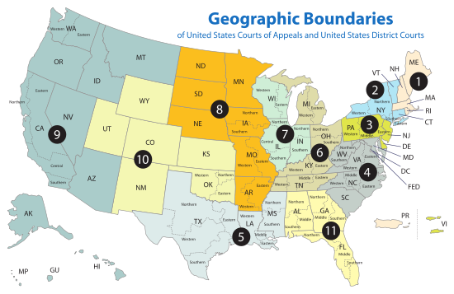
THE COURT OF APPEALS

Slide 15
The supreme court
Chapter 18 section 3

Slide 16
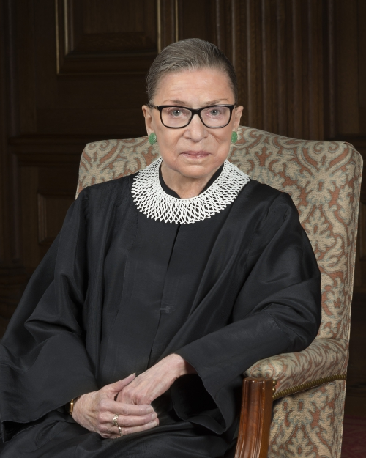
Federal Judges
The President of the United States names federal judges
  The Senate, however, has to confirm the President’s nomination
Appointed for life
  They serve until they resign, retire, or die in office
  Federal judges may be removed, however, through the impeachment process
    Only 15 judges have been impeached, with only 7 out of the 15 have been removed by the Senate
The Constitution does not:
  Set an age limit for judges
  Set requirements for residence or citizenship
  Require that a judge have a professional background in law
Supreme Court Justice
Ruth Bader Ginsburg

Slide 17
Judicial Review
Federal and State courts have extraordinary power to decide the constitutionality of an act of government, whether executive, legislative, or judicial
Ultimate power lays with the Supreme Court
Marbury v. Madison stated the following
  Constitution is the supreme law of the land
  All legislative acts and other actions of government are inferior to the supreme law and cannot be allowed to conflict with it
  Judges are sworn to enforce the provisions of the Constitution, and therefore must refuse to enforce any government action they find to be in conflict with it

Slide 18
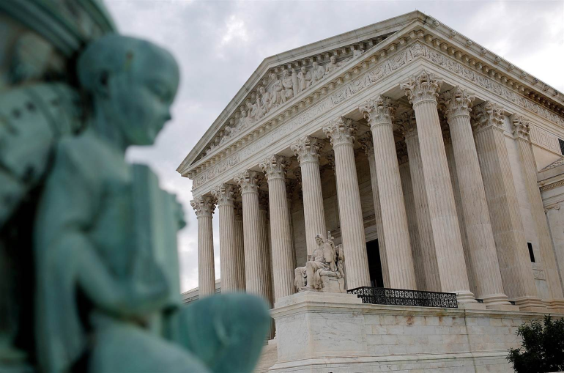
The Supreme Court
The Supreme Court is the only court specifically created by the United States Constitution.
The Court is made up of the Chief Justice of the United States and eight associate judges
Final authority in any case involving any question arising under the Constitution, an act of Congress, or a treaty of the United States
John Marshall from the first Supreme Court justice to increase the power of the Court

Slide 19
The Supreme Court
Article III of the Constitution
  Created the Supreme Court as one of the three branches
Is…
The last resort in all questions of federal law
The final authority in any case involving the Constitution, acts of Congress, and treaties with other nations
The decisions of the Supreme Court are binding on all lower courts
Nomination to the Supreme Court is a very high honor

Slide 20
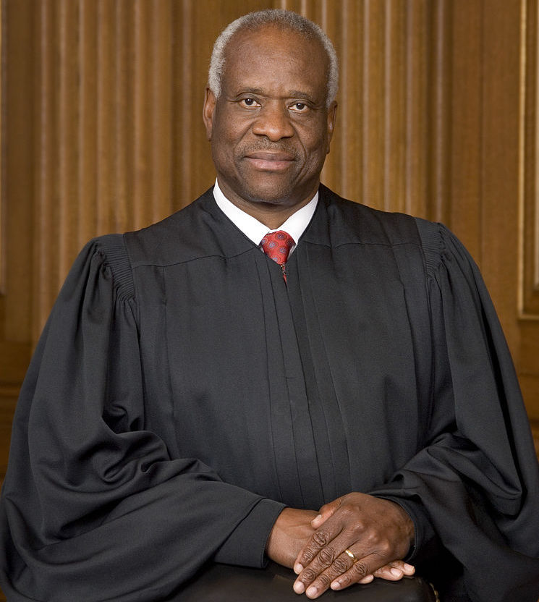
Duties of the Supreme Court
The main duty of the justices is to hear and rule on cases.
  Three decision making tasks:
    Decide which cases to hear from among the thousands appealed to the Court each year
    Decide the case itself
    Determine an explanation for the decision, called the Court’s opinion.
Supreme Court Justice
Clarence Thomas

Slide 21
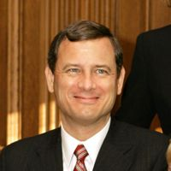
Duties of the Supreme Court
Chief Justice John Roberts has
several additional duties:
Presides over sessions and conferences at which cases are discussed
Carries out a leadership role in the court’s judicial work
Helps administer the federal court system

Slide 22
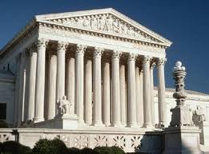
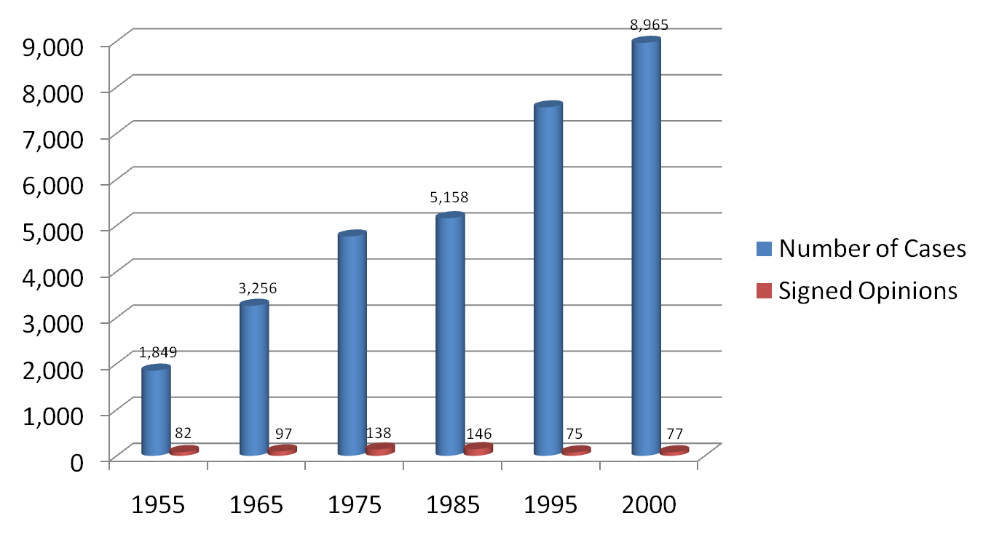
How the Supreme Court Operates
Only about 1% of cases sent to the Supreme Court are “heard” by the Court

Slide 23
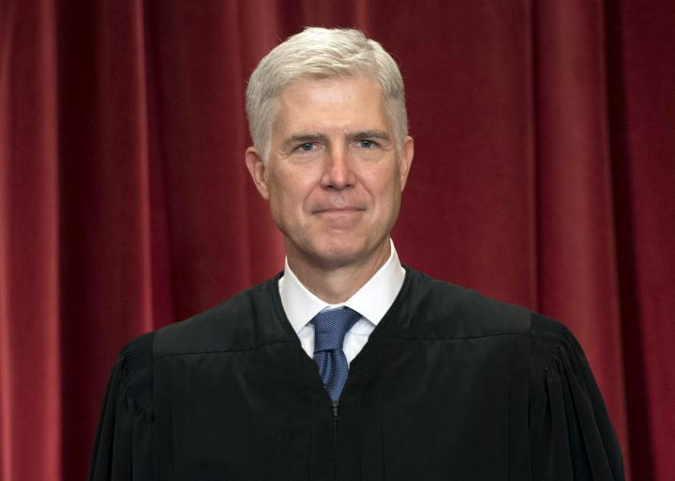
Selecting Cases
Justices or clerks identify cases worthy of serious consideration
Chief Justice then puts them on the “discuss list” for all of the justices to consider
Court operates by the “rule of four”
  4/9 justices agree to accept the case, the Court will do so
Supreme Court Justice
Neil Gorsuch

Slide 24
How the Supreme Court Operates
Oral Argument
  sets a date on which that case will be heard
  Arguments are limited to 30 minutes
Briefs
  Briefs are written documents filed with the Court before oral arguments begin
The Court in Conference
  Justices meet Wednesday and Fridays (from October-July) to consider the cases in which they have heard oral arguments
  Chief Justice presides over the conference (speaks first and usually indicates how he intends to vote)
  Each associate judge will then summarize his/her views
    Presentations are made in order of seniority

Slide 25
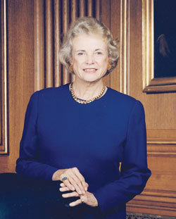
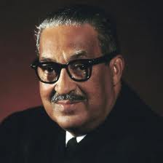
Historic Supreme Court Justices
Sandra Day O’Connor
Thurgood Marshall
First Female
Supreme Court Justice
First African American
Supreme Court Justice

Slide 26
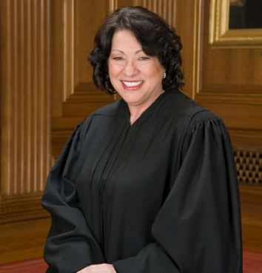
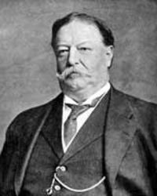
Historic Supreme Court Justices
Sonia Sotomayor
William H. Taft
First Hispanic
Supreme Court Justice
Only President to serve as a Supreme Court Justice

Slide 27
The court’s Opinions
Majority Opinion
  The courts opinion, announces the Court’s decision in a case and sets out the reasoning on which it is based
Precedents
  Examples to be followed in similar cases as they arise in the lower courts or reach the Supreme Court
Concurring Opinion
  To add or emphasize a point that was not made in the majority opinion
Dissenting Opinion
  Often written by those judges who do not agree with the majority decision

