Slide 1
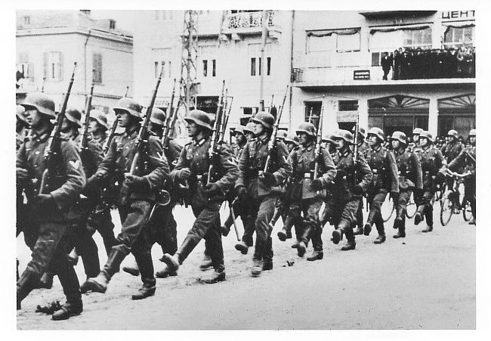
Chapter 16-Section 2-War in Europe

Slide 2
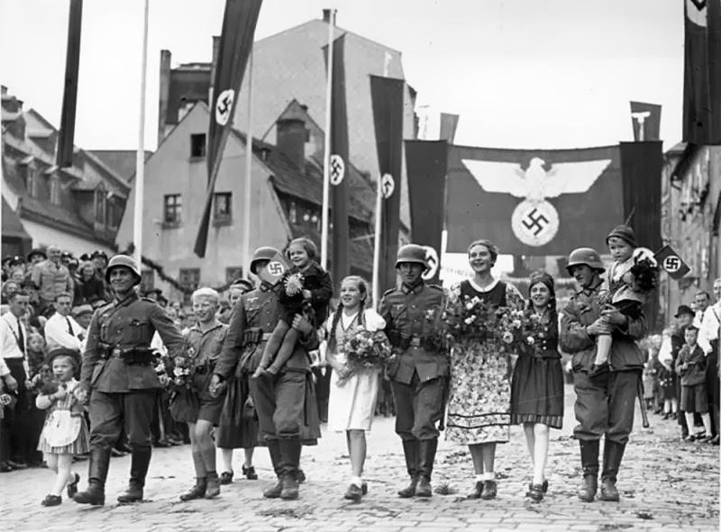
WAR IN EUROPE
AUSTRIA AND CZECHOSLAVAKIA FALL
Nov 5, 1937 Hitler met w/ military advisors
Declared that to grow and prosper Germany needed their land neighbors
Hitler’s 1st target became Austria
On March 12, 1938 German troops began marching into Austria unopposed
Following their victory in Austria Hitler turned his attention to Czechoslovakia

Slide 3
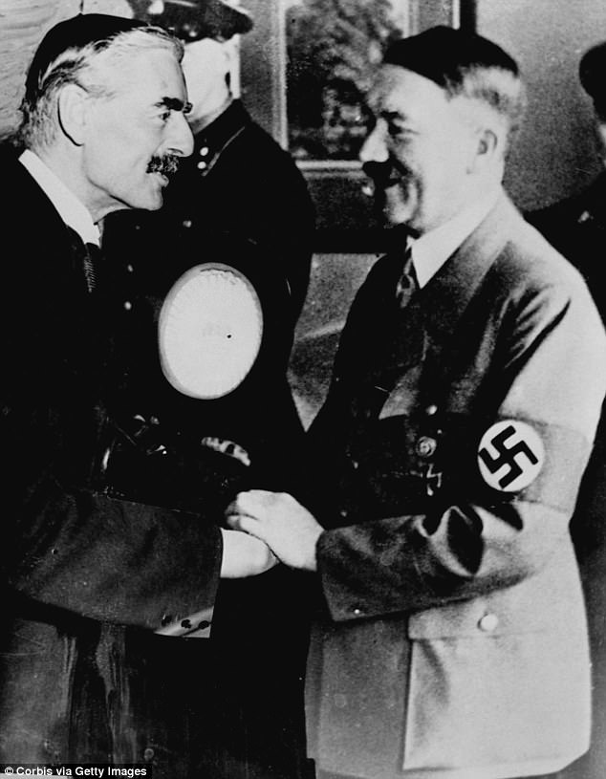
WAR IN EUROPE
Bargaining for the Sudetenland
Hitler said the Czechs were abusing the Sudeten Germans
Great Britain and France promised to protect Czechoslovakia
Hitler met with French premier Edouard Daladier and British Prime Minister Neville Chamberlain
He stated that this would be his “last territorial demand”
To avoid war they believed him and signing the Munich Agreement which introduced the policy of appeasement hoping if they gave Hitler a little of what he wanted that he would stop his invasion.

Slide 4
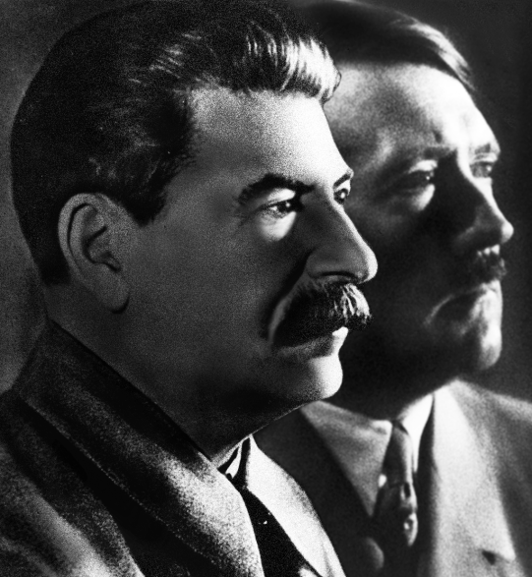
WAR IN EUROPE
Stalin surprised everyone by signing a nonaggression pact with Hitler
Fascist Germany and Communist Russia committed to never attack each other
Also signed a secret pact to split up Poland

Slide 5
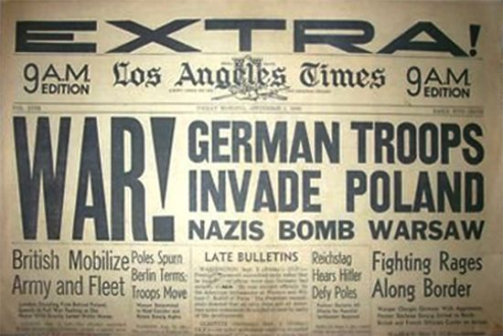
WAR IN EUROPE
The policy of appeasement ultimately failed as Hitler conquered Czechoslovakia and then turned to Germanys eastern neighbor Poland
Blitzkrieg (lightning war)-Germany’s new military strategy employed in Poland
An attack on Poland would:
Bring Germany in conflict w/ the Soviet Union
Provoke declaration of war from Britain and France (promised military aid to Poland)
The end result would lead to Germany fighting a two front war

Slide 6
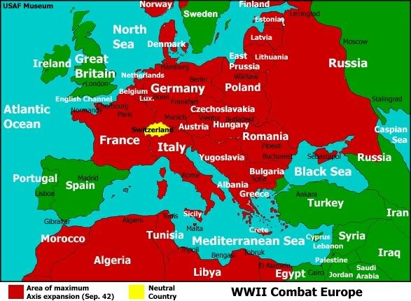
WAR IN EUROPE
French and British forces sat on the Maginot Line staring at Germany, waiting for something to happen
While all of this is going on the Soviet Union takes over Estonia, Finland, Latvia, and Lithuania
Hitler takes over Denmark and Norway then proceeds to take over Netherlands, Belgium and Luxembourg

Slide 7
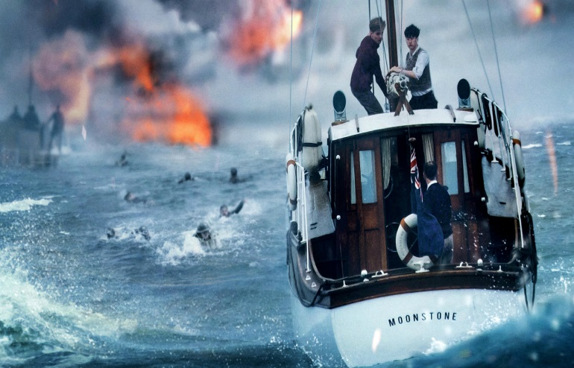
WAR IN EUROPE
FRANCE AND BRITAIN FIGHT ON-
Hitler sneaks around the Allied forces and goes through North East France
400,000 French and British flee to Dunkirk where they are trapped—330,000 make it to Britain
Days later, Italy joins the war and invades S. France, while Germans close in on Paris in the north

Slide 8
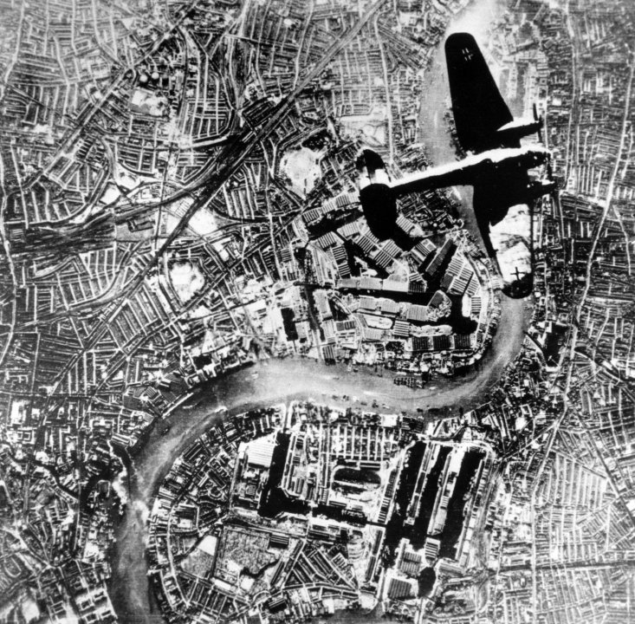
WAR IN EUROPE
The Battle for Britain-
The German assault on Great Britain began during the summer of 1940
Germany could not compete with Britain’s navy which preventing them from reaching England by sea
The German’s decided to launch a series of air attacks over Britain using their air force known as the Luftwaffe
On a single day (August 15th) about 2,000 German planes attacked Britain
Every night for 2 months bombers pounded London

Slide 9
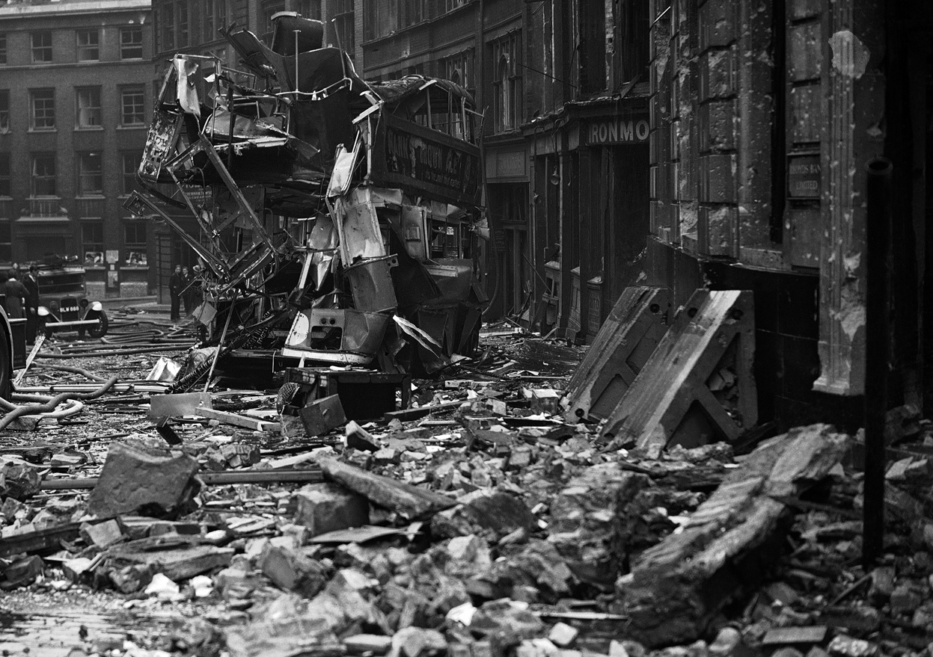

Slide 10
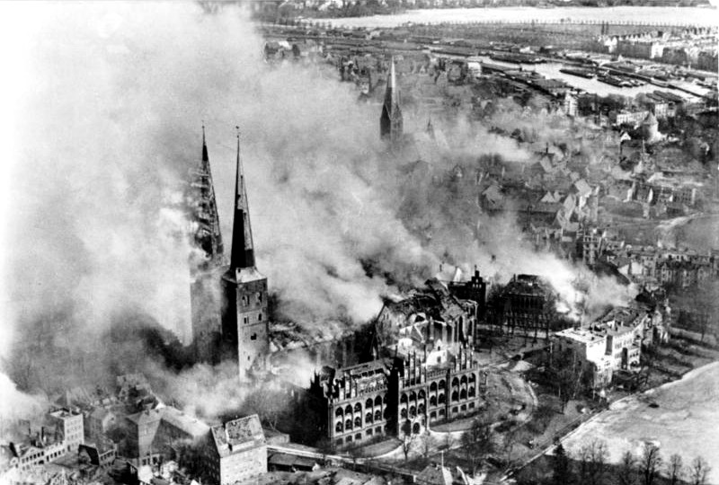

Slide 11
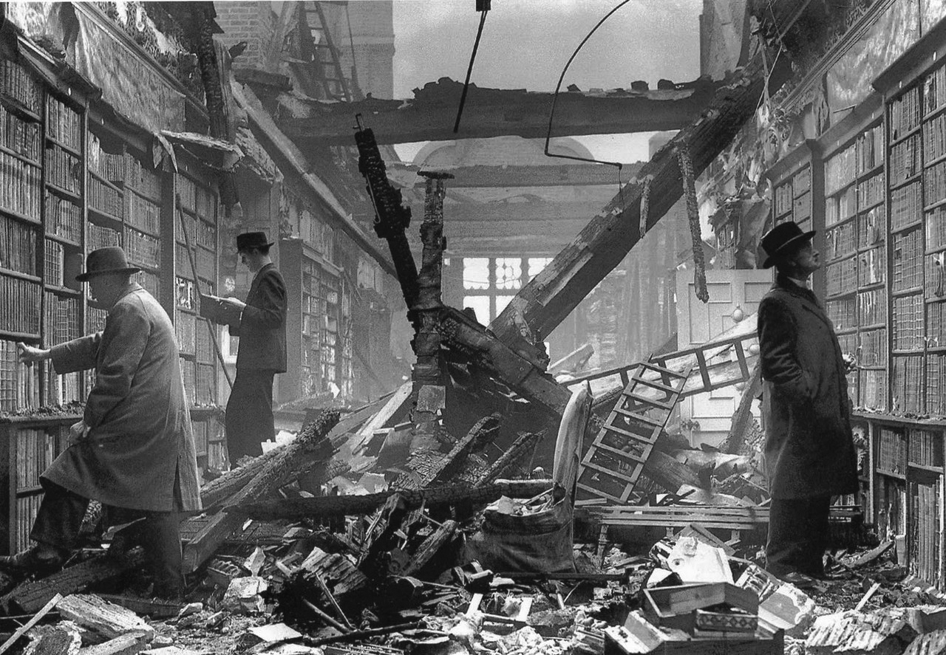

Slide 12
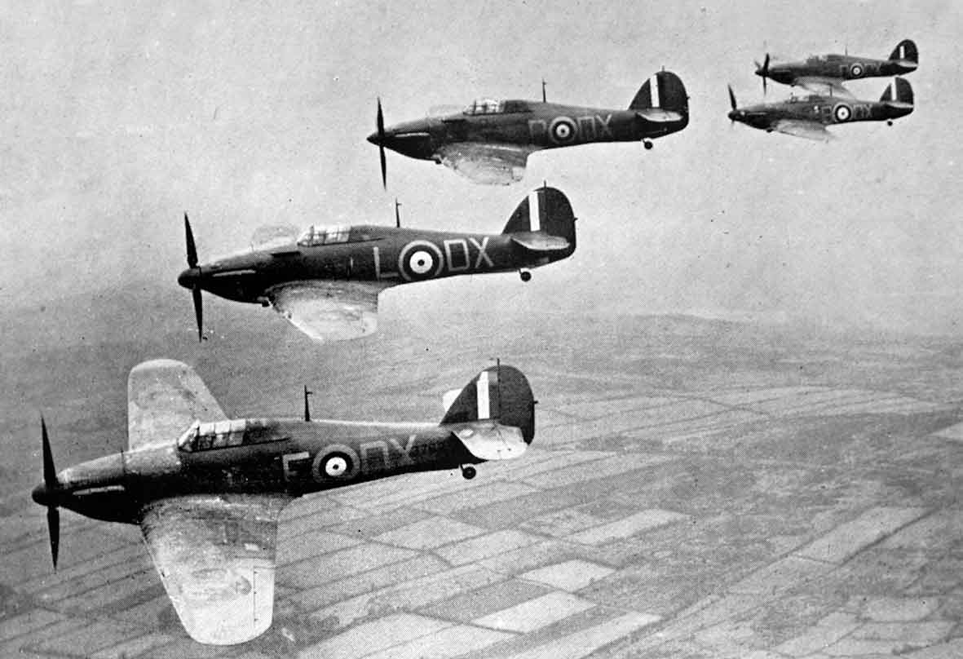
WAR IN EUROPE
The Battle for Britain-(continued)
Following the initial German onslaught the British Royal Airforce known as RAF began fighting back against Nazi air raids.
The British used radar to detect and plot the flight paths of German planes
The RAF is going to shoot down over 185 German planes severely crippling the Nazi air force
Hitler called off the attack indefinitely frustrated that they could not break the British

