Slide 1
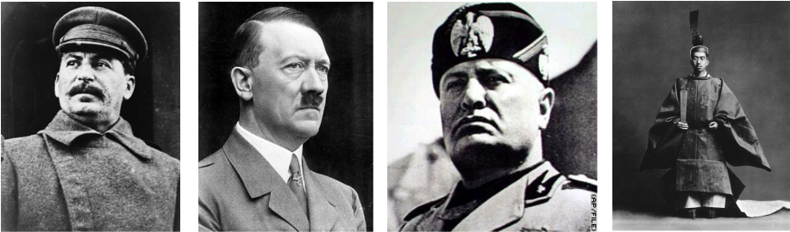
Dictators Threaten World Peace
Chapter 16-Section 1

Slide 2
Nationalism Grips Europe and Asia
Postwar Europe experienced an economic depression and witnessed democracies collapse
  Peace had not brought stability, but revolution
Dictators rose up to deal with hard times promising to support nationalism and increase territorial expansion
Nationalism-Pride in one’s country, loyalty, dreams of expansion

Slide 3
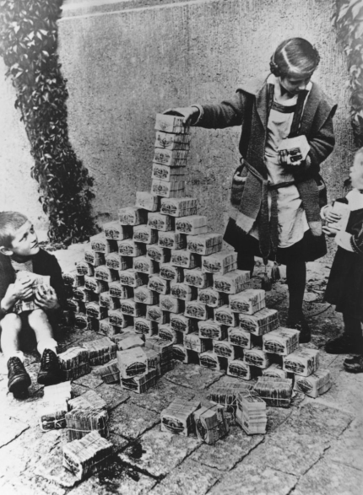
Nationalism Grips Europe and Asia
Treaty of Versailles did not truly bring peace it actually brought resentment for many Germans
  Germany in an economic depression and they could not pull itself out due to the massive amount of reparations they were forced to pay as a result of the War Guilt Clause
    They owed $33 billion to the U.S. and European nations
Young democracies in Europe were quickly overthrown leading to increased instability

Slide 4
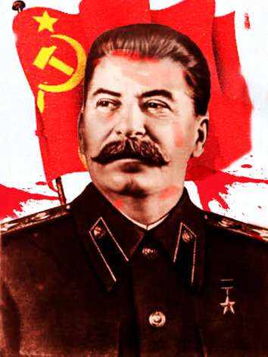
Nationalism Grips Europe and Asia
Joseph Stalin-The Soviet Union
The Soviet Union became a powerful nation under his “five year” plans following his assentation to power in 1924
  One of his key policies was supporting industrialization along with eliminating private farms and nationalizing them into collectively owned government farms
  This agricultural shift resulted in the deaths of millions due to restructuring, famine, and mistrust
  He also eliminated anyone who dared challenge him or get in his way
    Historians estimate Stalin is responsible for the deaths of somewhere between 8 and 13 million people

Slide 5
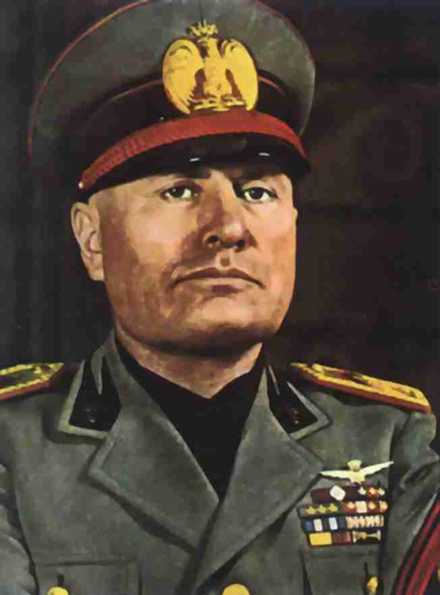
Nationalism Grips Europe and Asia
Benito Mussolini-Italy
  Powerful speaker
  Called himself “Il Duce”
  Appealed to many people because he said he would bring them out of the depression
  Established Italy’s Fascist Party in 1921

Slide 6
Nationalism Grips Europe and Asia
Totalitarian-A political state in which individuals have no rights and the government suppresses all opposition
Fascism-A form of government in which a belief in nationalism is stressed and the needs of the state are placed above the needs of its citizens
Factors that led to the rise of fascism:
  Italy’s national pride took a hit following WWI
  From an economic standpoint they were experiencing rising inflation and a high unemployment rate
    This led to massive social unrest

Slide 7
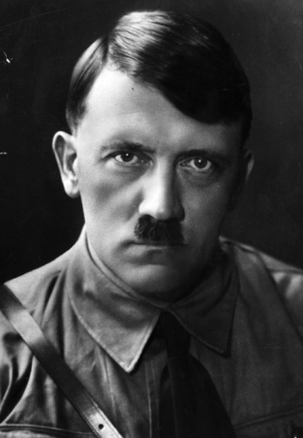
Nationalism Grips Europe and Asia
Nazism-A German brand of fascism that was based on the concept of extreme nationalism
Adolf Hitler-Germany
  Former WWI foot soldier, failed artist and political activist within the Nazi Party
  While serving eight months of a five year prison sentence writes Mein Kampf in 1925.
    In his book he outlines the basic beliefs of Nazism and their plan of action in Germany
  In 1933 he takes the title Der Fuhrer (“The Leader”) after coming to power much like Mussolini did in Italy
    Powerful and eloquent public speaker becoming the leader of the Nazi Party
    Promised to bring Germany out of crippling provisions of the War Guilt Clause and restore Germany to it’s pre-war glory

Slide 8
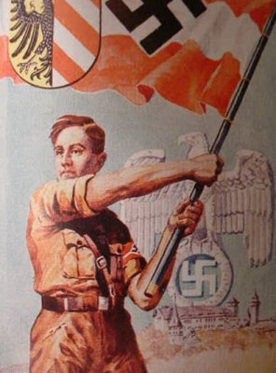
Nationalism Grips Europe and Asia
Hitler’s Three Goals for Germany
  Hitler was obsessed with racial purity and viewed the Aryan race as superior (those with blond hair, blue eyes and Germanic heritage)
    He felt all other inferior races were meant to serve those of Aryan decent
  Hitler dreamed of uniting all German-speaking people under a great German Empire which would require additional land to be conquered
  He also looked to strengthen the Nazi party by establishing the Third Reich (The Third German Empire)
Great Depression aided the Nazis and Hitler in their attempt to gain power

Slide 9

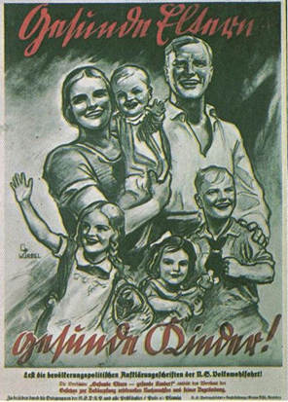
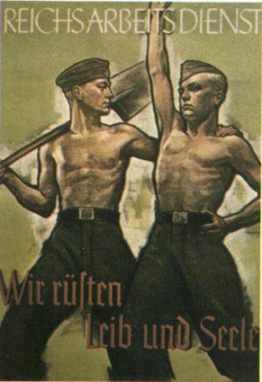
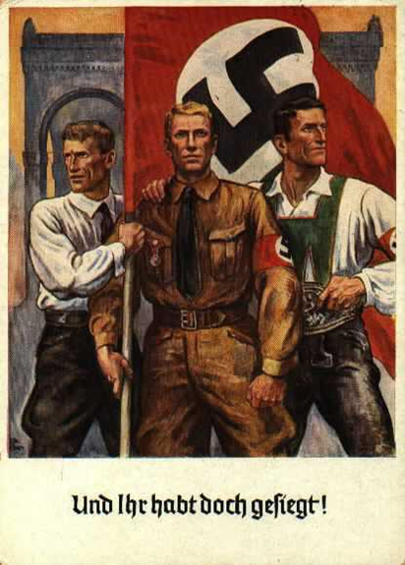
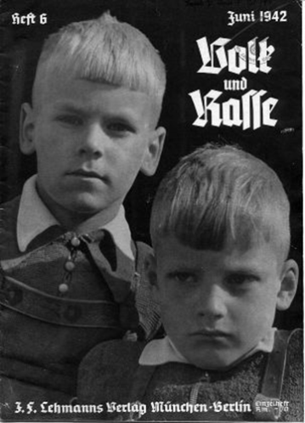
Nazi propaganda depicting the ideal Aryan members of Hitler’s “Master Race”

Slide 10
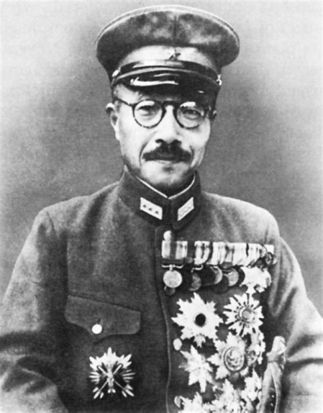
Nationalism Grips Europe and Asia
Hideki Tojo-Japan
Japan invaded Manchuria in 1931
  As an island Japan desired additional “living” space
  Manchuria was rich in much needed natural resources
Japan was condemned by the League of Nations for their actions however they simply quit the League and sided with the Axis Powers

Slide 11
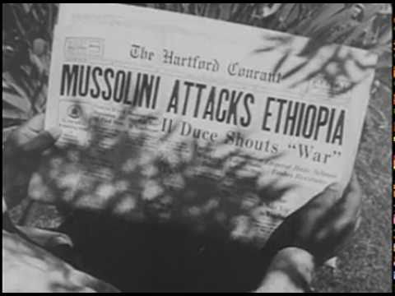
Nationalism Grips Europe and Asia
The failure of the League of Nations to punish Japan led to other European nations balking at the authority of the League.
  Germany pulls out of League of Nations in 1933
  In 1935 Italy under Mussolini invaded Ethiopia
  1936 Hitler began sending German troops into the Rhineland

Slide 12
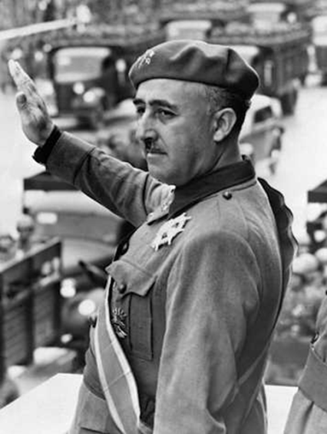
Nationalism Grips Europe and Asia
Francisco Franco-Spain
Franco led Spanish military officers in a rebellion against the Spanish Republic
  This led to a civil war in Spain
Soviet Union sent troops to help the Spanish government
Italy and Germany sent aid and supplies to Franco
3,000 Americans known as the “Abraham Lincoln Battalion” joined the fight against Franco, but it is not enough
Franco became Spain’s fascist dictator in 1939
  Shortly after he formed the Rome-Berlin Axis with Germany

Slide 13
The United States Responds Cautiously
Americans were alarmed with the events in Europe but felt that isolationism was the best course of action since this was “Europe's problem”
The Nye Commission led by North Dakota Senator Gerald Nye said U.S. was dragged into WWI by greed banks and manufactures that he referred to as “merchants of death”
Beginning in 1935, Congress passed a series of Neutrality Acts-
  The first two Neutrality Acts outlawed the sale of arms (weapons) or providing loans to waring nations
  The third act created a provision that would prevent us from selling arms to countries involved in civil wars

Slide 14
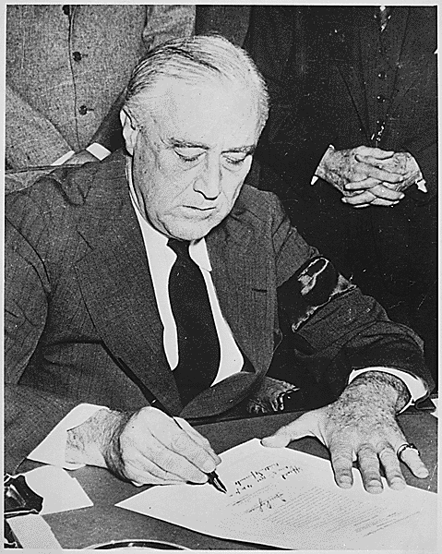
The United States Responds Cautiously
Despite Congressional attempts to remain neutral FDR began finding a way around the Neutrality Acts following Japan’s attack on China in 1937
  His excuse was since there was not a formal war declared between the two countries there was no need to enforce the Neutrality Acts
FDR also began speaking out against isolationism but received a massive amount of criticism from the media
  It would take a catastrophic event for the U.S. to set aside their insistence on neutrality and that would happen on December 7th, 1941

