Slide 1
The New Deal Affects Many Groups
Chapter 15-Section 3

Slide 2
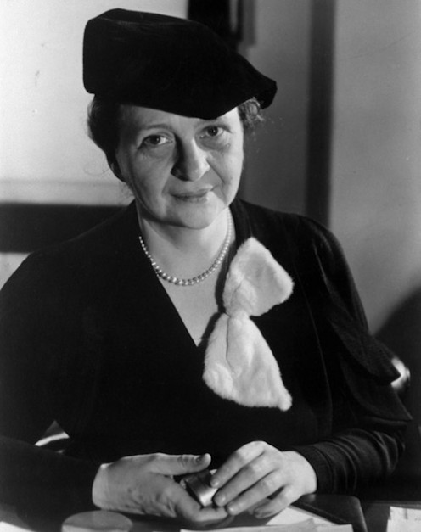
New Opportunities
Several Women appointed to government positions
Frances Perkins first female Cabinet Member (Secretary of Labor)

Slide 3
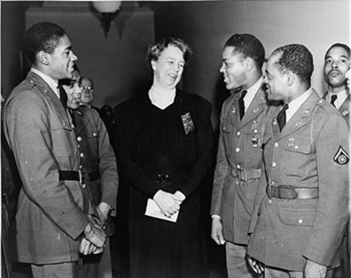
African-American Activism
1930’s saw growth of activism for African Americans
Laid groundwork for Civil Rights Movement (1950’s-60’s)
“Black Cabinet”–Group of influential African Americans to advise Roosevelt on racial issues.

Slide 4
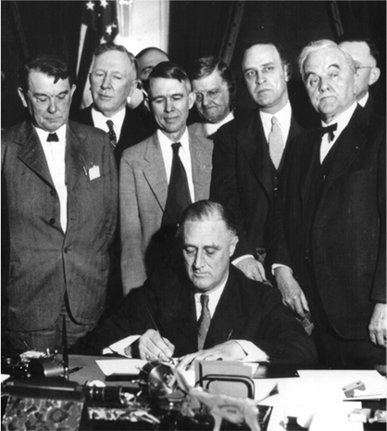
President Fails to Support Civil Rights
Roosevelt never committed to full civil rights for African Americans
Did not want to upset Southern voters
NRA, CCC and TVA discriminated against African Americans
Lower Wages
Few Jobs

Slide 5
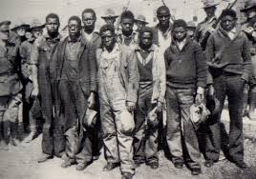
Powell v. Alabama
Powell v. Alabama was a Supreme Court Case in 1932
Nine African American men were put on trial for raping two white women
Eight of the Nine men were found guilty and sentenced to death in short 1 day trials
The men didn’t have adequate legal counsel (a lawyer)
Alabama ruled cases were legal
Supreme Court disagreed, said that states must provide lawyers in capitol cases (death penalty)

Slide 6
Culture in the 1930’s
Chapter 15 Section 4

Slide 7
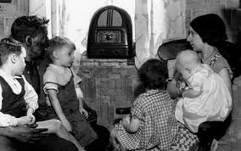
Motion Pictures and Radio
Very profitable during the 1930’s
By 1940 65% of Americans were attending the movies at least once a week
90% of American households owned a radio

Slide 8
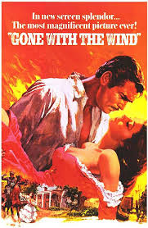
“Gone With The Wind”
Made in 1939
One of the most popular films of all time
Dealt with the life of plantation owners in the south
Acted as a “get-a-way” from the everyday hardships of the Great Depression

Slide 9
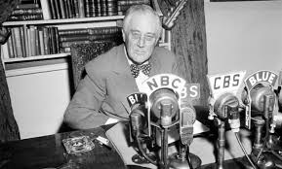
Fireside Chats
Families usually spent several hours a day together listening to the radio
Allowed FDR to speak directly to the people.
Spoke to them as if he were a friend, not the President.
These messages comforted the common man

Slide 10
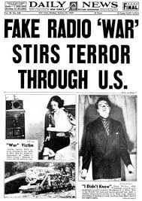
Orson Welles
Actor, director, producer, and writer
Created “War of the Worlds” (1938)
Many people actually believed it was a real news report

Slide 11
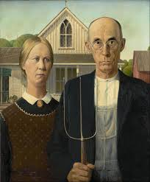
Grant Wood
American painter
Painted “American Gothic” – 1930
FDR appointed writers and artists to paint murals to cheer up Americans

Slide 12
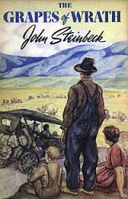
The Grapes of Wrath
Written by John Steinbeck in 1939
Also received assistance from the Federal Writer’s Project
About the lives of a group of people from Oklahoma and their hardships during the Dust Bowl

