Slide 1
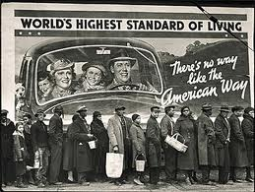
The Great Depression Begins
Chapter 14

Slide 2
The Nations Sick Economy
Chapter 14 Section 1

Slide 3
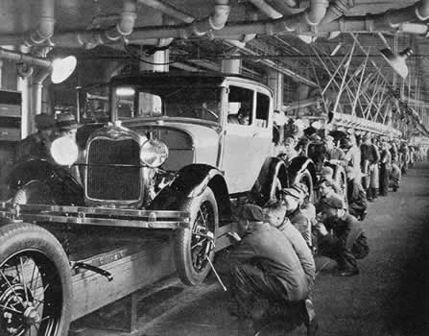
Economic Troubles on the Horizon
1920’s seemed prosperous, but there were hidden problems
Both wealthy and lower classes grew
Industries struggled and farmers were in trouble
Industries in Trouble:
Mining and lumbering, railroads, radio, steel and automobiles were among the industries who struggled
All of these industrial weaknesses signaled a declining economy

Slide 4
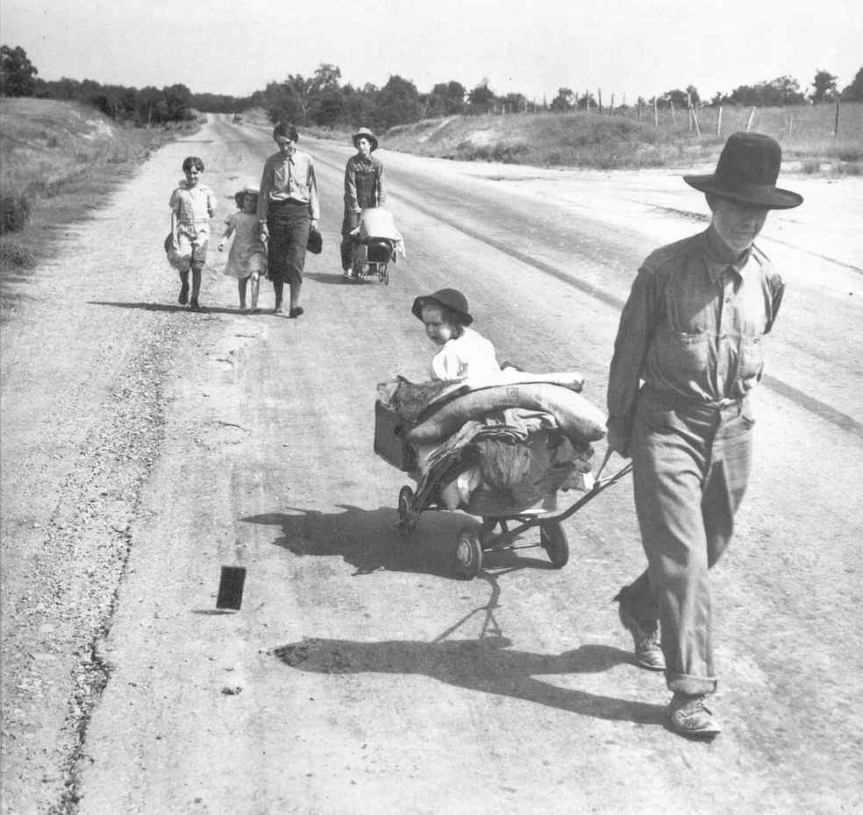
Agriculture and the Farmers
Prices for crops had been at an all-time high during WWI
Farmers had planted more and taken out more loans to buy more equipment
Government was buying food from the farmers at a very high rate and cost
After the war prices dropped by over 50%
A lot of farmers were unable to repay their loans and lost their farms

Slide 5
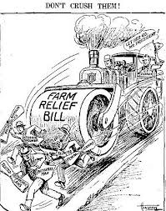
Agriculture and the Farmers
Banks begin to fail because farmers couldn’t repay their loans
McNary-Haugen Bill
A bill, calling for the federal government to purchase surplus crops. Twice passed by Congress (1927 and 1928) but both times vetoed by Coolidge.
Price-Supports-The government would buy surplus crops at guaranteed priced and sell them on the international market
This bill was vetoed by President Coolidge also

Slide 6
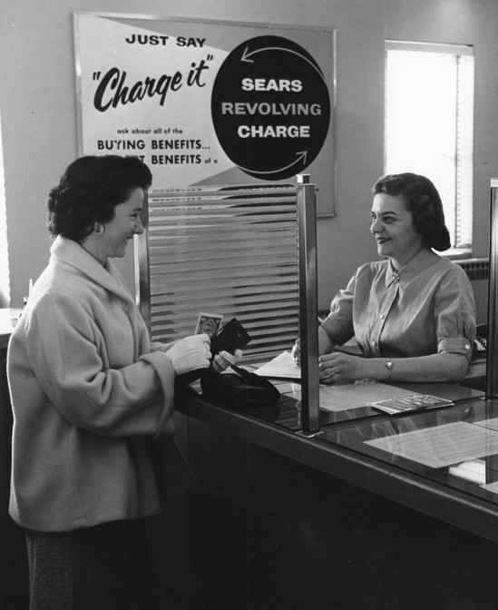
Living on Credit
Credit-Buy now pay later – usually with high interest rates
Seemed prosperous because people were buying with money, they did not have
Later when faced with rising debt, many consumers started cutting back on their spending
This cutback slowed the economy

Slide 7
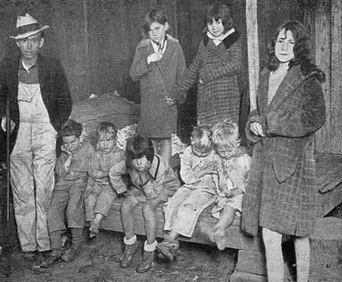
Uneven Distribution of Income
More than 71% of the population earned less than $2,500 per year
Most people could only afford one new set of clothes a year and many most did not have electricity or a furnace
Only 1 in 10 American’s had a refrigerator
Unfortunately, the rich were getting richer and the poor were getting poorer

Slide 8
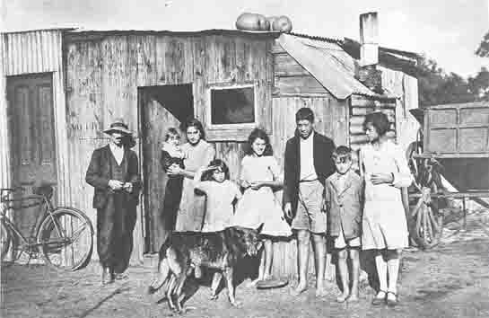

Slide 9
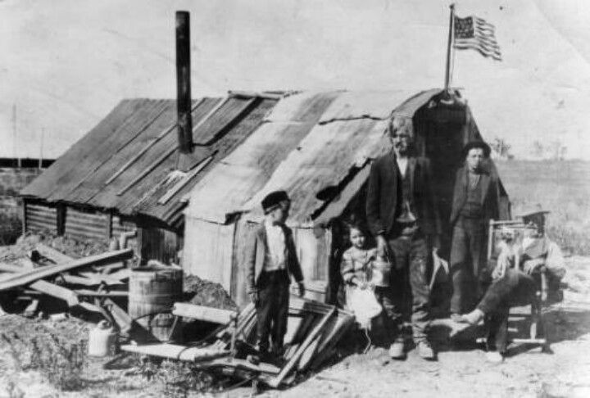

Slide 10
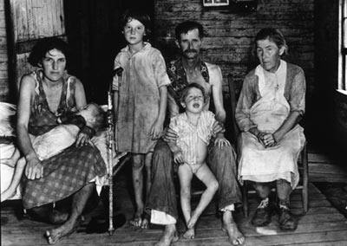

Slide 11
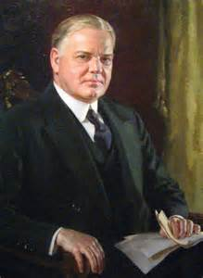
Hoover Takes the Nation
Election of 1928
Herbert Hoover (R) v. Alfred E. Smith (D)
Hoover wins the election easily and becomes the 31st President of the United States

Slide 12
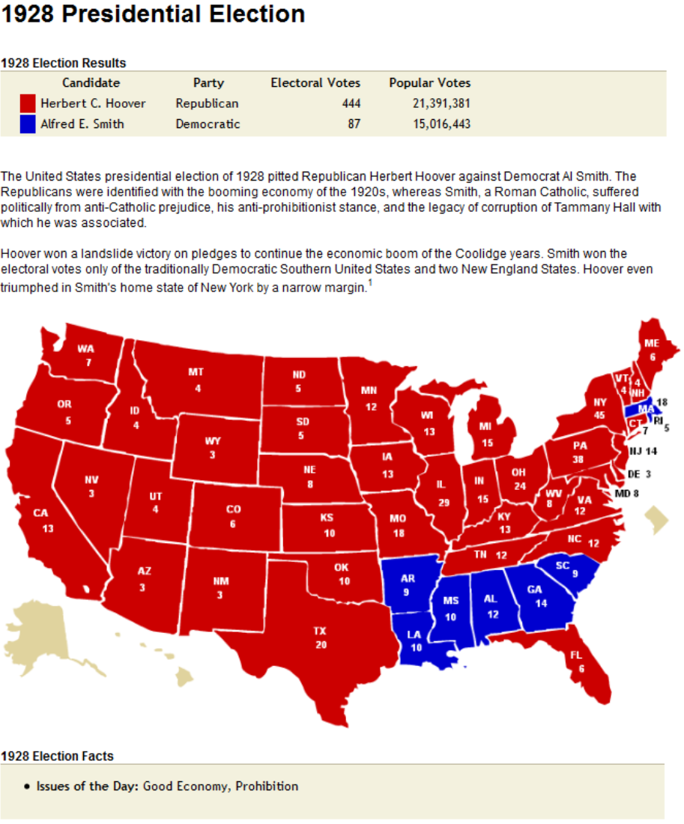

Slide 13
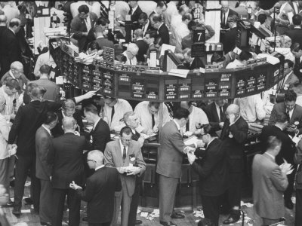
Stock Market
Americans who could afford it (and some who couldn’t) invested in the market
Dow Jones Industrial Average-Most widely used barometer of the stock market’s health
Measure based on the prices of stocks from twenty large companies

Slide 14
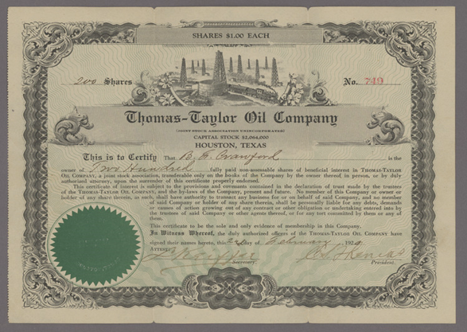
Stock Market
Speculation-People were buying stocks and bonds on the chance of a quick profit while ignoring risks
Buying on margin-paying a small percentage of a stock’s price as a down payment and borrowing the rest
Both speculation and buying on margin caused stock prices to rise
They caused over-investment because people bought more than they could pay for

Slide 15
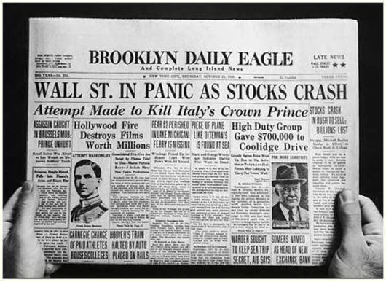
The Stock Market Crashes
Black Tuesday-
October 29, 1929
A record 16.5 million shares were sold
Millions more could not find buyers
People who had bought stock with loans were stuck with huge debt and unable to pay

Slide 16
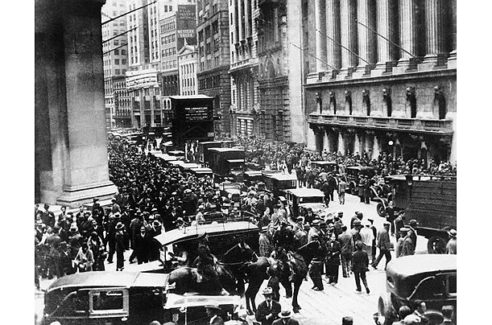
Financial Collapse
The stock market crash was the first sign of the Great Depression
Period between 1929 and 1940 in which the economy plummeted, and unemployment skyrocketed
The Great Depression was not just isolated to America – it was felt around the world

Slide 17
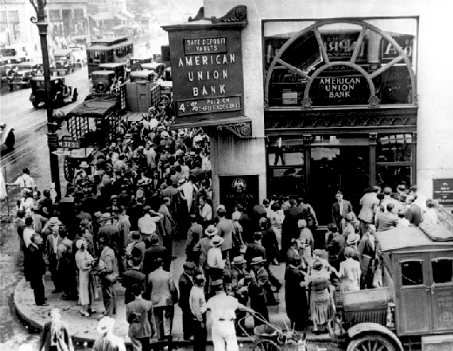
Bank and Business Failures
Banks also invested in the stock market – and they too lost their money
In 1929 around 600 banks closed–people could not get their money from the bank
By 1933 11,000 of the nation’s 25,000 banks had failed and lost their money
Millions of Americans lost all they had

Slide 18
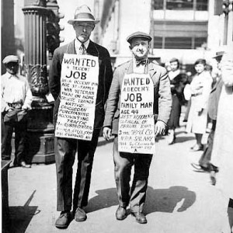
Unemployment
One out of every four Americans did not have a job by 1933
Those who did have a job were working for very little money with very little hours

Slide 19
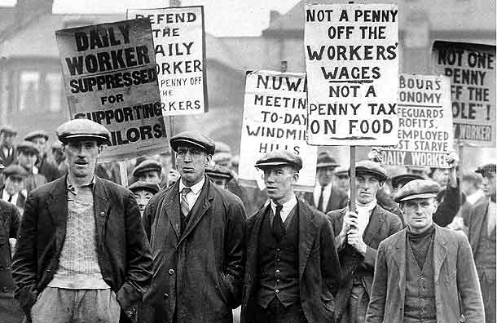
Hawley-Smoot Tariff
In 1930, Congress passed the Hawley-Smoot Tariff
Established the highest protective tariff in United States history
Designed to protect American farmers and manufacturers from foreign competition
But had the opposite effect.

Slide 20
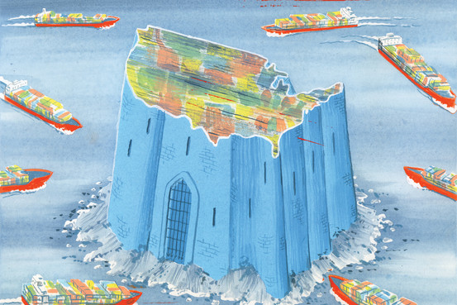
Hawley-Smoot Tariff
By reducing the flow of goods in to the U.S. other countries lost revenue – which they were using to repay their loans to the United States
Also caused unemployment rates to increase
World trade declined by almost 50%

Slide 21
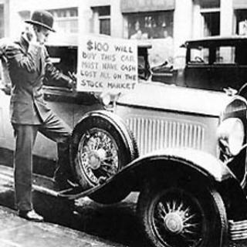
Causes of the Great Depression
Tariffs and war debt policies
Crises in the farm sector
Availability of easy credit
Unequal distribution of income

Slide 22
Hardship and Suffering During the Great Depression
Chapter 14 Section 2

Slide 23
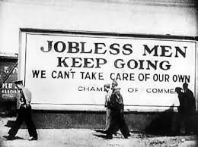
Depression in the Cities
During the Great Depression many people lost their jobs, were evicted from their homes, and ended up with nothing, wandering the streets
Shantytowns–Little towns consisting of shacks (built out of anything they could throw together for shelter)

Slide 24
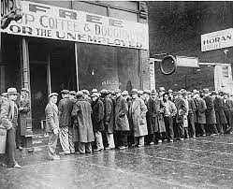
Depression in the Cities
Soup Kitchens–Offered free or low-cost food
Bread Lines-Lines of people waiting to receive food
Usually provided by charities or public agencies

Slide 25
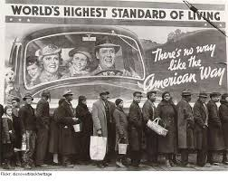
Minorities during the Depression
Minorities often had it harder than did whites
Suffered higher unemployment
Lower pay
And racial violence

Slide 26
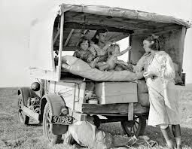
Depression in Rural Areas
Those living in rural communities had one main advantage over living in the city:
Some farmers were able to grow their own food
However, with falling prices, rising debt, and the drought, many farmers lost their land.
Between 1929 and 1932 over 400,000 farms were lost through foreclosure

Slide 27
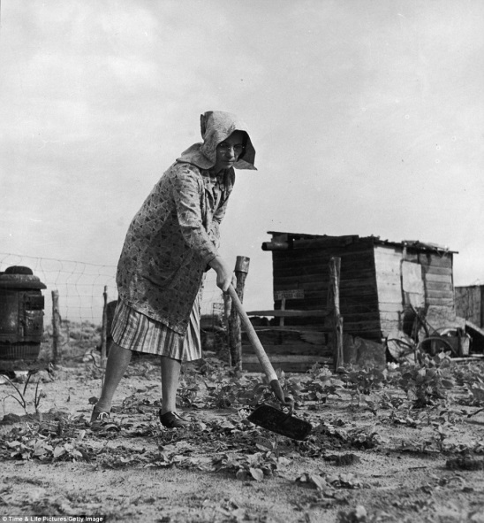
The Dust Bowl
The Dust Bowl was a period of severe dust storms that greatly damaged the ecology and agriculture of the American and Canadian prairies.
The Dust Bowl lasted about nine years from 1931 to 1939.
Farmers had cultivated the land so heavily during WWI that there was nothing to hold the soil down exhaustion of the land from overproduction was inevitable
The worst of the storms became known as black blizzards.
Their dust was recorded to have traveled as far as the East Cost

Slide 28
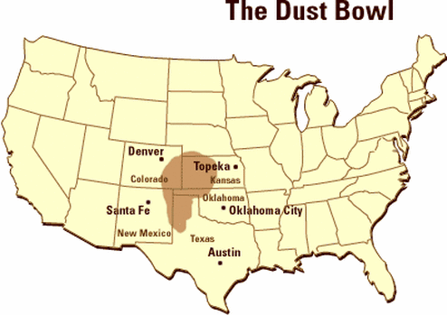
Dust Bowl cont….
Regions that were hardest hit:
Kansas
Oklahoma
New Mexico
Colorado
Texas

Slide 30
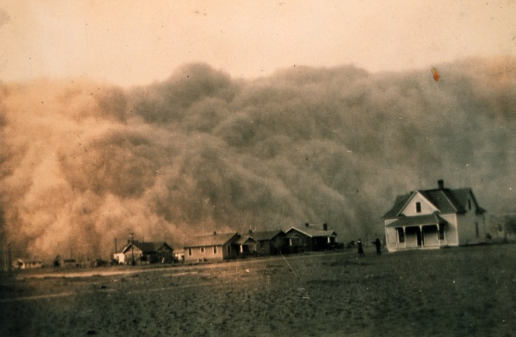

Slide 34
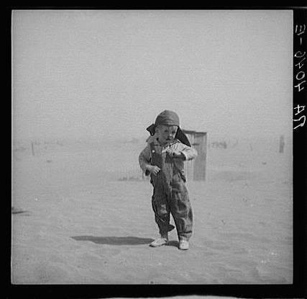

Slide 36
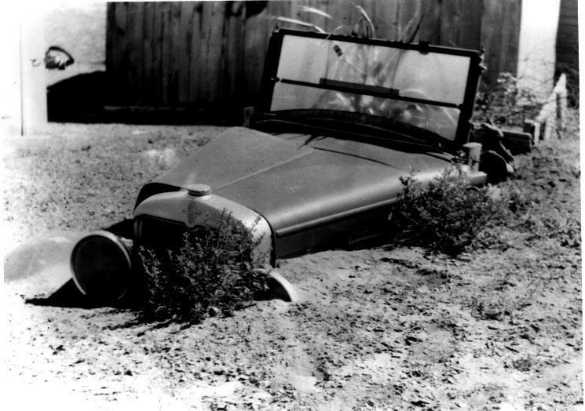

Slide 37
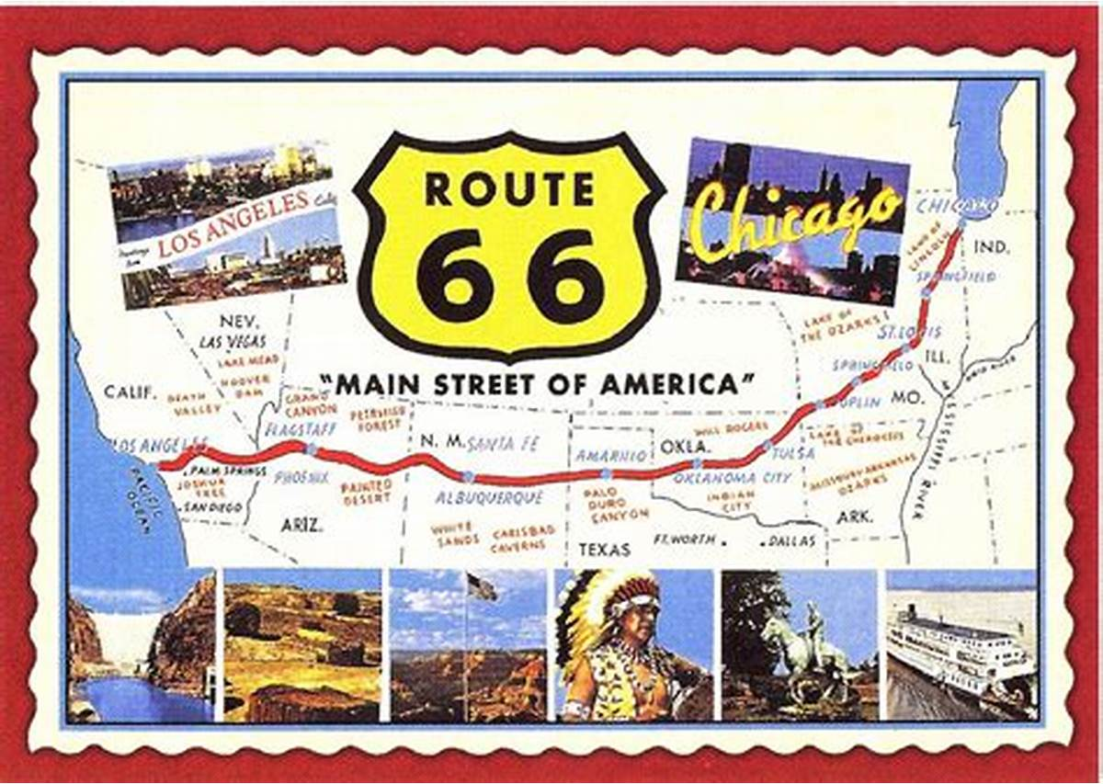
Dust Bowl cont….
Route 66- (US 66 or Route 66), Also known as the Will Rogers Highway, the Main Street of America or the Mother Road, was one of the original highways in the U.S. Highway System.
It became the route to California followed by many devastated farmers and their families
Those traveling from Oklahoma became known as Okies

Slide 38
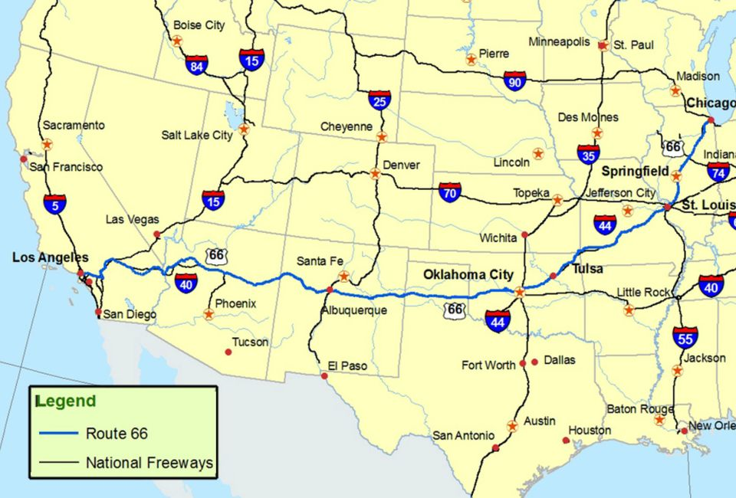

Slide 39
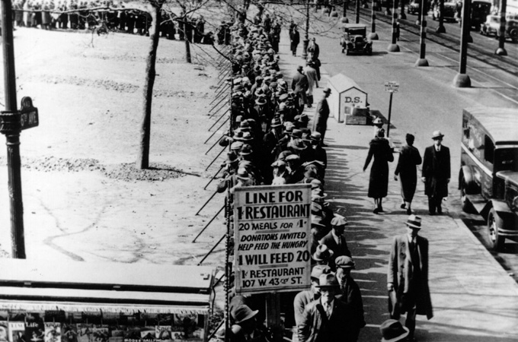
Direct Relief
Direct Relief-Cash payments or food provided by the government to the poor

Slide 40
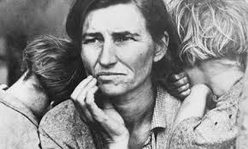
Women and Children during the Depression
Women
Had to manage tight household budgets; encountered opposition in holding jobs outside the home
Children
Suffered from poor diets and inadequate healthcare; many welfare programs and schools were shut down

Slide 41
The Legacy of the Depression
The Great Depression shattered many people’s dreams. But in terms of mental health there are two lessons to be drawn from the experience:
It is clear that the suffering of the Great Depression became part of the national legacy.
Fears of broken lives and ill health were handed down from parents to children.
The resiliency of a people, who banded together to help each other, with millions of anonymous acts of kindness illuminated an otherwise bleak landscape.

Slide 42
Hoover Struggles with the Depression
Chapter 14 Section 3

Slide 43
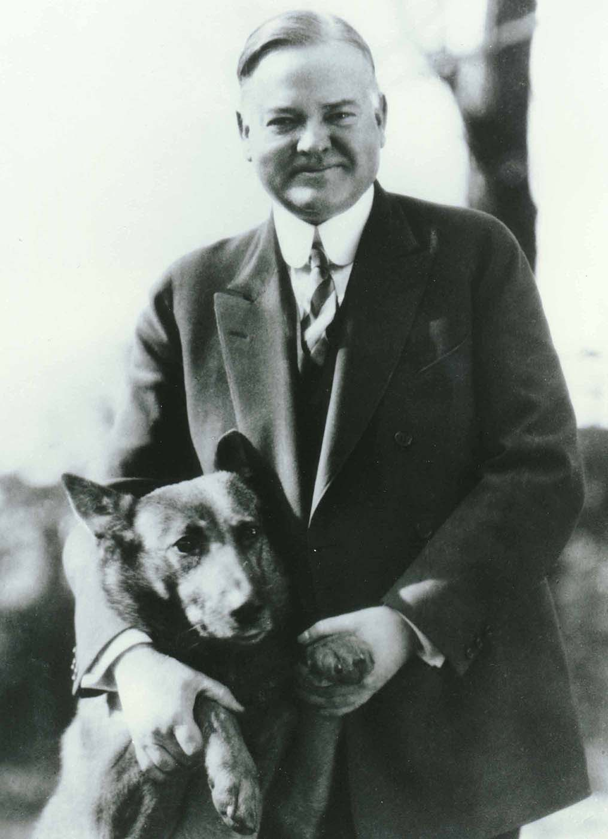
Herbert Hoover
Following his victory in the 1928 Presidential Election Herbert Hoover was sworn in as the 31st President of the United States.
His approach to governing included:
Laissez faire (hands off approach) to the economy.
A desire to foster cooperation between business and labor.
A belief that individuals, charities, and private organizations should help the poor and suffering.
Hoover was not a fan of government sponsored direct relief.

Slide 44
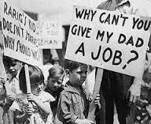
Hoover’s Cautious Steps
Hoover took a more cautious approach to our countries economic struggles.
Instead of using direct relief he instead asked employers not to cut wages or lay off workers
He also asked workers not to go on strike
However, in the end, none of these steps were working and the country sunk deeper into economic depression

Slide 45
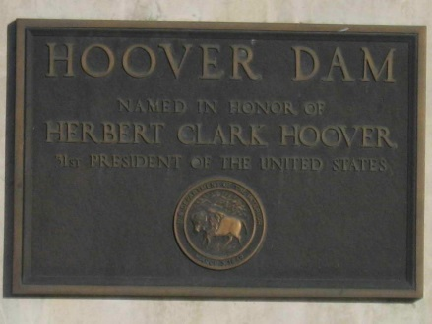
Boulder Dam
Boulder Dam (Hoover Dam) is a concrete dam in the Black Canyon of the Colorado River, on the border between the U.S. states of Nevada and Arizona.
It was constructed between 1931 and 1936 during the Great Depression and was dedicated on September 30, 1935, by President Franklin D. Roosevelt.
Its construction was the result of a massive effort involving thousands of workers, and cost over one hundred lives.
Originally known as Boulder Dam from 1933, it was officially renamed Hoover Dam, for President Herbert Hoover, by a joint resolution of Congress in 1947.
Provided jobs & water/electricity to the American South West

Slide 46
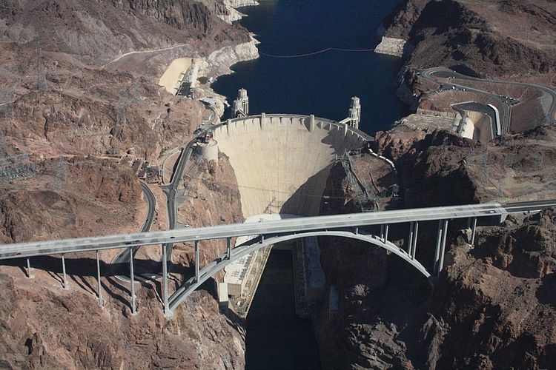

Slide 47
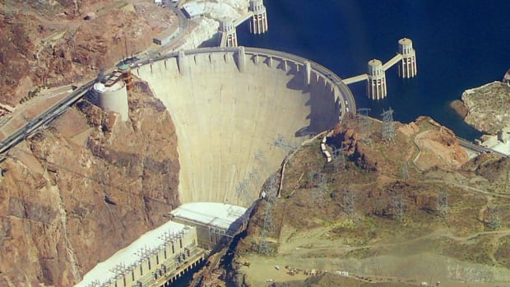

Slide 48
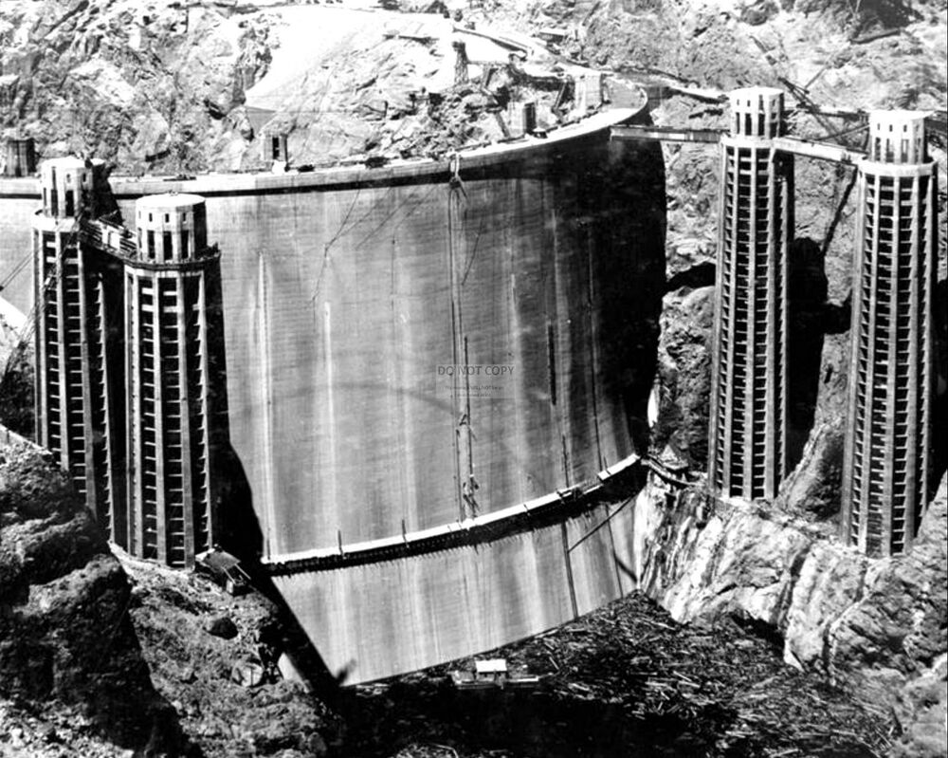

Slide 49
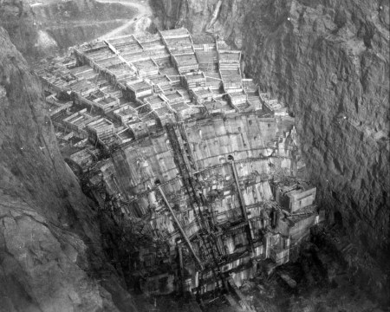

Slide 50
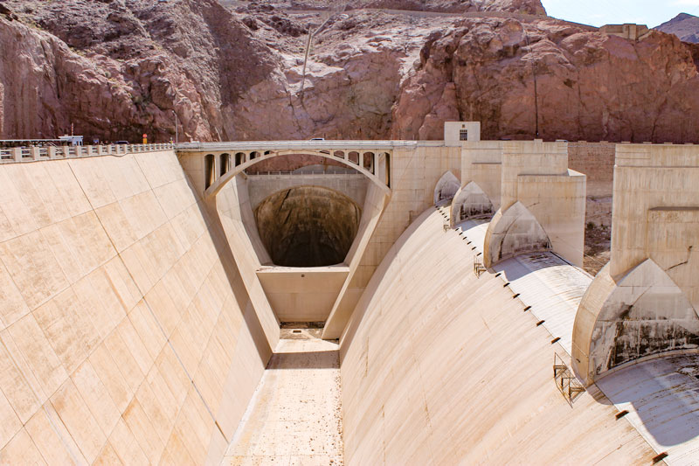

Slide 51
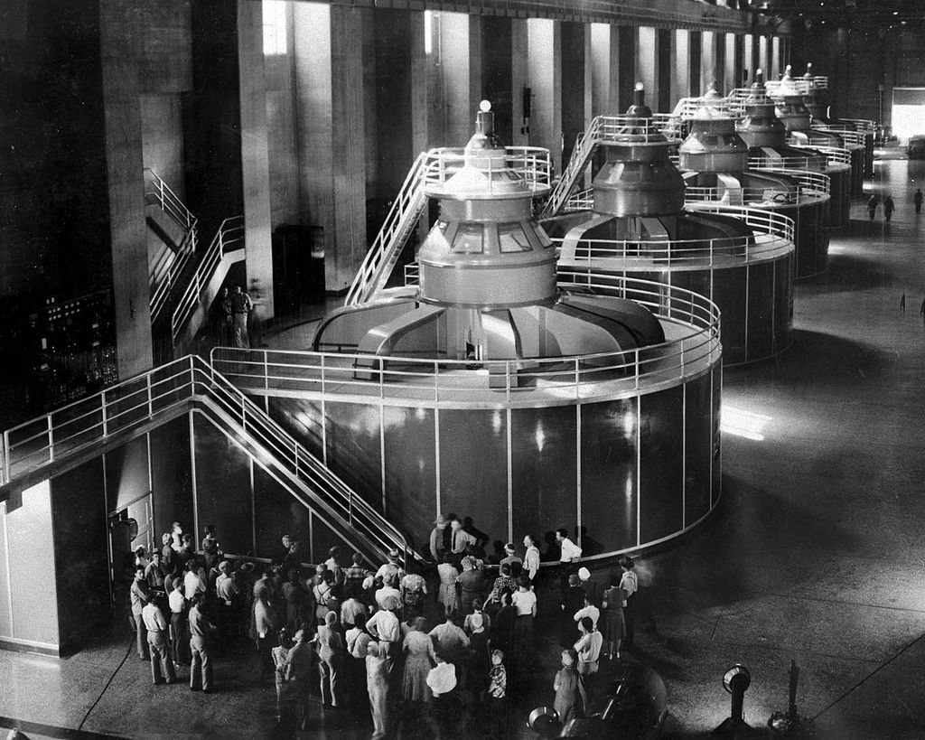

Slide 52
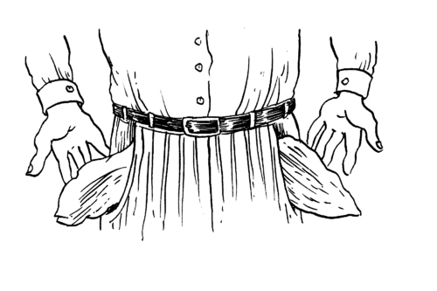
Hoovers Impact on American Lives
In the mists of the Great Depression many Americans began associating their frustrations with their economic struggles directly with President Hoover.
Americans started calling the shantytowns that had popped up across the country Hoovervilles.
Hoover flags were pants pockets turned inside-out to show that the person had no money.
A Hoover blanket was a newspaper used to keep warm at night by those forced to sleep in the open.

Slide 53
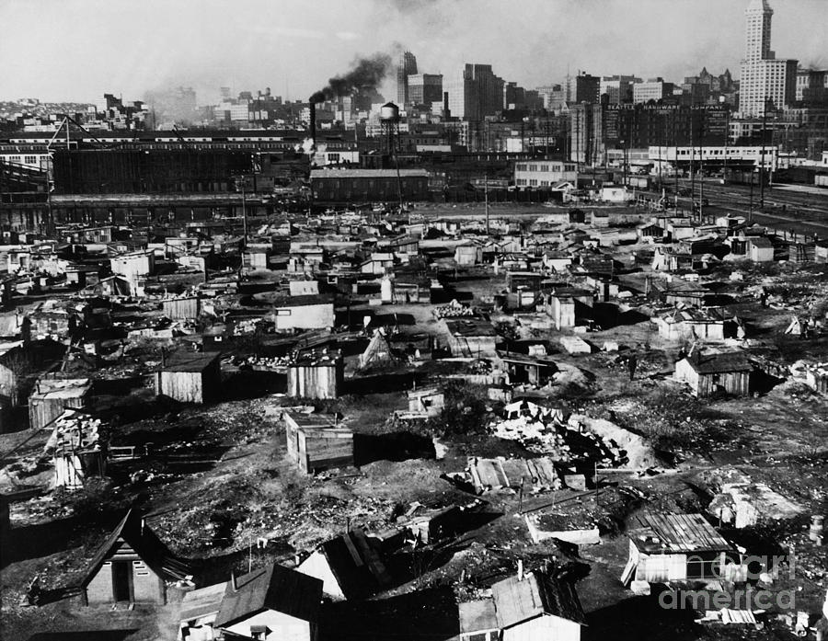
Hooverville

Slide 54
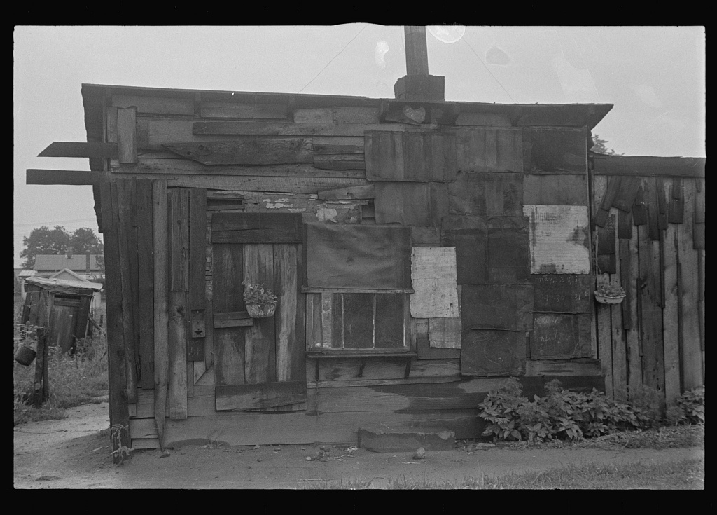
Hooverville

Slide 55
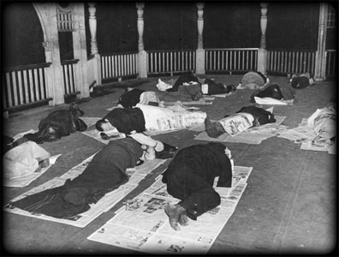
Hoover Blanket

Slide 56
Federal Home Loan Bank Act
The Federal Home Loan Bank Act, enacted July 22, 1932, is a United States federal law passed under President Hoover designed to lower the cost of home ownership.
It also allowed farmers to refinance their loans and avoid foreclosures
It established the Federal Home Loan Bank Board to charter and supervise federal savings and loan institutions.

Slide 57
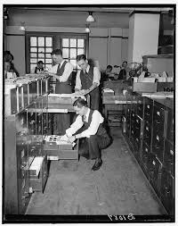
Reconstruction Finance Corporation (RFC)
The Reconstruction Finance Corporation (RFC) was a government corporation administered by the U.S. government from 1932 to 1957.
The RFC provided financial support to state and local governments and made loans to banks, railroads, mortgage associations, and other businesses.

Slide 58
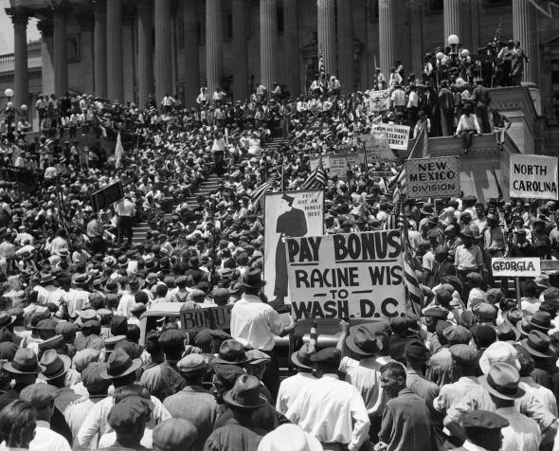
Bonus Army
-Between 10,000 and 20,000 WWI veterans (1932) known as Bonus Marchers gathered in Washington to demand their pay promised to them and their families for time served in WWI
-Most dispersed in peace
-The ones that stayed are gassed and pushed away with force
-This incident made Americans dislike Hoover even more

