Slide 1
Foreign Policy and National Security
American Government
Chapter 17

Slide 2
What is Foreign Policy?
Foreign Policy is all the actions, affairs, and stands that the U.S. takes in its relations with other nations.
Foreign Policy incorporates many programs, departments, business aspects, and many other aspects of our governmental relations. (Vague)
Department of Foreign Affairs was created in 1781 Under the Articles of Confederation.

Slide 3
Domestic vs. Foreign Affairs
Domestic Affairs- The relations and policies that the U.S. has amongst itself.
Ex. Education, Civil Rights, Taxes
Foreign Affairs- The relations that the U.S. has with other nations.
Ex. Trade, Oil, Peace

Slide 4
Isolationism vs. Internationalism
Isolationism- A purposeful refusal to become generally involved with the rest of the world.
Ex. U.S. hesitation to enter World War I
Internationalism- The thought that the well being of the U.S. is affected by what goes on in the rest of the world.
Ex. World War II, War on terrorism

Slide 5
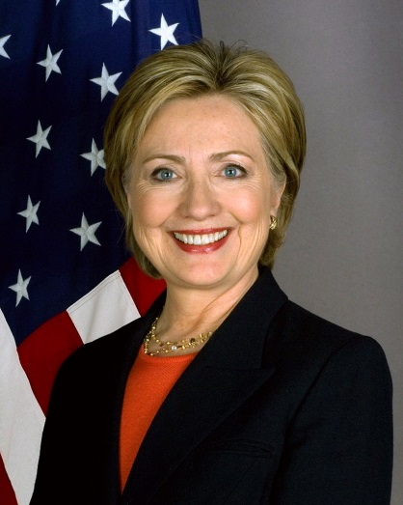
The State Department
The State Department is headed by the Secretary of State who is selected by the President and then must be approved by the Senate.
This was the first Executive department created by congress
The State Department is given Right of Legation which gives them the right to send and receive diplomatic representatives.
Ambassador- Official representative of the U.S. appointed by the President to represent the nation in matters of diplomacy. (180+ Countries)

Slide 6
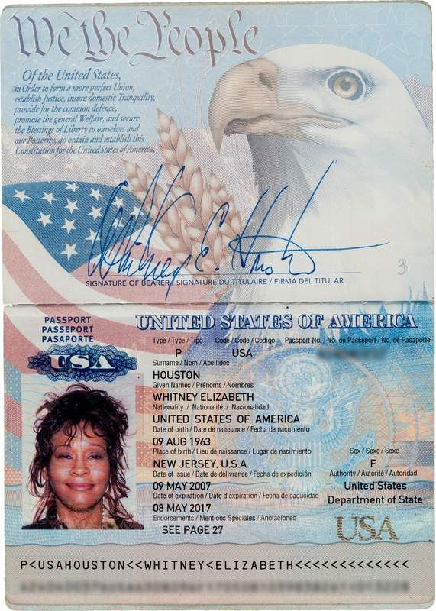
Passports and Diplomatic Immunity
Passport- is a certificate issued by the government to citizens who choose to travel or live abroad. Entitles citizens to privileges given by international customs/treaties.
Diplomatic Immunity- The exception to right of legation. This states that Ambassadors can’t be arrested, sued, or taxed as they are there on official business. However, country can kick them out.

Slide 7
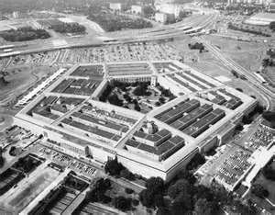
The Defense Department “The Pentagon”

Slide 8
The Military Departments
Set into place to protect our country
Each headed by a civilian secretary that reports directly to the Secretary of Defense
Made up by the Departments of:
The Army
The Navy
The Air Force
Marines
Coast Guard
Soon to be added Space Force

Slide 9
The Air Force
The U.S. Airforce is the youngest of the military forces was established as a separate branch of the U.S. Armed Forces on 18 September 1947 with the passing of the National Security Act of 1947.
Prior to this it was known as the Army Air Corps.
Its’ main objectives are to protect the U.S. and to defeat enemy air, ground, and sea forces.
Also, they strike war-related targets in enemy territories, and transport and support land and naval operations.

Slide 10
The Army
The Army is the oldest and largest of the three forces.
Mainly group forces whose objectives are to defeat any attack on the U.S., while using forceful action in matters abroad.

Slide 11
The Navy
Major Objectives:
1. Seize or defend land bases from which the fleet can operate.
2. To carry out land campaigns using their combat ready land force, The Marines.

