Slide 1
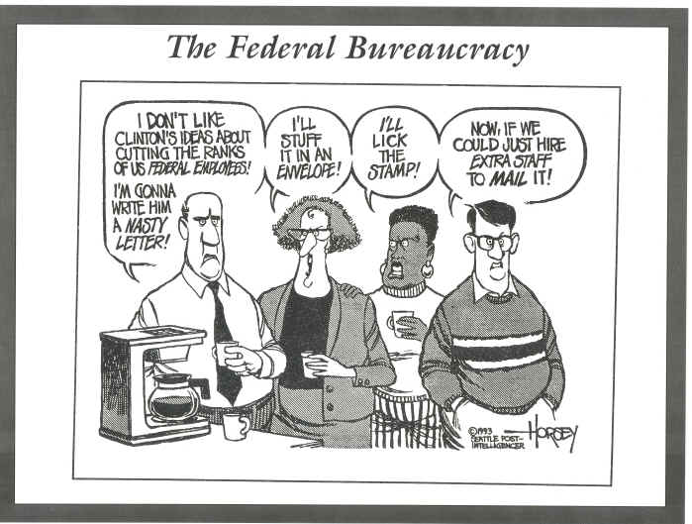
Federal Bureaucracy
Chapter 15-Supplemental Power Point

Slide 2
Federal Bureaucracy
Bureaucracy-A governmental organizations, usually staffed with officials selected on the basis of experience and expertise, that works to implement public policy.
Bureaucrats-An official in a government department, in particular one perceived as being concerned with procedural correctness at the expense of people's needs.
Most bureaucrats belong to the Executive branch, but some report to Congress

Slide 3
Federal Bureaucracy
How are bureaucracies organized?
Agencies
Boards
Commissions
Corporations
Advisory committees
Why do we have bureaucracies?
Efficient: They set up a clear chain of command, one person is boss with final decision
Effective: They set procedures and rules, specific functions, defined responsibilities

Slide 4
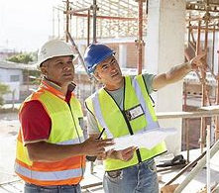
Growth of the Federal Bureaucracy
In 1789 the Federal Government employed roughly fifty employees
By the year 2000 that number had increased to nearly 2.8 million (excluding military, subcontractors, and consultants who also work for federal government)
We've seen the largest area of growth mainly at state and local level since 1970
Federal government began devolving powers and services to state and local government
Total federal, state and local employees make up roughly 21 million people

Slide 5
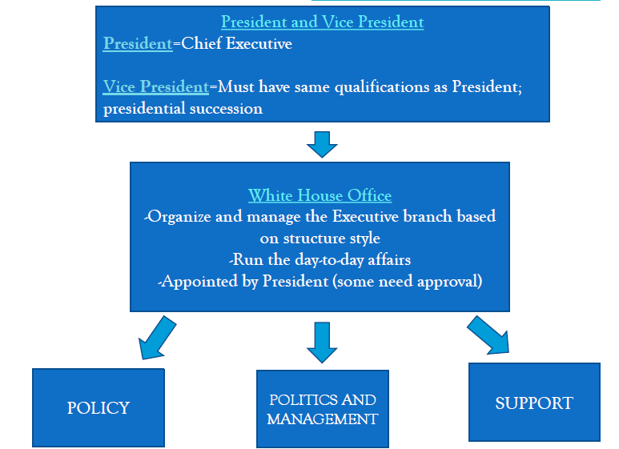
How is the Executive Branch organized?

Slide 6
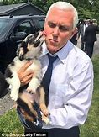
Political and Management
Executive office of the President
Key White House staff, close advisors and experts (appointed by President, some need approval)
Offices:
Office of White House
Office of the Vice President
Only constitutional duties: President of Senate, 25th amendment becomes President is President is disabled, Presidential succession
Office of Management and Budget
Assist President in preparing budget and supervise administration after Senate approves *Economic Policy
U.S. Trade Representatives
Advise President on foreign trade
Vice President
Mike Pence

Slide 7
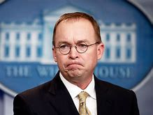
Political and Management
Chief of Staff
Closet advisor
No Senate approval
Coordinate day-to-day activities of the President
Oversee other offices
National Security Advisor
Daily security briefings
This person often becomes
Secretary of State
Chief of Staff Mick Mulvaney

Slide 8
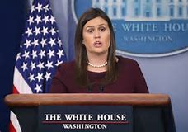
Bureaucratic Support
Press Secretary
An office that does not require Senate approval
Acts as the chief spokesman for the President
In charge of press briefs which allows them control flow of information and set the media’s agenda
White House Press Secretary Sarah Sanders Huckabee

Slide 9
The President’s Cabinet
Presidential Cabinet-Established in Article II, Section 2 of the Constitution, the Cabinet’s role is to advise the President on any subject he may require relating to the duties of each member’s respective office.
Article II list the need for “heads of departments”; but doesn’t list specifics about president’s advisors
Currently the President has fifteen members serving in his cabinet a number that has increased from George Washington’s five members due to the creation of new agencies
Chosen for expertise in area:
Appointed by President, confirmed by Senate
Must be “vetted” (review credentials)
Can be fired by President without Senate approval
Becoming more diverse
Each department has many levels of authority

Slide 10
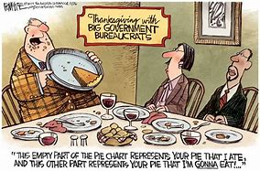
Political Control of Bureaucracy
Who should control the bureaucracy?
Bureaucracy should be responsive to elected officials (Congress, the President)
Members of the bureaucracy are not elected, and must be held accountable for their actions
Making them responsive to elected officials give the public a voice in bureaucratic operations
The bureaucracy should be free from political pressures
They should be autonomous

Slide 11
Bureaucratic Agencies
1. Department of the State
Led by the Secretary of State they are in charge of Implements foreign policy
Staffs embassies (offices of ambassadors in foreign countries)
Represents the U.S. at United Nations
2. Department of the Treasury
Led by Secretary of Treasury
Manages the nation’s money
Collect and oversee taxes
Borrow and print money

Slide 12
Bureaucratic Agencies
3. Department of Defense
Led by the Secretary of Defense.
Manage armed forces
Maintain forts, bases, harbors
Conduct military intelligence
4. Department of Justice
Led by the Attorney General Attorney for U.S.
Run FBI, maintain federal prisons
Investigate federal law violations

Slide 13
Bureaucratic Agencies
5. Department of the Interior
Charged with protecting public parks and land
Leading agency is the Department of Natural Resources (DNR)
Helps support Native American Programs
6. Department of Agriculture
Help farmers (subsidies)
Food stamps/EBT
School lunch program

Slide 14
Bureaucratic Agencies
7. Department of Commerce
Helps regulate businesses in U.S. and abroad
Conducts the U.S. census to measure population
Weather service, patents, weights, measures
Tide and current report
8. Department of Labor
Protect American workers
Upholds minimum wage
Provides unemployment benefits
Offers job training

Slide 15
Bureaucratic Agencies
9. Department of Health and Human Services
Implements national health policy
Social Security and Medicare
Food, drug and Cosmetics laws (works with FDA)
10. Department of Housing and Urban Development (HUD)
Assists with building and supporting public housing
Ensures equal housing for women and minorities
Works to improves roads, sewers

Slide 16
Bureaucratic Agencies
11. Department of Transportation
Interstates, railroads, airports, mass transit regulation and safety standards
12. Department of Energy
Plans energy policy
Monitors gas and electric sales
Supports conservation programs from fossil fuels to alternative energy

Slide 17
Bureaucratic Agencies
13. Department of Education
Federal assistance programs for schools
College grants and loans
NCLB and Race to the Top
14. Department of Veteran Affairs
Benefits, hospital care and education for veterans and their families

Slide 18
Bureaucratic Agencies
15. Department of Homeland Security
Controls border patrol (immigration), Coast Guard, Disaster Relief (FEMA), Secret Service, works with FBI and CIA
Other Bureaucratic Agencies Funded by the U.S. Government
PBS-Public Broadcasting Service
NPR-National Public Radio
NASA
United States Postal Service

Slide 19
Independent Regulatory Agencies
Created by Congress, appointed by President, approved by Senate
Quasi-judicial and quasi-legislative
Examples: FTC (trade), FCC (media), FEC (campaigns), EPA (Environment), FDA (food and drugs), CSPC (product recalls), OHSA (health and safety at work), Federal Reserve (inflation and interest)

Slide 20
