Slide 1
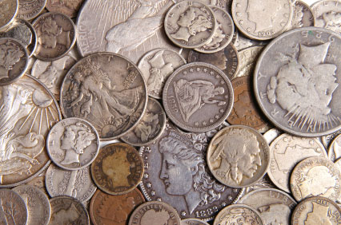
Financing the Government
Chapter 16

Slide 2
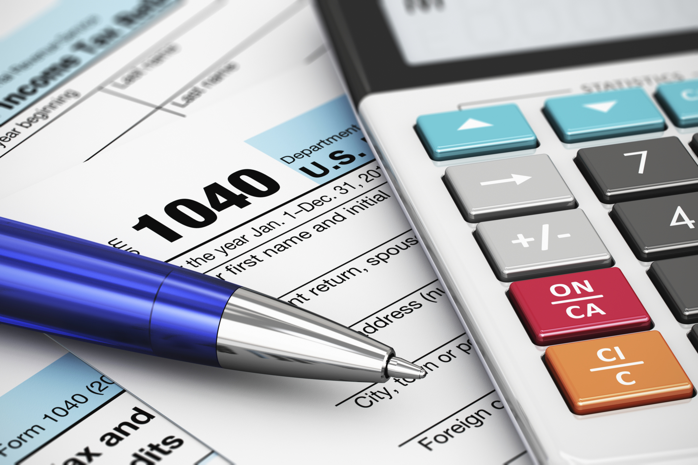
Section 1-Taxes and Other Revenue

Slide 3
The Power to Tax
Tax-A mandatory financial charge or some other type of levy imposed upon a taxpayer by a governmental organization in order to fund various public expenditures.
The power to tax comes from Article I, Section VIII, Clause I of the U.S. Constitution
Facial Policy-The various means by which a government raises and spends money in an attempt to influence their nations economy.
Fiscal Year- An established period of time when an organization's annual financial records commence and conclude.
The fiscal year is expressed by stating the year-end date.
A fiscal year end can be the end of any quarter as defined by the IRS which says a fiscal year is "12 consecutive months ending on the last day of any month except December 31st.".
The U.S. fiscal year runs from October 1st to September 30th (i.e. October 1st, 2018 to September 31st, 2019)

Slide 4
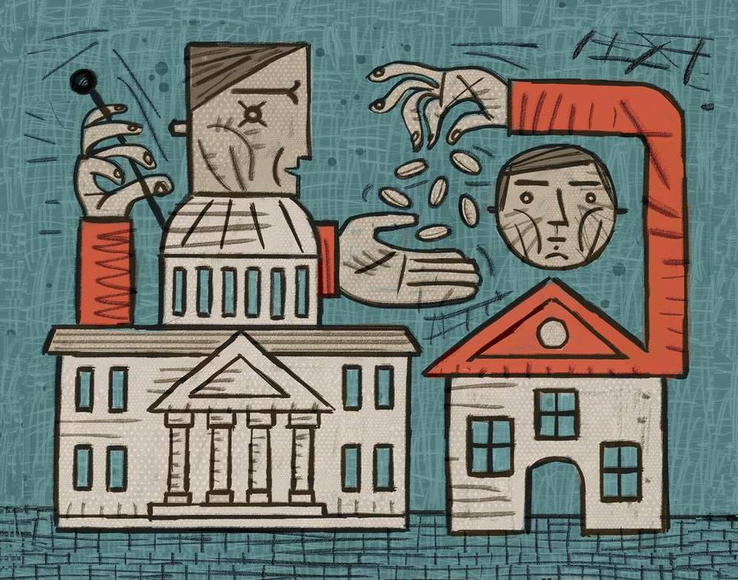
Constitutional Limitations
The power to tax is not unlimited, in fact Congress must exercise their taxing power in accord with the Constitution.
Four Expressed Limits on Taxes:
I. Taxes must be used for public purposes only.
Not for the benefit of private interests.
II. Prohibition of export taxes.
Tariffs can be applied only to imports –goods brought into the U.S.
III. Direct taxes must be equally apportioned, or distributed.
Income taxes
Indirect taxes, initially placed on the distiller, but then is put on the person. (liquor)
IV. Indirect taxes, such as duties and imports, must be levied at the same rate in all parts of the country.

Slide 5
Constitutional Limitations
Implied Limitation:
Federal taxes cannot be imposed on state governments when they are performing such tasks as providing public education, furnishing health care, or building streets and highways.
In 1891, the Supreme Court case McCulloch v. Maryland, declared that “the power to tax involves the power to destroy.”
The federal government could tax the state out of existence and so destroy the federal system if they truly wanted to.

Slide 6
Concurrent Federal Taxes
There are a various types of taxes from which the government draws their needed revenue.
Some examples are:
Income Tax-Authorized by the 16th amendment
It is often progressive meaning that the higher one’s income the higher tax rate they pay
It is levied on earnings of individuals and corporations
Individual income tax is the largest source of government revenue.
Corporation Income Tax: Corporations must pay a tax on its net income, all earnings above the costs of doing business.
Social Insurance Taxes: Are collected to fund Social Security program, Medicare, and unemployment compensation.
Excise Tax: A tax laid on the manufacture, sale, or consumption of goods, and /or the performance of services.
Estate and Gift Tax: A tax imposed on the asset of one who dies; one imposed on the making of a gift by a living person.
First $675,000 of an estate is exempt from this tax.
Up to $10,000 in tax free gifts are allowed to be given once a year.
Custom and Duties: A tax laid on good brought into the US from abroad.
Tariffs, import duties, or imposts.

Slide 7
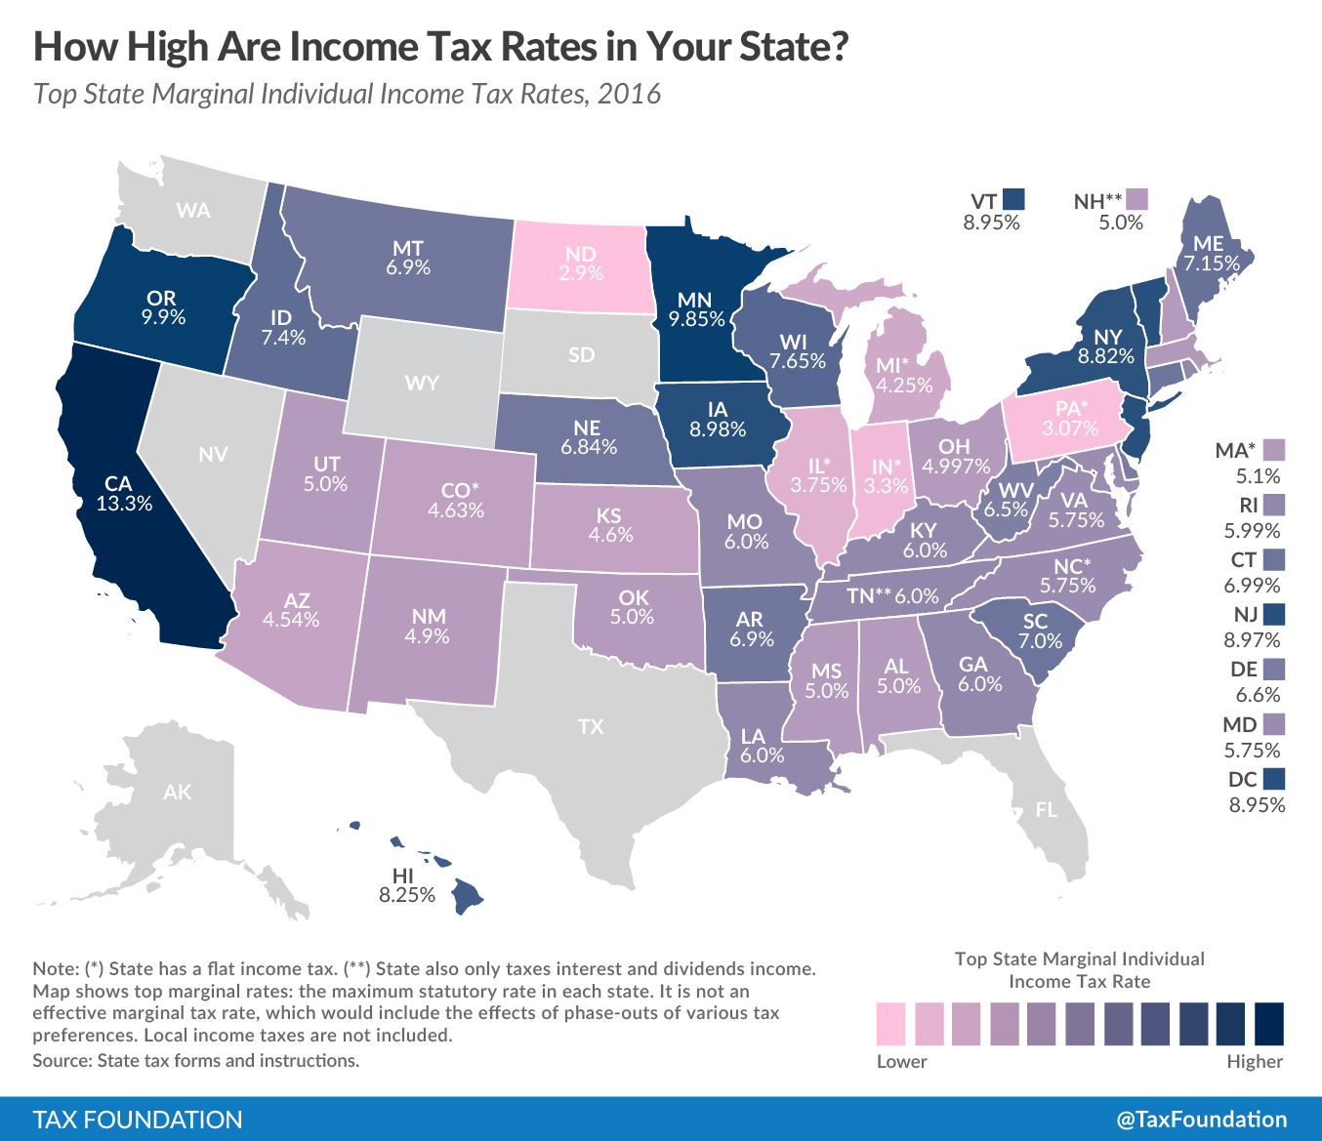

Slide 8
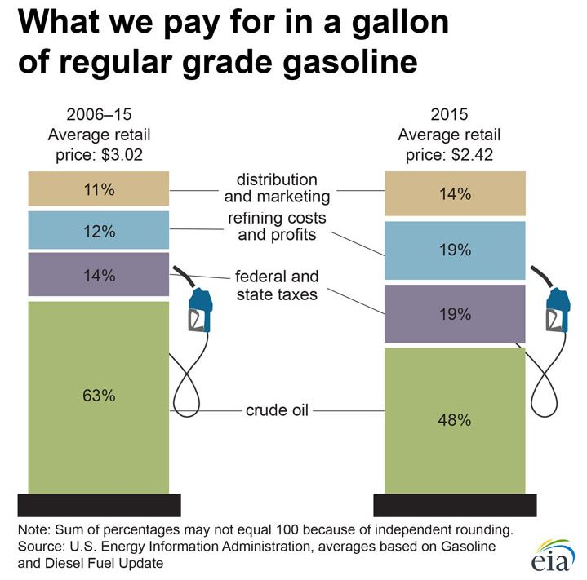
Section 2-Non-tax Revenues and Borrowing

Slide 9
Non-revenue Taxes
Taxing for non-revenue purposes:
This purpose is to regulate and even discourage some activity that Congress thinks is harmful or dangerous to the public.
Narcotics
Certain firearms
Hunting of migratory birds
Gas-guzzling cars
Etc.

Slide 10
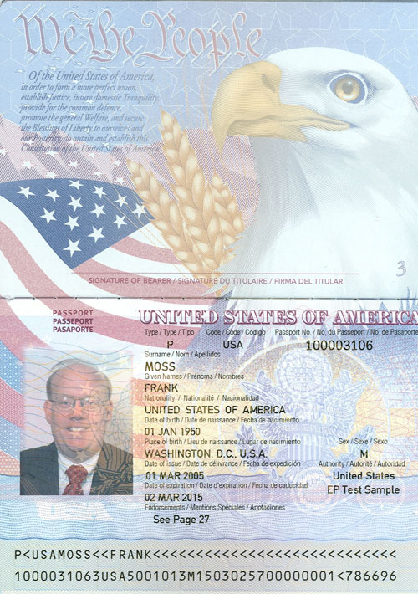
Non-revenue Taxes
Nontax Revenues:
Interest is a charge for borrowed money.
Canal tolls
Fees for passports
Copyrights, patents, and trademarks.
Seigniorage: profit the US Mint makes in the production of coins.
United States Postal Service: Generates nontax revenue for the government by selling mint-condition stamps to collectors.
Roughly, $100 million anually.

Slide 11
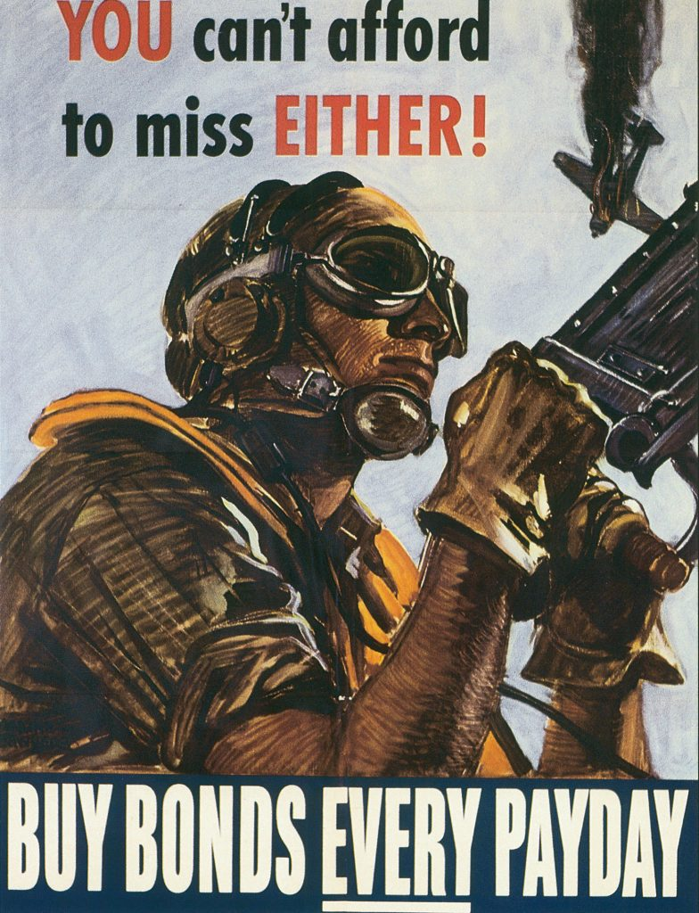
Borrowing Money
The government often borrows money for:
Costs of short and long term crisis situations
Finance large scale projects that could not be paid for out of current income.
WWI
Great Depression
WWII
Congress must authorize all federal borrowing.
Borrowing is done by the Treasury Department.
They issue securities to investors (banks, individuals, etc.)
Government borrows at low interest rates.

Slide 12
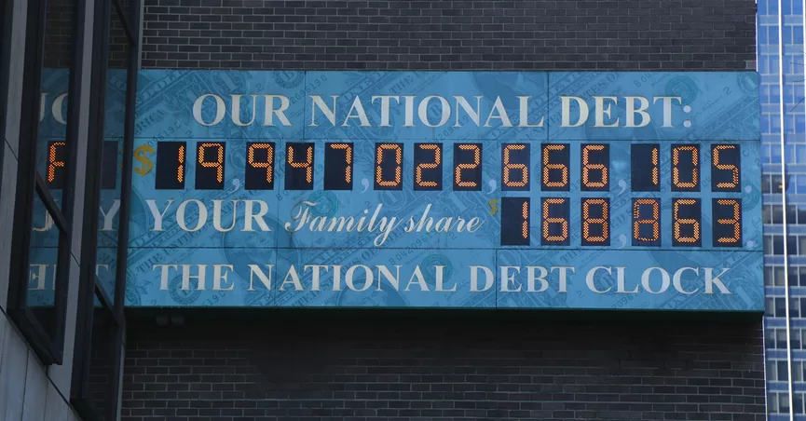
Public Debt
Result of the Federal Government’s borrowing over many years.
It is the government’s total outstanding indebtedness.
All of the money borrowed, and not yet repaid, plus the accrued, or accumulated, interest.
US DEBT CLOCK
Debt more than doubled in the years 1981 thru 1985 because of deficit financing.
By 1992 deficit spending had quadrupled the debt.
There is no constitutional limit on the amount that may be borrowed, and so there is no constitutional limit on the public debt.
There is a ceiling that congress has put, but they adjust it as needed.
Should future generations be worried?

Slide 13
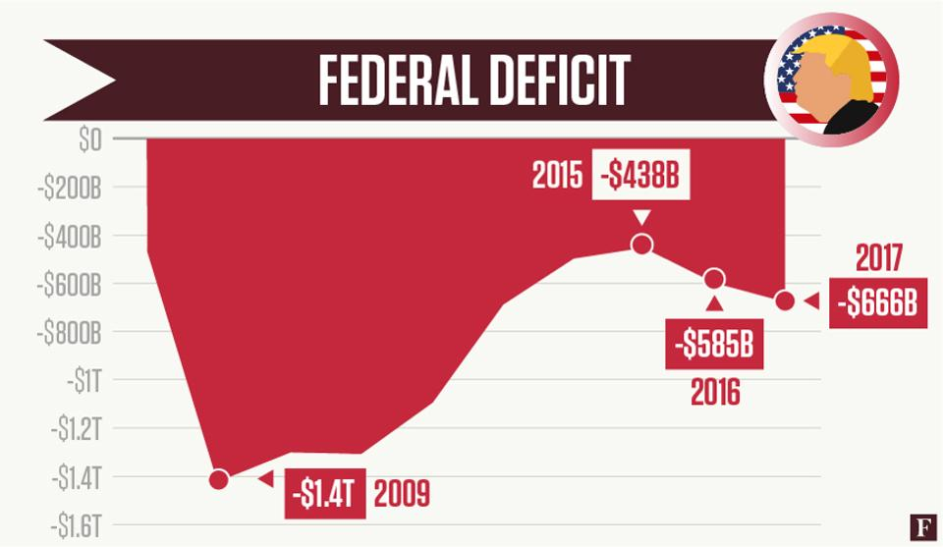
National Defecate
The Federal Budget Deficit-The difference between the money federal government’s annual revenues and expenditures.
The deficit for fiscal year 2018 is $440 billion.
The national debt is the total of all unpaid funds borrowed by the U.S. government.

Slide 14
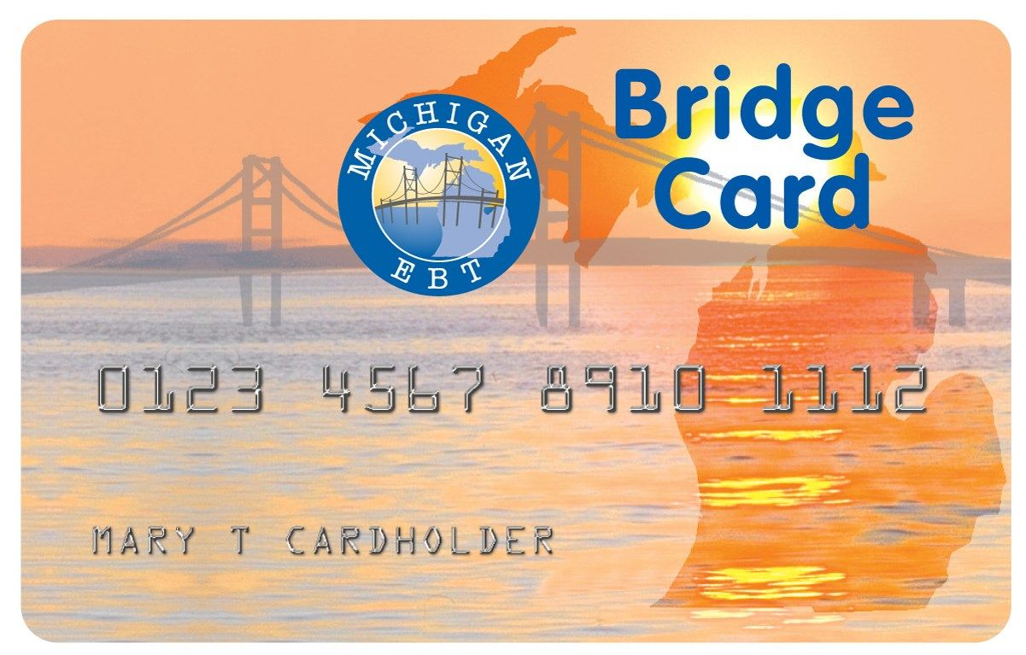
Spending and the Budget
Entitlement Funds: Benefits that federal law says must be paid to all those wo meet the eligibility requirements. i.e. certain age or income level.
Medicare, Medicaid, food stamps, unemployment compensation, and veterans pensions.
Interest on public debt has grown to become the second largest category of federal spending today.

Slide 15
Controllable and Uncontrollable Spending
Controllable Spending:
Congress and the President decides how much will be spent each year.
Examples: military equipment, aid to education, and environmental protection.
Uncontrollable Spending: Estimated to be about 80% of all current spending.
Congress and the President have no power to change it directly.
Examples: interest on debt, social security, food stamps, entitlements

Slide 16
Federal Budget
The President initiates the spending process by submitting a budget at the beginning of each congressional session.
The federal budget serves as a political statement through a declaration of the public policies of the U.S., with dollar signs attached to it.
It is the Presidents work plan for the conduct of government.
The budget making process begins 18 months prior to the start of the fiscal year for the budget intended, each federal agency prepares detailed estimates then submits to Office Management and Budget (OMB).

Slide 17
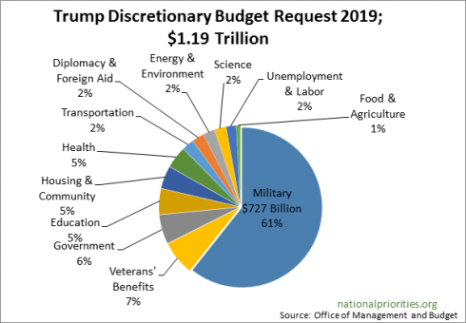
Federal Budget
Congress becomes involved in the process by reviewing the budget and then enacting on several appropriations measures.
If the thirteen appropriations measures are not passed by the beginning of the fiscal year then an emergency spending bill must be passed to avoid government shutdown.
Also known as continuing legislation.

Slide 18
The Budget Process
I. Each federal agency must submit an estimated budgets
II. The Office of Management and Budget (OMB) will review the budgets and determine what will be discussed and what will be tabled Hearings
III. The President writes and submits his budget Writes President’s
House and Senate Appropriations and Budget Committees (CBO) analyzes the President’s budget
V. Federal Subcommittees will then propose:
Approbation Measures and craft spending Bills
VI. Congress must pass the Appropriation measures before October 1st or must pass (an) Emergency spending legislation (continuing resolution) to keep the government operating

