Slide 1
The Second New Deal Takes Hold
Chapter 15-Section 2

Slide 2
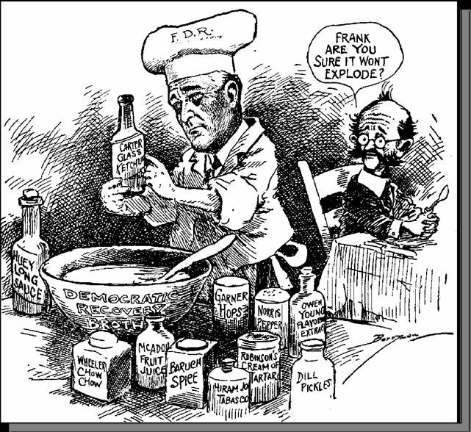
The Second Hundred Days
Economy had improved during FDR’s first two years as president
He still wanted more improvement
Unemployment rates remained high
Production still lagged behind 1920’s levels
In 1934, Roosevelt decided to launch a Second New Deal which acted as another burst of activity aimed at providing more help for farmers and workers

Slide 3
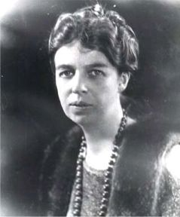
Eleanor Roosevelt
Eleanor Roosevelt was an American political figure, diplomat and activist.
She served as the First Lady of the United States from March 4, 1933, to April 12, 1945, during her husband President Franklin D. Roosevelt's four terms in office, making her the longest-serving First Lady in United States history.
Her contributions in the areas of civil rights, the welfare of young Americans and her political presence was a very important part of the second new deal

Slide 4
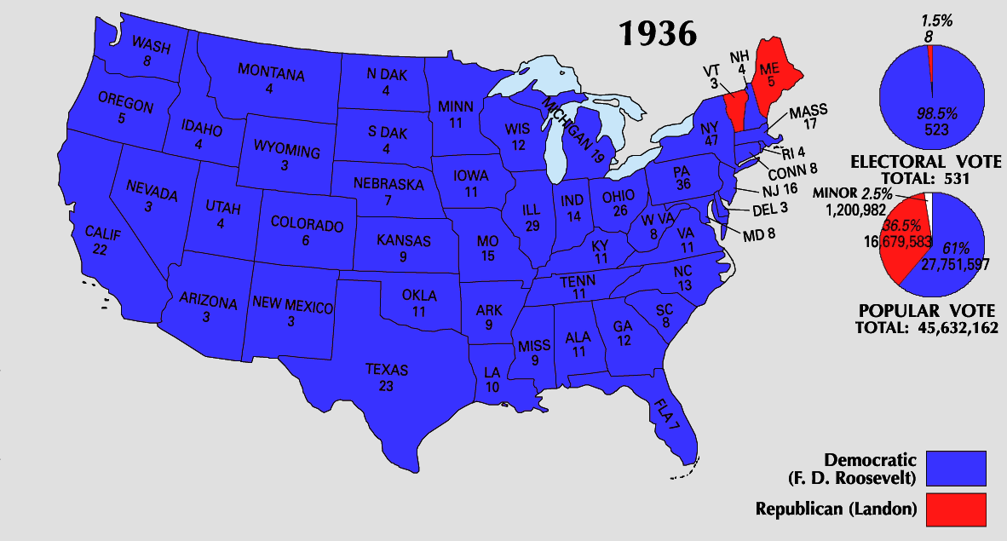
Re-electing FDR
1936 presidential election
FDR (Democrat) vs. Alfred Landon (Republican)
Overwhelming victory by FDR
FDR won 523 out of 531 Electoral College votes
Landon only won 8

Slide 5
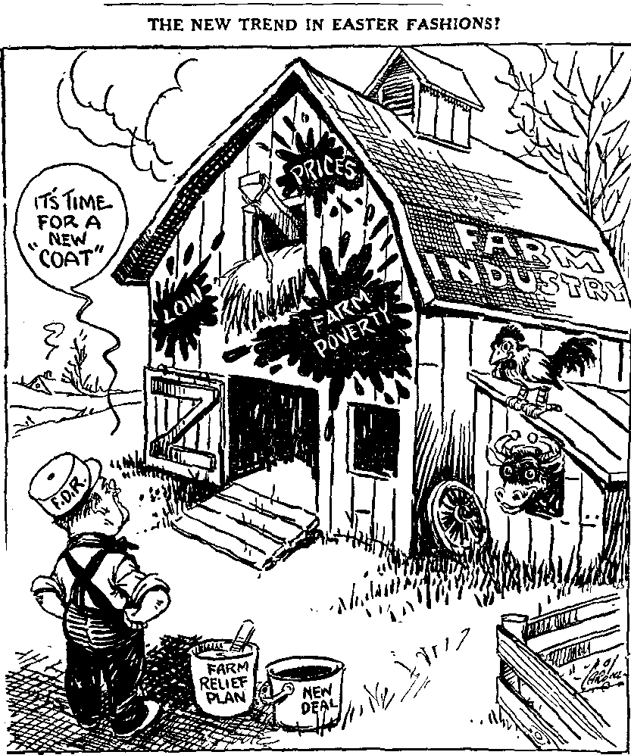
Helping Farmers
Soil Conservation and Domestic Allotment Act
Paid farmers for cutting production
1938-Second Agricultural Adjustment Act
Did not include a previous processing tax to pay for farm subsidies

Slide 6
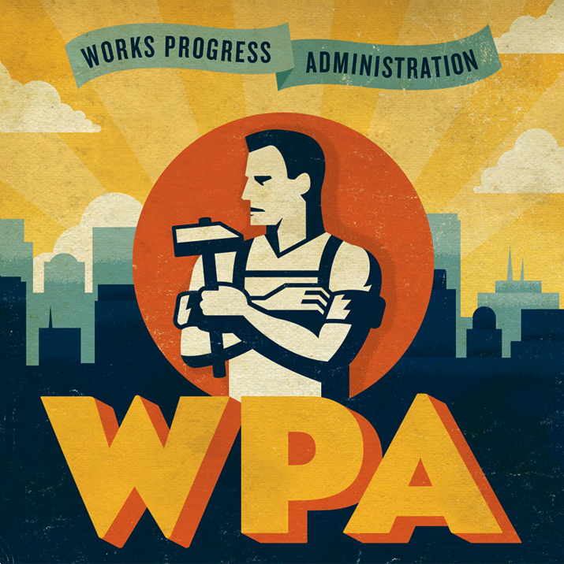
Works Progress Administration (WPA)
Designed to help the nation’s youth, professionals, and other workers
Headed by Harry Hopkins
Provided the unemployed with jobs in construction, garment making, teaching, arts, and other fields

Slide 7
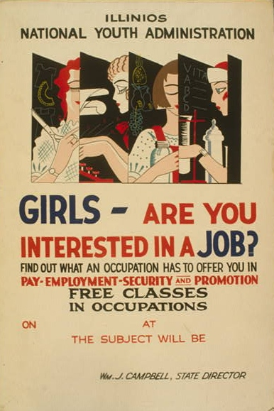
National Youth Administration (NYA)
Created to provide education, jobs, counseling, and recreation for young people
Eleonore Roosevelt was a major supporter of this program
Also provided financial aid for high school, college, and graduate school

Slide 8
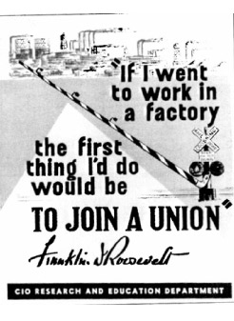
Wagner Act
Re-established the NIRA provision of collective bargaining
Protected the rights of workers
Allowed them to join unions without pressure from management

Slide 9
Social Security Act
Passed in 1935 it contained three major provisions:
Old-age insurance for retirees 65 or older and their spouses
Unemployment compensation system
Aid to families with dependent children and the disabled

