Slide 1
A New Deal Fights the Depression
Chapter 15-Section 1

Slide 2
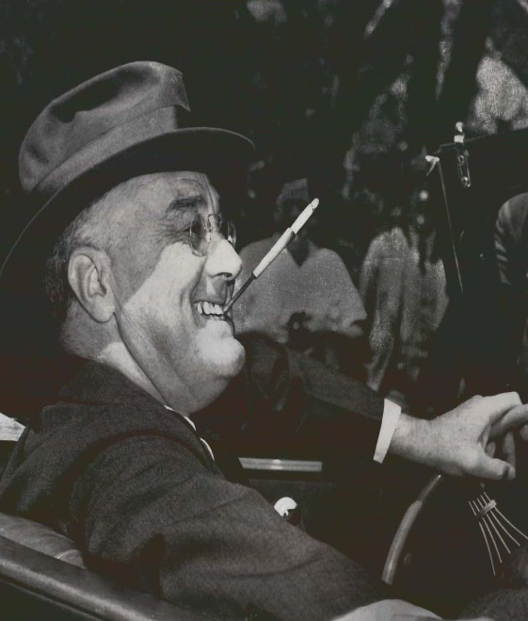
America Gets a New Deal
Franklin Delano Roosevelt often referred to as FDR, served as the 32nd president of the United States from 1933 until his death in 1945.
FDR’s twelve years in office makes him the longest serving President in U.S. history
Roosevelt led the United States through two of the greatest crises of the 20th century: the Great Depression and World War II.
In so doing, he greatly expanded the powers of the federal government through a series of programs and reforms known as the New Deal.

Slide 3
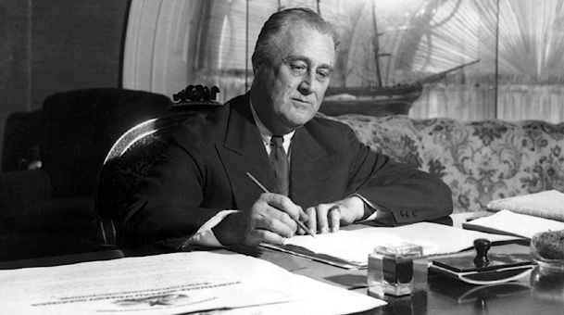
America Gets a New Deal
FDR’s First 100 Days-During the first hundred days of FDR’s presidency (March 4th to June 16th, 1933) he presented a series of initiatives to Congress designed to counter the effects of the Great Depression.
During this time he passed thirteen pieces of major New Deal legislation
He had signaled his intention to move with unprecedented speed to address the problems facing the nation in his inaugural address, declaring: "I am prepared under my constitutional duty to recommend the measures that a stricken nation in the midst of a stricken world may require.”
Since then, the first 100 days of a presidential term is considered a benchmark to measure the early success of a president.

Slide 4
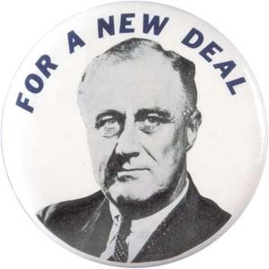
America Gets a New Deal
Roosevelt’s New Deal policies focused on three general goals:
Relief (for the needy)-The immediate effort to help the one-third of the population that was hardest hit by the depression
Economic Recovery-The effort in numerous programs to restore the economy to normal health
Financial Reform-Government intervention to stabilize the economy, and to balance the interests of farmers, business and labor

Slide 5
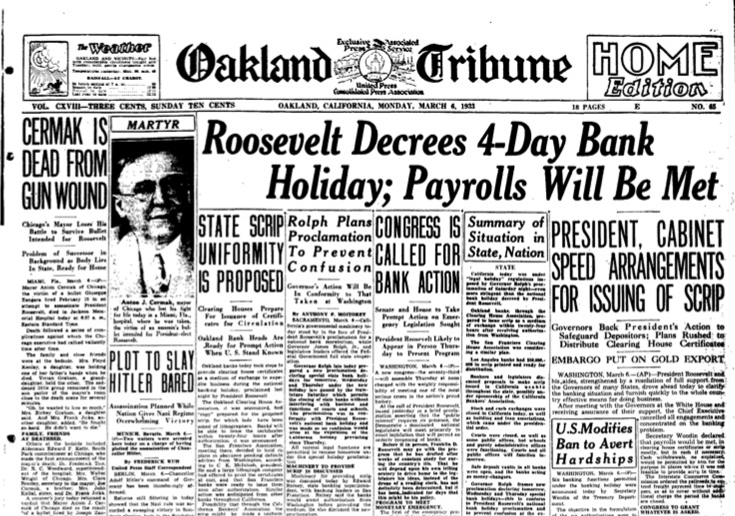
The “Bank Holiday”
After a month-long run on American banks, Franklin Delano Roosevelt proclaimed a Bank Holiday, beginning March 6, 1933, that shut down the banking system until March 13th, 1933.
The Emergency Banking Act stated that banks could only be re-opened under the supervision of the Treasury Departments
Federal loans were handed out as needed
Helped restore the publics confidence in the nation’s banking system

Slide 6
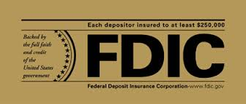
Regulating Banking and Finance
Glass-Steagall Act (1933)
Established the Federal Deposit Insurance Corporation (FDIC)
Provided federal insurance on each bank account
Restored confidence to the customers with the banks

Slide 7
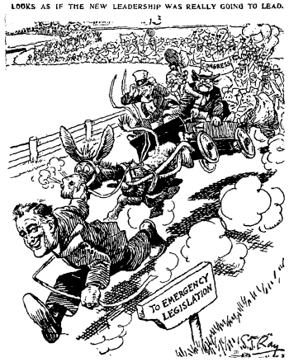
Federal Securities Act (1933)
Required corporations to provide complete information on all stock offerings
Created the Securities and Exchange Commission to regulate stock market

Slide 8
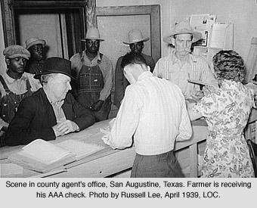
Help for the Farmers
Agricultural Adjustment Act (AAA)
Sought to raise crop prices by lowering production
The government paid farmers to leave some of their land fallow (unseeded)
This lowered production which in turn raised crop prices

Slide 9
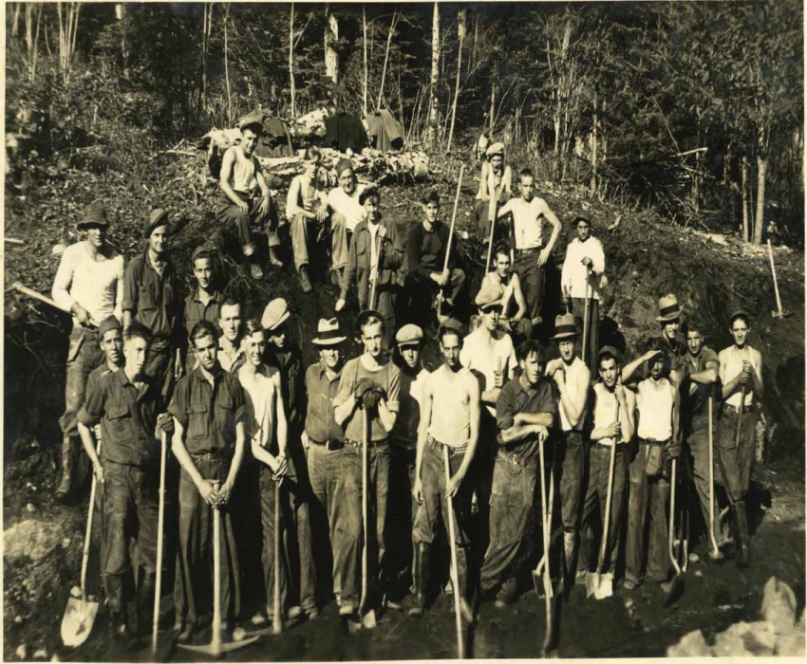
New Deal Projects
Civilian Conservation Corps (CCC)
Put young unemployed men to work building roads, developing parks, planting trees, and helping in soil-erosion and flood-control projects

Slide 10
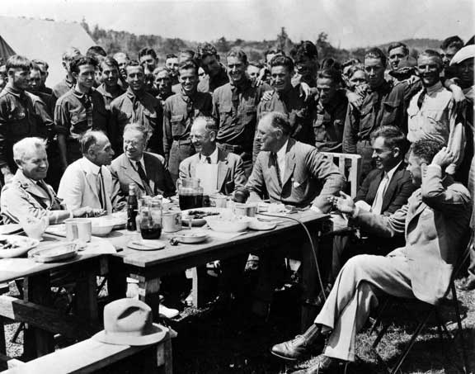
National Industrial Recovery Act (NIRA)
Established codes of fair practice for Industries and to promote industrial growth
Example:
Public Works Administration (PWA) - Provided money to states to create jobs chiefly in the construction of schools and other community buildings

Slide 11
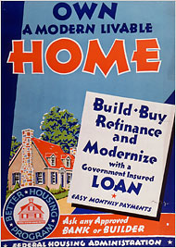
Food Clothing and Shelter
Home Owners Loan Corporation (HOLC)
Provided government loans to homeowners who faced foreclosures
Federal Housing Administration (FHA)
Furnishes loans for home mortgages and repairs
Federal Emergency Relief Administration (FERA)
Provided direct relief for the needy

Slide 12
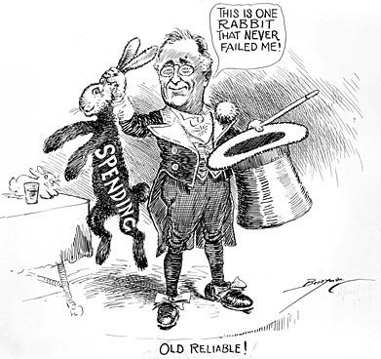
Deficit Spending
Spending more money than the government receives in revenue
FDR regarded deficit spending as a “necessary evil” to bring the United States out of the depression

Slide 13
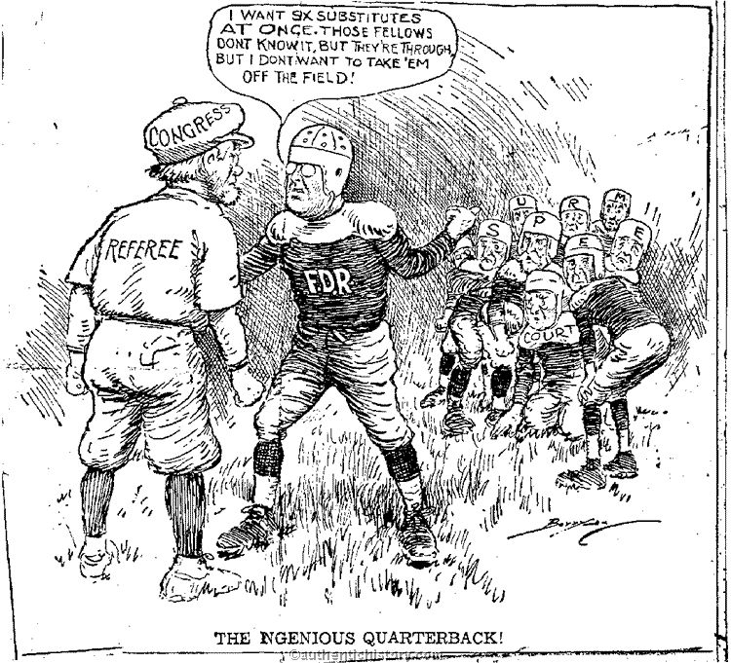
FDR vs. Supreme Court
Supreme Court in the early 1930’s was more conservative (did not favor New Deal) & declared many programs unconstitutional
1935 found the NIRA to be unconstitutional
1936 found the AAA to be unconstitutional and struck it down
In 1937 FDR proposed a Congressional bill to reorganize the Supreme Court calling for six new justices (And by law, he gets to appoint those justices!!!)
Congress and press were outraged at his “Court-Packing” Bill
Eventually he gets his way as several justices over the next four years retire

