Slide 1
Interest Groups and Lobbying
Chapter 9

Slide 2







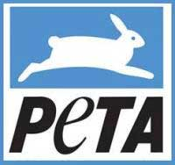



Interest Groups (Part I)

Slide 3
Interest Groups
Interest Groups-A collection of people who share certain views on public matters and work to shape public policy to their benefit.
  They are sometimes referred to as Special Interest Groups.
Public Policy-All of the many goals that a government pursues in all of the many areas of human affairs in which it is involved.
James Madison in the Federalist Paper 10 believed that interest groups would discourage the formation of an oppressive majority rule.
  In his eyes they were a necessary evil
Many interest groups justify their existence through citing the First Amendment
  It’s guarantee of free speech and right to peaceably assemble protects the actions of interest groups.

Slide 4
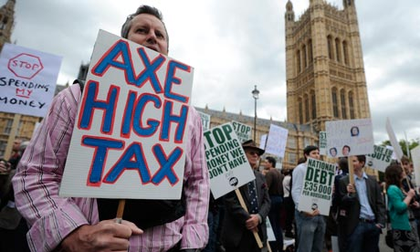
Interest Groups
When choosing which interest group to become affiliated with some Americans identify with groups distinguished by race, gender, ethnicity, age, occupation or sexual orientation.
  Others join groups based on common issues or interests .
    Ex. gun control, tax reduction, education or moral issues.

Slide 5

The Five Basic Types of Interest Groups
Economic Interest Groups are formed on the basis of representing the economic interests of businesses, labor, agriculture and other key professions
  Business Oriented Groups-Businesses that share strong (sometimes similar) economic interests
    Ex. American Manufactures Association
    Trade associations such as the American Trucking Association or the Association of American Railroads would fit into this category
  Labor Oriented Groups-Membership consists of those working similar jobs within a common industry
    Ex. UAW-The United Auto Workers or The AFL-CIO-American Federation of Labor and Congress of Industrial Organizations

Slide 6

The Five Basic Types of Interest Groups
Agricultural Groups-Designed to serve both small scale individual farmers and large farming corporations
  Ex. National Grange, American Farm Bureau and the National Farmers Union
Professional Associations-Work to protect it’s members who generally have a high level of training and education
  Ex. The American Medical Association, American Bar Association and the National Education Association
Issue Oriented Groups- Work to promote specific Causes
  American Civil Liberties Union, the Jewish Anti-Defamation League and Veterans of Foreign Wars

Slide 7

Other Examples of Interest Groups
The Women’s Movement led to the creation of interest groups such as the National Organization of Women (NOW)
The Civil Rights Movement created groups such as the National Association for the Advancement of Colored People (NAACP)
Environmental Interest groups such as Green Peace or the Sierra Club
Public interest groups focus on overall interests of community.
  For example, Ralph Nader’s group worked to make cars safer, Common Cause works to make government more responsive, and Mothers Against Drunk Driving to make teen drivers safer.

Slide 8
Positive Functions of Interest Groups
There are six Valuable Functions of Interest Groups-
  1.) They stimulate interest and raise awareness regarding public affairs issues
  2.) They often represent their members based on shared ideas and not based on geographic location
  3.) Provide the government with useful, specialized and detailed information that helps shape public policy
  4.) They act as vehicles for political participation since most Americans are not inclined to run for political office or even volunteer for campaigns
  5.) They act as a system of checks and balances in regards to public officials and agencies
  6.) They compete to limit the powers of opposing agencies

Slide 9

Functions of Interest Groups
Influence-
  Their level of power and influence usually far outweighs their size.
    Their level of power is dependent on how they’re organized and where their financial backing comes from
Representation-
  Since requiring interest groups to list accurate membership figures is nearly impossible it makes it difficult for the public to contextualize the demographics and size of some interest groups
    There in no minimum number of members requires so some interests groups have a handful of members while others have millions

Slide 10
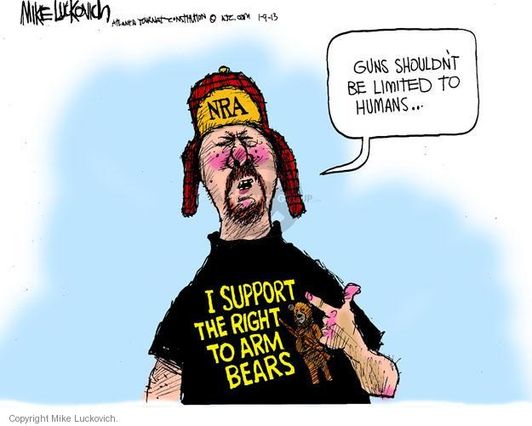
Functions of Interest Groups
Views-
  Due to who holds power within an interest group they often represent the views of a few members not the views of all their members
Tactics-Some interest groups use illegal tactics that could compromise or undermine the entire political process
  Ex. Bribery, threats and physical violence

Slide 11
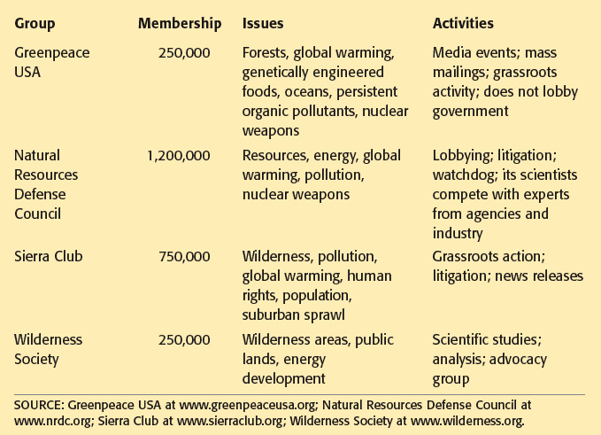

Slide 12
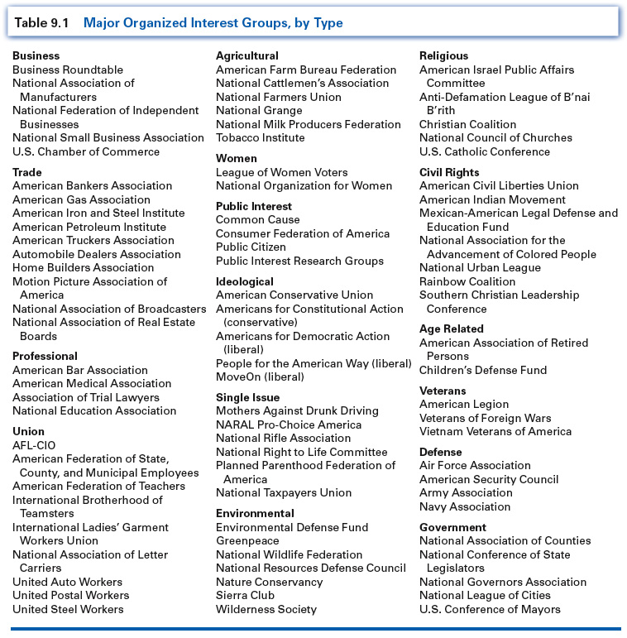
Major American Interest Groups

Slide 13

Why People Join
Solidarity Incentives-The desire to associate with others with the same interests (e.g. Audubon society for birds)
Material Incentives-Refers to economic benefits of membership (e.g. American Association Retired Person gives insurance and travel benefits)
Purposive Incentives-People agree to main purpose such as human rights or environmental protection (e.g. Amnesty International)

Slide 14

What Makes a Group Powerful?
Size-The larger the group the wider its outreach
  Ex. American Federation of Labor
Resources-The greater the financial resources the more a group can accomplish in terms of bringing attention to an issue or making economic impacts for their cause
  Ex. US Chamber of Commerce
Leadership-Strong leadership helps maintain an organized and focused mission
  Ex. National Rifle Association

Slide 15
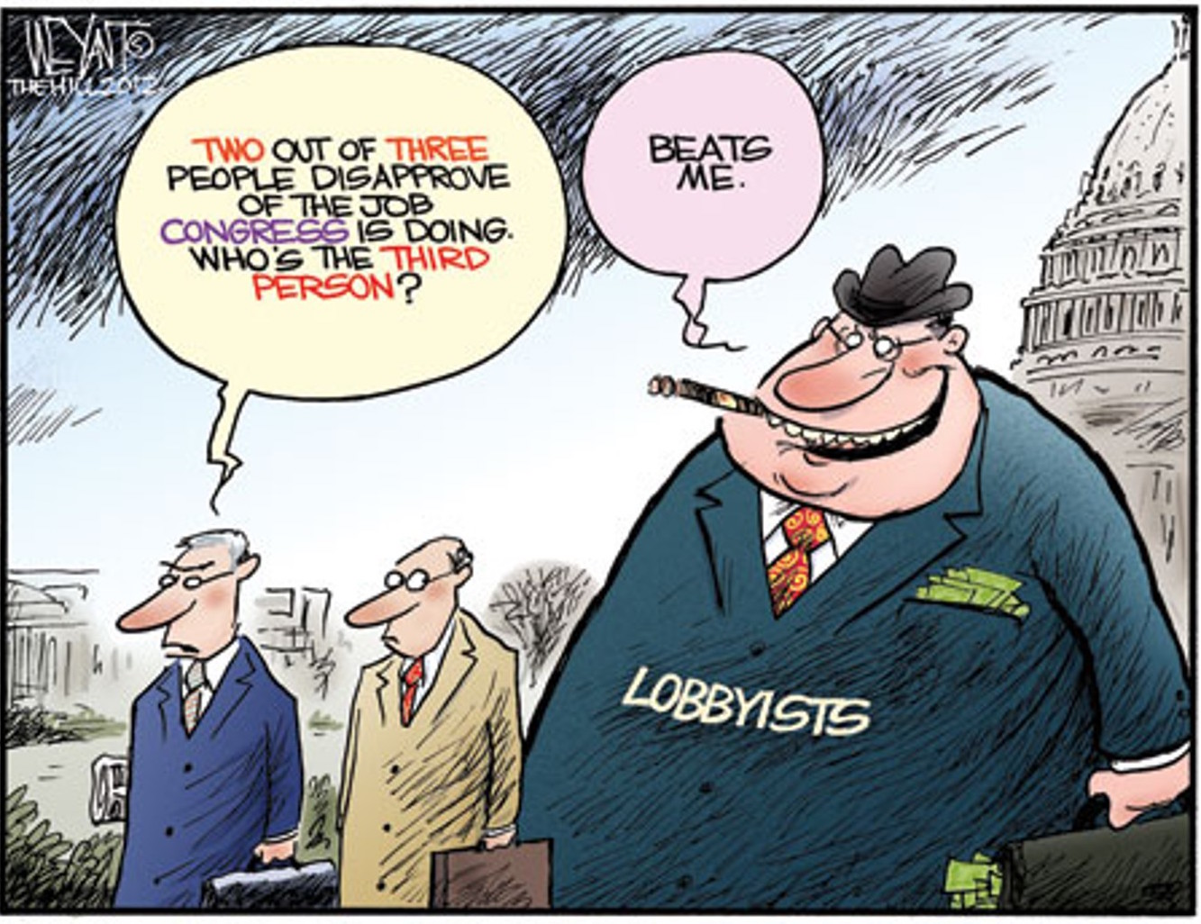
Lobbying and Lobbyists (Part II)

Slide 16
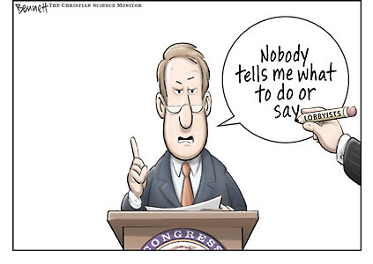
Lobbying
Lobbying-Process by which organized interests groups attempt to affect the decisions and actions of public officials.
Lobbyists-Those people who try to persuade public officials to do those things that interests groups want them to do.
1965 Lobbying Act-Defines the role of a lobbyist.
  Following the passage of this act each lobbyists must register with the government and report their lobbying efforts
    1995 a new lobbying law banned Lobbyists from giving gifts to legislators

Slide 17
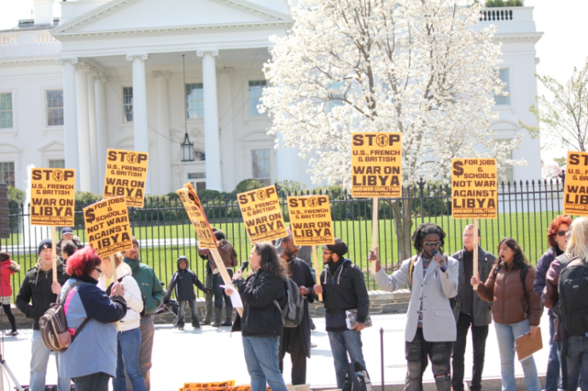
Indirect Lobbying Techniques
Not all interest group activity is directly related to lobbying legislators and distributing campaign contributions to candidates
Interest groups may also be involved in indirect techniques which include organizing protests or demonstrations, letter writing in the hopes of rallying support for an issue and political advertising

Slide 18
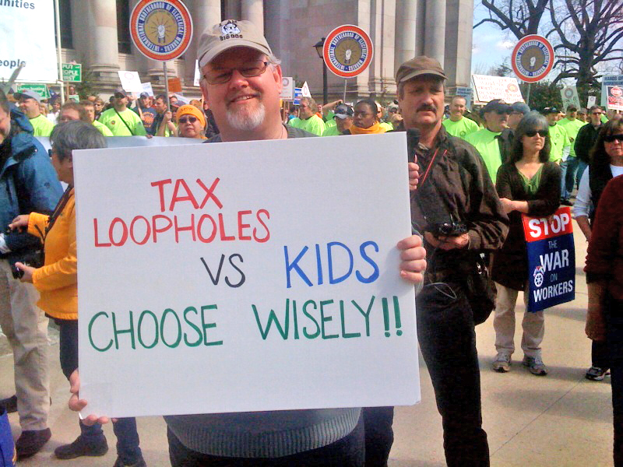
Concerns Regarding Lobbying
Many people may benefit from interest groups but do not participate in their activities. Essentially they get a “free ride” from the work that interest groups do.
Interest groups may also exert influence beyond their actual numbers, and in some cases engage in illegal or unethical behavior

Slide 19
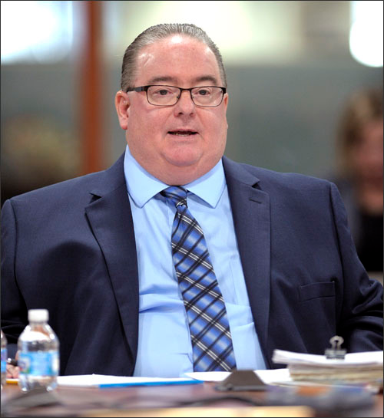
Lobbyist Interaction
Lobbyists-People who can be either full-time employees of the organization or hired from law firms or public relations firms
Lobbyists can be a major source of fundraising for candidates
Typical interaction between lobbyists and policymakers is transmission of information or access

Slide 20
PACS and Super PACS
Political Action Committees (PACS)- An organization that pools contributions from group members and donates those funds to candidates for office
  There are over 4,000 PACS contributing money to specific issues and candidates
  Most PACs are small and give less than $50,000 in total during a 2-year election cycle
  About 50 PACs contributed at least one million during the 2016 election cycle
    The primary goal of contributions is generally to gain access to politicians (Running or incumbent)
Super PACS-An independent organization that may raise unlimited and spend unlimited sums of money as long as they are not directly associated with a particular candidate.
  The 2010 Citizen’s United Supreme Court Decision allows donors to make unlimited contributions to Super PACS.

Slide 21
Lobbying Tactics
There are several ways in which lobbyists work:
  Direct Lobbying-Is where the lobbyist attempts to influence a legislator’s vote through personal contact
  Grassroots Lobbying- A more personal style of lobbying where a lobbyist will draw support form rank-and-file members along with potential new members
  Informational Campaigns- Are where a lobbyists efforts are organized to bring public attention to the groups views in order to gain public backing
    Often this is done for financial reasons
  High-Tech Lobbying- Using e-mail, polling and the internet to expand an organization’s reach and access to new members
  Coalition Building- The banding together of several interest groups for the purpose of lobbying for a common goal

Slide 22
Who Lobbies?

