Slide 1
The Electoral Process
Chapter 7

Slide 2
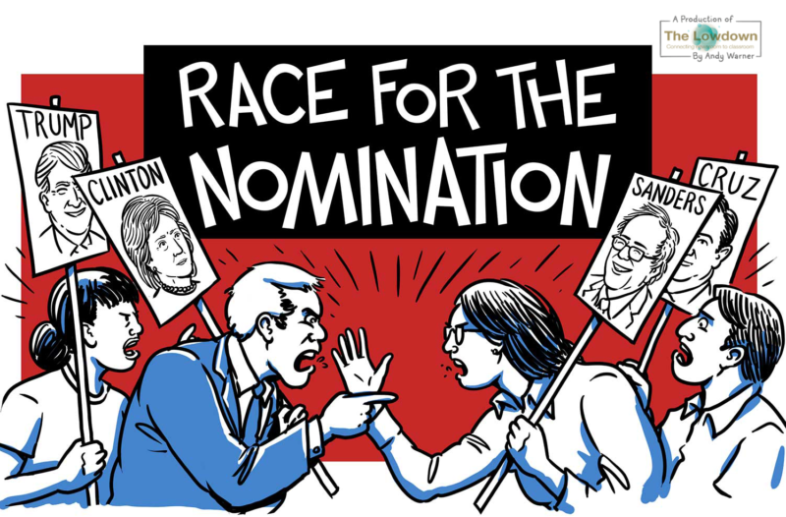
The Nominating Process
Section 1

Slide 3
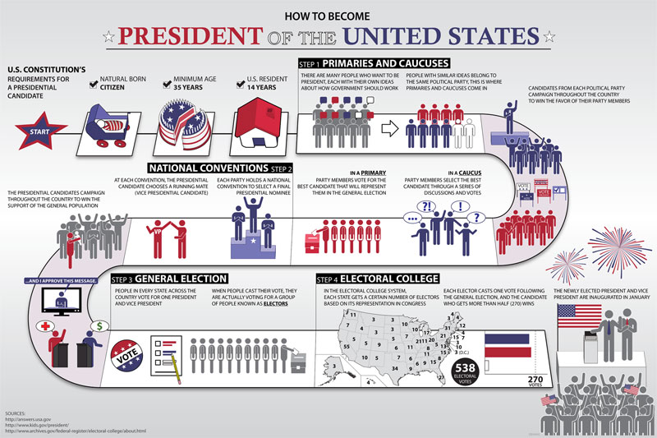

Slide 4
The Nominating Process
The nominating process is the process of selecting a candidate for political office
The Two Steps of the Election Process-
  Nomination–The naming of those seeking office
  General Election–regularly scheduled election where voters make the final choice of officeholder

Slide 5
Five Ways to Nominate
Self-Announcement–person who wants to run for office announces their candidacy
  - Mainly used early in early years of our nation and for write in candidates
Caucus–A meeting between a group of like minded people who elect the candidates they will support in an upcoming election
  not widely used since the 1820’s but still used in places like New England for local nominations

Slide 6
Five Ways to Nominate
1.) Convention–A process where party members meet to pick candidate for local offices while at the same time selecting delegates to represent them at the county conventions
  By around 1910 the direct primary system had replaced the conventions as the principal nominating process
    however, they still play a part in Connecticut, Michigan, South Dakota, Utah and Virginia

Slide 7
Five Ways to Nominate
2.) Petition–candidate gathers a required number of signatures required to qualify for the general election
  The required number of petition signatures for various offices are:
    President of the United States-860,000 signatures Nationwide as of 2016
    U.S. Senator, Governor, Lt. Governor, Attorney General - 10,000
    U.S. Congress - 2,000
    State Senator - 300
    State Representative - 150

Slide 8
Five Ways to Nominate
3.) Direct Primary–An intraparty election held to choose candidate to represent the party in the general election
4.) Open primary-a nominating process in which any qualified voters can cast a ballot
5.) Closed Primary-A party’s nominating process in which only declared (or registered) Party members can vote

Slide 9
Closed vs Open Primary
Arguments in favor of a closed primary
  It prevents one party from “raiding” the other primary in hopes of nominating a weaker candidate
  It helps make candidates more responsive to the platform (It’s members)
  Makes voters more thoughtful b/c they have to identify with a party in order to vote
Arguments against a closed primary
  It compromises the secrecy of the ballot because voters have to identify with a particular party
  It excludes independent voters from the voting process

Slide 10
Closed vs open primary
Supporters of an open primary feel that it addresses the concerns associated with closed primaries
  They feel that it promotes individuality since a voter is not forced to publicly identify with a political party
  Independent voters are not excluded from the voting process

Slide 11
Nonpartisan and Presidential primaries
Nonpartisan primary-Elections where candidates are not identified by party labels
  About half of the states in the United states use this process for electing judges
Presidential primary-One part of the process by which presidential candidates are chosen
  This is not a nominating device

Slide 12
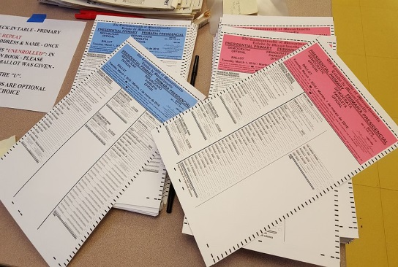
Nonpartisan and Presidential primaries
Super Tuesday-refers informally to one or more Tuesdays early in a United States presidential primary season when the greatest number of U.S. states hold primary elections and caucuses on the same day.
  On super Tuesday more Primary delegates can be won than on any other single day of the primary calendar.

Slide 13
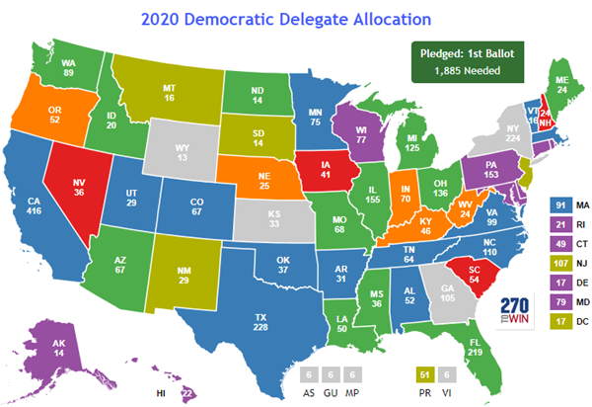

Slide 14
Nonpartisan and Presidential primaries
Delegate-a person sent or authorized to represent others, in particular an elected representative sent to a conference.
Super Delegates-(in the Democratic Party) an unelected delegate who is free to support any candidate for the presidential nomination at the party's national convention.

Slide 15
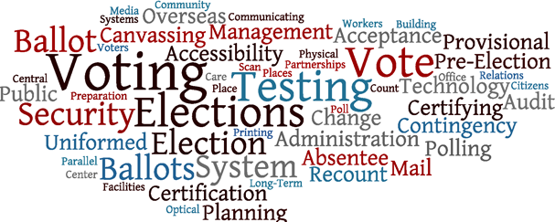
Elections
Section 2

Slide 16
Extent of Federal Control
All elections in the United States are held to select nearly 500,000 elected positions in over 89,000 units of government at the state and local levels
Most election law in U.S. are concentrated at the State Law.
Elections are held on the Tuesday after the first Monday in November of even numbered years

Slide 17
Extent of Federal Control
Ballots-Are Instrument on which voter registers their choice for political officers
  Forms include paper, optical scanner, and touch screens
Characteristics of a Ballot-
  Based on the concept of the Australian ballot
  Printed at public expense
  All candidates from the two major parties and those who received a qualifying amount of votes in the previous election are listed
  Marked in secret—FYI: it’s not polite to ask someone who they are voting for

Slide 18
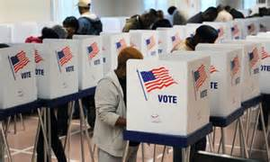
Extent of Federal Control
The constitution gives congress the ability to fix
the time, place and manner of elections
Require secret ballot
Regulates financing of campaigns for federal office

Slide 19
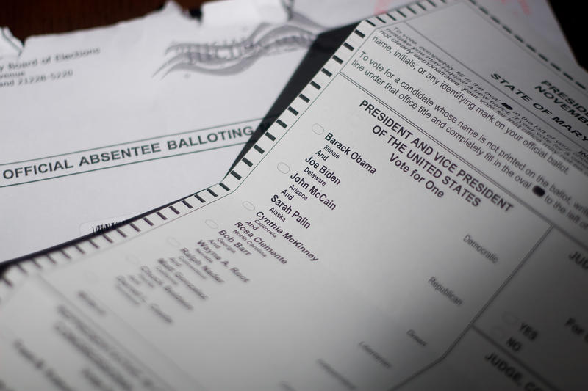
Absentee Voting
Who tends to file absentee ballots
  I. People who are ill or unable to leave their homes
  II. Those who know they will not be in their local town during the election
    Away at college, Traveling for work or leisure
  III. Those serving in the military

Slide 20
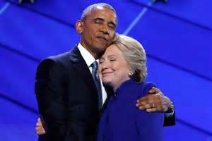
The Coattail Effect
The Coattail Effect-The phenomenon that occurs when a strong candidate running for an office at the top of the ballot helps attracts voters to other candidates on the party’s ticket

Slide 21
Precincts and Polling Places
Precinct -is a voting district
  Smallest political unit in elections
About 500 to 1,000 voters
Polling place -is where those in a precinct vote
Poll watchers -from each party help monitor fairness at polling place

Slide 22
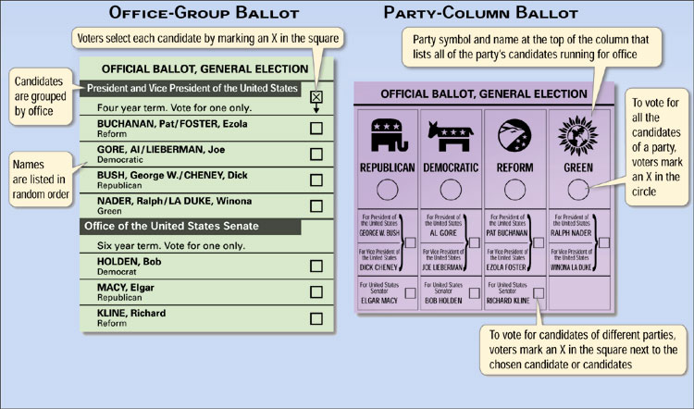
Types of Ballots

Slide 23
Electoral COlllege Votes
The Representatives and Senators in your state make up your Electoral Votes
Total of 538 electoral votes
  (435 Members of the House of Representatives, 3 from Washington D.C. and 100 total Senators)
Based on the popular vote
  Whoever the people voted for is who the Electoral votes go to
“Winner Takes All”
  ALL electoral votes go to the candidate who won the most popularity votes in that state

Slide 24
270 Votes To Win
Candidate must win majority of electoral votes to win presidency (270)
IF THERE IS A TIE – House of Representatives votes. Each state has 1 vote
IF the candidate wins the POPULAR VOTE but not the ELECTORAL VOTE they DO NOT become President
  (could be decided by as few as 11 states up until 2010 Census)

Slide 25
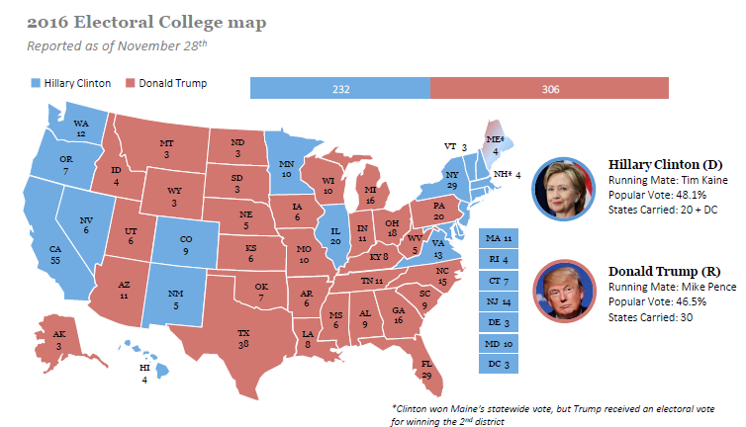
2016 Election

Slide 26
Near Failures of System?
1888- Cleveland received 48.6% of popular vote while Harrison received 47.8%
Harrison won electoral college with 233 votes to Cleveland’s 168 votes
1960-JFK won with 303 electoral votes to Nixon’s 219
Results were much closer in popular vote with JFK receiving 49.7% to Nixon’s 49.5%
2000-Al Gore received 539,947 more popular votes than George W. Bush
Bush won with 271 EC votes to
Gore’s 266
1800- Thomas Jefferson & Aaron Burr (same party) each had 73 electoral votes
- Jefferson was chosen by House on 36th attempt
- Led to the passing of the 12th Amendment
1876 - Rutherford B. Hayes lost the popular election to Samuel Tilden (48% to 51%)
- Electoral votes disputed in 4 states
- Committee in House gave states to Hayes in exchange to end Reconstruction

Slide 27
Why the Electoral College?
Three Reasons why the framers of the Constitution wanted an electoral college:
  Equality – balanced between big states and small states (population)
  Fear – general public wasn’t educated enough to cast adequate votes
  Knowledge - No way for people to know about candidates from other places (no media!)

Slide 28
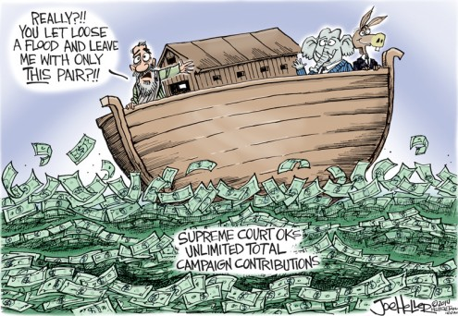
Money and Elections
Section 3

Slide 29
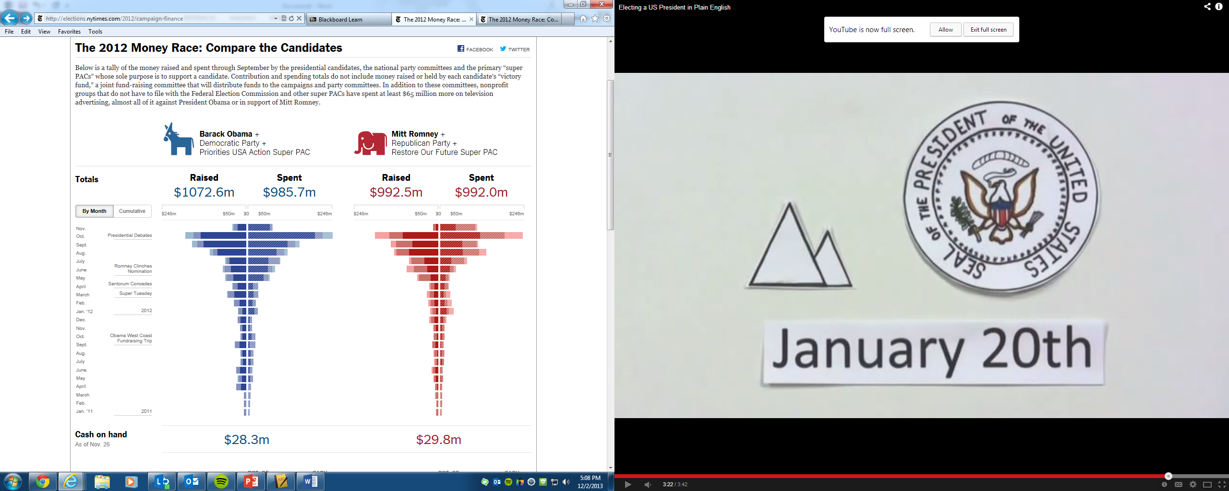
Money and Elections
Money is a necessary campaign resource
The getting and spending of $ can corrupt the political process

Slide 30
Sources of Funding
Private and Public Sources
  Small Contributors-People who occasionally might give $5 or $10 dollars to a campaign.
    Only about 10% of the voting public make donations to political campaigns so even small contributions are important
  Wealthy Individuals-Sometimes referred to as “fat cats”, they tend to make large contributions to those candidates who reflect their personal or financial interests
  Candidates-Often the candidates running will donate to their own campaign
    Ex. Donald Trump put about $52.6 million dollars into his campaign (Although most of it was a loan)
    However, Ross Perot holds the record with the use of over $65 Million of his own money
  Political Action Committees (PACs)-Special interest groups with a stake in the election process
  Temporary Organizations-Groups formed to make an immediate impact on a campaign

Slide 31
Sources of Funding
Private and Public Sources of Campaign Money
Small contributors
Nonparty groups such as PACs
(Political Action Committees)
Ex: Priorities USA or
Restore Our Future
Wealthy supporters
Temporary fund-raising organizations
(direct mail requests, telethons, Internet solicitations)
Candidates
Ross Perot - $65 Million

Slide 32
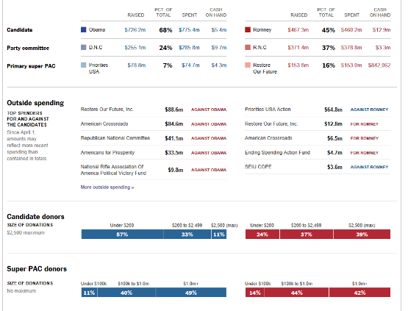

Slide 33
Why do people donate?
Political participation
Believe in party or candidate
Access to government
Want appoint to office
Social recognition
Organizations want things done

Slide 34
FEC regulates campaign finance
The Federal Election Commission (FEC) enforces:
Timely disclosure of campaign finance information
Limits on campaign contributions
Limits on campaign expenditures
Provisions for public funding of presidential campaigns

Slide 35
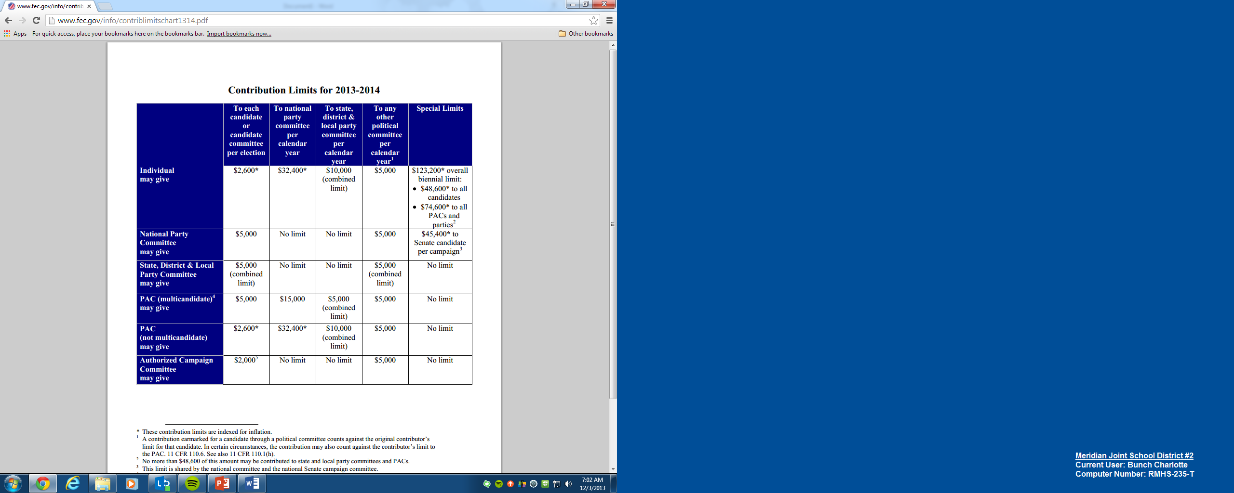

Slide 36
Campaign Finance
Subsidy-A grant of money in the form of federal or public funding
Hard Money-Campaign contributions that are given directly to a candidate for their campaigns for congress or the white house
  These amounts are limited and must be reported
Soft money-money given to State and local party organizations for “party-building activities”
  filtered to presidential or congressional campaigns.
  $500 million was given in 2000

Slide 37
Loopholes in the law
“More loophole than law…” —Lyndon Johnson
Independent campaign spending—a person unrelated and unconnected to a candidate or party can spend as much money as they want to benefit or work against candidates.
Issue ads—take a stand on certain issues in order to criticize or support a certain candidate without actually mentioning that person’s name.

