Slide 1

Chapter 13-Section 3- Education and Popular Culture

Slide 2

Schools and the Mass Media Shape Culture
In 1914, approximately one million Americans were attending high school.
  By 1926 the number soared to four million
  Families didn’t need kids to work anymore
  Industry jobs required education
    Vocational training began to be offered
  Many new students were immigrants
    Difficulty speaking English at first
      Assimilated through education
  Taxes raised to cover the costs

Slide 3
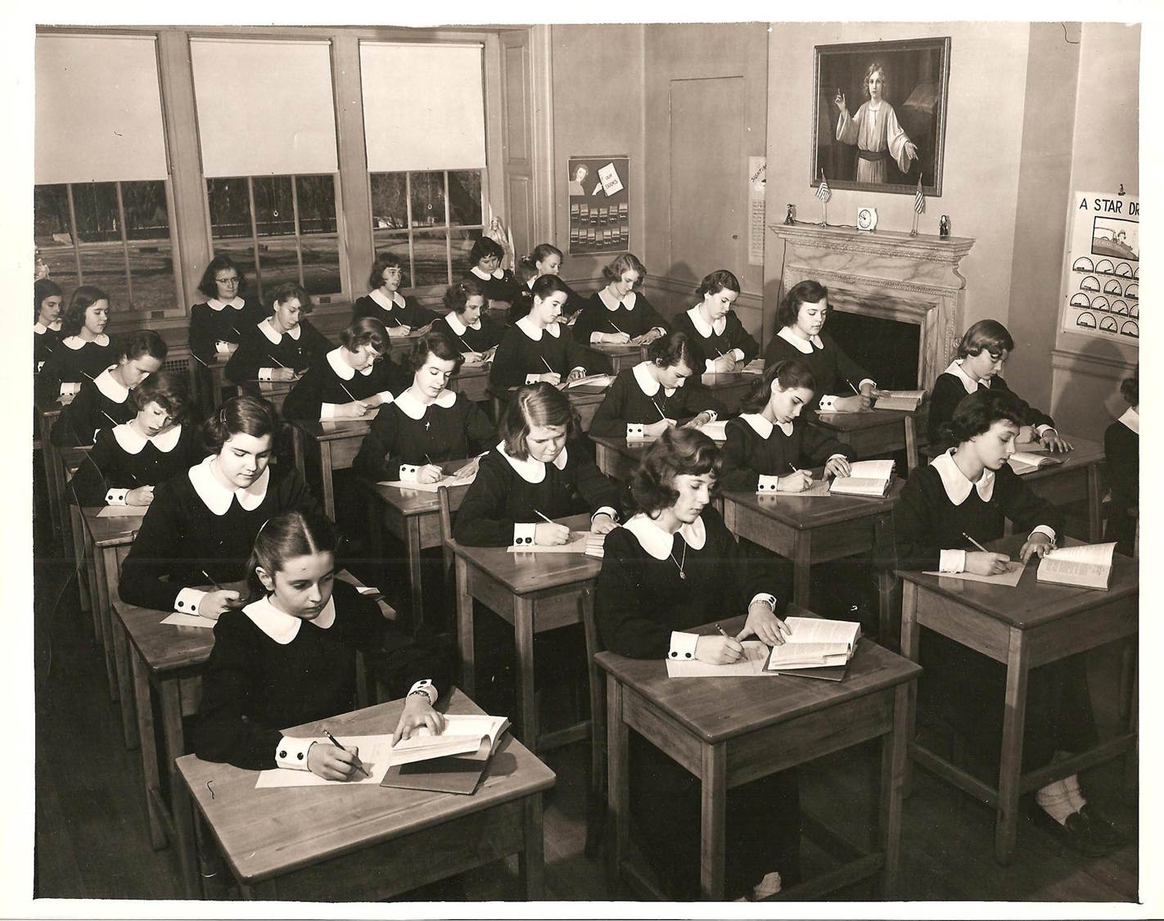

Slide 4
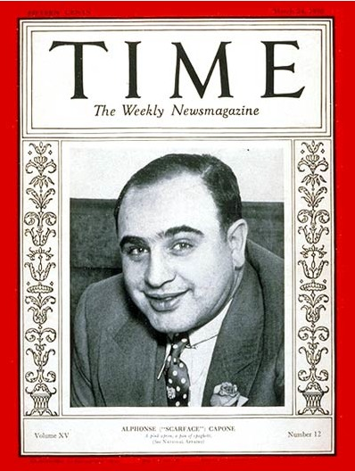
Expanding News Coverage
With widespread education literacy increased across America
  With that newspaper circulation increased
    Big city papers became very popular
Nationally published magazines also became popular
  Time Magazine and Readers Digest are examples

Slide 5
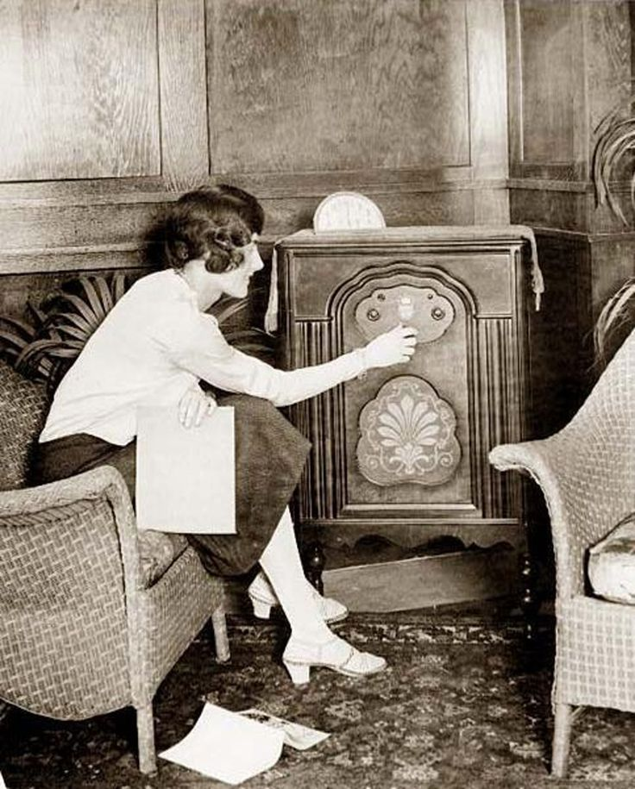
Radio Comes of Age
Radio soon became the most powerful way to communicate news, events, entertainment and advertisements during the 1920’s and 1930’s
    Went from being a hobby to a formal affair where nearly forty percent of American homes now had a radio inside

Slide 6
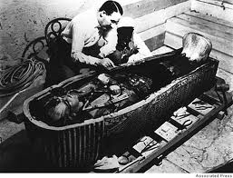
America Chases New Heroes and Old Dreams
During the 1920’s American’s had more money and time to spend
1922-King Tut’s tomb was discovered and many women began dressing in Egyptian fashion
1929-Americans spent $4.5 billion on entertainment and passing fads
  Many new sports stars begin to emerge

Slide 7
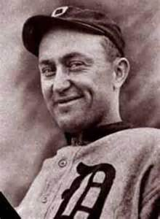
Sports Stars of the 1920’s
Gertrude Ederle-
  Swam the English Channel
Andrew “Rube” Foster-
  Chicago Ace’s Pitcher and one of the founders of the Negro League
Helen Willis-
  Tennis player and eight time Wimbledon Champion
Ty Cobb-
  Detroit Tigers star who also made four million w/ Coke-a-cola stock
Babe Ruth-
  “The Great Bambino” king of hitting home run

Slide 8
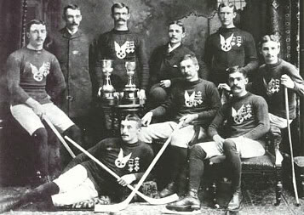
Detroit Cougars

Slide 9
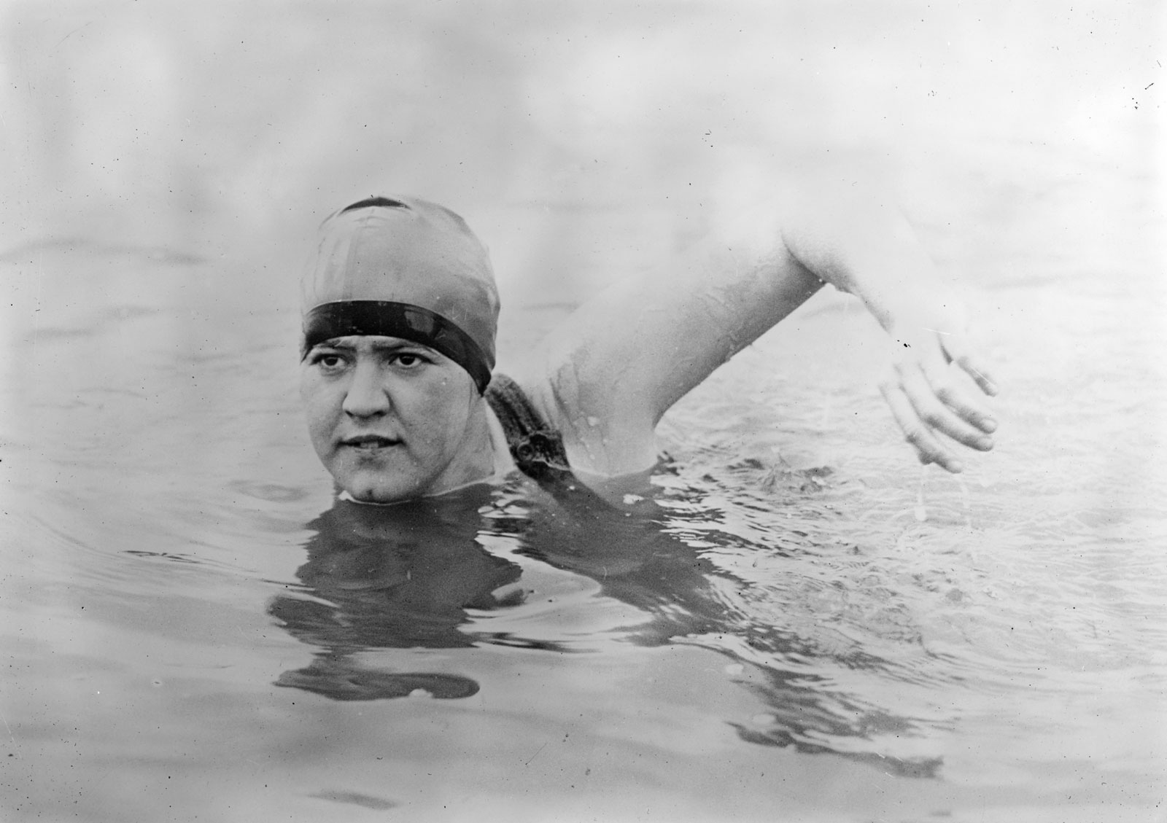
Gertrude Ederle

Slide 10
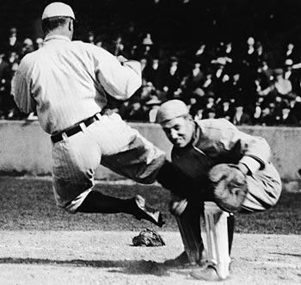
Ty Cobb

Slide 11
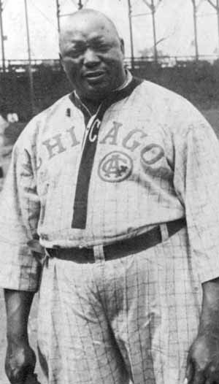
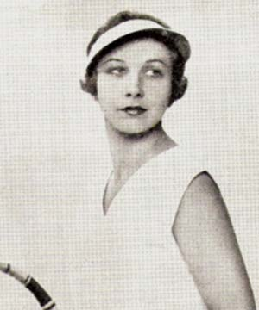
Andrew “Rube” Foster
Helen Willis

Slide 12
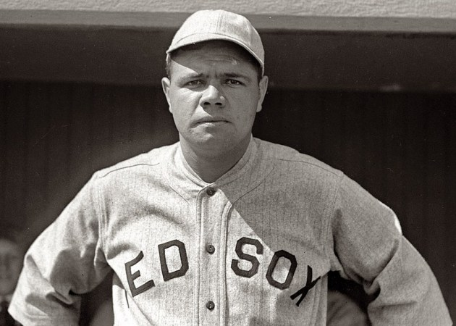
Babe Ruth

Slide 13
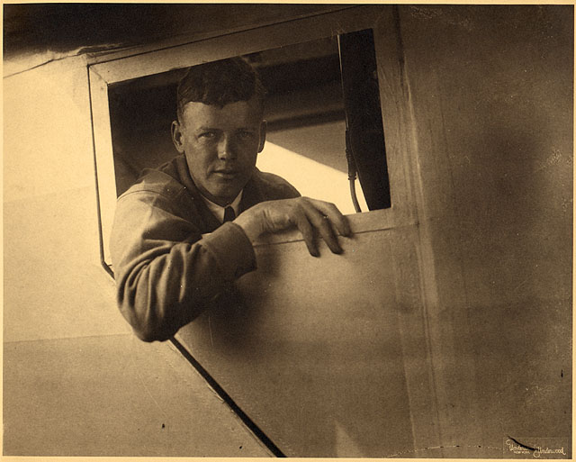
Lindbergh’s Flight
Charles Lindberg was a pilot and one of America’s most beloved hero
  $25,000 prize was offered for the first person to complete a solo mission across the Atlantic
  On May 27th,1927 he flew from New York to Paris in only 33 hours and 29 minutes

Slide 14
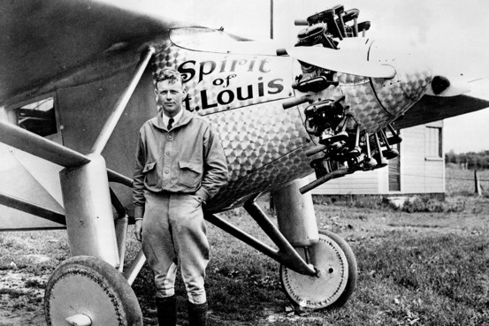

Slide 15
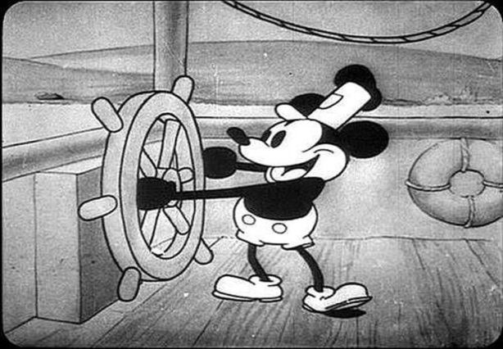
Entertainment and the Arts
1927-Jazz Singer
  1st movie with sound
1928-Steam Boat Willie
  1st animated film with sound
1930’s-The “Talkies” helped doubled movie attendance
  But ended the career of many silent film stars

Slide 16

Entertainment and the Arts
George Gershwin
  Blended traditional musical elements with jazz
Georgia O’Keeffe
  Painted the grandeur of New York

Slide 17
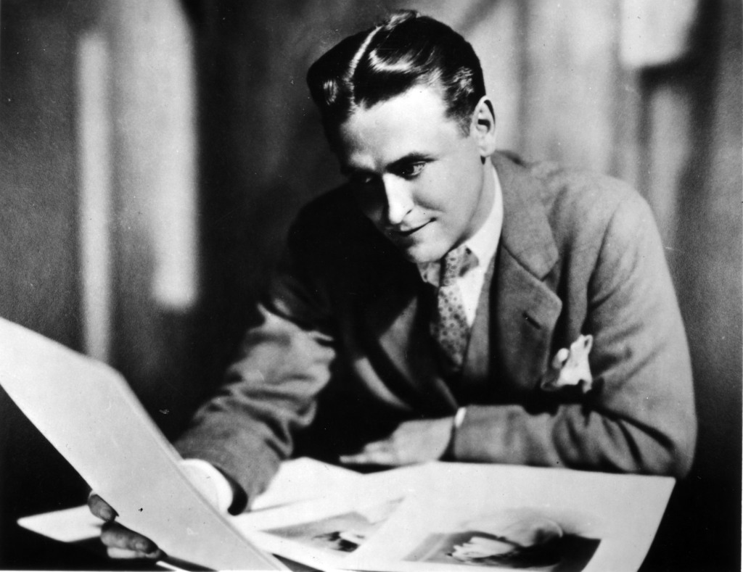
Writers of the 1920’s
F. Scott Fitzgerald
  Wrote the Great Gatsby and coined the term the “Jazz Age”
Ernest Hemingway
  Wrote The Sun Also Rises and A Farewell to Arms
  Introduced a tough, simplified style of writing

