Slide 1
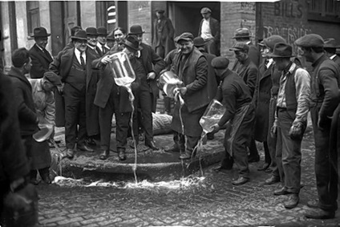
Chapter 13-Section 1- Changing Ways of Life

Slide 2
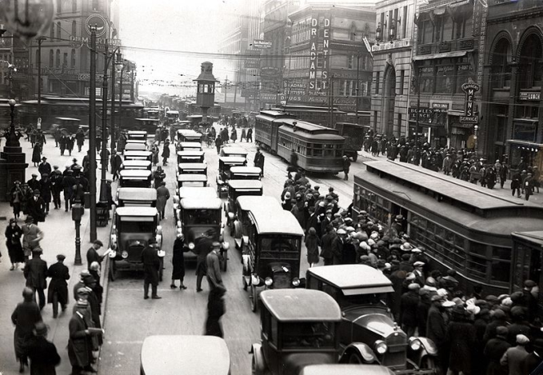
Rural and Urban Differences
During the 1920’s we saw a dramatic shift in population with more people moving from rural areas to the city
In 1920 roughly 51% of Americans lived in small towns
From 1922-1929 a mass migration to the cities changed the way many Americans lived and worked
The city was new, exciting and provided opportunity
Detroit MI in the 1920’s

Slide 3
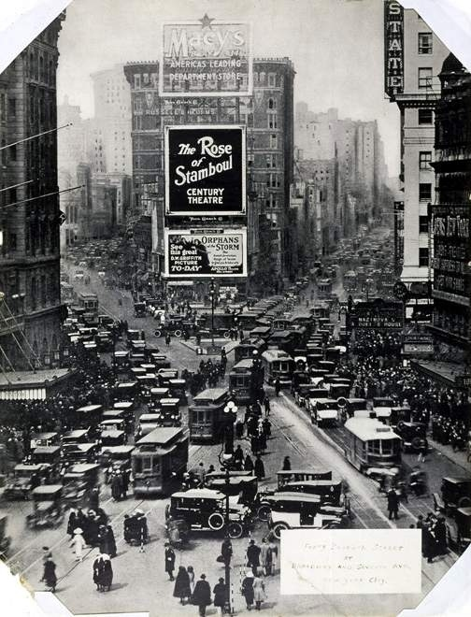
The New Urban Scene
There were several large cities that dominated the American landscape in the 1920’s:
New York City, New York
pop. 5.6 million people
Chicago, Illinois
pop. 3 million
Philadelphia, Pennsylvania
pop. 2 million
Detroit, Michigan
Pop. 1.5 million
There were sixty-five additional U.S. cities by 1920 had populations of 100,000 people or more
Most of these cities were thriving industrial centers
New York in the 1920’s

Slide 4
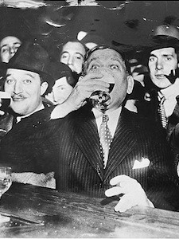
The New Urban Scene
Large cities tended to be ethnically mixed
Whites, Blacks, Poles, Irish, Russians. Italians, Swedes, Arabs, French, Chinese and immigrants lived, worked and interacted with one another
New ideas such as drinking, gambling and casual dating were accepted
The job market was competitive
In the city the individual was more important, where in rural (farming) areas the community was more important
For many city living was fast paced and exciting

Slide 5
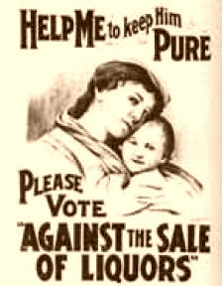
The New Urban Scene
In spite of all the advantages of city living there were some disadvantages as well:
City life tended to be impersonal, frightening and lonely
Some felt the residents lacked morality
All the new technologies combined with fast paced living led to people wanting a return to conservative values.
This tended to focus on laws regarding alcohol reform and a resurgence of religion

Slide 6
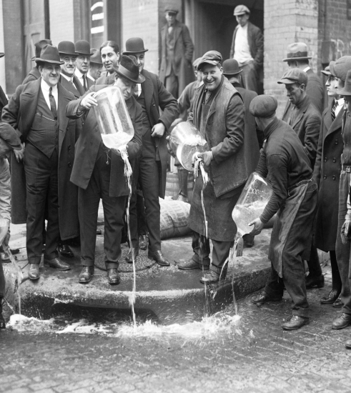
The Prohibition Experiment
Prohibition-Under the 18th Amendment the manufacturing, sale and transportation of alcoholic beverages were legally prohibited in the United States.
The main reason for passing the 18th Amendment was an attempt to maintain morality within our society
Previously in 1919, the Volstead Act was passed creating the Prohibition Bureau who’s main job was to monitor American citizens and enforce the ban on alcohol
Prohibition was mainly supported by those living in the South and in the Western parts of the U.S.A.

Slide 7
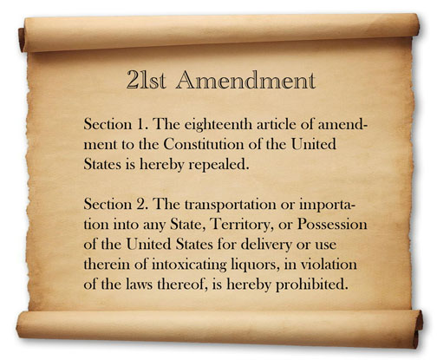
The Prohibition Experiment
The enforcement of prohibition seemed to be an immediate success
However, the Prohibition Bureau was underfunded and the law alienated newly arriving immigrants
Absenteeism within the family structure is down and some saw their savings increase
Ultimately the goals of prohibition fails and the 18th Amendment is repealed through he introduction of the 21st Amendment in 1933

Slide 8
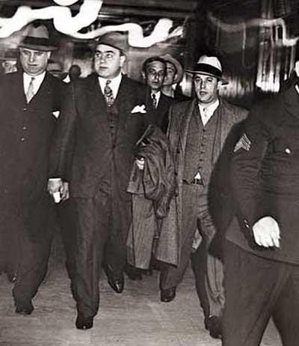
The Prohibition Experiment
What did Prohibition Create:
A market for speakeasies and bootleggers emerged due to the trafficking of illegal liquor
These were mostly enjoyed by middle and upper class Americans
Organized crime became mainstream to handle the demand for alcohol
Led to violence from gangsters like Al Capone

Slide 9
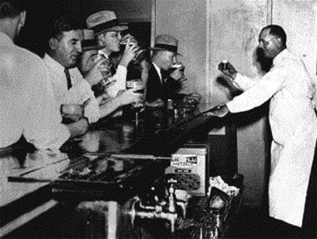

Slide 10
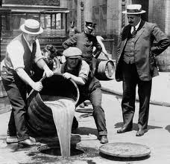

Slide 11
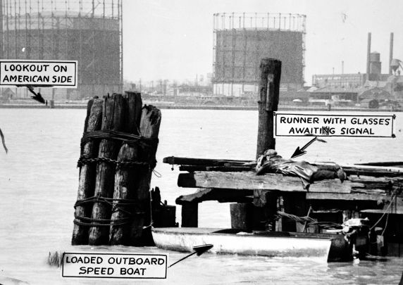

Slide 12
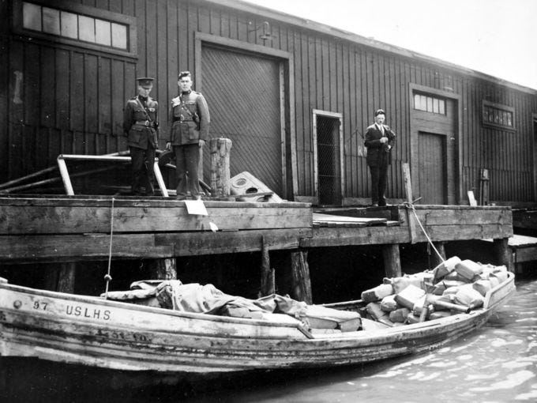

Slide 13
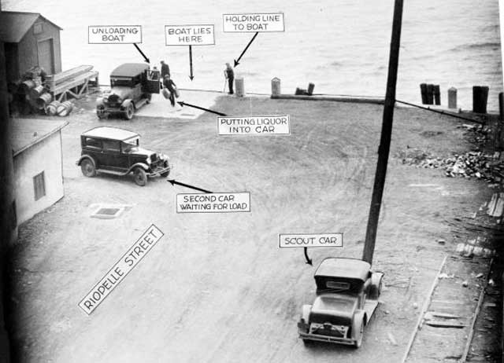

Slide 14
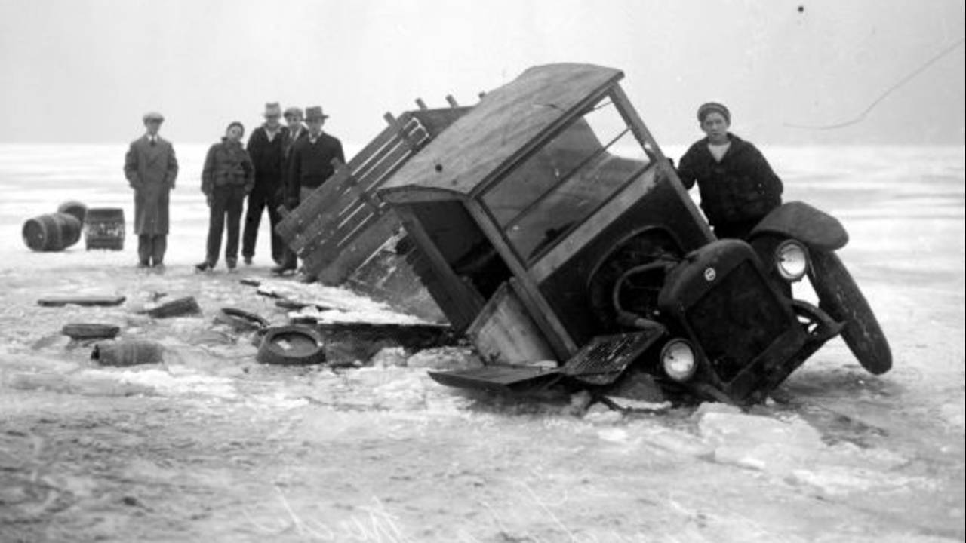

Slide 15
Organized Crime
Charles “The Bug” Workman
Jack “Legs” Diamond
Al Capone
“Scar Face”

Slide 16
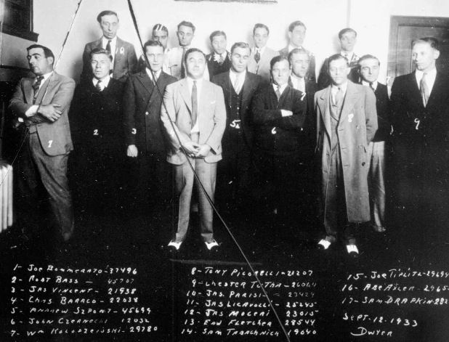
The Purple Gang

Slide 17
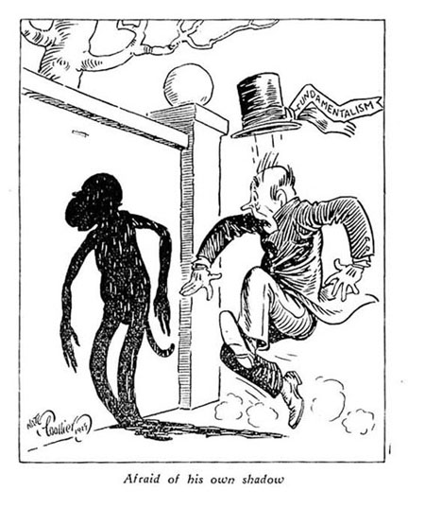
Science and Religion Clash
As people became more “modern” during the 1920’s, a clash between traditional values and progressive ideas emerged
One of these main conflicts was between the teaching of evolution in schools

Slide 18
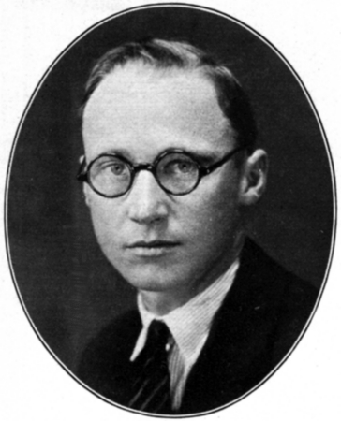
The Scopes Trial
The Scopes Trial that took place in July, 1925 was a highly publicized trial in where John Thomas Scopes (a substitute teacher) was brought before the court for violating a Tennessee state law by teaching the theory of evolution at a local high school
ACLU supported him making it clear that they wanted a teacher to be the one who challenge this law not lobbyists
The debate over teaching evolution becomes a battle between Fundamentalists and Modernists
Fundamentalists believed in strict religious teachings
Modernists supported teachings of modern science

Slide 19
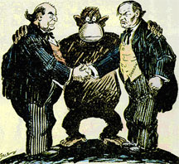
The Scopes Trial
Scopes was represented by Clarence Darrow a lawyer for the ACLU
William Jennings Bryan represents the State of Tennessee
In the end Scopes is found guilty (which the ruling was later overturned) and was issued a $100.00 fine

Slide 20
