Slide 1
Chapter 11-The First World War
-Test Materials

Slide 2
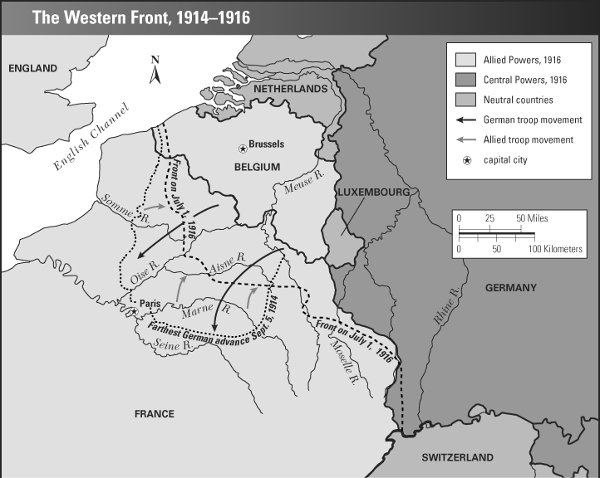

Slide 3
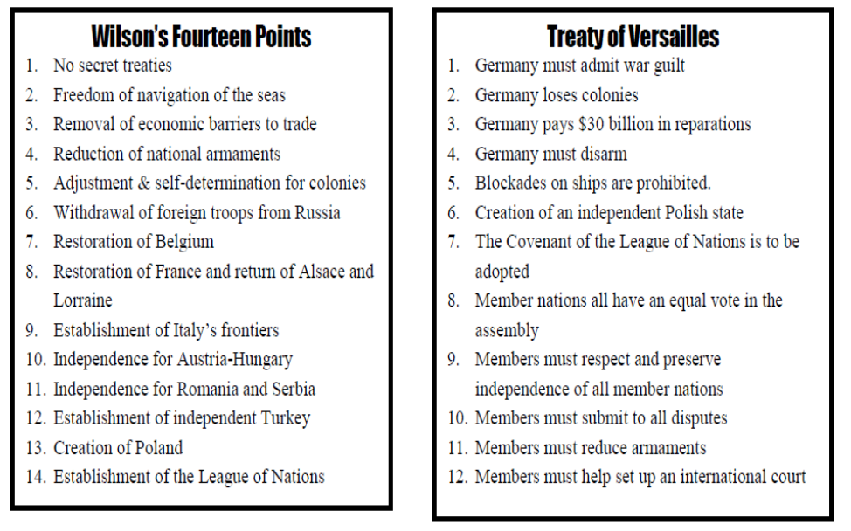

Slide 4
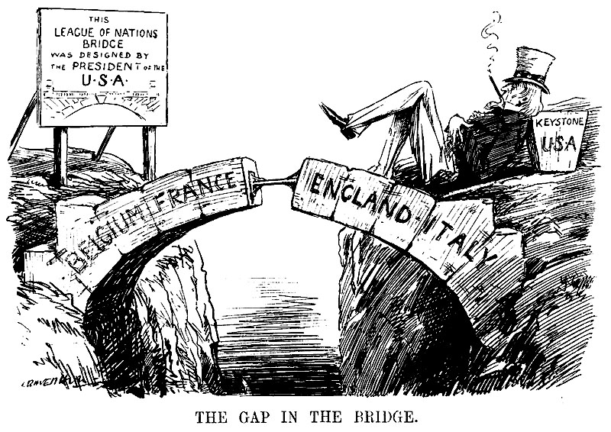

Slide 5
