Slide 1
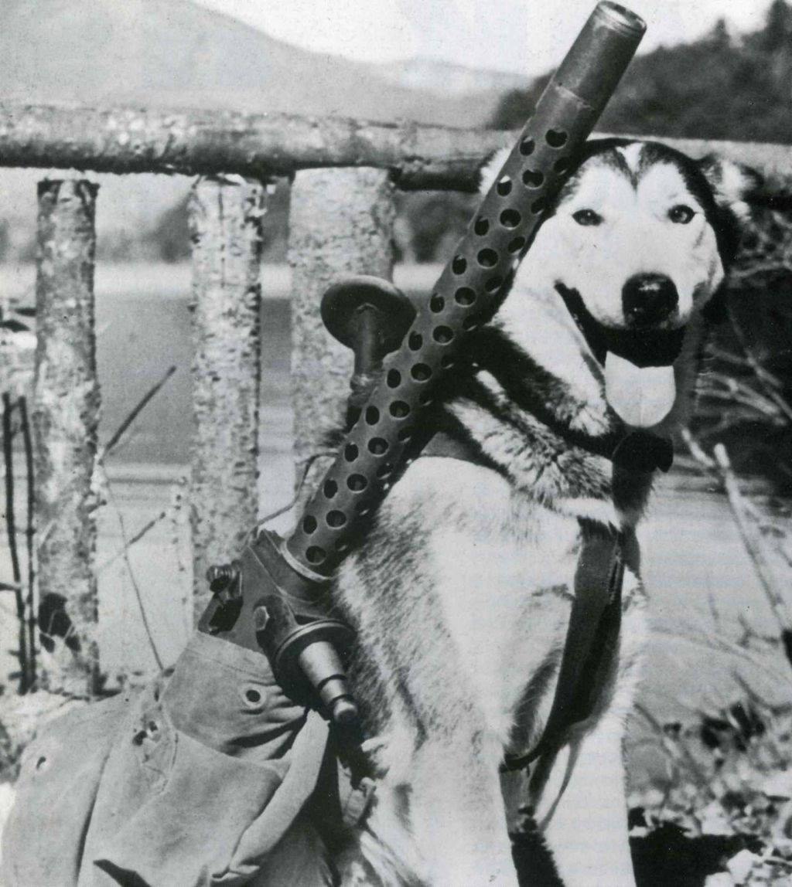
Chapter 11-The First World War
Test Materials

Slide 2
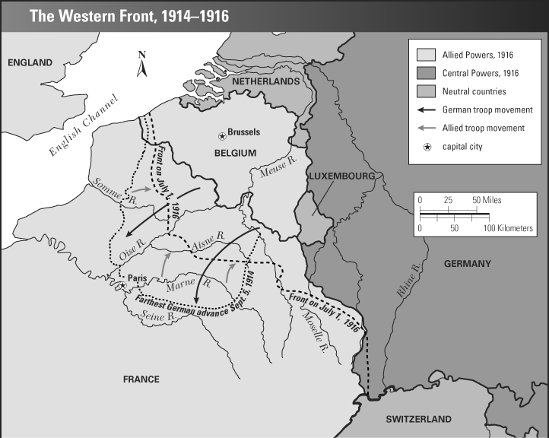

Slide 3
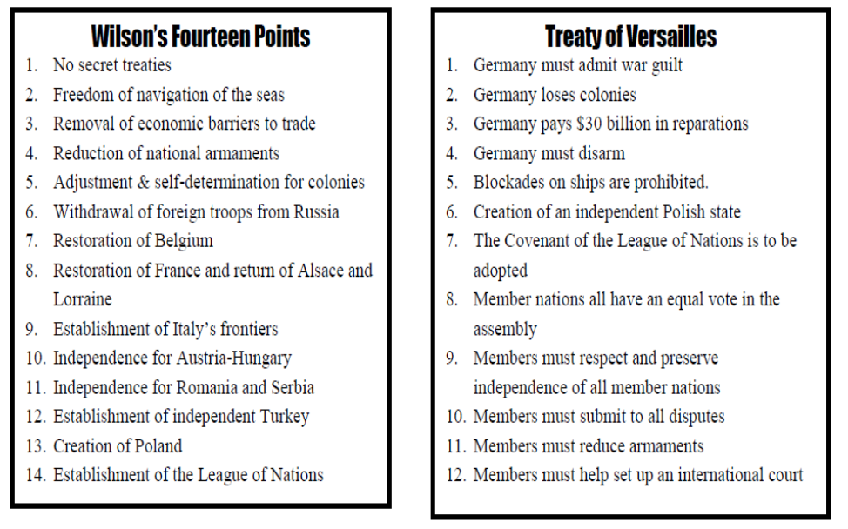

Slide 4
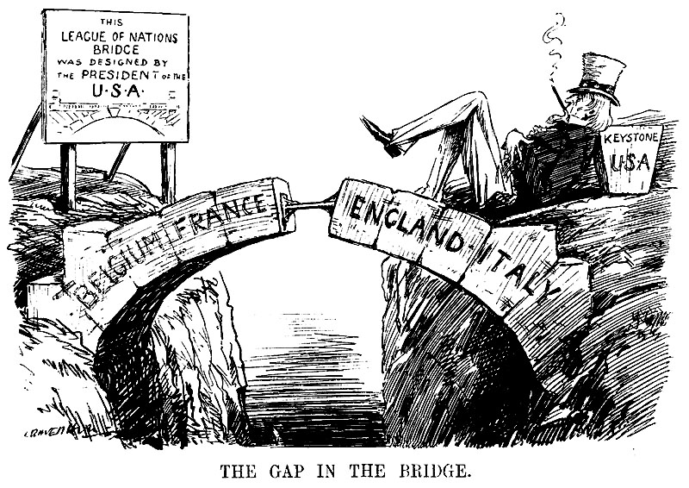

Slide 5
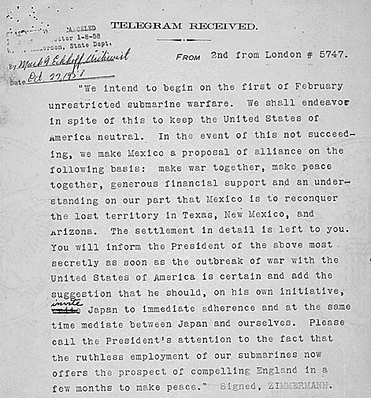

Slide 6
Learning Target 5-Sentence Stems
28.)
The major provisions (points) included in the Treaty of Versailles…
The names of the “Big Four” were…
The countries they represented were…
Three new nations that were created were __________, __________, and __________.
*Pick your viewpoint:
The conditions placed on Germany were fair because…
Or
The conditions placed on Germany were fair because…

Slide 7
Learning Target 5-Sentence Stems
29.)
The main characteristics of trench warfare were…
These methods were used mainly because…
The new technologies used in warfare in WWI…
The two nations that used mainly trench warfare ________ and ________.
Trench warfare was a tedious (tiring) because…
Trench warfare was useless because…

Slide 8
Learning Target 5-Sentence Stems
30.)
The United States finally entered WWI…
The United States involvement of American troops was important in the Allied victory because…
The United States earned the right to define the terms of peace…
The reason(s) why the United States re-entered a position of isolationism was…
The United States did not join the League of Nations because…

