Slide 1
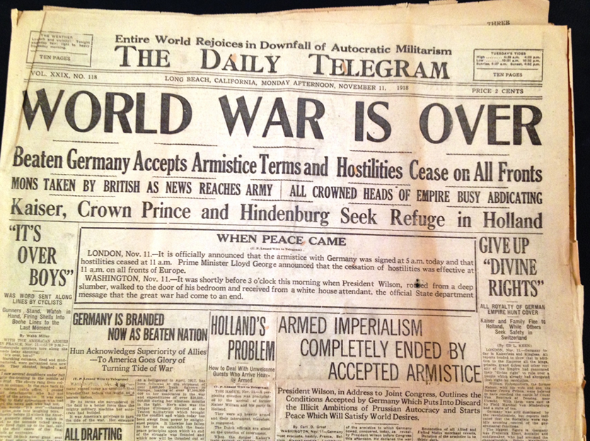
Chapter 11-Section 4-
Wilson Fights for Peace
Wilson Fights for Peace

Slide 2
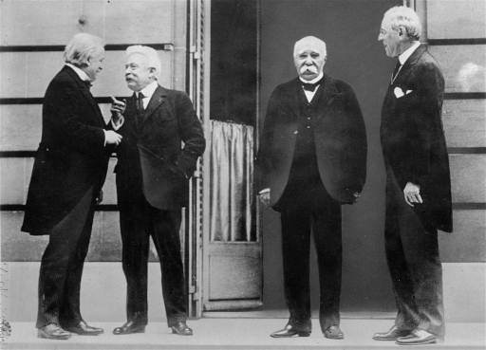
Wilson Presents His Plan
January 18th,1919 delegates representing 32 nations met to discuss the terms of peace at the Palace of Versailles
  The Big Four held most of the decision making power
    Woodrow Wilson of the U.S., Georges Clemenceau of France, David Lloyd George of Great Britain, and Vittorio Orlando of Italy

Slide 3
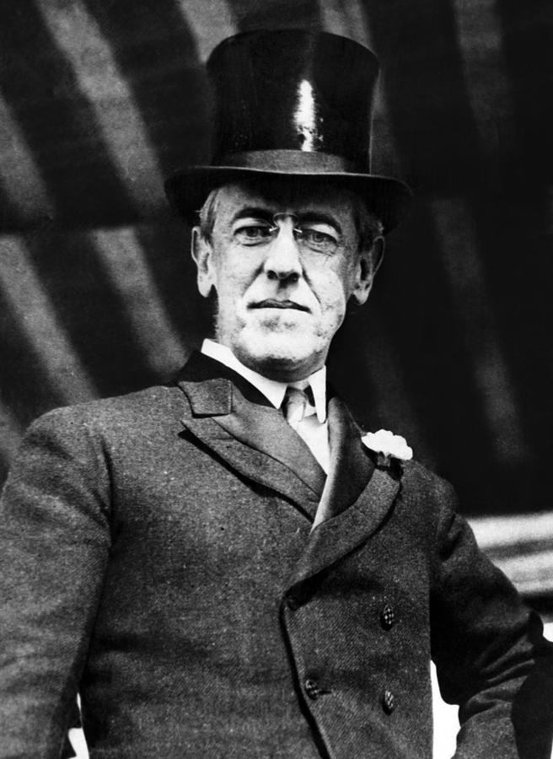
Wilson’s Fourteen Points
On January 18th, 1918 Woodrow Wilson delivered his Fourteen Points before Congress
  They were divided into three groups
    The first five points Wilson believed had to be addressed if future wars were to be prevented
    The next eight dealt with boundary changes
    The fourteenth and final point called for the creation of an international organization designed to address diplomatic causes
      The League of Nations

Slide 4
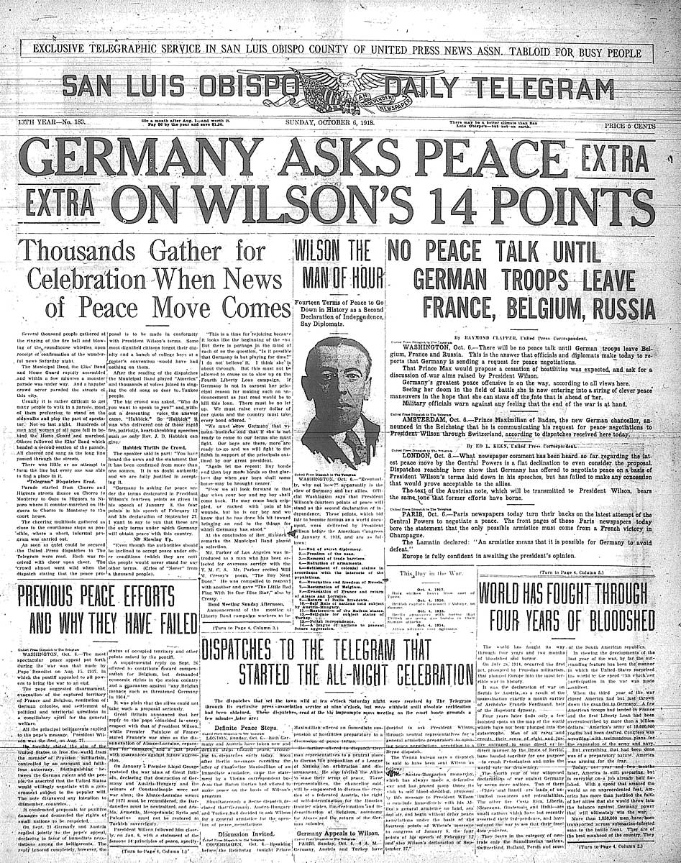
The First Five Points
1.) No secret treaties
2.) Freedom of the seas
3.) Tariffs lowered or abolished
4.) Decrease in armaments
5.) Colonial policies should take into account the interests of the colonized
6-13.) Deal with specific boundary changes
14.) Created the League of Nations

Slide 5
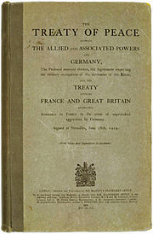
Debating the Treaty of Versailles
The Treaty of Versailles-An agreement designed to bring peace among the nations, and punish Germany
  As a result Germany lost all of it’s war making powers
  Wilson’s Fourteen Points were adopted
  The League of Nations was created but the U.S doesn’t join
    Its goal was to keep peace among the nations

Slide 6
Debating the Treaty of Versailles
A total of five treaties were signed by the allied powers
  This created feelings of bitterness and betrayal among the losing nations
New Nations Created After WWI-
  Austria, Hungary, Czechoslovakia, and Yugoslavia were recognized as independent nations
  The Ottomans lost all of their territory except modern day Turkey

Slide 7
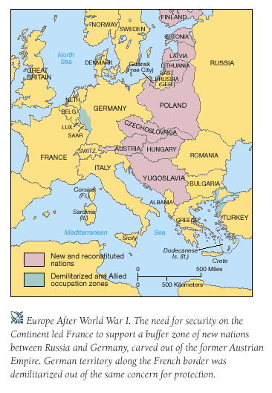

Slide 8
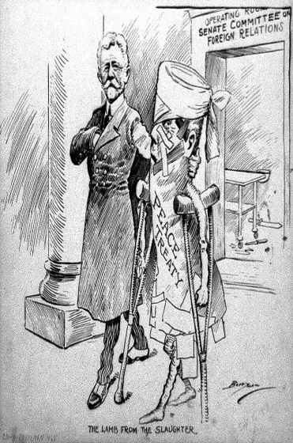
The Treaties Weakness
End Results of WWI-
  The Treaty of Versailles could not guarantee lasting peace
    The U.S. ultimately rejected the Treaty of Versailles in favor of an isolationist approach
  The War Guilt Clause left Germany extremely bitter
    Germany received the harshest punishment including $33 billion dollars in reparations owed to the allied powers
  Africa and Asia were upset with the way the Allies disregarded their calls for independence

Slide 9
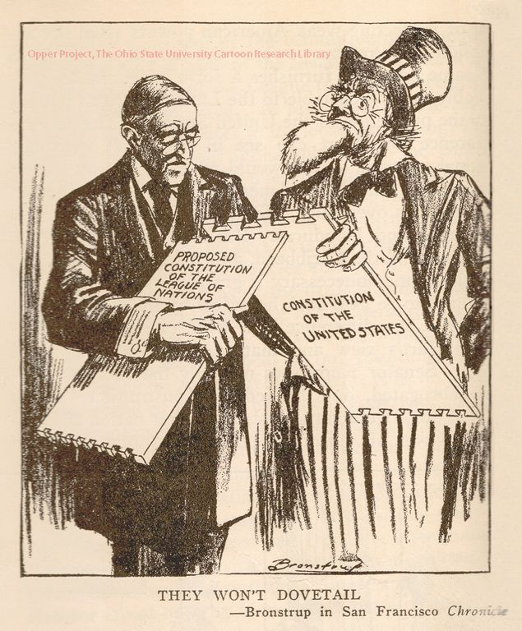
Debate Over The League of Nations
Many felt it would draw U.S. into further war
Senate wanted to weaken it, but Wilson would not back down
  Senate refused to ratify Treaty of Versailles
U.S. signed a separate peace in 1921, never joined the League of Nations

Slide 10
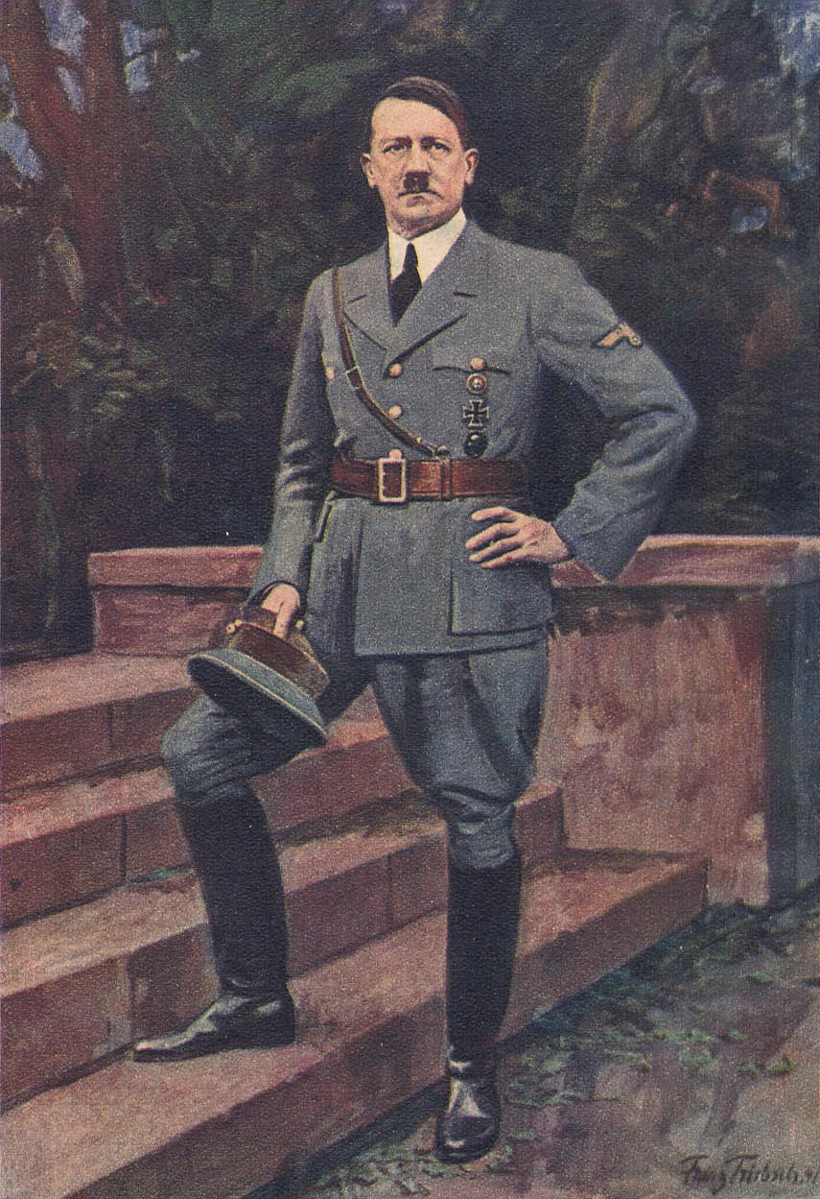
The Legacy of the War
Most Germans did not really know they had been defeated
Germans shocked by Armistice and angered by the Treaty
Many believed war would have to be fought again
  Two decades later Adolf Hitler would lead Germany into an even more disastrous war

