Slide 1
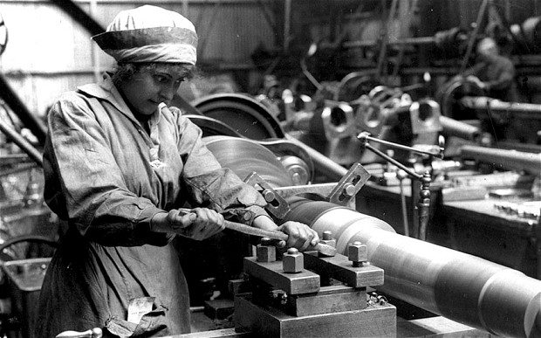
Chapter 11-Section 3 The War at Home

Slide 2
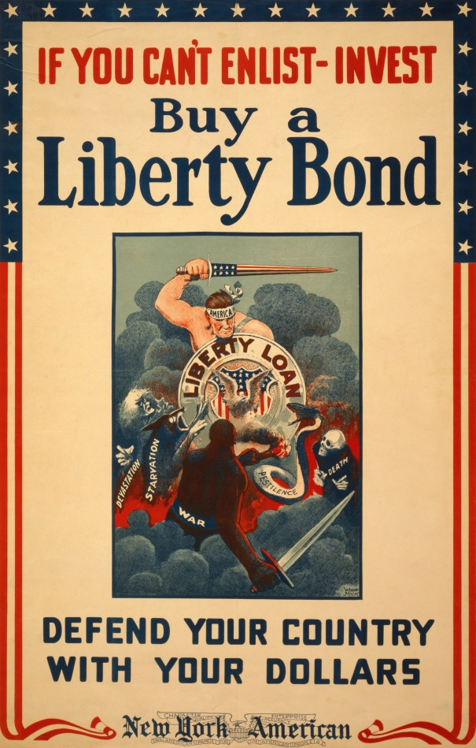
American Proprieties During WWI
The Three Priorities of Congress during WWI
1. Supply allies with food and equipment
Over a million women joined the work force
2. Raise money to pay for war
Selling war bonds
3. Get the American public to maintain support for the war
Use of war propaganda

Slide 3
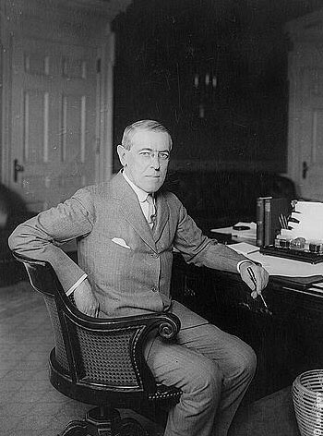
Congress Gives Power to Wilson
Due to the war being such an immense conflict private industry and the government began to work together to guide the U.S. economy from the production of consumer goods to war time materials
Congress gave Wilson direct control over the economy
Including the power to fix prices and nationalize or regulate war-related industries

Slide 4
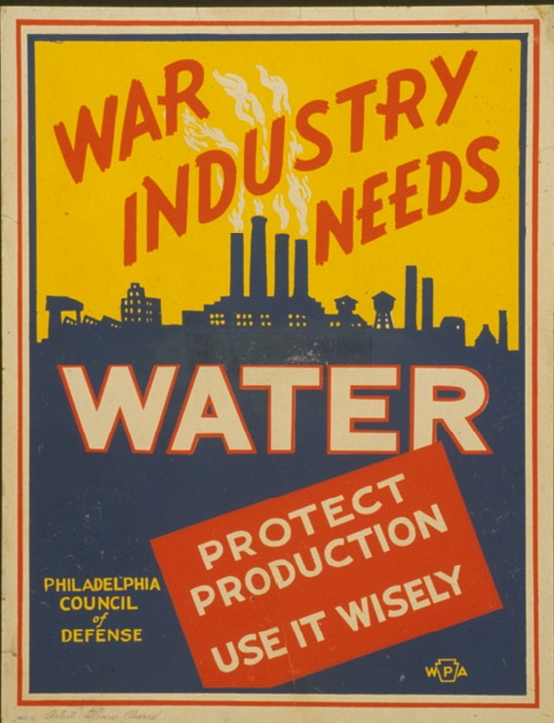
War Industries Board
War Industries Board
Created in 1917 and headed by Bernard Baruch
Purchased items for war
Converted factories
Could control prices
Businesses made massive profits, but consumers lacked many of the things they needed

Slide 5
War Industries Board
The WIB (War Industries Board) along with the Fuel Administration and Railroad Administration helped regulate the economy during the war
Regulated the railroads, boosted coal and oil production, encouraged conservation of energy
In March 1918 the Fuel Administration created Daylight Savings Time
Originally suggested by Ben Franklin in the 1770’s

Slide 6
War Economy
Designed to prevent Labor disputes
Union membership doubled
Membership climbed to nearly four million
There were also more than 6,000 strikes that broke out
Better pay and working conditions
Mainly those in metal trades, shipbuilding and meatpacking by roughly 20%
However, household incomes were undercut by rising food costs

Slide 7
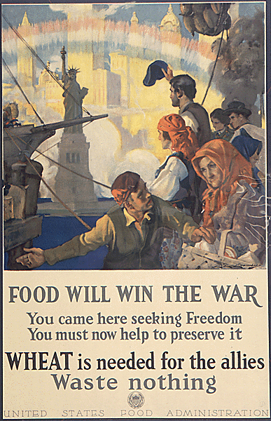
Food Administration
Food Administration-Created by Wilson under the Hoover administration
Instead of rationing food Wilson encouraged people to prevent waste citing the “gospel of the clean plate”
He declared to prevent waste Americans should have one day “meatless”, one “sweetless”, two days “wheatless” and two days “porkless”
Restaurants removed sugar bowls from tables and only served bread after the first course

Slide 8
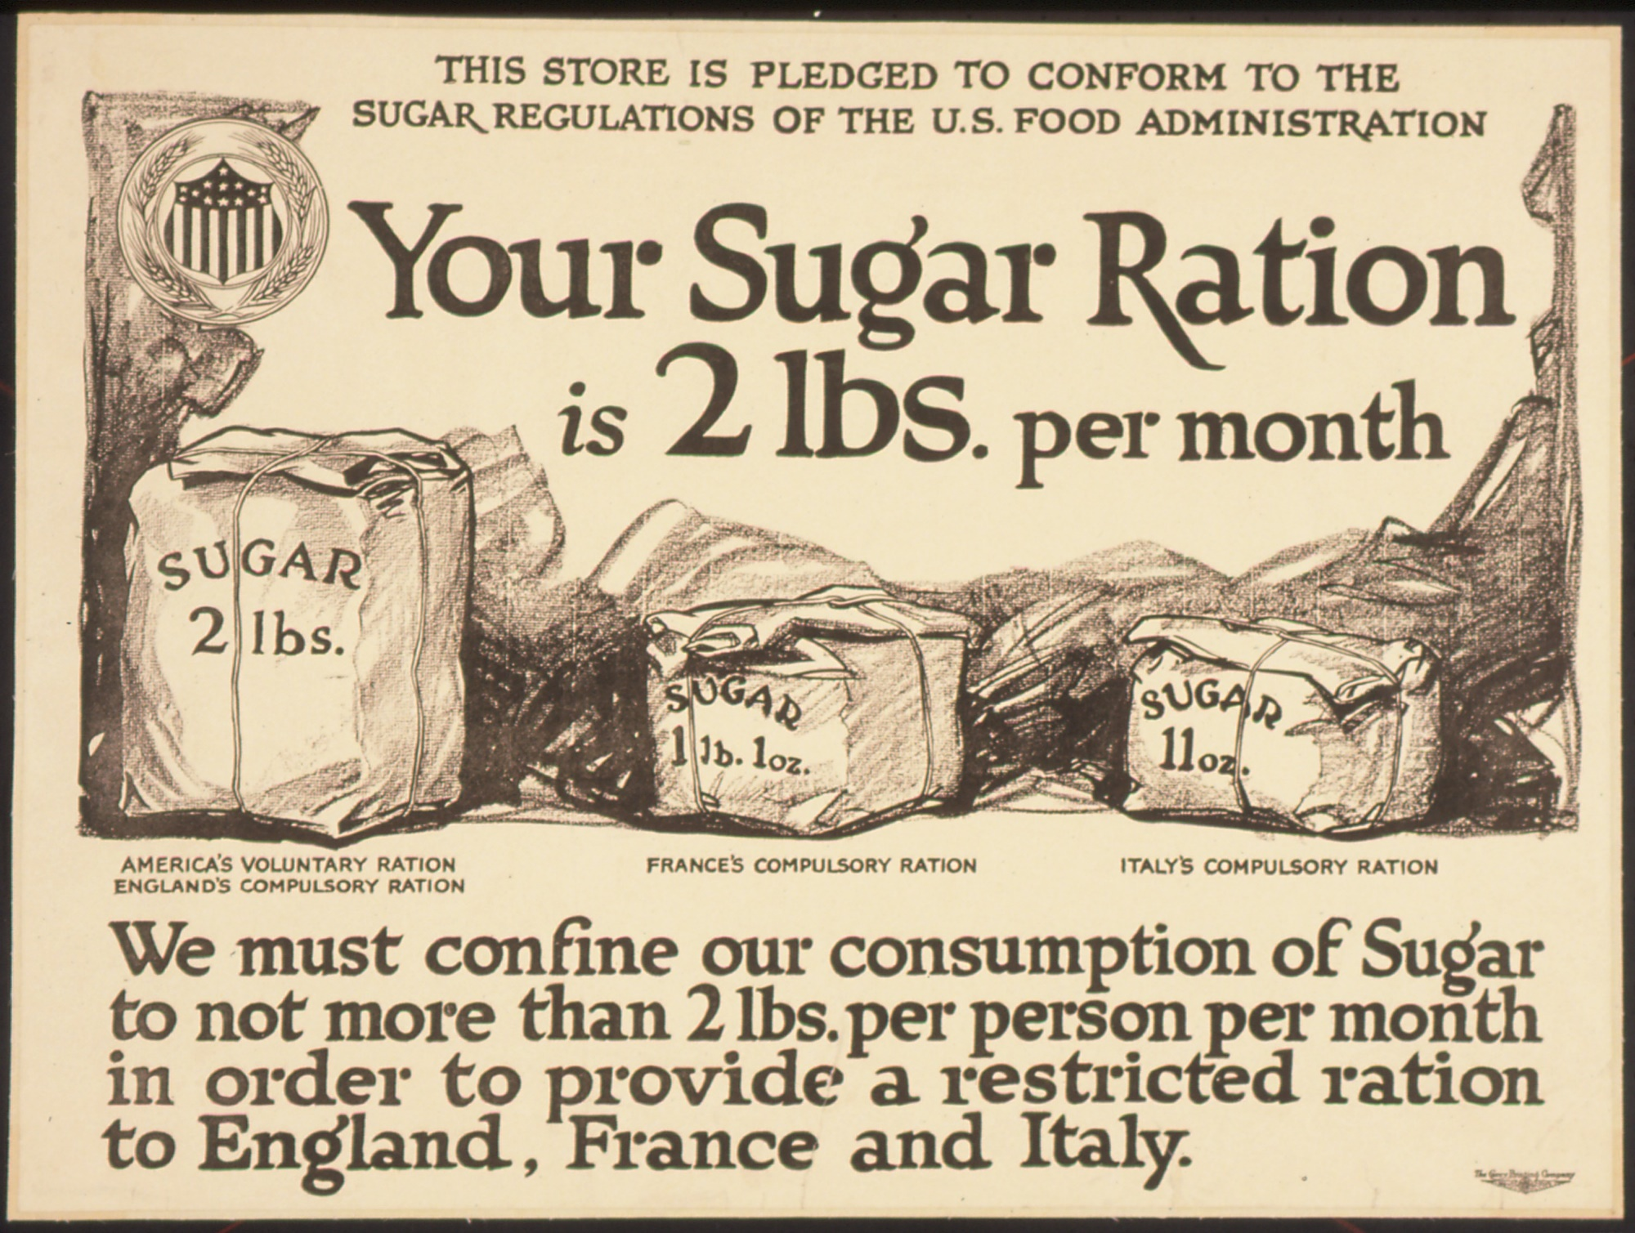

Slide 9
War Financing
The United States spent about $35.5 billion on the war.
They raised the money through:
1. Taxes-
Not just income, but corporate and excise tax (gum, liquor…)
2. Bonds-
Sold to “War Bonds” and solicited “Victory Loans” from the public
3. Propaganda-
They used films, posters, public speakers and radio ads to help

Slide 10
Espionage and Sedition Act
U.S. Government was worried about spies so they passed the Espionage and Sedition Acts (1918)
Fine and jail people who violate these laws which limited 1st Amendment
Schenck v. U.S.-
Charles Shenck was a socialist who wrote pamphlets that said the draft was like slavery
The Supreme Court ruled that the freedom of speech protected in the First Amendment could be restricted if the words spoken or printed represented to society a “clear and present danger.”
As a result he was sentenced to jail time

Slide 11
The Great Migration
During the War many African American’s seeking better opportunities began moving North in search of jobs
This movement was called “The Great Migration”
African Americans experienced less discrimination and found a better standard of living
Although some race riots erupted

Slide 12
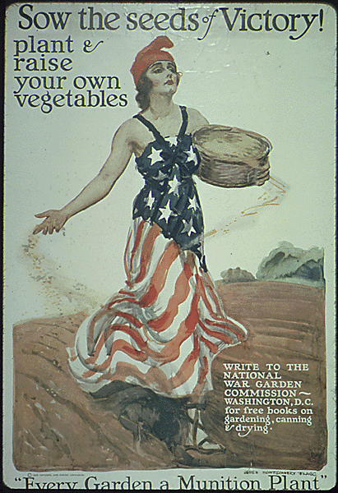
A Citizens Role
Regular people had part to play
Herbert Hoover encouraged volunteerism and created the Food Administration
Women went to factories, proved they could do mans job and got vote
Americans created “Victory Gardens”
Americans sacrificed with things like “Wheat-less Wednesdays”
Government bought farmers goods for soldiers at great price

Slide 13
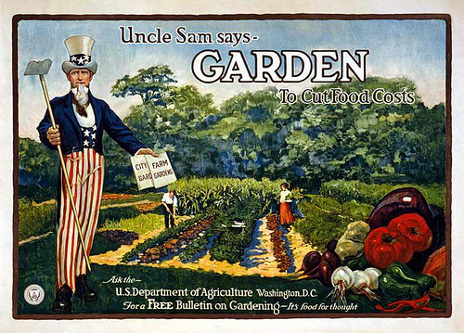

Slide 14
Anti-German Sentiment
Some Germans were picked on and many citizens did not want to be connected to anything German
Change city names
Change food names
Ban German books and songs
Some violence against recent German immigrants

Slide 15
The Flu Epidemic
In 1918 the flu hit Americans during war
People stayed home and businesses shut down to avoid contagion
Doctors did not have answers and many soldiers affected due to close quarters
Nearly 30 million people around the world died from the flu among them roughly 500,000 Americans
The epidemic ended in 1919
Only real answer was to clean up and quarantine

