Slide 1
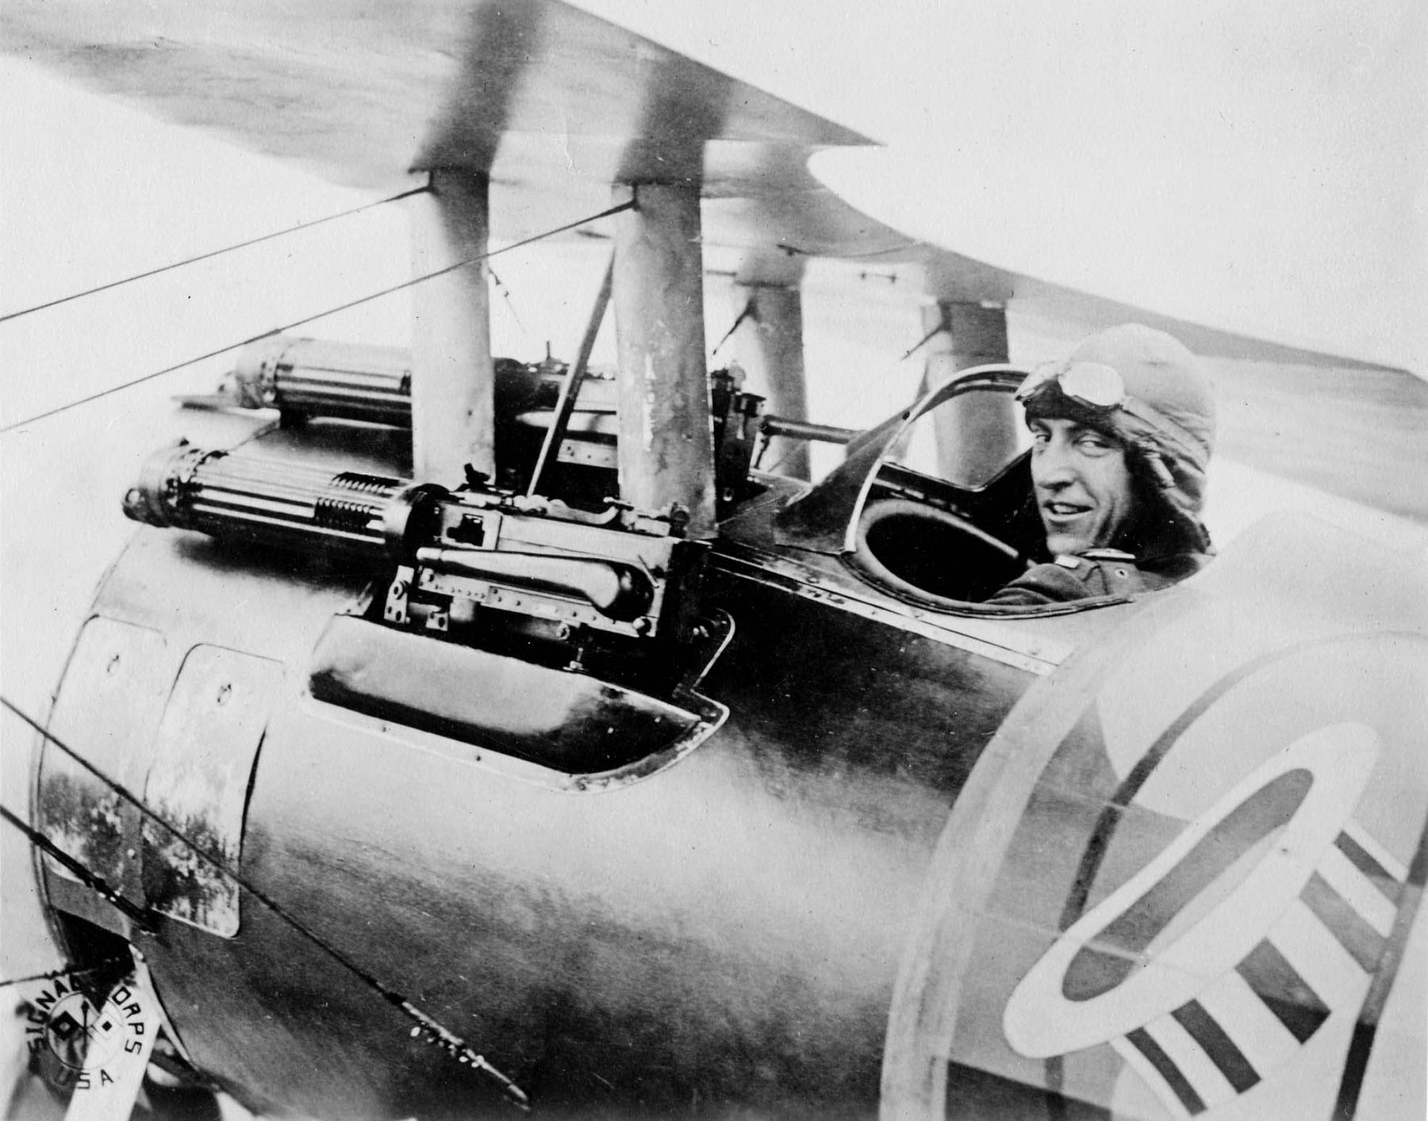
Chapter 11-Section 2-
American Power Tips the Balance

Slide 2
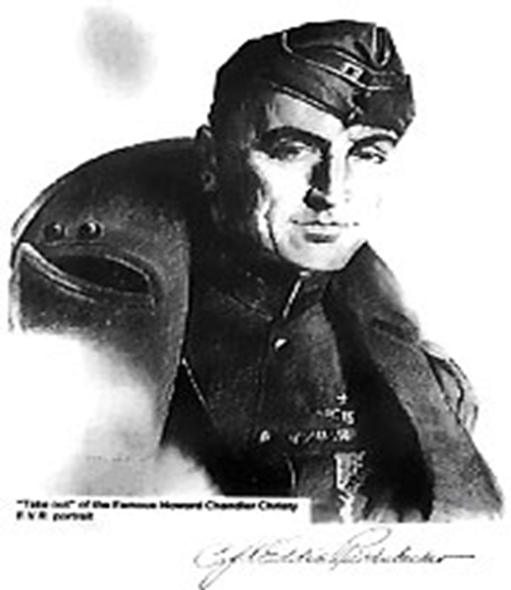
A New American HEro
Eddie Rickenbaker
  Famous WWI fighter pilot who before the war was a race car driver
Very little military training and he actually learned to fly on his own
He is best known for fighting the German “Flying Circus” led by the “Red Baron” Manfred von Richthofen
Engaged in 134 air battles and downed 26 enemy aircrafts
  He received the nickname “American Ace of Aces”

Slide 3
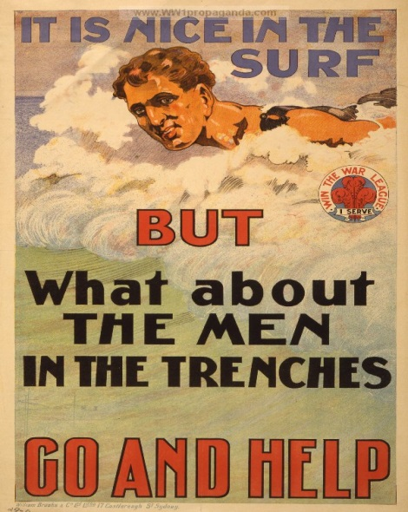
1. How did the United States raise an army?
Selective Service Act-This act forced men to register to be randomly selected for military service.
  There was only 200,000 men in service when war was declared.
  Selective Service Act required all abled bodied men 18 to 45 to register
  24 million register; 3 million are drafted; 2 million go to Europe.
  Most did not attend high school (illiteracy at 25%)
  Almost ½ million African Americans in US armed forces; over ½ served in France.
    Their units were segregated. The all-black 369th infantry saw more continuous duty on front line than any other regiment.
  Women served in the Navy & Marines (non-combat positions).

Slide 4
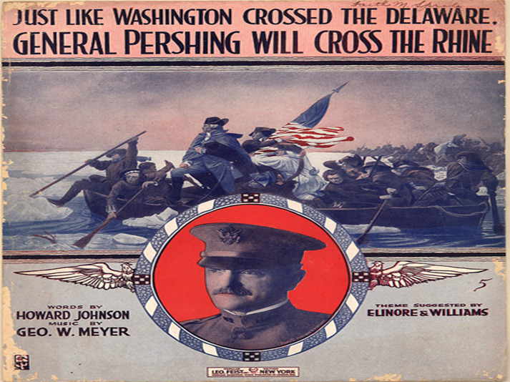
2. How did U.S. soldiers help win the war?
Government made mass production of ships a priority.
US factories were able to mass produce ships allowing them to quickly get men and equipment overseas
After almost three years of fighting, Allied forces were exhausted.
American troops were fresh and enthusiastic!

Slide 5
3. How did the U.S. build its naval force?
Four crucial steps:
  Did not draft shipyard workers
  Emphasized the importance of shipyard workers
  Prefabrication using standardized parts saved valuable time
  Government took control of all ships.

Slide 6
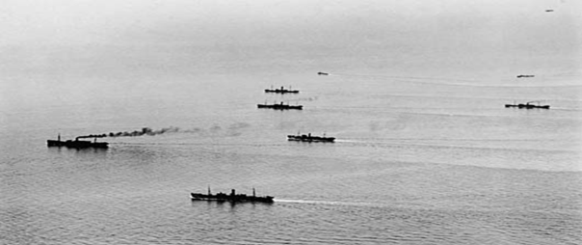
4. How did the U.S. Navy help win the war?
Convoy System-A strategy where armed destroyers escorted merchant ships across the Atlantic Ocean
Laid a 230-mile barrier of mines in the North Sea to “bottle” the German subs (U-boats) & keep them out of the Atlantic.
  This cut down the number of American lives lost at sea significantly.
On land, US troops brought freshness & enthusiasm.
  After two and a half years of fighting, Allied troops were exhausted & demoralized.

Slide 7
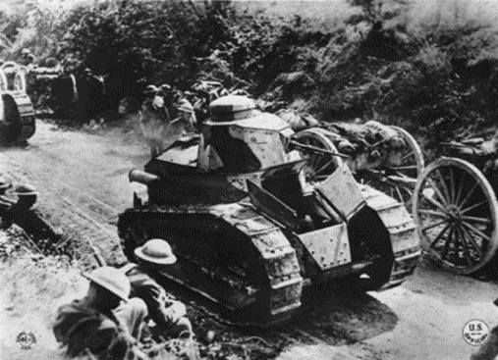
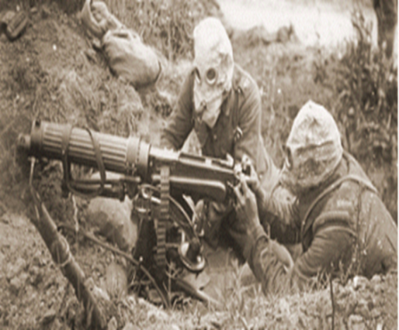
5. Why were US troops so effective in combat?
Strong Leadership-General John. J. Pershing – Commander of U.S. Army in Europe (AEF).
  He changed the style of combat from a series of DEFENSIVE (trenches) battles to one marked by strategic OFFENSIVE attacks.
Dough Boys- The nickname for American infantryman.
New Weapons were introduced:
  Machine gun; Tanks; Airplanes; Antiaircraft guns
    Poison gas masks became standard issue.

Slide 8
6. American troops on the offensive…
Russia pulls out of the war in 1917 and soon the Germans are within 50 miles of Paris.
  US troops arrived in time to stop Germany from making big gains in France.
    By mid-year the tide had turned against the Central Powers.
Alvin York emerged as a U.S. war hero, despite his initial position as a conscientious objector (a person who opposes warfare on moral grounds, based on religious beliefs).
  He kills 25 Germans and with the help of six other dough boys captures another 132

Slide 9
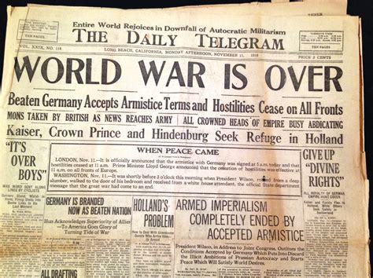
6. American troops on the offensive…
Collapse of Germany–November 1918 naval mutiny quickly spreads throughout German army
  That same month Socialist leaders take control of the gov’t. and the Kaiser gives up the throne.
On November 11th, 1918 and ARMISTACE (truce/cease fire) is signed officially ending WWI.

Slide 10
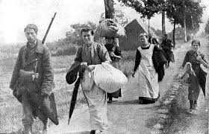
7. What did the war cost in terms of the number of…
22 million people die during WWI
  Civilian deaths accounted for nearly half of that number.
  Military deaths are estimated to between nine and eleven million
    Twenty million soldiers are wounded but survive
    Ten million refugees are forced to leave their homes
The cost of American involvement:
  52,000 died in battle
  62,000 died of disease
  200,000 wounded

Slide 11
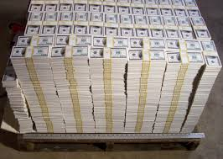
8. What were the estimated economic costs?
The war cost an estimated $338 billion dollars
  Since Germany was the last of the Central Powers to surrender the burden of this debt will rest squarely on their shoulders setting the stage for WWII

Slide 12
WWI impacts life in the U.S.
Closing Activity-Marking Predictions
Brainstorm with your small groups as to how you think being involved in a long, costly war like WWI would affect the lives of Americans on the home front during its course.
  Create a thinking map that would help list the economic, social and political changes your group thinks we might have experienced at home as a result of America entering into WWI.

