Slide 1
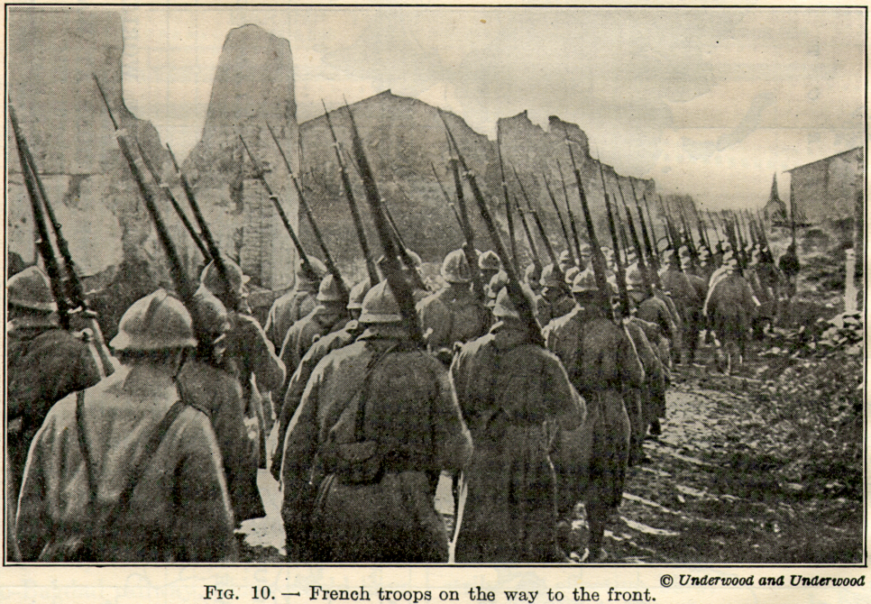
Chapter 11-Section 1-World War I Begins
Part II

Slide 2
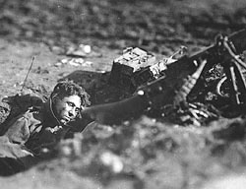
The Fighting Starts
Western Front- The deadlocked region of Northern France fought over in WWI
The Eastern Front-The battlefield along the German and Russian border
Russians and Serbs battled Germans and Austro-Hungarians for control of the Eastern front

Slide 3
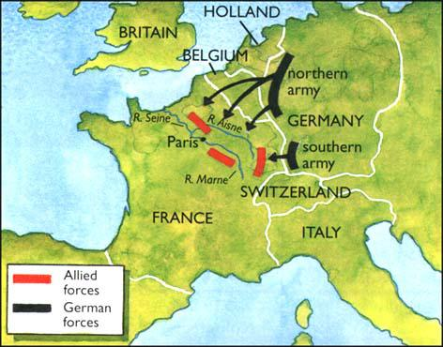
The Fighting Starts
Schlieffen Plan-The Germany plan in which they would defeat France 1st then turn east to fight Russia
A quick defeat of France was vital to the plan

Slide 4
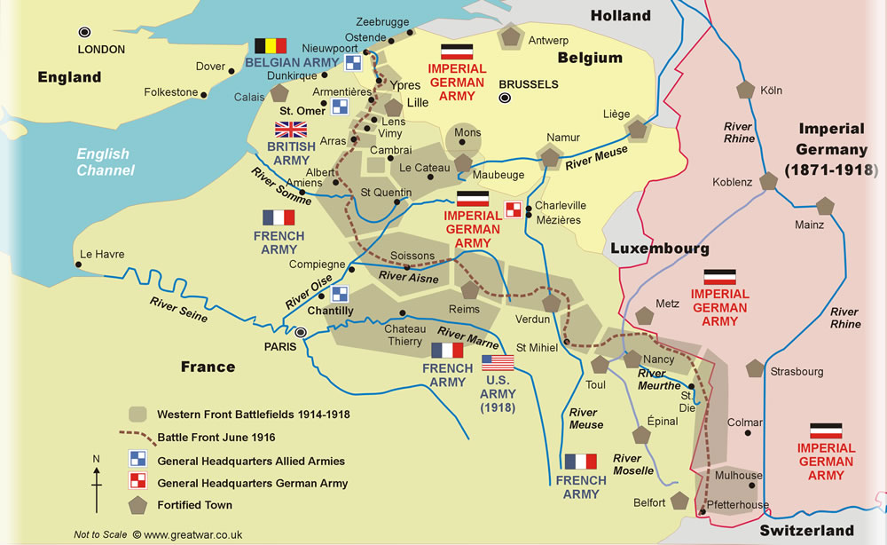

Slide 5
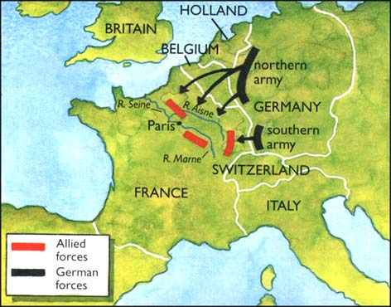
The Fighting Starts
Failures of the Schlieffen Plan-
Sept. 5th, 1914 Allied forces attacked the Germans northeast of Paris in the valley of the Marne River
600 taxicabs brought Allied re-enforcements to the front
Sept.9th, the Germans retreated
The 1st Battle of the Marne left the Schlieffen Plan in ruins b/c a quick victory no longer existed

Slide 6
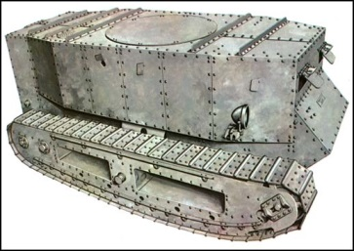
The Fighting Starts
Trench Warfare-Soldiers would fight from trenches often for pitifully small pieces of land
The space between the trenches was called “no man’s land”
The trenches along the Western Front reached nearly 500 miles from the North Sea to the Swiss border
New Military Technologies-
Machine guns, poison gas, tanks, armored cars and submarines were widely used for the 1st time in war

Slide 7
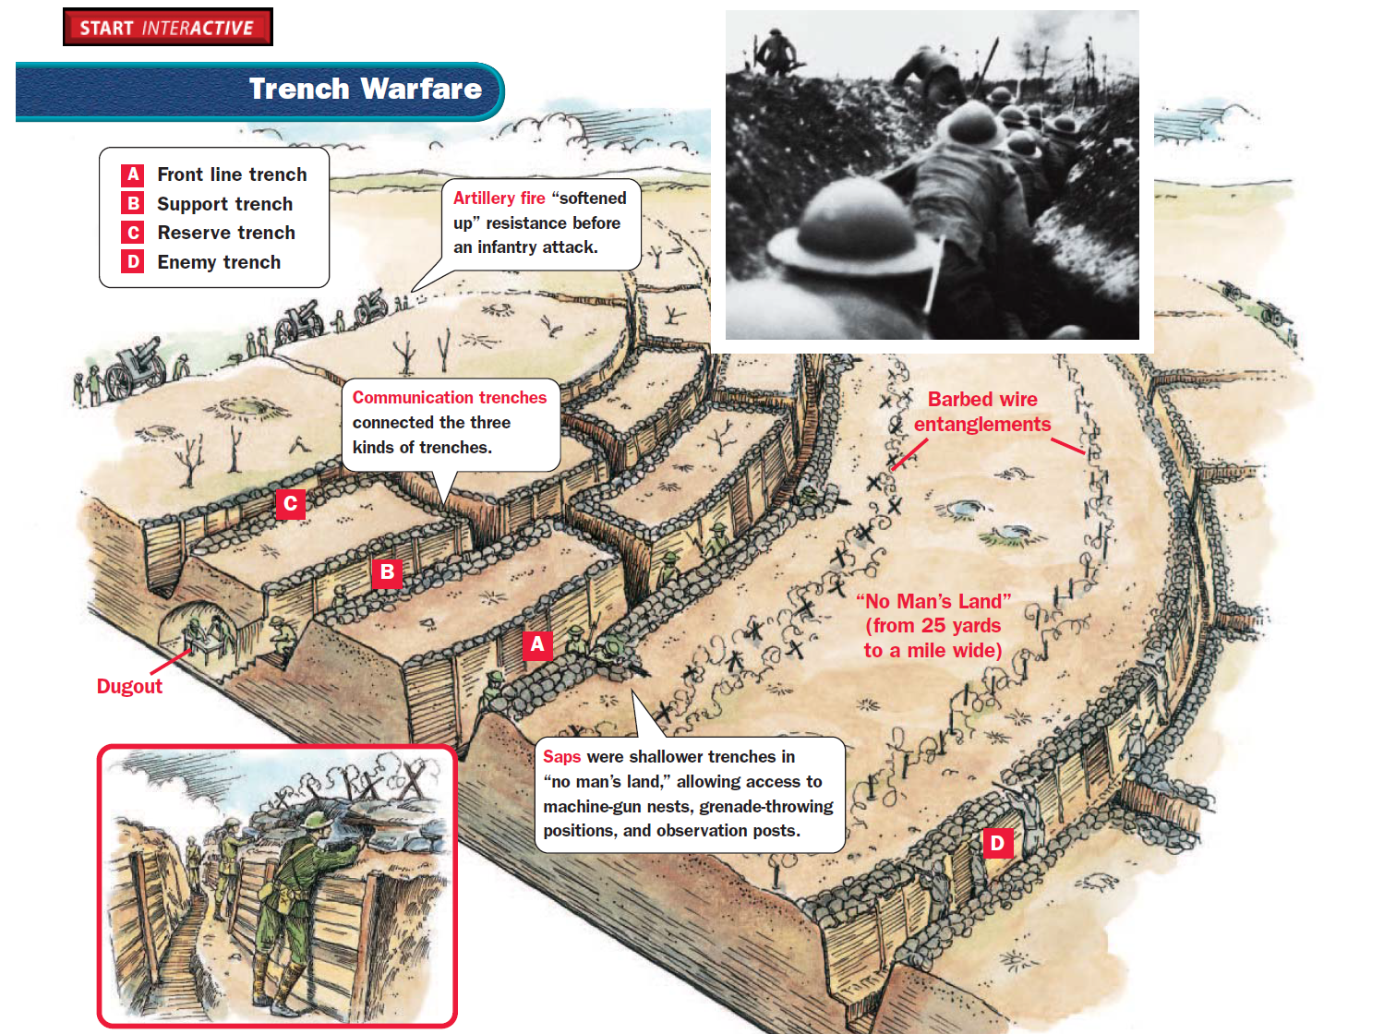

Slide 8
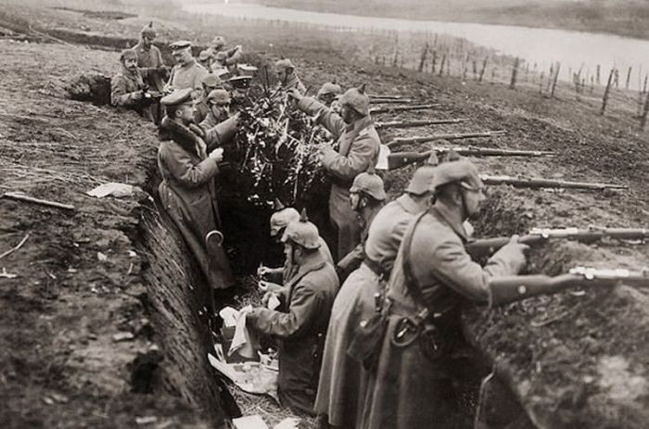

Slide 9
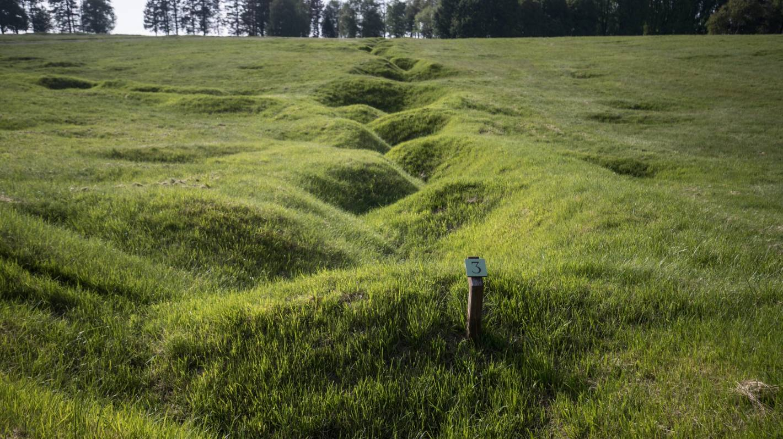

Slide 10
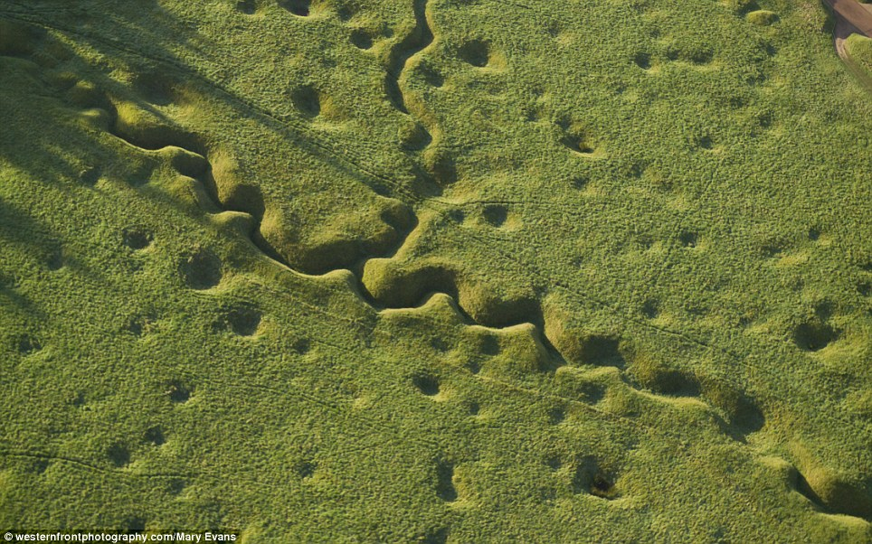

Slide 11
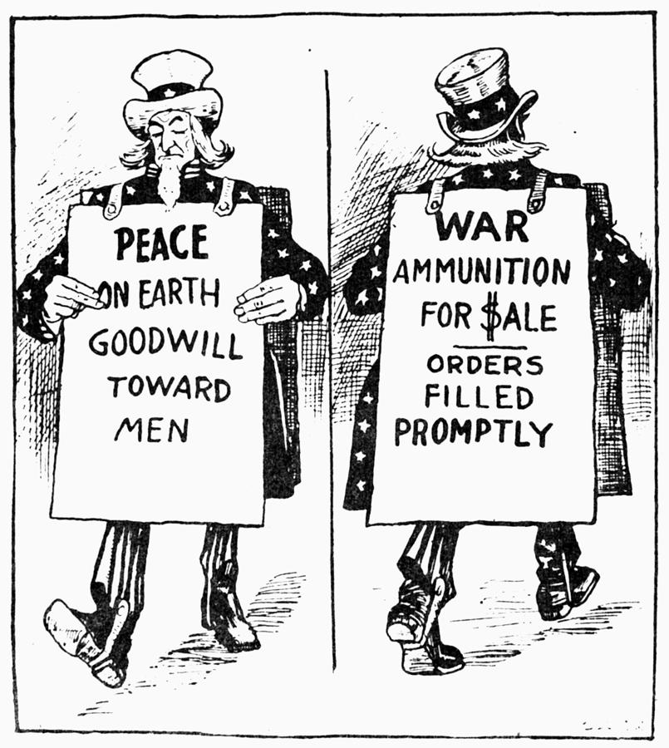
Americans Question Neutrality
In 1914 many Americans felt we had no reason to get involved in a war 3,000 miles away.
Most preferred an isolationist approach
Another issue was that many former immigrants identified and sympathized with the nations which they came from.
This divided Americans along ethnic and social lines
America’s economic ties also played a role in our favored position to support the Allies over the Central Powers

Slide 12
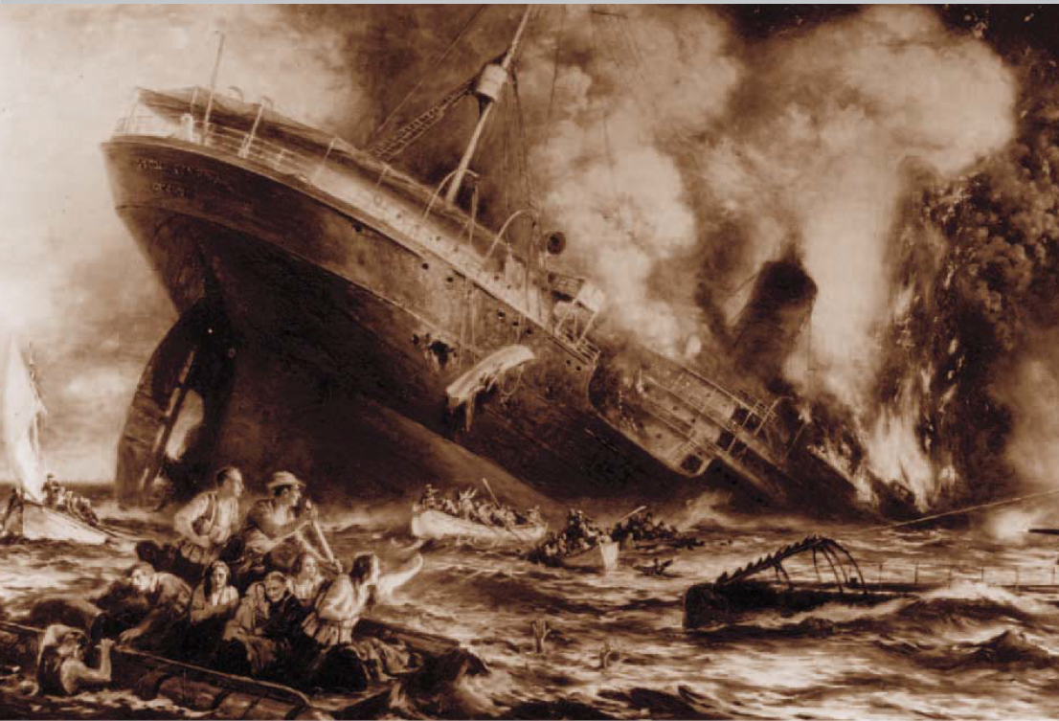
The War Hits Home
Unrestricted Submarine Warfare- Germany announced that their submarines would sink any ships in the water surrounding Britain without warning
After the cruise ship Lusitania was sunk by a German U-boat leaving 1,198 passengers (128 of them American) dead the U.S. threatened action if the Germans continued to sink neutral ships

Slide 13
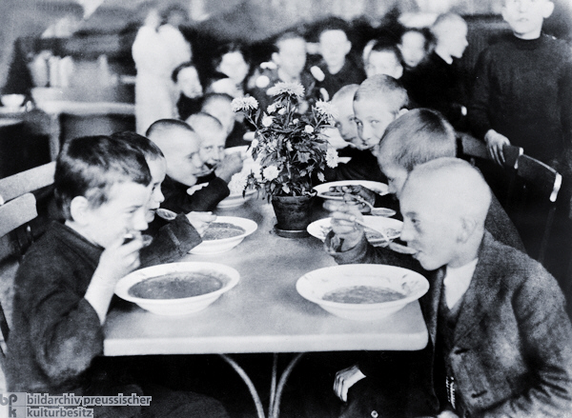
The War Hits Home
Americans Join the Fight-
Germany returned to unrestricted submarine warfare in 1917
The British Blockade-
As the war raged on Great Britain began blocking the German coast to prevent weapons and other military supplies from reaching the hands of the Germans
By 1917, famine gripped Germany resulting in nearly 750,000 Germans starving to death

Slide 14
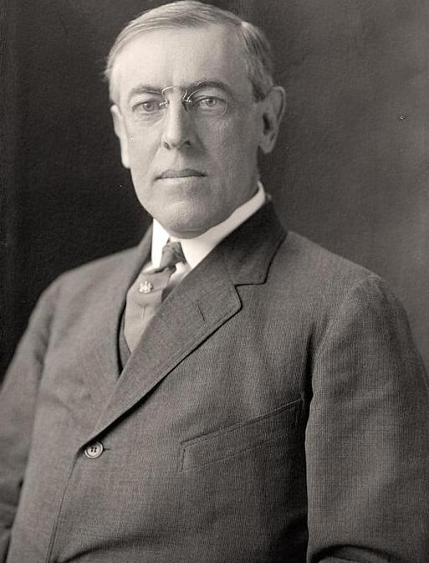
The War Hits Home
The Election of 1916-
President Woodrow running under the slogan “He kept us out of war” wins the election against Supreme Court Justice Charles Evans Hughes

Slide 15
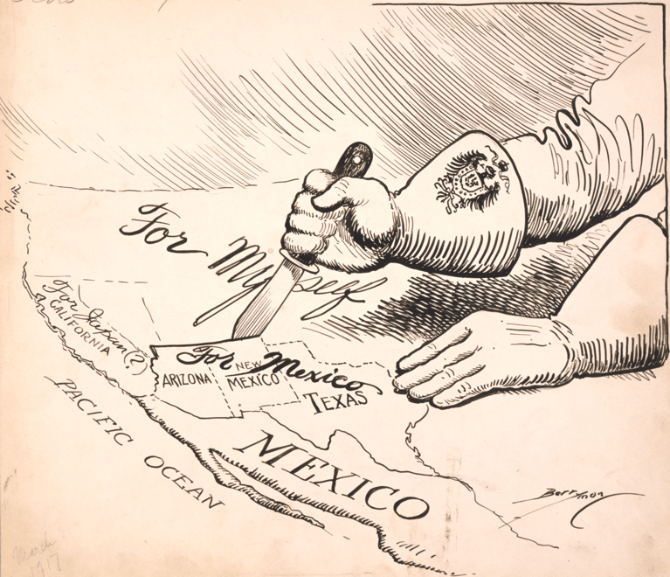
The United States Declares War
The Zimmerman Note- In February, 1917 the U.S. intercepted a German telegram headed to Mexico
Germany wanted Mexico to join their fight and in return they would help Mexico “reconquer” the lands they lost to the U.S.
This led President Wilson to ask for a declaration of war against Germany on April 2nd, 1917

Slide 16
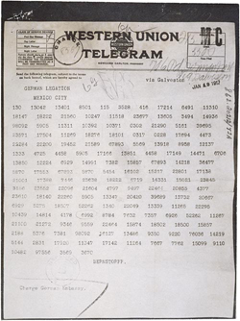
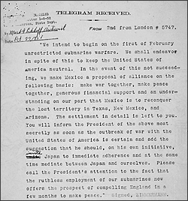
The Zimmerman Note

Slide 17
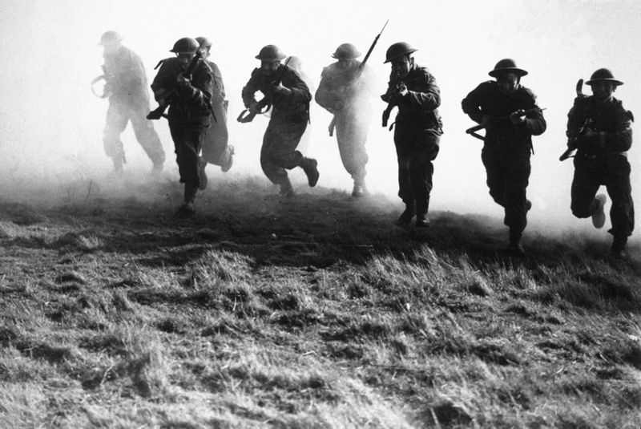
The United States Declares War
America Acts-
On April 2nd, 1917 President Wilson delivered his war resolution in which he hoped to make the world “safe for democracy”
Congress granted a declaration of war a few days later allowing the United States to enter the war on the side of the allies

