Slide 1
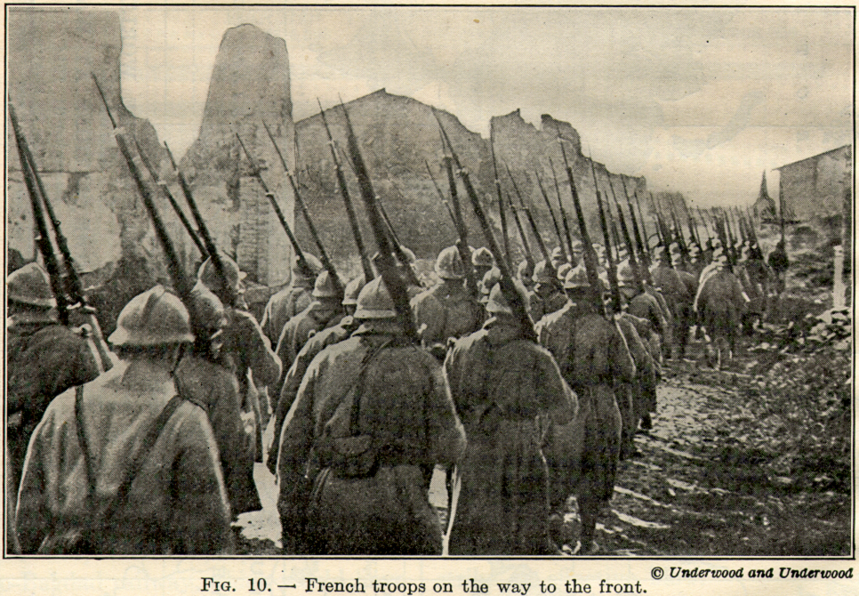
Chapter 11-Section 1-World War I Begins
Part I

Slide 2
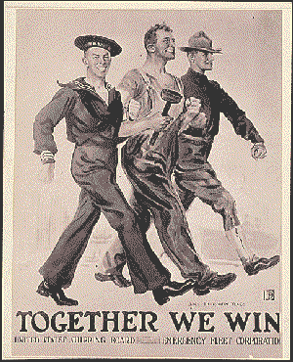
Causes of WWI
Although many Americans wanted to continue their isolationist approach and stay out of Europe's conflicts several factors including industrial interests and our position as a world power made U.S. neutrality difficult

Slide 3
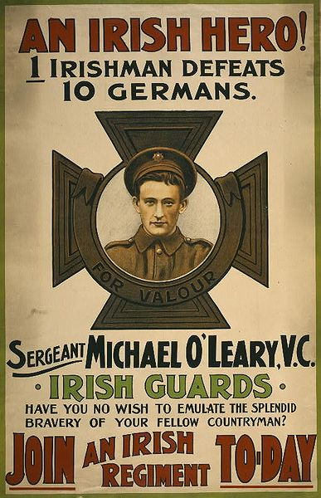
Causes of WWI
Generally historians cite four long-term causes of WWI:
  Nationalism
  Imperialism
  Militarism
  Alliance Systems

Slide 4
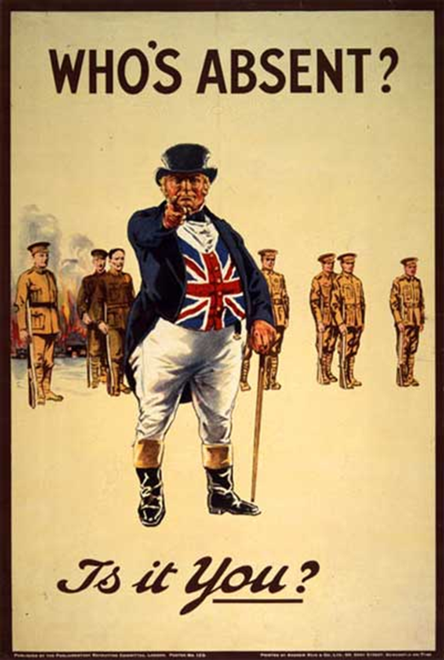
Causes of WWI
Nationalism-A deep devotion to one’s own nation
    It can serve as a unifying force or the catalyst for fierce competition among others
      Ex. By the turn of the 20th century Great Britain, Germany, Russia, Italy, France and the Austria-Hungarian empire were engaged in a fierce rivalry
Imperialism-For centuries European nations had been building empires slowly extending their economic and political control around the world

Slide 5
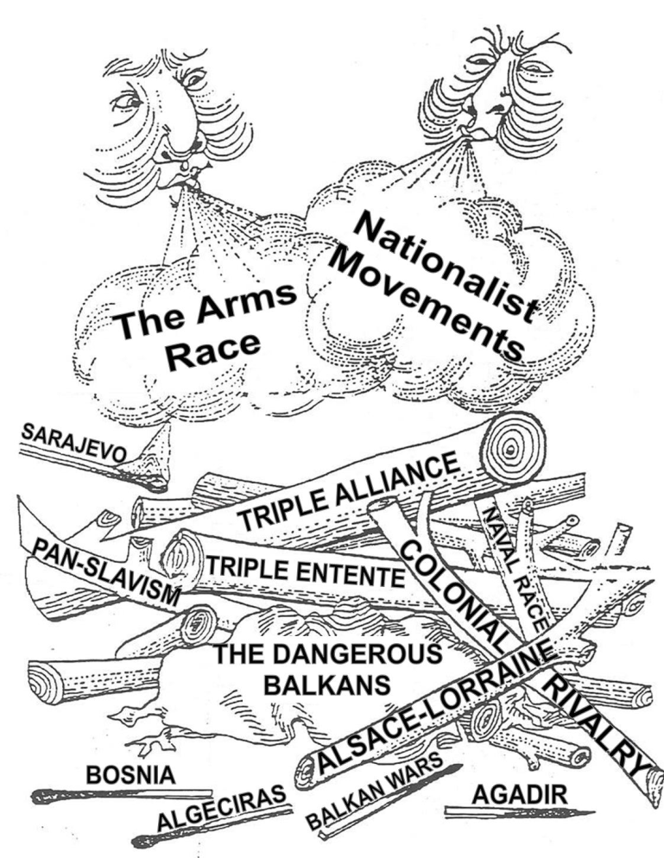
Causes of WWI
Militarism-The policy of glorifying military power and keeping an army prepared for war
Alliance System-There were two major alliance systems in Europe at the beginning of WWI
  The Triple Entente
    Later known as the Allies
  Triple Alliance
    Later known as the Central Powers

Slide 6
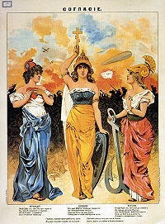
Causes of WWI
Triple Entente-Britain’s alliance with France and Russia
  Did not mean that Britain would fight with them but it did ensure they would not fight against them
By 1907 the Triple Alliance and Triple Entente were the strongest powers in Europe and would soon lead them into war

Slide 7
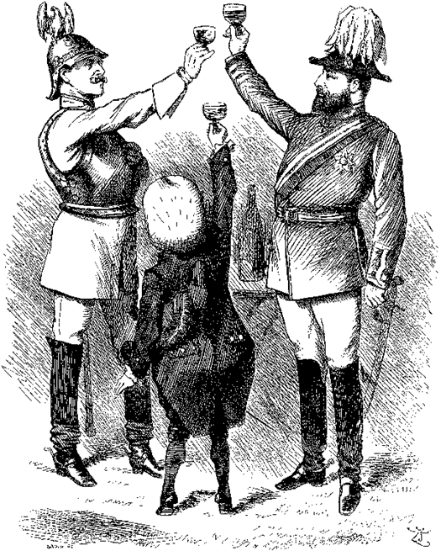
Causes of WWI
Triple Alliance-Alliance between Germany, Austria-Hungary and Italy whose goal was to isolate France
  Otto von Bismarck felt that “As long as it is without allies, France poses no danger to us (Triple Alliance)”

Slide 8
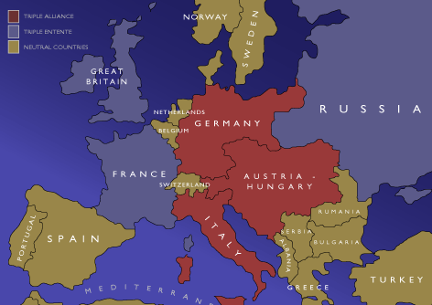

Slide 9
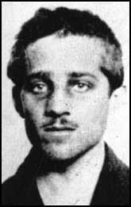
An assassination Leads to War
In 1908 Austria-Hungary annexed Bosnia and Herzegovina thus creating tension in the region
On June 28th, 1914 Gavrilo Princip assassinated the Archduke Franz Ferdinand and his wife Sophie in Sarajevo, Bosnia.
  Princip was Serbian so the Austrians declared war to punish Serbia
    Harsh demands were placed on Serbia
Russia soon sided with Serbia and soon the rest of Europe began to take sides as well

Slide 10
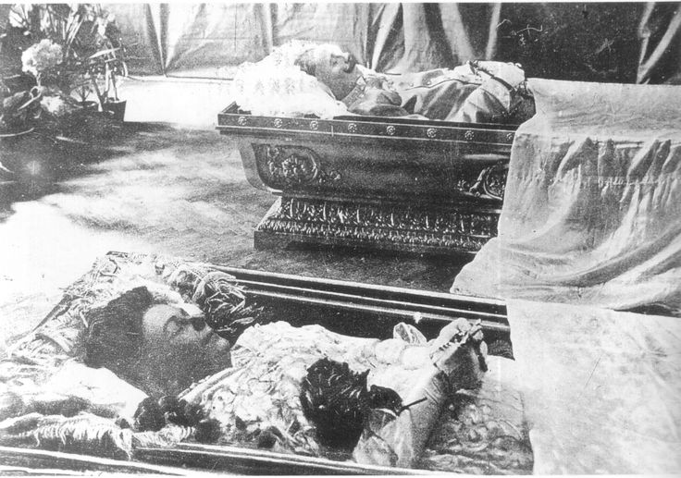

Slide 11
Source: John T. McCutcheon, cartoonist, Chicago Tribune, August 5th, 1914

