Slide 1
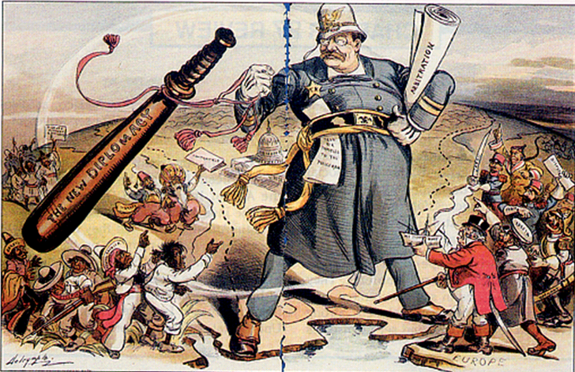
Chapter 10-Section 4
America as a World Power

Slide 2
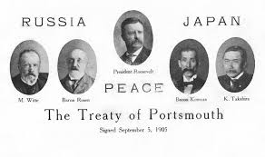
Negotiations between Russia and Japan
Japan secretly asked the U.S. to help negotiate a peace treaty
Mediated by Teddy Roosevelt
Helped him win the 1906 Nobel Peace Prize
Japan received half of Sakhalin Island, & Russian interests in Manchuria and Korea

Slide 3
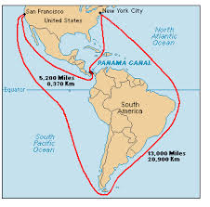
Panama Canal
Would reduce travel time for military and commercial ships
Would provide a shortcut between the Atlantic and Pacific Oceans
Work began in 1904
Some 43,400 workers were employed
5,600 of those died
Disease
Accidents

Slide 4
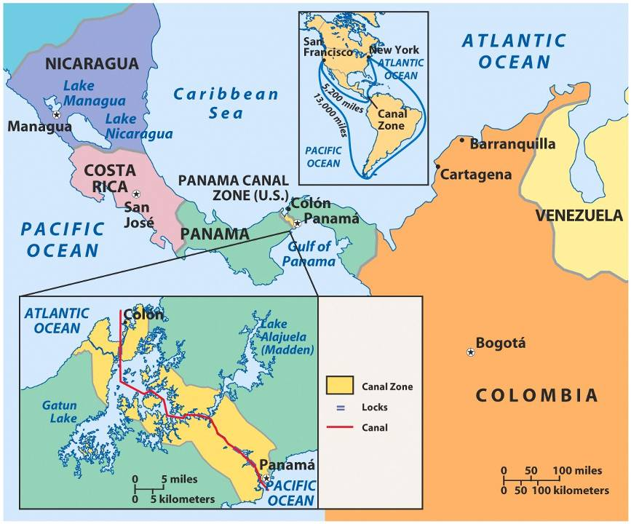

Slide 5
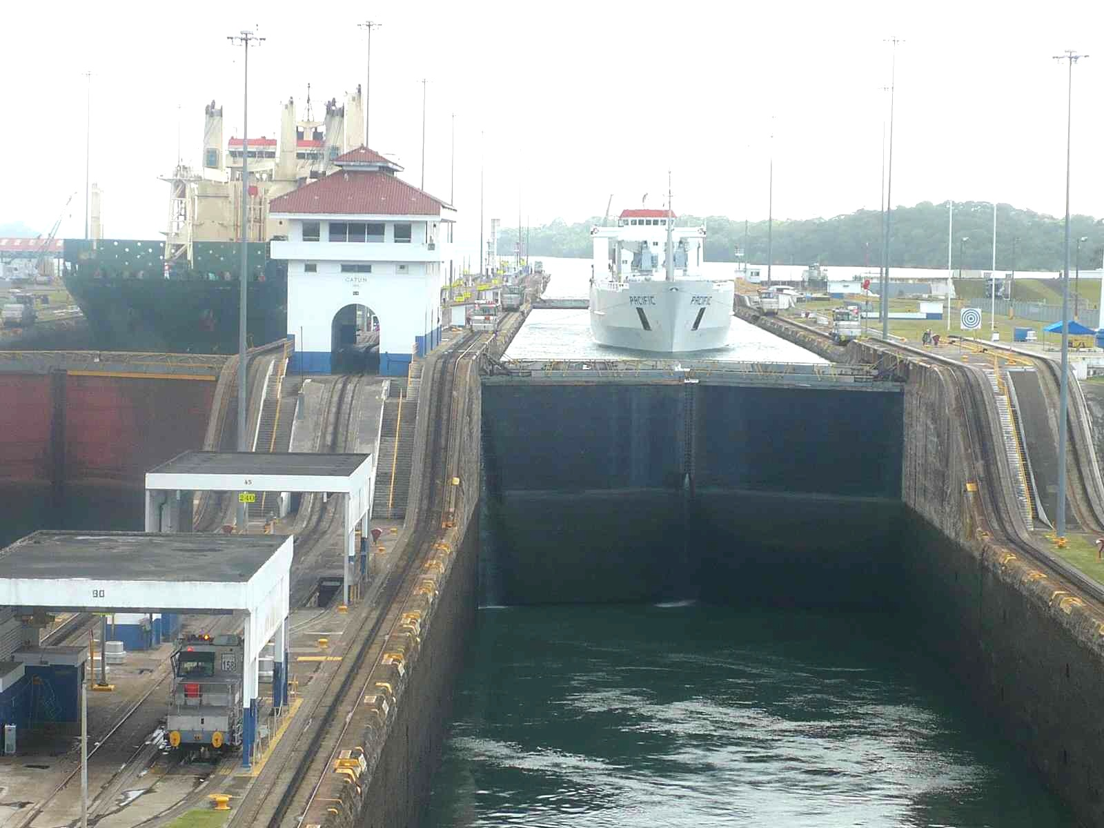
Panama Canal Locks

Slide 6
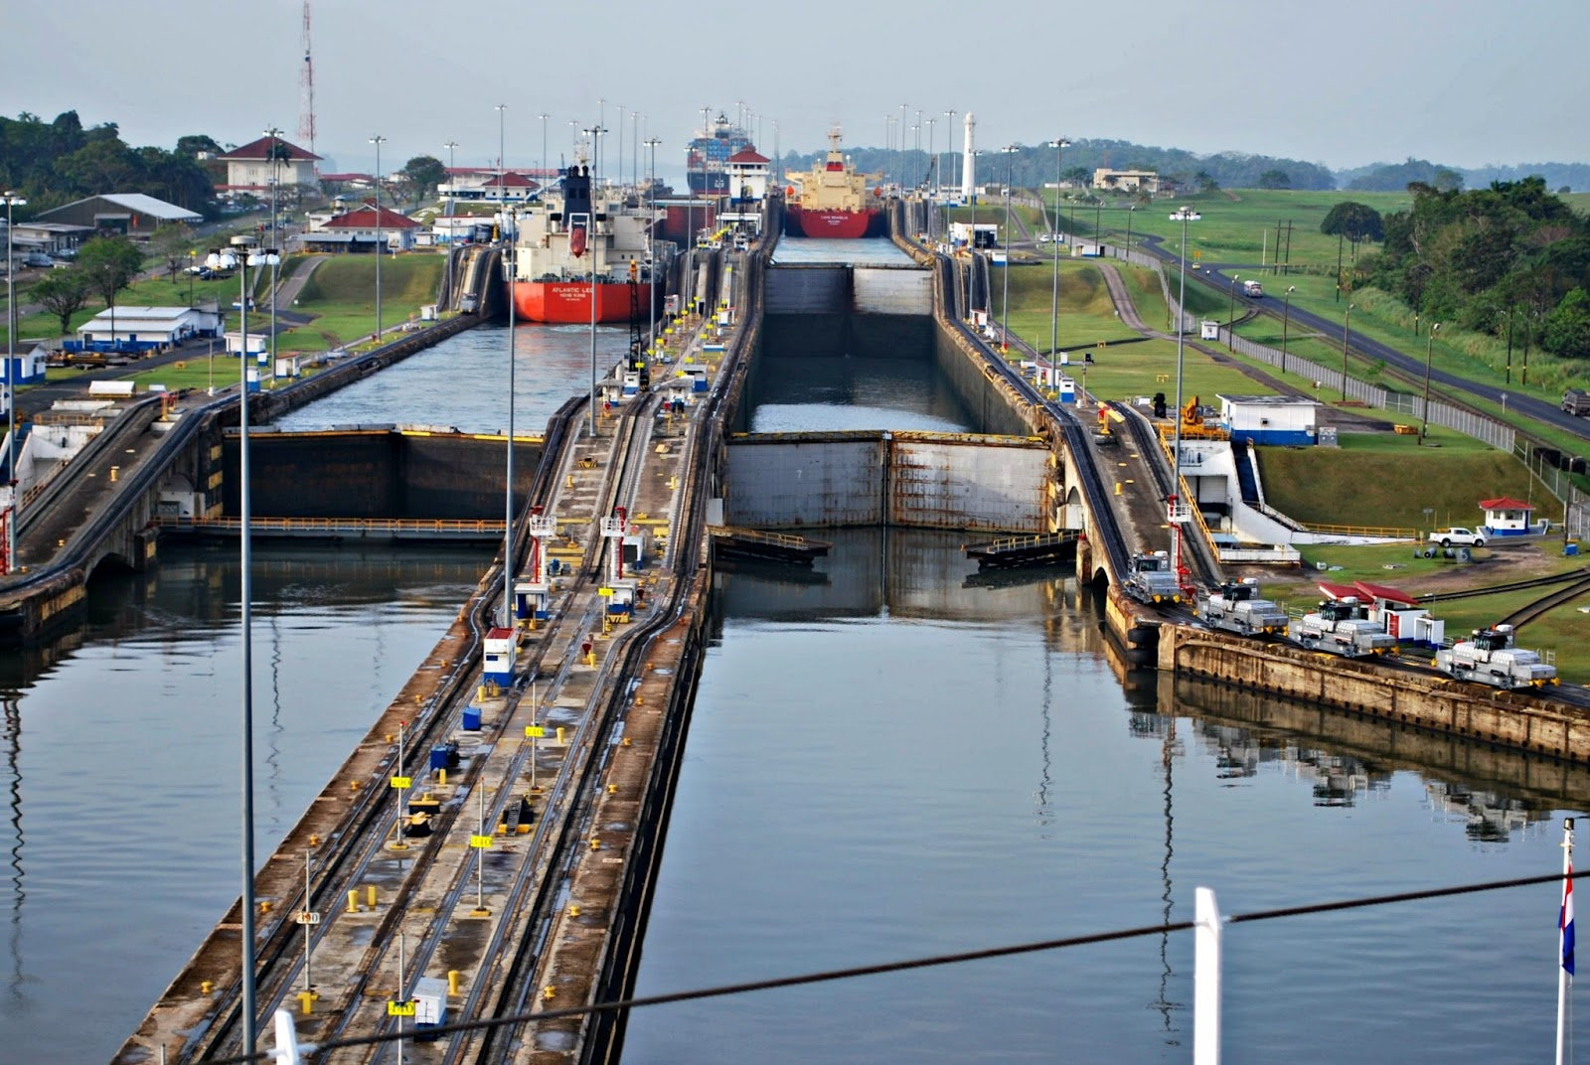
Panama Canal Locks

Slide 7
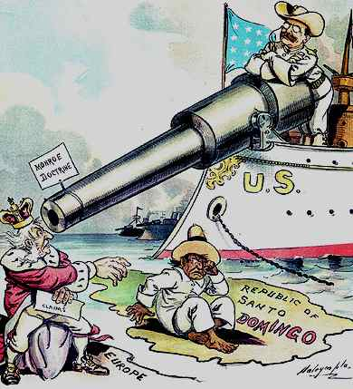
Roosevelt Corollary
Added to the previous warnings of the Monroe Doctrine
Announced in 1904
The U.S. claimed the right to use military intervention to protect its’interests in Latin America

Slide 8
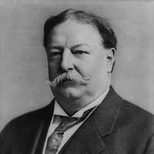
Dollar Diplomacy
U.S. policy of using the nation’s economic power to exert influence over other countries
Created under William Howard Taft
American bankers & businessmen loaned money to help keep Latin American countries afloat.
Haiti, Nicaragua, Dominican Republic
This guaranteed that the Americans would be repaid (with interest of course)
Also guaranteed that these countries would be friendly (i.e. buy American goods) with America.
We sent “collectors” to get our money, and then also sent Marines to reassure payment of debts

Slide 9
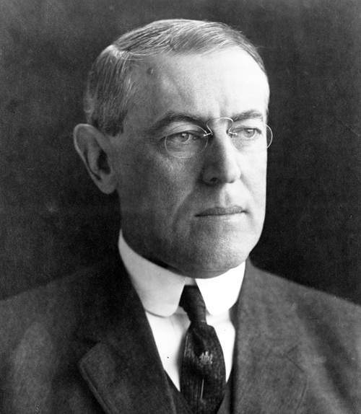
Wilson’s Missionary Diplomacy
The U.S. had a moral responsibility to deny recognition to any Latin American government it viewed as oppressive, undemocratic, or hostile to U.S. interests

Slide 10
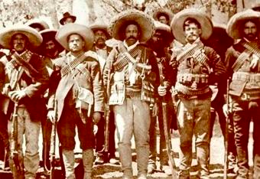
Pancho Villa & Emiliano Zapata
Rebels that led the rebellion in Mexico vs. the Carranza led government
John J. Pershing was sent by President Wilson to capture Villa either dead or alive

Slide 11
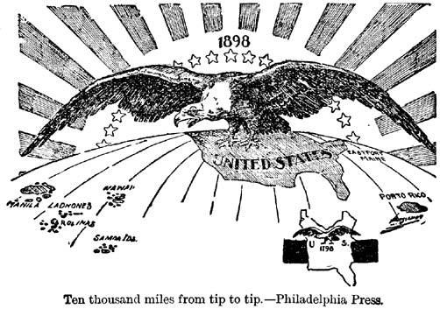
United States Foreign Policy Goals of the Early 20th Century
1. It expanded its access to foreign markets in order to ensure the continued growth of the domestic economy
2. Built a modern navy to protect its interests abroad
3. Exercised its international police power to ensure dominance in Latin America

