Slide 1
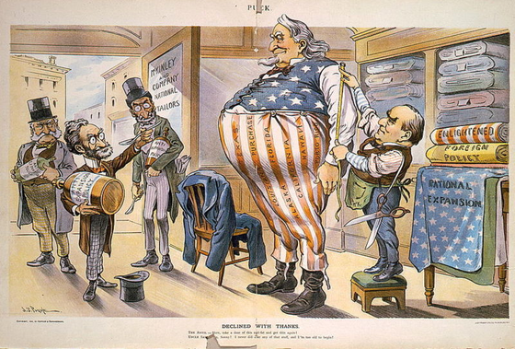
Chapter 10-Section 3
Acquiring New Lands

Slide 2
The Foraker Act
This act ended U.S. military rule in Puerto Rico and set up a civil govt. there.
This act also gave the U.S. President the power to appoint Puerto Rico’s governor and legislators.
Only members of the lower house would be elected by the Puerto Rican people.
This act also squashed the hopes that many had of having Puerto Rico become a state.

Slide 3
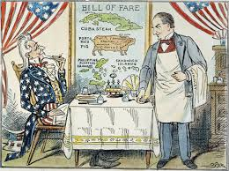
The Platt Amendment
Amendments to the Cuban Constitution were forced to happen as a result of this Platt Amendment.
This amendment said:
Cuba couldn‘t make a treaty that would limit its independence or allow a foreign power to control it.
U.S. could not intervene in Cuba.
Cuba was not to go into debt.
U.S. could buy or lease land on Cuba for naval and refueling stations.

Slide 4
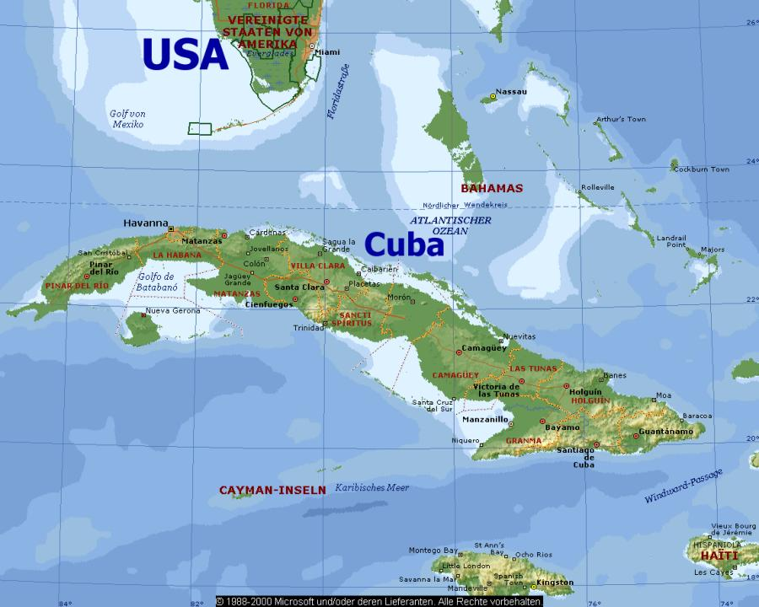
Cuba…
Then became a U.S. protectorate, better known as a country whose affairs are partially controlled by a stronger power.

Slide 5
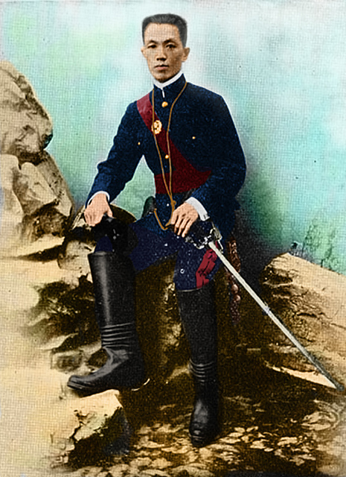
The Philippines
The Filipinos were outraged when they learned of the terms of the Treaty of Paris. The treaty called for American annexation of the Philippines.
A man by the name of Emilio Aguinaldo, led rebel Filipino troops against the U.S. using guerilla tactics to fight against annexation and fight for an independent Philippines.
The war was costly and atrocities were committed by the American troops.

Slide 6
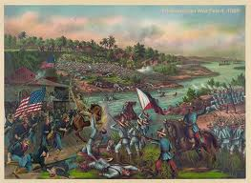
Aftermath of the Filipino War…
The U.S. would set up a government very similar to the one established in Cuba.
The Philippines would be a protectorate until July 4, 1946.

Slide 7
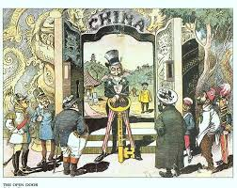
China…
To protect U.S. trading interests Secretary of State John Hay issued in 1899 a series of policy notes or statements called the Open Door Notes.
These notes were sent to other imperialist nations to get them to share trading rights to China, so that no one single nation had exclusive trading rights to China.
The other imperialist nations reluctantly agreed to this policy.

Slide 8
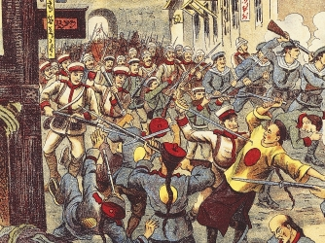
China and the Boxer Rebellion…
The Boxers were a group of Chinese people that resented foreign/western influence and control of trade and culture in China.
The growing resentment led to the Boxer rebellion where Chinese martial artists went around killing any Chinese accepting Christianity and other westerners.
Thousands of Chinese died as a result of the rebellion, but ultimately it was unsuccessful in stopping western influence and trade in China.

Slide 9
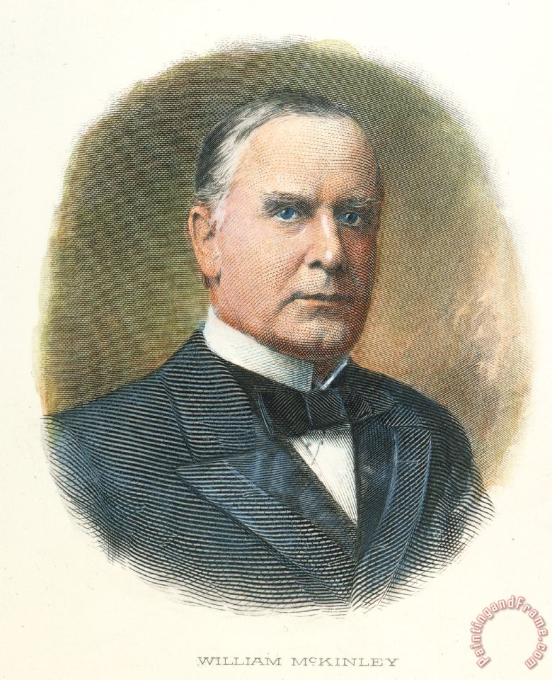
Imperialism
Was favored by most Americans because they re-elected a pro imperialism president in William Mckinley as opposed to an anti-imperialist William Jennings Bryan.
As a result of Imperialism the United States had gained an empire by 1900.
Later anti-imperialist sentiments would arise and gain support.

