Slide 1
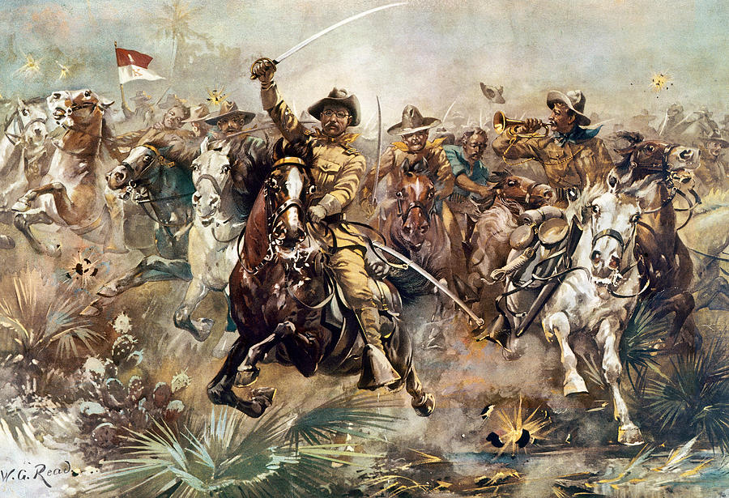
Chapter 10-Section 2
The Spanish-American War

Slide 2
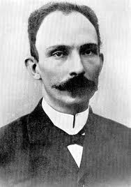
Cubans Rebel Against Spain
Cuba Libre!-A term meaning “a free Cuba”
Jose Marti-Cuban poet and journalist who wanted Cuba to be an independent nation

Slide 3
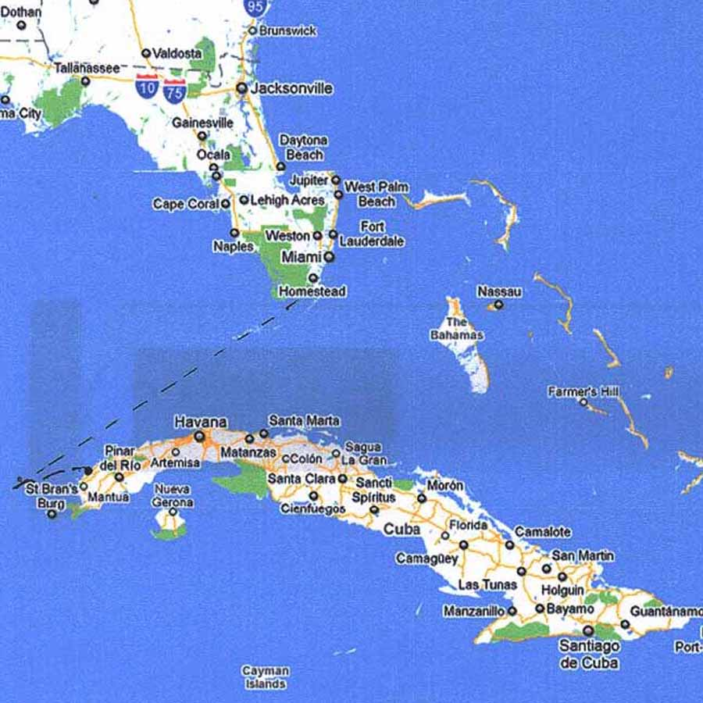

Slide 4
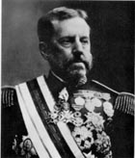
War Fever Escalates
Valeriano Weyler-Sent by Spain to Cuba in order to restore order
Gathered more than 300,000 Cubans into concentration camps where many died of hunger and disease

Slide 5
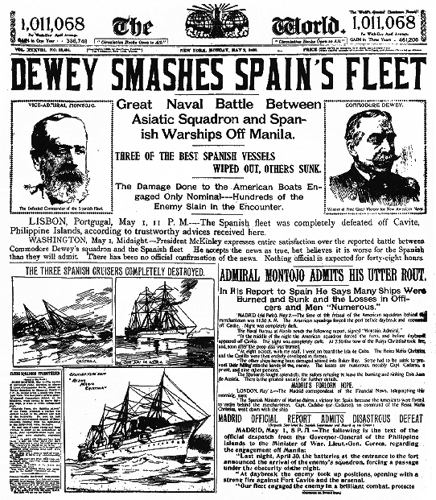
Yellow Journalism
Yellow Journalism-The use of sensationalized and exaggerated reporting by newspapers or magazines to attract readers
Weyler’s actions fueled a war of words between the New York Journal and the New York World
New York Journal-William Randolph Hearst
New York World-Joseph Pulitzer

Slide 6
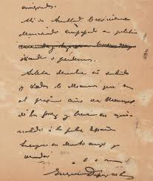
The De Lome Letter
1898 published by the New York Journal
Written by Enrique Dupuy de Lome the Spanish minister to the United States
Criticized President McKinley
“Weak and a bidder for the admiration of the crowd”
Why is this such a big deal?
Roosevelt had been bad mouthing McKinley for quite some time. (Called him “White livered” and that McKinley “had the backbone of a chocolate éclair”)

Slide 7
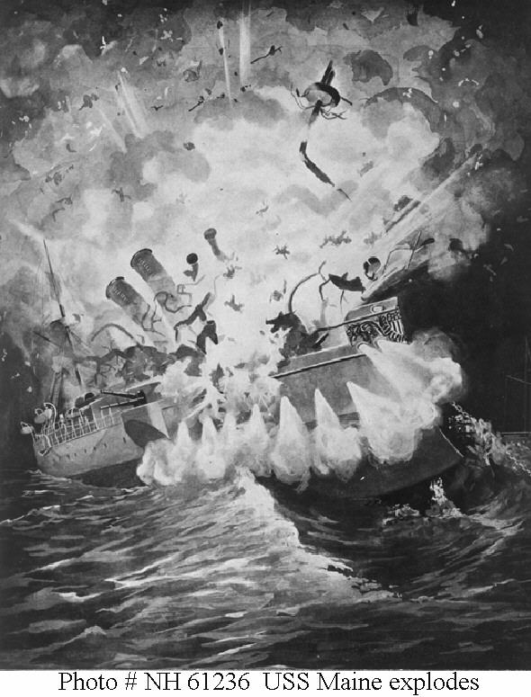
The U.S.S. Maine
Feb. 15th 1898 a U.S. ship named the USS Maine exploded outside of Havana, Cuba
266 were killed
Blame was directed at the Spanish
“Remember the Maine!!” becomes battle cry for war
In 1976 a study proves the sinking of the Maine was most likely an accident

Slide 8
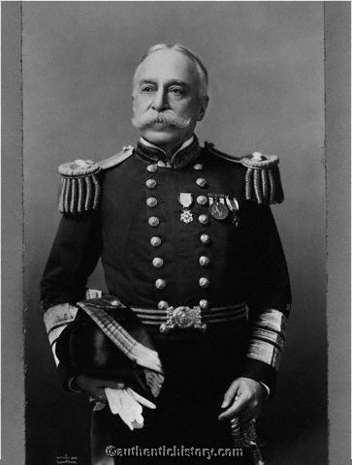
War in the Philippines
First battle of the Spanish-American War
George Dewey the commander of one of the U.S. Navy fleets defeated a fleet of Spanish ships at Manila
This victory allowed American troops to take land in the Philippines

Slide 9
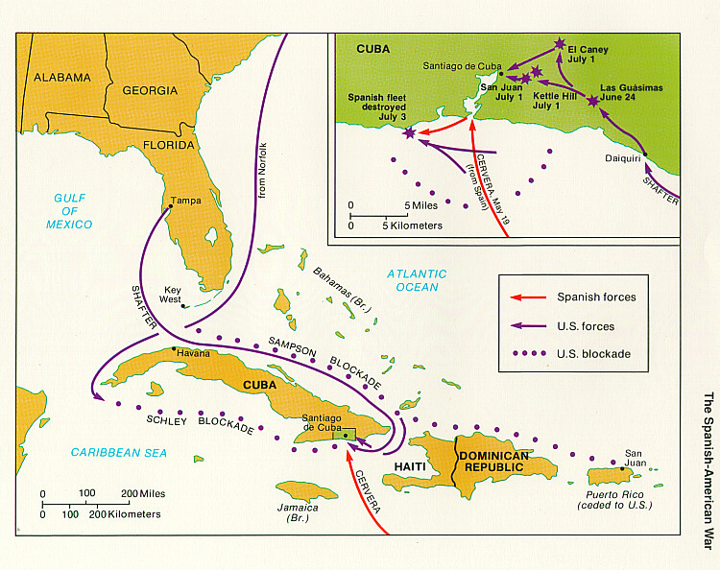
War in the Caribbean
The Naval blockade of Cuba was designed to block the Spanish Navy Fleet from leaving the harbor of Santiago de Cuba
Rough Riders-A volunteer cavalry under the command of Leonard Wood and Theodore Roosevelt during the Spanish-American War

Slide 10
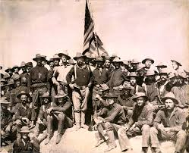
San Juan Hill
The Battle of San Juan Hill was most famous land battle of the Spanish-American War
It began on July 1st 1898
A quick victory over the Spanish fleet in the harbor followed resulting in the complete destruction of the fleet
Although Roosevelt and his Rough Riders played only a minor role in the battle several newspapers declared him the “Hero of San Juan Hill”

Slide 11
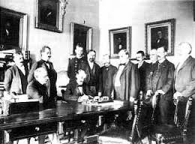
Treaty of Paris
The Treaty of Paris-Signed on December 10th.1898
Spain freed Cuba and turned over the islands of Guam and Puerto Rico to the United States
Spain sold the U.S. the Philippine Islands for $20 million dollars

Slide 12
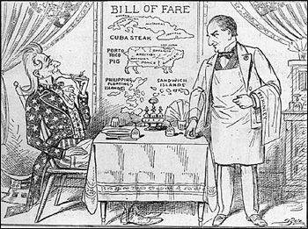
“Splendid Little War”
5,462 died, but only 379 in battle during the Spanish American War
Most died from diseases
Malaria, typhoid, dysentery or yellow fever
End of Spain’s New World Empire

