Slide 1
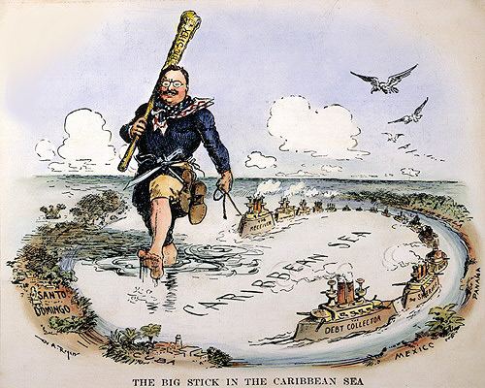
Chapter 10-Section 1
Imperialism and America

Slide 2
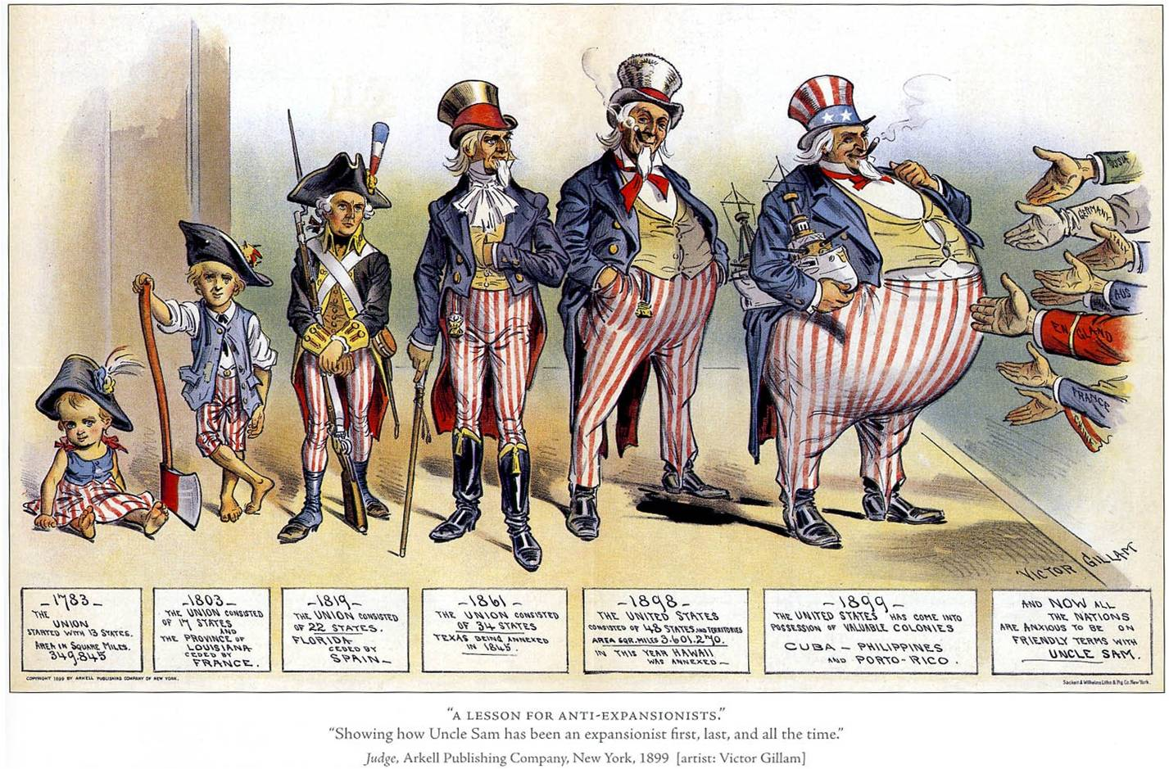
American Expansionism
Imperialism-The policy in which stronger nations extend their economic, political, or military control over weaker territories
Does expansionism differ? Why do we prefer to call it expansionism?

Slide 3
Three Factors Behind American Imperialism/Expansionism
The three driving factors behind the push for American Imperialism were:
  A desire for military strength
  A thirst for new trade markets
  A belief in cultural superiority

Slide 4
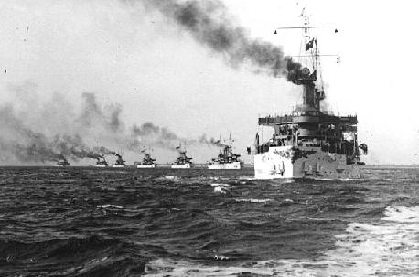
Desire for Military Strength
Other nations were establishing a military presence around the world
Alfred T. Mahan an Admiral in the U.S. Navy urged the United States to strengthen the navy in order to compete with other nations

Slide 5
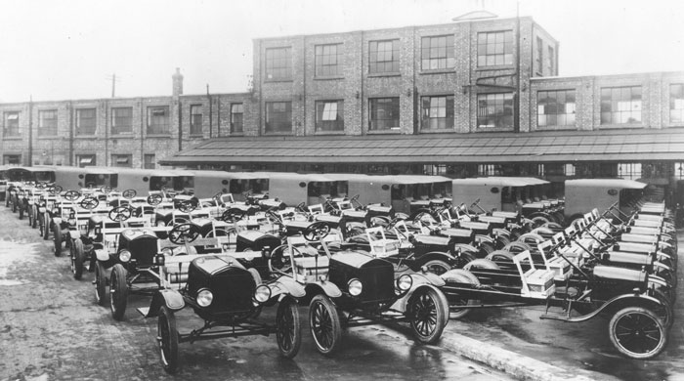
Thirst for New Markets
Advances in technology enabled farmers and factories to produce more than American citizens could use
Needed more raw materials for the factories
New markets to sell the goods to

Slide 6
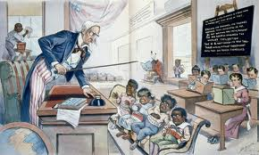
Belief in Cultural Superiority
Some people believed and argued that Americans had a responsibility to spread Christianity and their beliefs to other nations
Social Darwinism-A belief that free-market competition would lead to the survival of the fittest

Slide 7
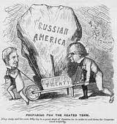
Alaska
Purchased in 1867 from Russia for only $7.2 million dollars
  Roughly, $218.7 million in today’s money
  Arranged by William Seward (Sec. of State under Abe Lincoln & Andrew Johnson)
Admitted as the 49th state in 1959
The newly acquired territory was rich in timber, minerals and oil

Slide 8
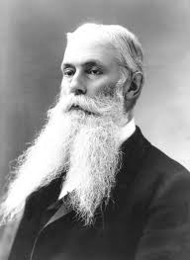
Hawaii
Pearl Harbor-1887 became a naval base and refueling station for American ships
Sugar plantations became a huge part of the Hawaiian economy
1898-Congress proclaimed Hawaii an American territory
Hawaii was admitted as the 50th state in 1959

Slide 9
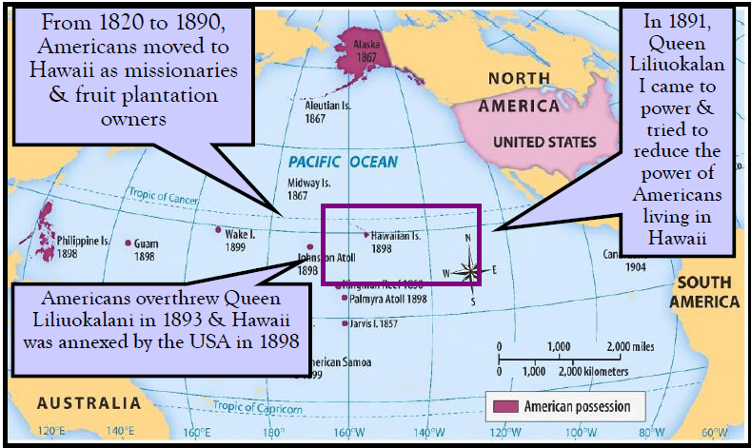
U.S. Imperialism in Hawaii

Slide 10
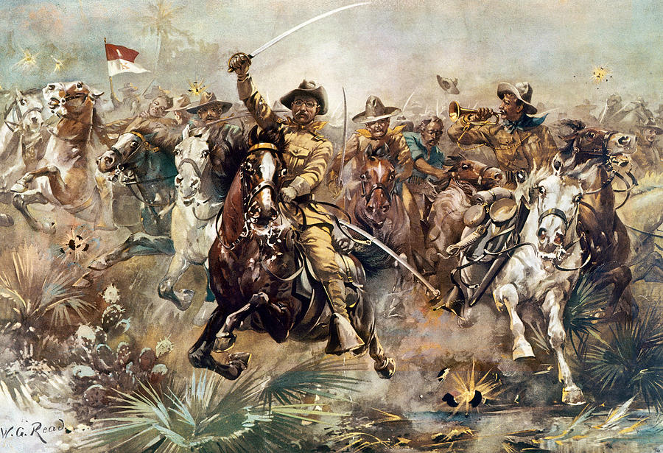
Chapter 10-Section 2
The Spanish-American War

Slide 11
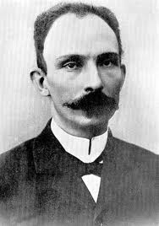
Cubans Rebel Against Spain
Cuba Libre!-A term meaning “a free Cuba”
Jose Marti-Cuban poet and journalist who wanted Cuba to be an independent nation

Slide 12
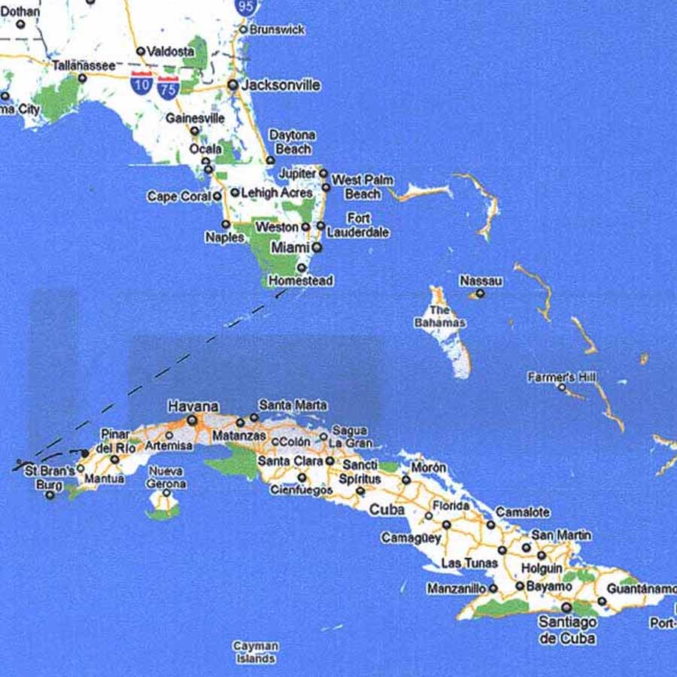

Slide 13
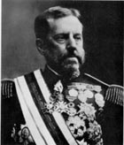
War Fever Escalates
Valeriano Weyler-Sent by Spain to Cuba in order to restore order
Gathered more than 300,000 Cubans into concentration camps where many died of hunger and disease

Slide 14
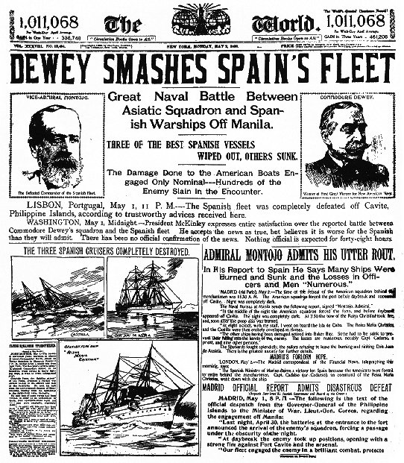
Yellow Journalism
Yellow Journalism-The use of sensationalized and exaggerated reporting by newspapers or magazines to attract readers
Weyler’s actions fueled a war of words between the New York Journal and the New York World
New York Journal-William Randolph Hearst
New York World-Joseph Pulitzer

Slide 15
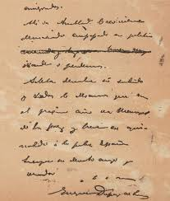
The De Lome Letter
1898 published by the New York Journal
Written by Enrique Dupuy de Lome the Spanish minister to the United States
Criticized President McKinley
  “Weak and a bidder for the admiration of the crowd”
Why is this such a big deal?
  Roosevelt had been bad mouthing McKinley for quite some time. (Called him “White livered” and that McKinley “had the backbone of a chocolate éclair”)

Slide 16
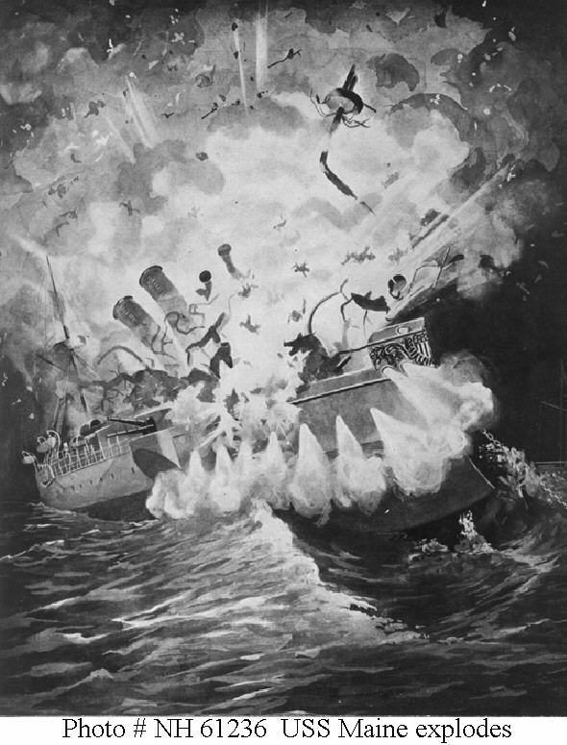
The U.S.S. Maine
Feb. 15th 1898 a U.S. ship named the USS Maine exploded outside of Havana, Cuba
  266 were killed
Blame was directed at the Spanish
“Remember the Maine!!” becomes battle cry for war
In 1976 a study proves the sinking of the Maine was most likely an accident

Slide 17
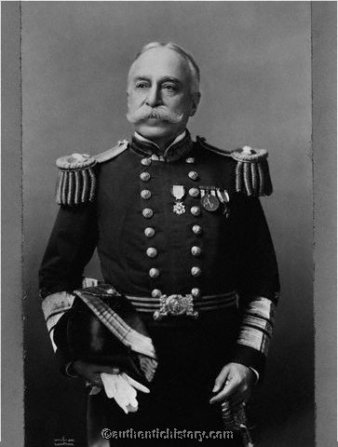
War in the Philippines
First battle of the Spanish-American War
George Dewey the commander of one of the U.S. Navy fleets defeated a fleet of Spanish ships at Manila
This victory allowed American troops to take land in the Philippines

Slide 18
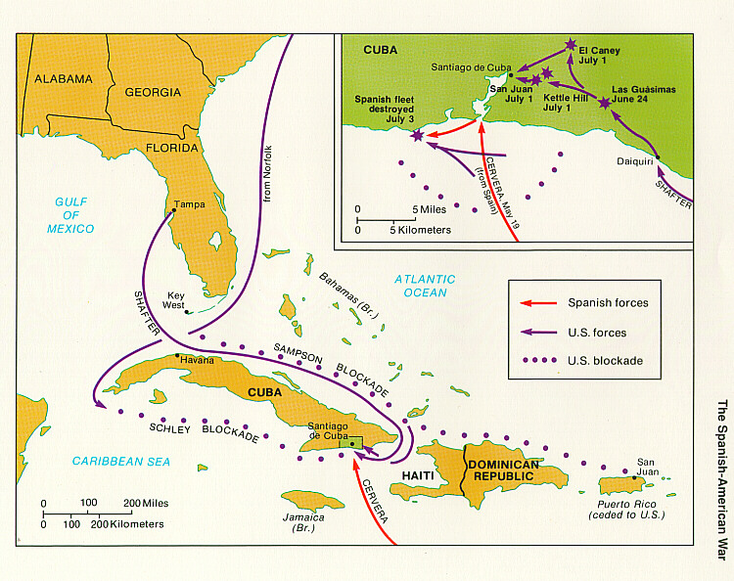
War in the Caribbean
The Naval blockade of Cuba was designed to block the Spanish Navy Fleet from leaving the harbor of Santiago de Cuba
Rough Riders-A volunteer cavalry under the command of Leonard Wood and Theodore Roosevelt during the Spanish-American War

Slide 19
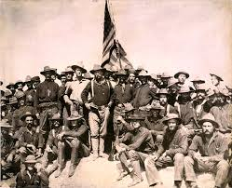
San Juan Hill
The Battle of San Juan Hill was most famous land battle of the Spanish-American War
  It began on July 1st 1898
A quick victory over the Spanish fleet in the harbor followed resulting in the complete destruction of the fleet
  Although Roosevelt and his Rough Riders played only a minor role in the battle several newspapers declared him the “Hero of San Juan Hill”

Slide 20
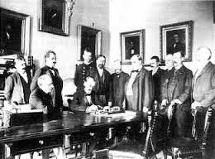
Treaty of Paris
The Treaty of Paris-Signed on December 10th.1898
Spain freed Cuba and turned over the islands of Guam and Puerto Rico to the United States
Spain sold the U.S. the Philippine Islands for $20 million dollars

Slide 21
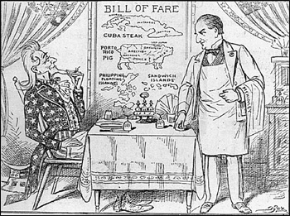
“Splendid Little War”
5,462 died, but only 379 in battle during the Spanish American War
Most died from diseases
  Malaria, typhoid, dysentery or yellow fever
    End of Spain’s New World Empire

