Slide 1
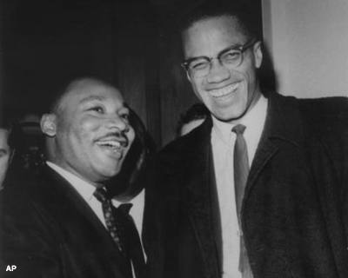
Section 3-Challenges and Changes in the Movement

Slide 2
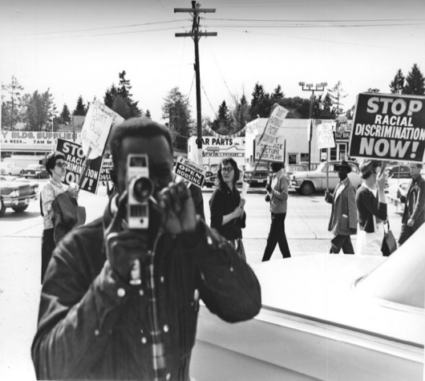
African Americans Seek Greater Equality
During the 1960’s those supporting Civil Rights began calling for a newfound sense of equality
In 1965 as tensions began to grow many Civil Rights groups began to drift apart
In the North their focus shifted to issue of a growing sense of racial prejudice

Slide 3
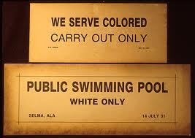
African Americans Seek Greater Equality
There were two main types of segregation in the United States
De-Facto Segregation–Segregation which exists by practice and custom
This was mostly a problem in North following WWII
De-Jure Segregation–Segregation which is required by law

Slide 4
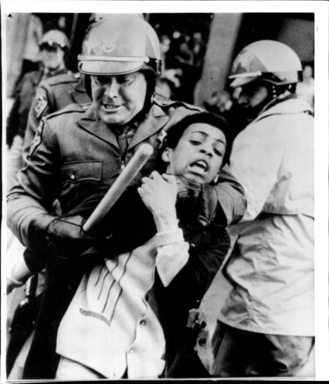
African Americans Seek Greater Equality
Issues with Equality During the 1960’s-
African-Americans were being denied equal opportunity in the area of employment, housing and education
Most urban blacks live in slums with landlords who ignore city ordinances and are slow to address patience issues
African-American unemployment was twice as high as white unemployment
Many African-American’s were angry at the treatment they received from white police officers
A large portion of the money for Johnson’s War on Poverty and his Great Society was redirected towards the Vietnam War

Slide 5
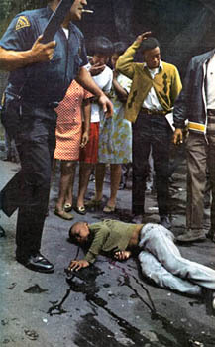
African Americans Seek Greater Equality
During the mid-1960s, numerous clashes between white authority and black civilians resulted in violent riots
1964 Harlem Riot (NY)
1965 Watts Riots (CA)
1967 Detroit Riots (MI)
Many whites baffled by African-American rage however, LBJ recognized the cities needed help and wants to start a war on poverty but the money was not there b/c of Vietnam

Slide 6
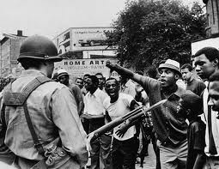

Slide 7
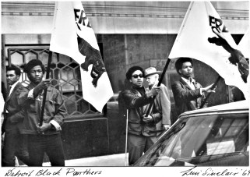

Slide 8
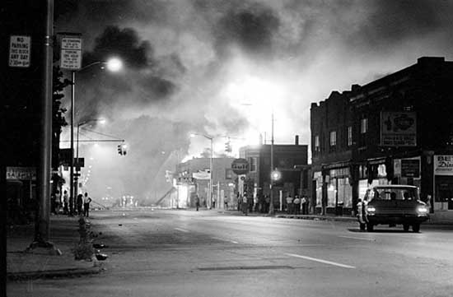

Slide 9
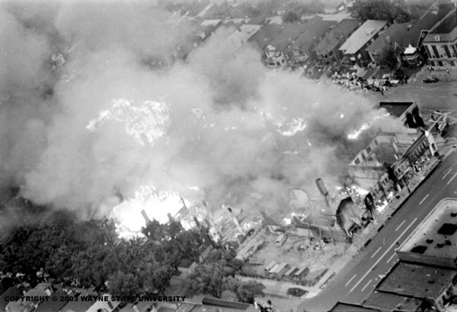

Slide 10
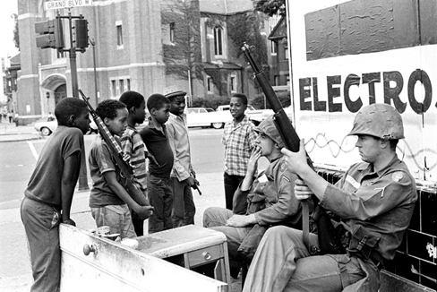

Slide 11
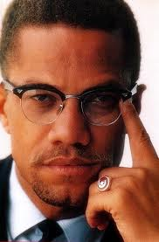
New Leaders Voice Discontent
Nation of Islam- A group of black Muslims who advocated for blacks to separate from whites believing whites to be the source of a majority of the problems African-Americans were facing during the 1960’s
Malcolm X—Controversial Muslim leader and speaker who massive publicity during the Civil Rights movement
While in jail for larceny he studied the teachings of Elijah Muhammad and became a member of the Nation of Islam
He advocated for self defense and separation from white society by “any means necessary”
His militant attitude frightened many whites, moderate blacks and caused resentment by other Black Muslims

Slide 12
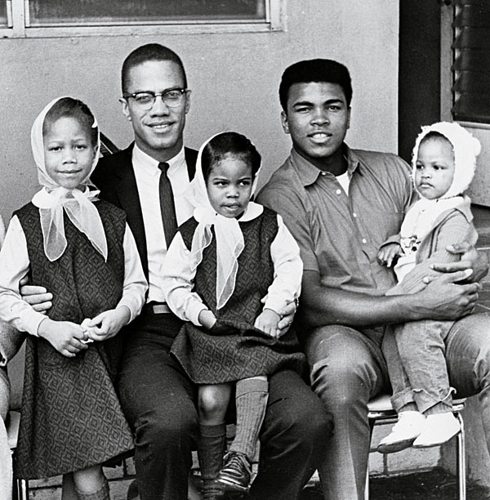

Slide 13
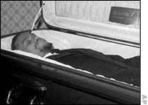
New Leaders Voice Discontent
As time progressed Malcolm X’s attitude toward whites changed following Pilgrimage to Mecca changes
He realized that Orthodox Islam preached racial equality while the Nation of Islam did not
Following his split Malcolm X feared retribution from the Nation of Islam and on February 21, 1965, his fears were realized.
While addressing the OAAU in Manhattan's Audubon Ballroom he dies after being shot a total of twenty-one times

Slide 14
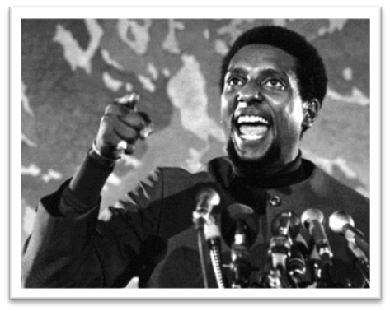
New Leaders Voice Discontent
As we move throughout the 1960’s groups like CORE and the SNCC become more militant while the SCLC pursues traditional tactics
MLK doesn’t approve of this divisiveness
Stokely Carmichael-The head of SNCC who called for African-Americans to define their goals and lead their own organizations
Best known for saying “We Shall Overcome”
Black Power-A political movement/activism (some violent and some peaceful) designed to achieve a form of African Americans control over their own lives and communities without the interference of whites while promoting black empowerment.

Slide 15
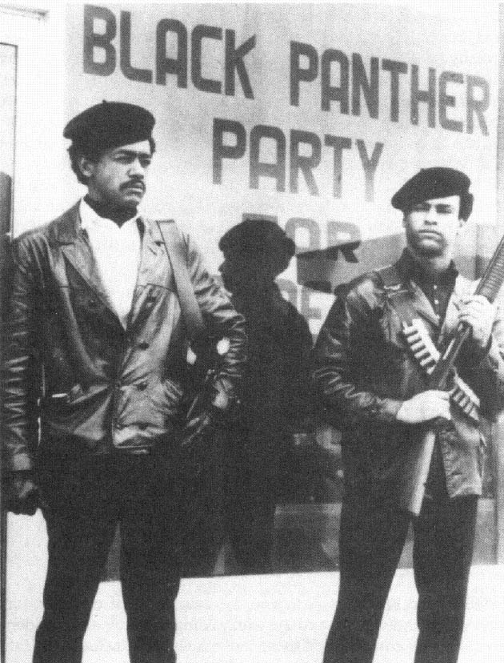
New Leaders Voice Discontent
Black Panthers-Was a political organization founded by Bobby Seale and Huey Newton in October 1966 designed to fight police brutality in the ghettos and inner-cities and promote black self-sufficiency
The Black Panthers didn’t conform with the non-violent movement
Where MLK said “We shall overcome”
The Black Panthers said “We shall overrun” and would often have violent confrontations with police
They dressed in signature black leather jackets and black berets

Slide 16
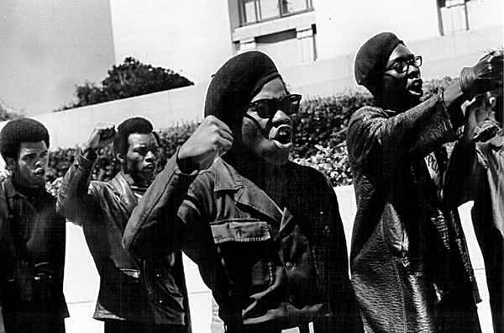

Slide 17
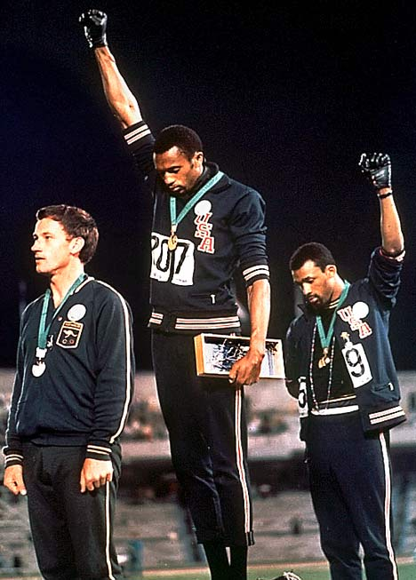

Slide 18
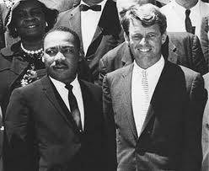
1968-A Turning Point in Civil Rights
Dr. Kings Death-
On April 4th, 1964 while in Memphis, Tennessee MLK was shot while on his hotel balcony by James Earl Ray
Robert Kennedy’s Death-
On June 5th, 1968 following his victory speech after winning the California Primary he shot by Sirhan Sirhan because of his support for Israel during the Six Day War

Slide 19
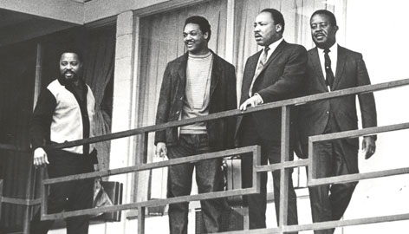

Slide 20
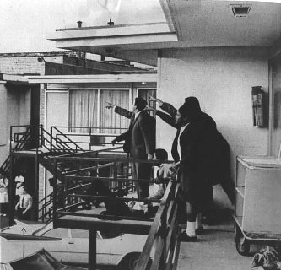

Slide 21
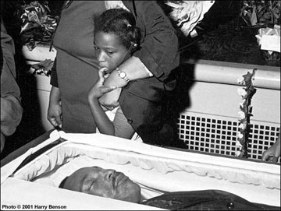

Slide 22
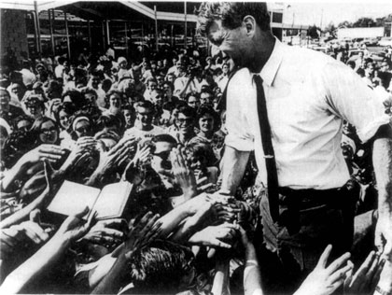

Slide 23
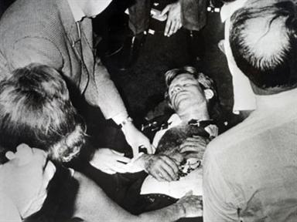

Slide 24
Legacy of the Civil Rights Movement
Dr. King’s death leads to worst urban rioting in U.S. history over a hundred American cities were affected
I. Kerner Commission-An eleven member Presidential Commission established by President Lyndon B. Johnson in Executive Order 11365 to investigate the causes of the 1967 race riots and to provide recommendations for the future.
It named white racism as main cause of urban violence
In response Congress passed Civil Rights Bill of 1968 which was a landmark piece of legislation that provided for equal housing opportunities regardless of race, creed, or national origin.

Slide 25
Legacy of the Civil Rights Movement
II. African-American pride and self respect increases-
An increased number of black students finish high school, college and begin to land better jobs
A greater pride in racial identity develops leading to Black Studies programs
Larger African-American participation in movies and television
III. Political Gains-
By 1970, two-thirds African-Americans eligible to vote were registered to vote
Increased voter registration among African-Americans results in more black officials being elected
Leaders like Jessie Jackson rose to prominence
IV. Affirmative Action-
Making special efforts to hire or enroll groups who have been discriminated against

