Slide 1
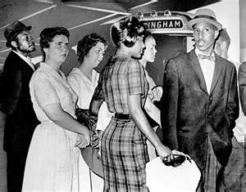
Chapter 21-Section 2-The Triumphs of a Crusade

Slide 2
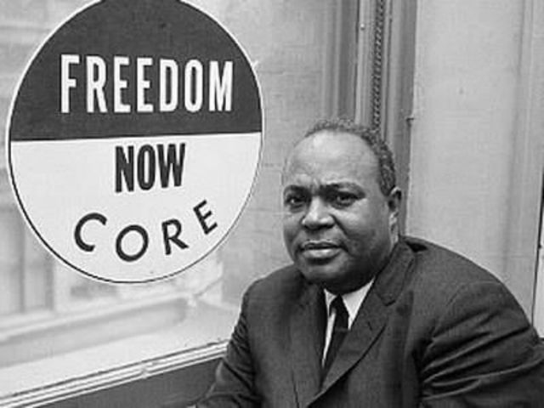
Riding for Freedom
Starting in 1961, CORE (Congress of Racial Equality) tests Court decision banning interstate bus segregation
Freedom Riders-Civil rights activists who rode interstate buses into the segregated southern United States in 1961 and following years to challenge the non-enforcement of the United States Supreme Court decisions Irene Morgan v. Commonwealth of Virginia (1946) and Boynton v. Virginia (1960), which ruled that segregated public buses were unconstitutional.
Riders brutally beaten by Alabama mobs, one bus was firebombed and many others wouldn't let African-Americans on their buses
Attorney General Bobby Kennedy threatens to shut down the bus companies and eventually African-Americans are let back on Southern buses

Slide 3
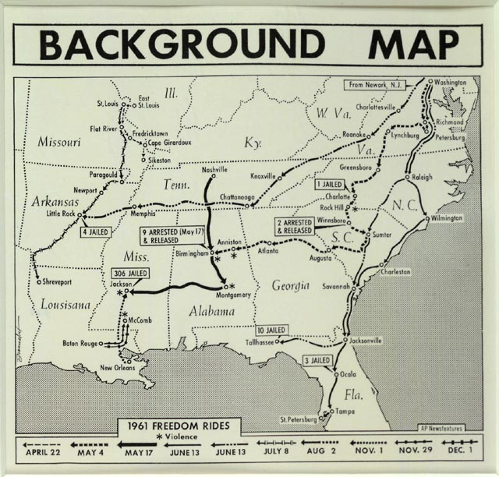
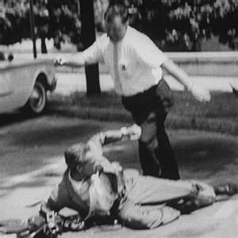
Riding for Freedom
Promised Kennedy African-Americans would be protected but jumped when they got to Montgomery
Violence got protestors the attention they needed
400 U.S. Marshalls were sent to support the riders
Segregation banned in interstate travel facilities

Slide 4
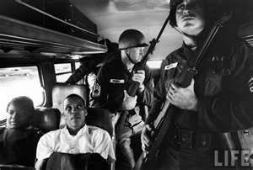

Slide 5
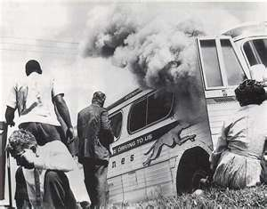

Slide 6
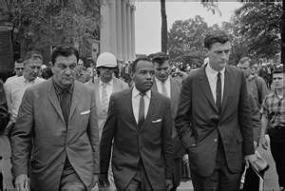
Standing Firm
Integrating the University of Mississippi-
In 1962 James Meredith a U.S. Air Force Veteran attempted to attend Old Miss however, after meeting with Mississippi Governor Ross Barnett he was denied admission because he was black
Following the news of this reaching the media riots broke out causing soldiers to arrest nearly two hundred protestors
Eventually James Meredith was admitted but required soldiers to escort him for his safety

Slide 7
Standing Firm
Between 1957 and 1963 churches and other African-American meeting places in the city of Birmingham, Alabama experienced eighteen bombings leading to the city being nicknamed “Bombingham”
April 1963, the SCLC begins to demonstrate with the goal of desegregating Birmingham
During the protests, Dr. Martin Luther King Jr. was arrested
While in jail he write a “Letter from Birmingham Jail” (later bailed out by President Kennedy)
TV news show police attacking child marchers with fire hoses, dogs, clubs
Continued protests, economic boycott, bad press help to end segregation

Slide 8
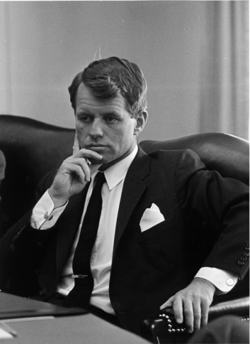
Standing Firm
President Kennedy is mad that Alabama officials didn’t protect the those protesting from mob attacks
Newspapers throughout nation denouncing beatings
JFK sends four hundred U.S. marshals to protect riders and on June 11, 1963 he began sending troops to force Alabama’s Governor Wallace to integrate the University of Alabama
Kennedy demands a Civil Rights Bill be passed through Congress
Attorney general Robert Kennedy helps pass the Interstate Commerce Commission Act which banned segregation in all interstate travel facilities

Slide 9
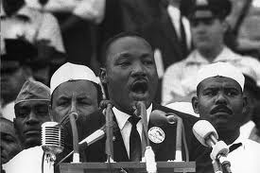
March on Washington
In August 1963, over 250,000 people converge on Washington in support of a proposed Civil Rights Bill that would grant equal access to all public accommodations to those of color
During the march Dr. King gives his famous “I Have a Dream” speech

Slide 10
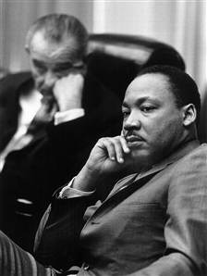
March on Washington
Two weeks later on September 4th,1963 after Dr. King’s speech a bombing in Birmingham kills four young girls JKF begins to increase his push for civil rights until his death on November 22nd, 1963
Newly, appointed President Johnson (LBJ) steps in to office and vows to carry on JFK’s work
The Civil Rights Act of 1964-Ended discrimination based on race, religion, national origin and gender

Slide 11
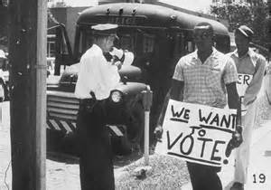
Fighting for Voting Rights
Freedom Summer-A volunteer campaign launched in June 1964 with the goal to register as many African-American voters as possible in Mississippi.
Blacks had been cut off from voting since the turn of the century due to barriers to voter registration and other laws.
Mississippi Freedom Democratic Party forms led by Fannie Lou Hamer
Many African-Americans felt that the Democratic Party had betrayed them so they were looking for a political party that had their interests in mind

Slide 12
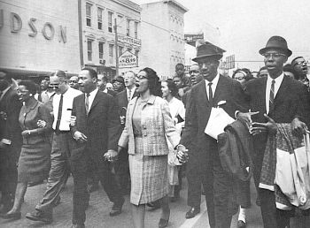
Fighting for Voting Rights
The Selma Campaign-Kicked off in 1965 to fight for voting rights
On March 7th,1965 MLK helps plan a 50 mile march to protest the death of a voting rights demonstrator killed in Selma, AL
King leads 600 protesters on this march
TV stations show police violently trying to stop them
Second march was organized on March 21st, 1965 with federal protection, swells to 25,000 people

Slide 13
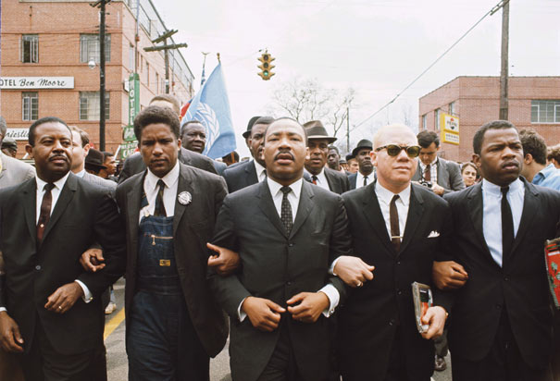

Slide 14
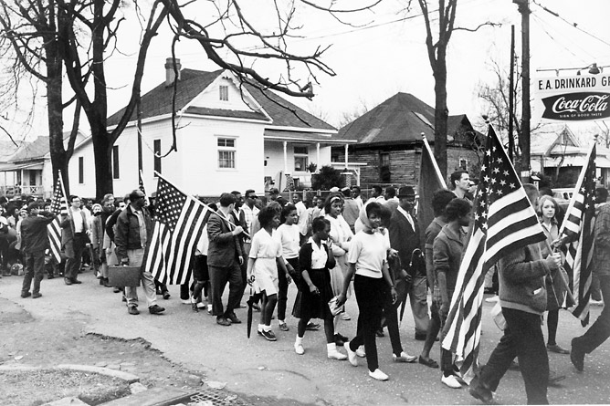

Slide 15
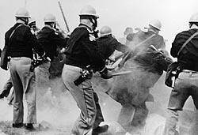

Slide 16
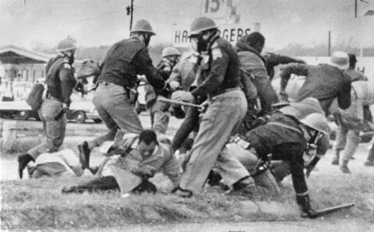

Slide 17
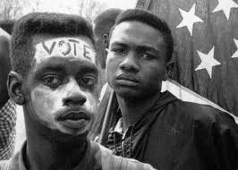
Fighting for Voting Rights
The Voting Rights Act of 1965-A landmark piece of federal legislation in the United States that prohibits racial discrimination in voting.
This includes stopping literacy tests, allows federal officials to enroll voters
Increases black voter enrollment from 10% in 1964 to 60% by 1968

Slide 18
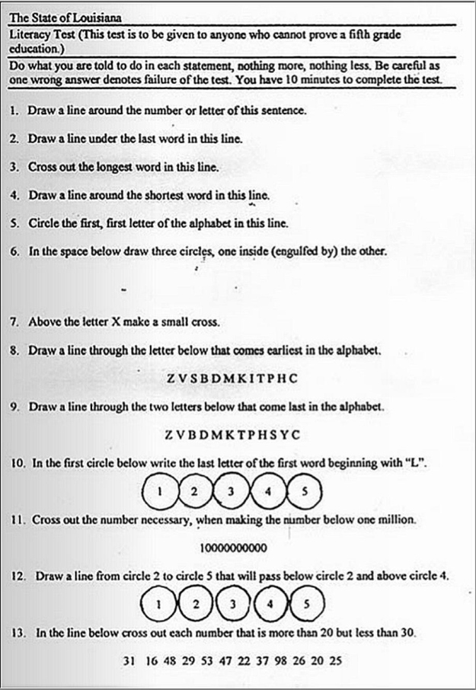
State of Louisiana Literacy Test

