Slide 1
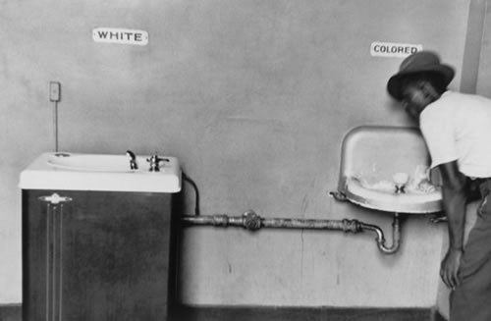
Chapter 21-Section 1-Taking on Segregation

Slide 2
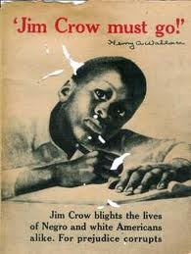
The Segregation System
The Civil Rights Act of 1875-Also referred to as the Enforcement Act or Force Act, guaranteed African Americans equal treatment in public accommodations, public transportation, and prohibited exclusion from jury service.
  The Supreme Court ruled in 1883 that the act was unconstitutional.
Plessy v. Ferguson (1896)-A landmark constitutional law case in which the U.S. Supreme Court upheld racial segregation laws for public facilities under the doctrine of "separate but equal".
  These “Jim Crow Laws” led to a ban on interracial marriages, separate schools, street cars, waiting rooms, railroad coaches, elevators, drinking fountains, witness stands, and restrooms for “White” and “Colored” Americans

Slide 3
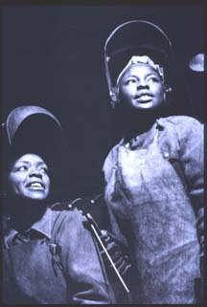
The Segregation System
WWII creates job opportunities for African Americans
An increased need for able bodies fighters pressured the armed forces to end many of their discriminatory policies
  Nearly one million African Americans ended up serving in the armed forces during WWII
FDR ends government, war industries discrimination
Civil rights organizations fought for rights and challenged Jim Crow laws

Slide 4
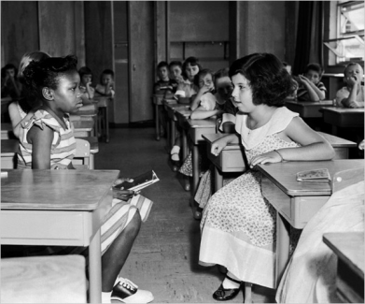
The Segregation System
Brown v. Board of Education of Topeka (1954)- A landmark United States Supreme Court case in which the Court declared state laws establishing separate public schools for black and white students to be unconstitutional.
REACTION TO THE BROWN DECISION-
  Within a year, more than 500 schools have to desegregate
  The KKK begins to reappears and White Citizens Councils boycott businesses
  1955 a second ruling known as “Brown II” moved to expedite the process of de-segregation with “all deliberate speed”

Slide 5
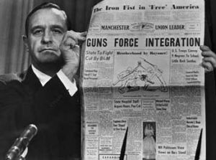
Crisis in Little Rock
Since 1948, Arkansas was slowly working on integrating state university and private groups
However, Governor Orval Faubus needed to gain support for his re-election so he began to close off schools to black students
Eisenhower puts the 101st Airborne Division National guard under his control and sends paratroopers to help a group of students known as the “Little Rock Nine” students attend class
  African-American students harassed by whites at school all year
1957 Civil Rights Act—This act gave the Federal Government the power over schools and voting

Slide 6
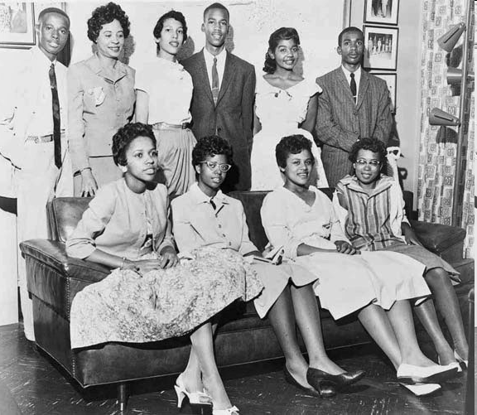

Slide 7
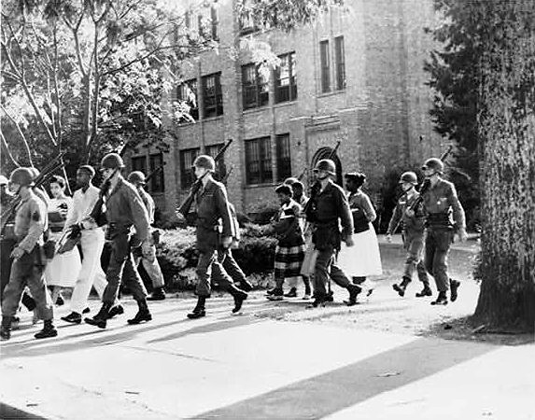

Slide 8
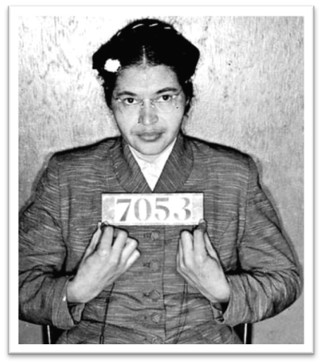
The Montgomery Bus Boycott
Early Champions of the Civil Rights Movement Included:
  Claudette Colvin who was fifteen years old at the time was arrested on March 2, 1955, for refusing to give up her seat on a bus in segregated Montgomery, Alabama.
    Nine months prior to Rosa Parks' famous arrest for the same offense
  Rosa Parks an NAACP officer was arrested on December 1st, 1955 and received national attention for refusing to give up seat on bus and move to the back of the bus
    After her arrest the Montgomery Improvement Association formed, organizes bus boycott
  They elect 26-year-old Baptist pastor Martin Luther King, Jr. as their leader

Slide 9
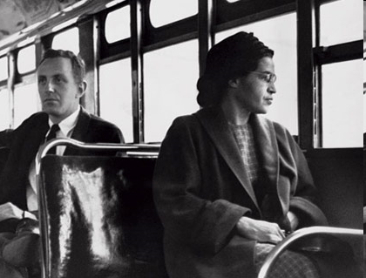

Slide 10
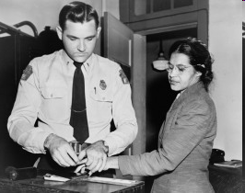

Slide 11
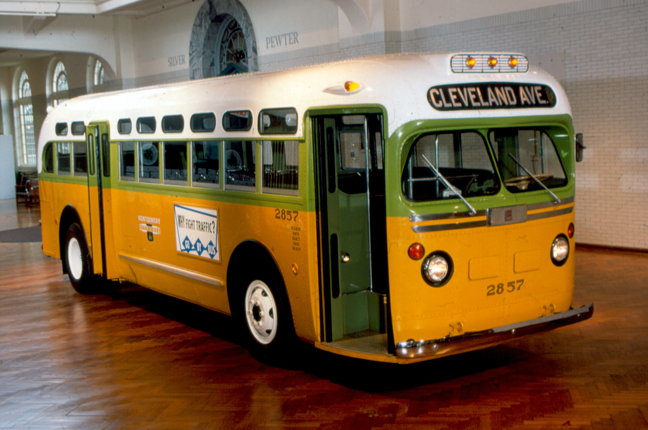

Slide 12
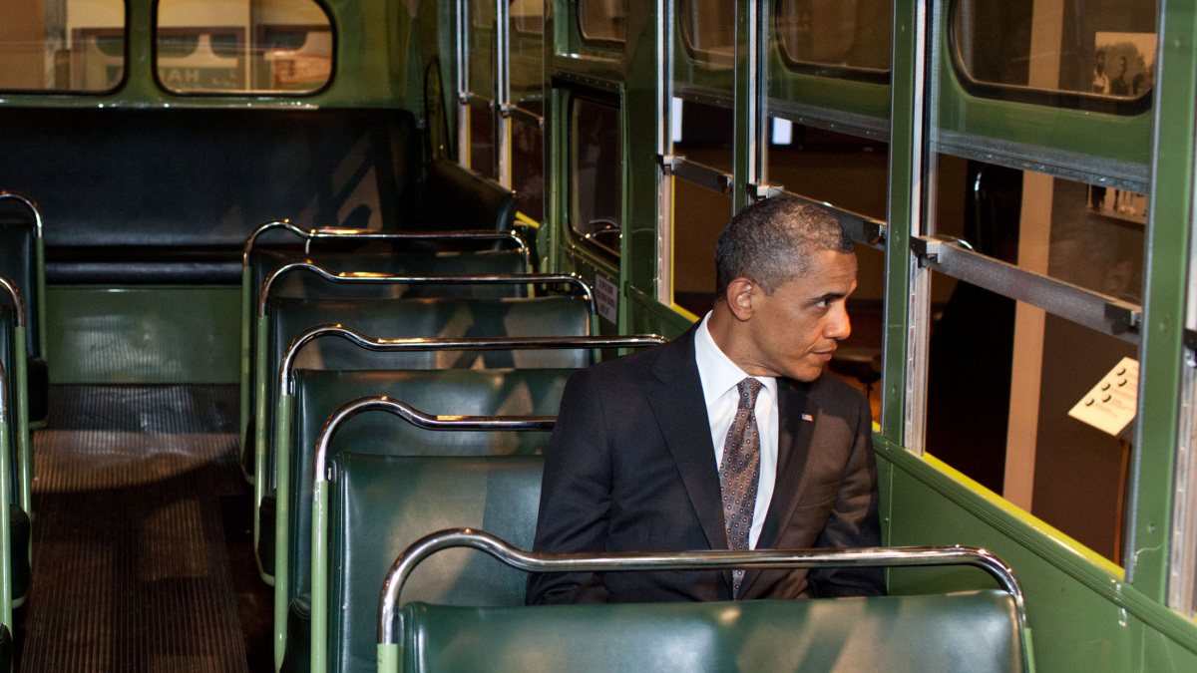

Slide 13
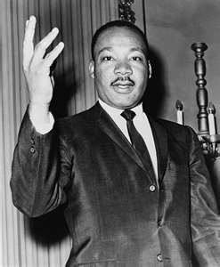
Martin Luther King and the SCLC
King calls his brand of nonviolent resistance “soul force”
Civil Disobedience-A massive non-violent demonstrations
  He is on a record saying “We will not hate you, but we cannot obey your laws”-MLK
King encourages protestors to remain nonviolent in face of violence after Brown decision

Slide 14
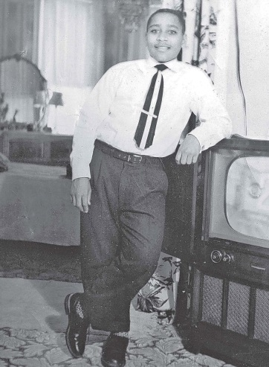
The Murder of Emmett Till
Emmett Till was a 14-year-old African-American who was lynched in Mississippi in 1955, after a 21 year old white woman named Carol Bryant said she was offended by him flirting and whistling at her.
  Several nights after the store incident, Bryant's husband Roy and his half-brother J.W. Milam went armed to Till's great-uncle's house abducted the boy, beat and mutilated him before shooting him in the head and sinking his body in the Tallahatchie River.
    Three days later, Till's body was discovered and retrieved from the river.
  The brutality of his murder and the fact that his killers were acquitted drew attention to the long history of violent persecution of African Americans in the United States.

Slide 15
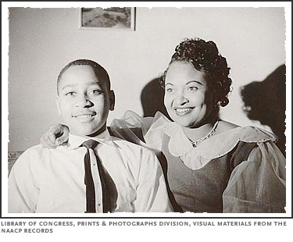

Slide 16
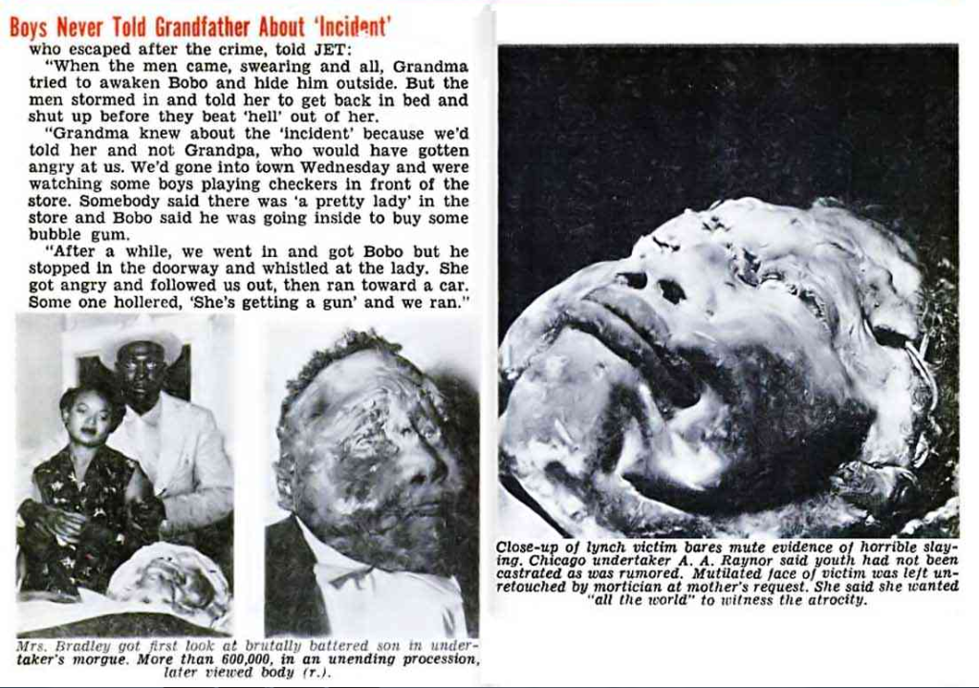

Slide 17
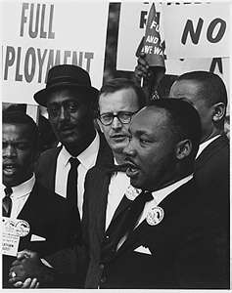
Martin Luther King and the SCLC
Southern Christian Leadership Conference (SCLC) is created in 1957
  Carry message of nonviolence used churches as bases, protested throughout the south
By 1960, many African-American students think pace of change too slow so they decide to join the Student Nonviolent Coordinating Committee (SNCC) which was a group designed to prepare college students to peacefully protest racial inhustice

Slide 18
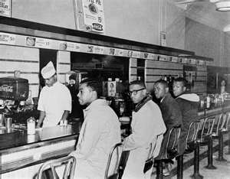
The Movement Spreads
SNCC adopts nonviolence, but calls for more confrontational strategy
Influenced by Congress of Racial Equality (CORE) to use sit-ins protests where they would refuse to leave segregated lunch counter until they were served
  First sit-in at Greensboro, NC Woolworth’s shown nationwide on TV
    In spite of abuse, arrests, movement grows, spreads to North
    Late 1960, lunch counters desegregated in 48 cities in 11 states

Slide 19
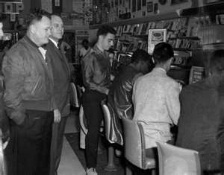

Slide 20
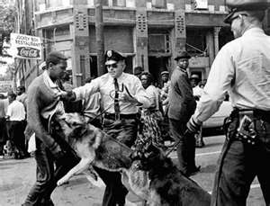

Slide 21
