Slide 1
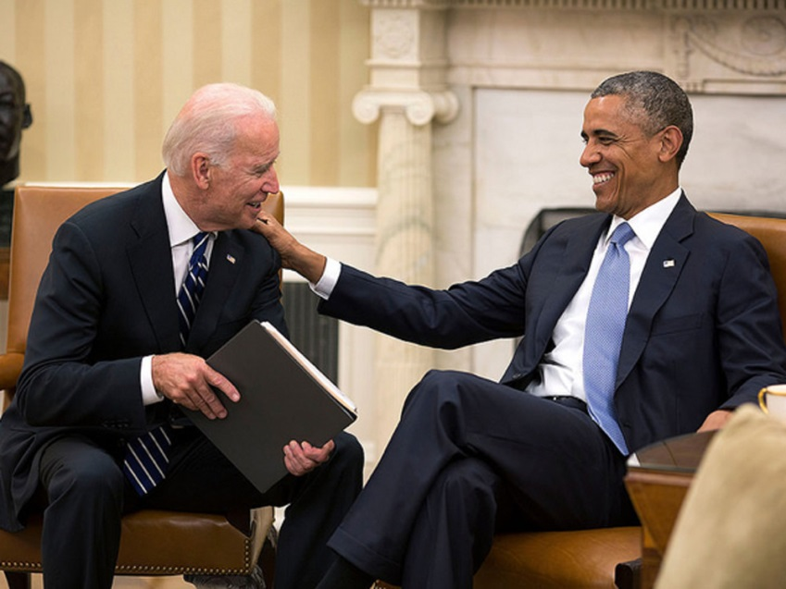
Chapter 13-Section 2-Presidential Succession and the Vice Presidency

Slide 2
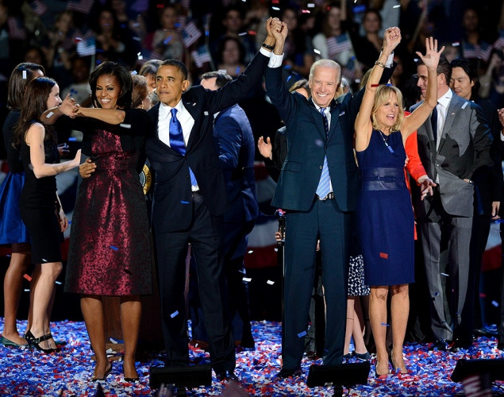
Key Terms
Presidential Succession
Presidential Succession Act of 1947
Balance the ticket

Slide 3
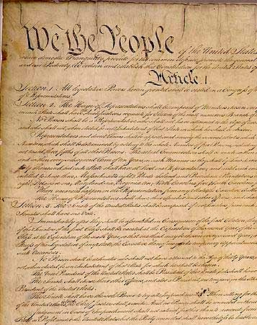
The Constitution and Succession
Presidential Succession-How a presidential vacancy is filled if president dies, resigns or is removed from office
The Constitution stated that the Presidential powers would dissolve to the Vice-President in the event that the President can no longer carry out his duties

Slide 4
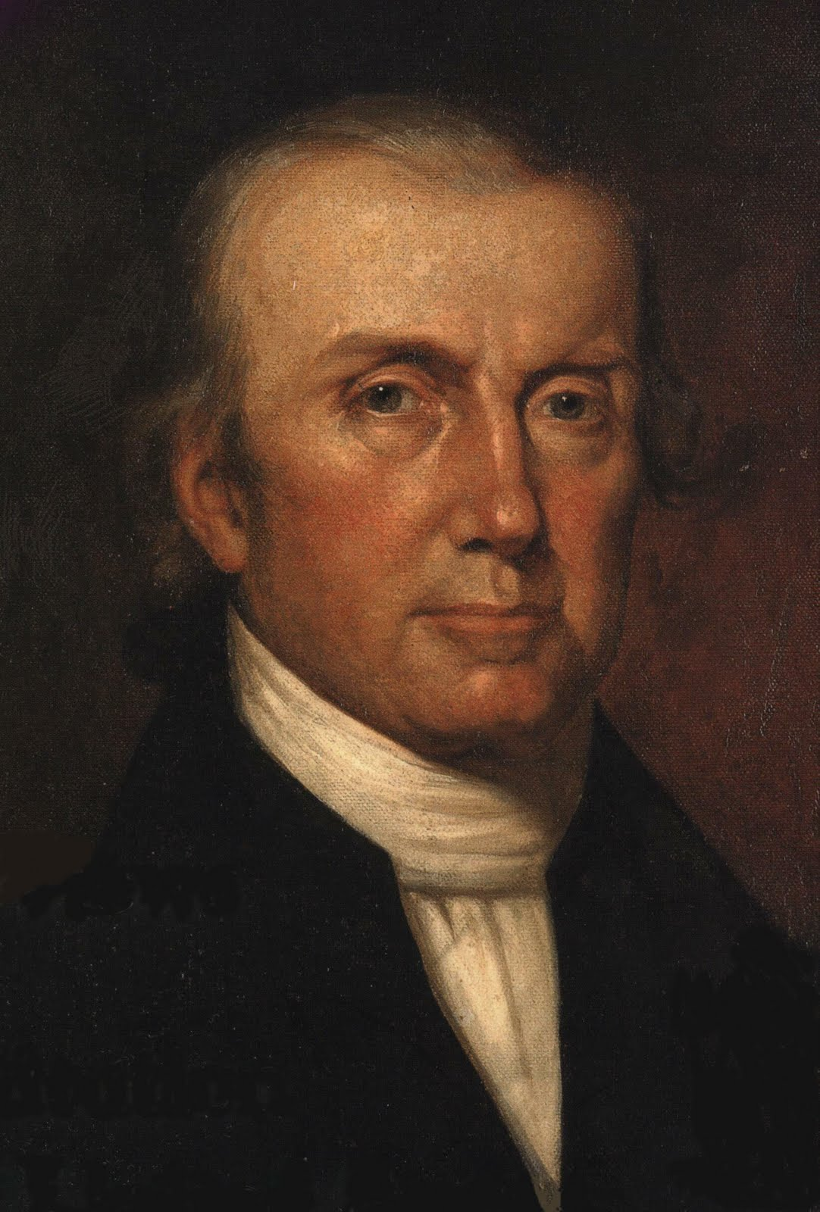
Presidential Succession
Vice President John Taylor was the first V.P. to fill the Presidential void in 1841
Constitution did not provide a direct path for succession until the 25th Amendment was passed in 1967
This officially states that the vice-President will succeed the President

Slide 5
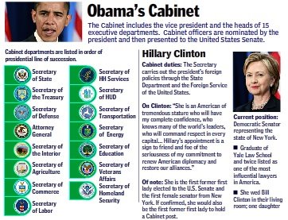
Presidential Succession Act 1967
Set the line of Presidential Succession
Vice-President
Speaker of the House
President pro tempore
Secretary of State
Rest of the 14 members of the cabinet

Slide 6
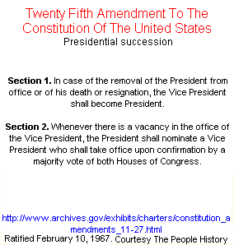
Presidential Disability
Until the 25th Amendment there were serious gaps in the line of succession
Neither Constitution nor Congress made provisions for a disabled President
For 180 years the nation tempted fate
Garfield
Wilson
Reagan
All disabled for a period of time

Slide 7
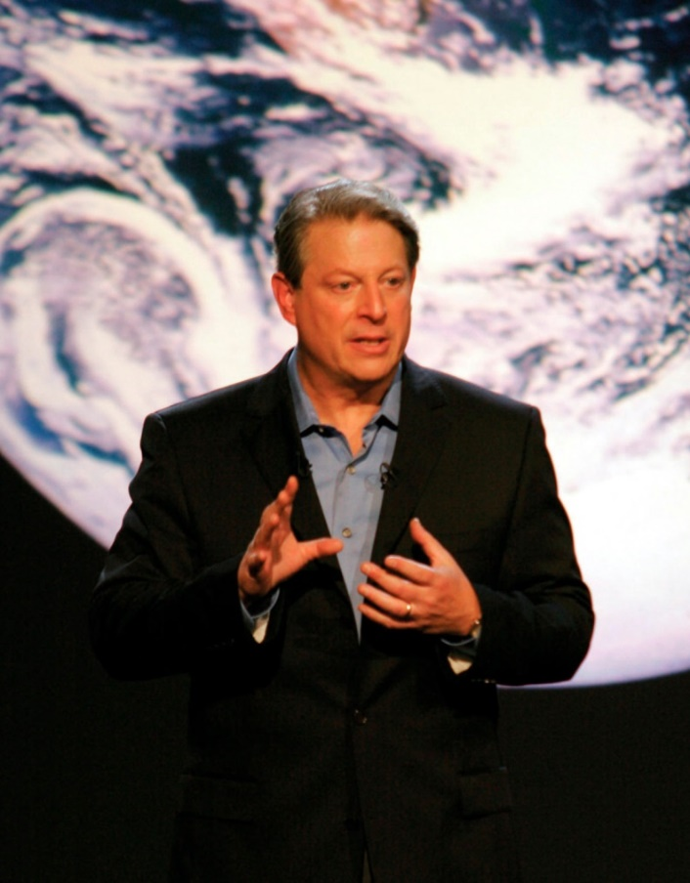
Presidential Disability
Sections 3 and 5 of the 25th Amendment fill disability gap
Vice-President becomes acting President if:
President informs Congress is writing he will be unable to perform his duties
VP and majority of Congress decide president is incapable
Vice President Al Gore

Slide 8
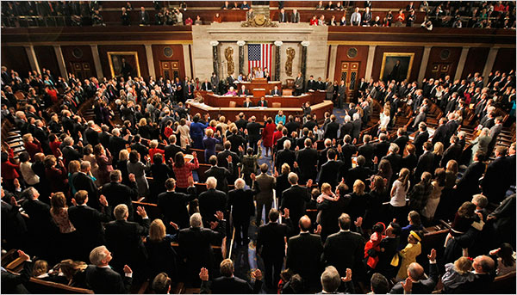
Presidential Disability
President can resume powers by notifying Congress
Vice-president and majority of congress can make a challenge
Congress has 21 days to decide the matter

Slide 9
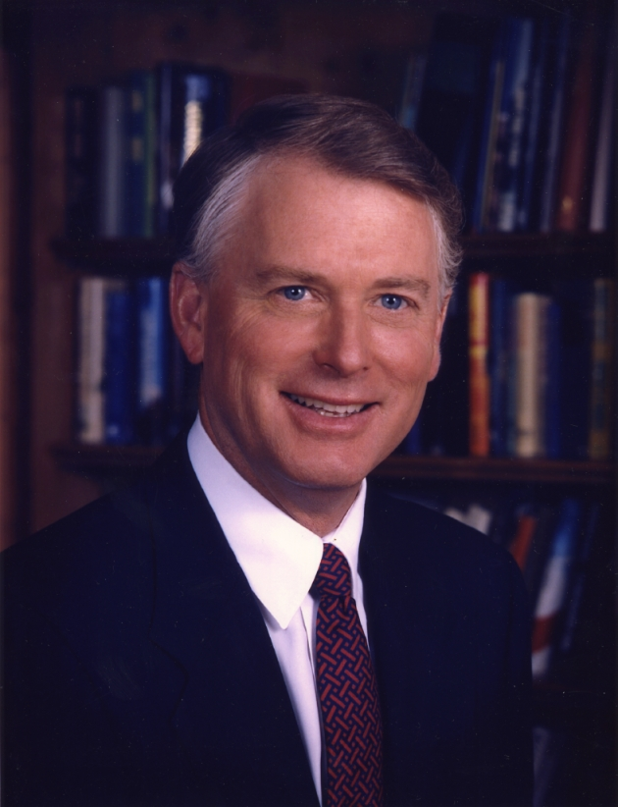
Presidential Disability
25th Amendment has been used three times
Ronald Regan 1985 presided for George Bush for 8 hours because of surgery
2002, 2007 Dick Cheney for George W. Bush for medical procedures
Vice President Dan Quayle

Slide 10
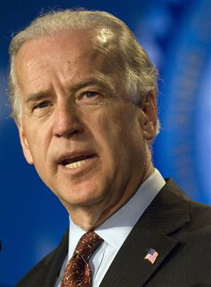
The Vice Presidency
Constitution pays little attention to the office but they have two formal duties:
1.) To preside over the Senate
2.) To help decide the question of presidential disability
Throughout history the office treated with little importance
Vice President Joe Biden

Slide 11
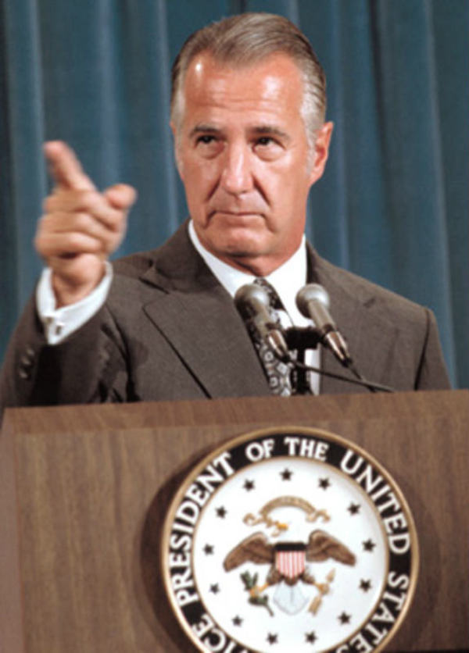
The Vice-Presidency
Most who have served over time have made unkind comments
The job is heartbeat away from the presidency
Balance the Ticket-When a person is chosen as a running mate who can strengthen the ticket for the presidential candidate
Vice President Spiro Agnew

Slide 12
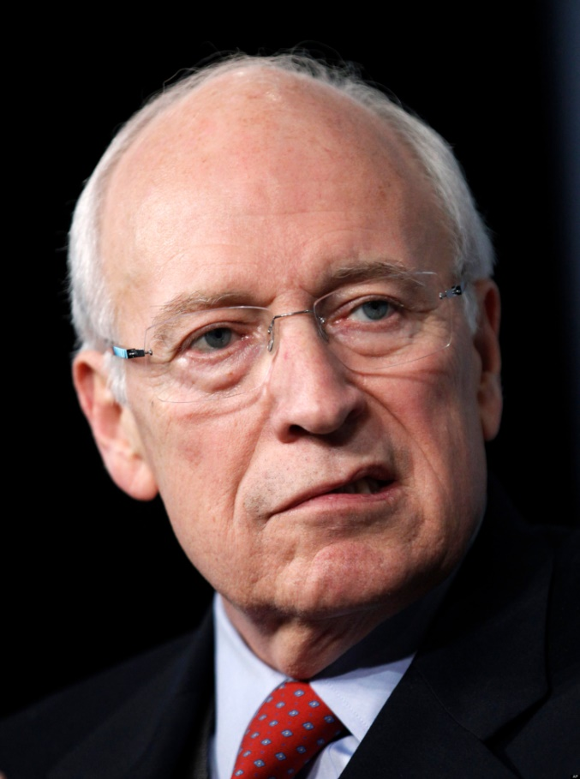
The Vice President Today
Presidents have made them more important
Dick Cheney seen as the most influential V.P. (2001-2007)
Vice president Biden spent 36 years in the Senate and the head of the Foreign Relations Committee
Vice President Dick Chaney

Slide 13
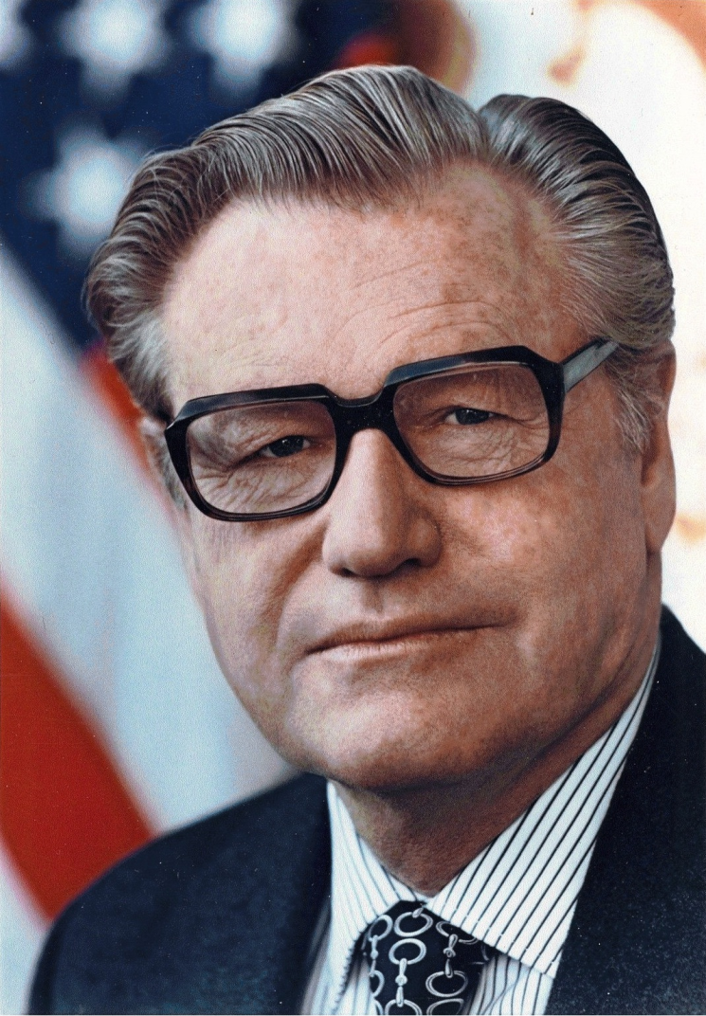
Vice President
The Vice President is seen as a “true assistant President”
The Vice-president is not subject to removal from office by the President they must have Congresses approval
Vice President Nelson Rockefeller

Slide 14
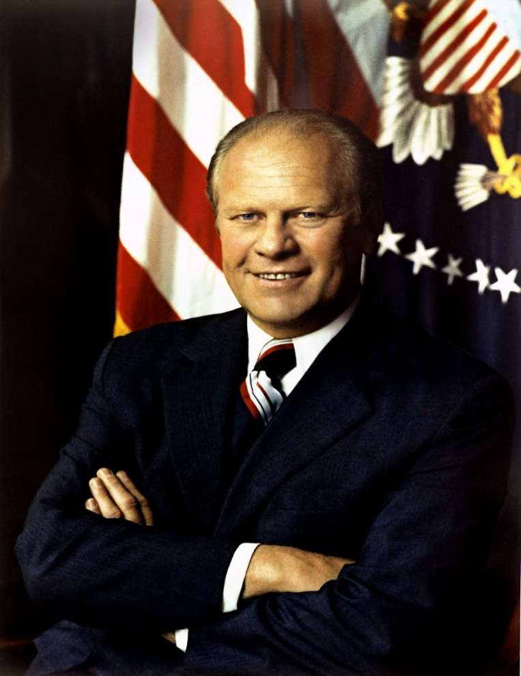
Vice Presidential Vacancy
There has been eighteen total vice presidential vacancies
Nine times by succession to President
Twice by resignation
Seven times by death
Whenever there is a vacancy the President shall nominate the Vice-President, approved by majority of both houses
Rockefeller and Ford
Vice President Gerald Ford

Slide 15
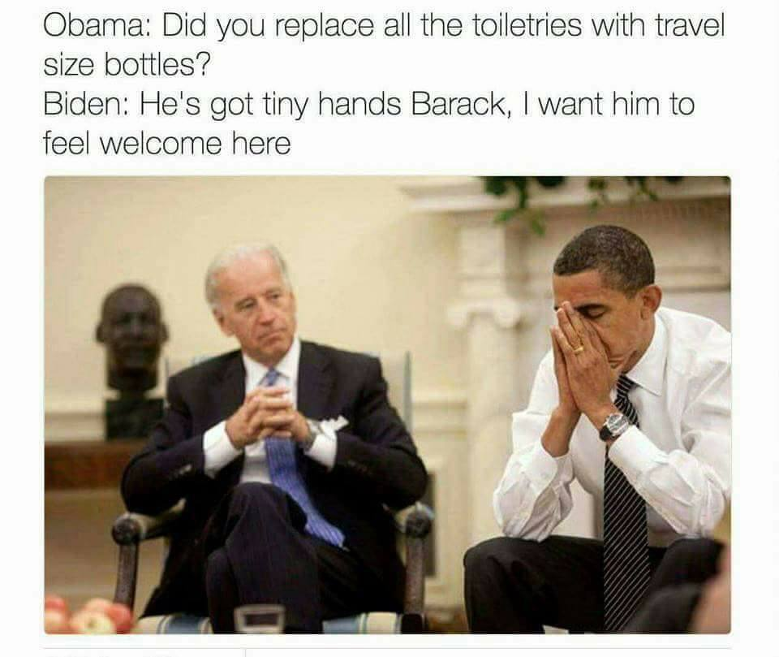

Slide 16
