Slide 1
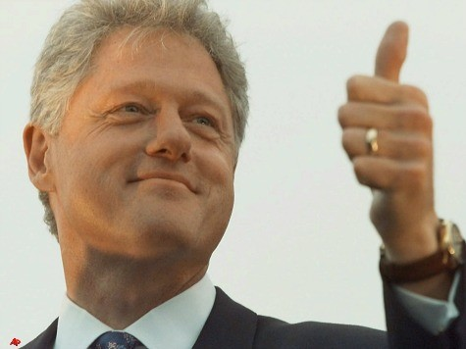
Section 1- The President’s Job Description

Slide 2
THE PRESIDENT’S Top Eight ROLES
The President must simultaneously assume many different roles while in office some examples include:
1.) Chief of State
Ceremonial head of government—the symbol of all people in the nation
In some nations, the chief of state reigns but does not rule (ex. Queens in England & Denmark)

Slide 3
THE PRESIDENT’S ROLES
2.) Chief Executive
Constitution give President “executive power”
Immensely broad in both domestic and foreign affairs
“The most powerful office in the world”
The President IS NOT all-powerful
Checks and balances regulate power

Slide 4
THE PRESIDENT’S ROLES
3.) Chief Administrator
Director of the Executive Branch
Administration employs more than 2.7 million civilians and spends $3 trillion per year
4.) Chief Diplomat
Main architect of American foreign policy

Slide 5
THE PRESIDENT’S ROLES
5.) Commander in Chief
1.4 million men and women in armed forces and nation’s entire military arsenal are subject to direct and immediate control
6.) Chief Legislator
Main architect of public policy
President sets the overall shape of Congressional agenda

Slide 6
THE PRESIDENT’S ROLES
President initiates, suggests, requests, insists, and demands that Congress enact much of the major legislation proposed
The first six roles come directly from the Constitution but they do not complete the list
7.) Chief of Party
Acknowledged leader of the political party that controls the executive branch

Slide 7
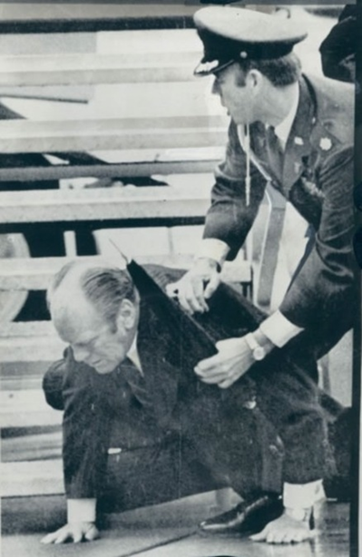
THE PRESIDENT’S ROLES
8.) Chief Citizen
President is expected to be the “representative of all the people”
Work for and represent the public interest
FDR said the office was “pre-eminently a place of moral leadership”
President must play these roles simultaneously

Slide 8
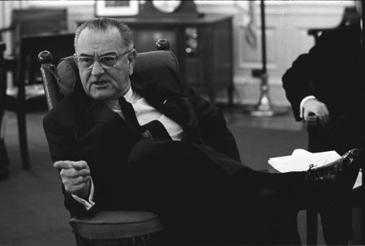
The Struggles of Playing Duel Roles
Two Illustrations
Presidents Lyndon Johnson and Richard Nixon
Each was a strong and relatively effective President during their early years
LBJ’s actions as commander in chief during the Vietnam War seriously damaged he credibility that he chose not to run for re-election in 1968

Slide 9
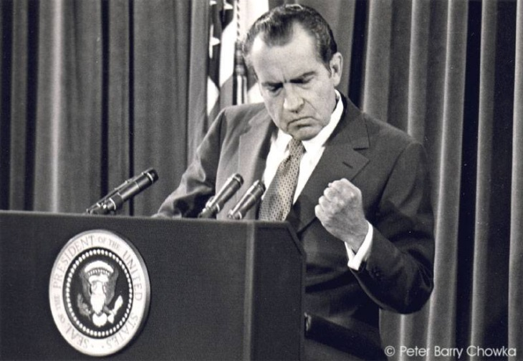
The Struggles of Playing Duel Roles
The Watergate Scandal proved to be Nixon’s downfall.
The way he filled the roles of party leader and chief citizen so destroyed Mr. Nixon’s presidency that he was forced to resign the office in disgrace in 1974 or face certain impeachment and removal

Slide 10
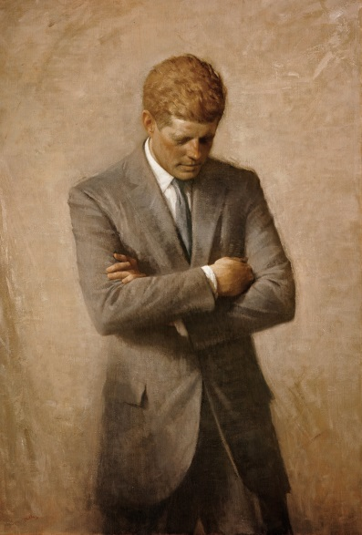
FORMAL QUALIFICATIONS
1.) A natural born Citizen…of the United States
A person born abroad to American citizen parents is legally an American citizen at birth
2.) Be at least 35 years old
JFK was the youngest person ever elected at 43
Theodore Roosevelt reached the office through succession at 42

Slide 11
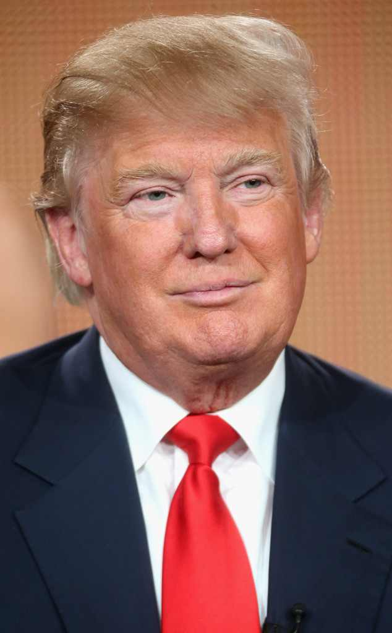
FORMAL QUALIFICATIONS
Six other people took the oath of office before age 50: James K. Polk, Franklin Pierce, Ulysses Grant, James Garfield, Grover Cleveland, Barack Obama
Donald Trump is the oldest person to be elected President at 70 years and 220 days old
Ronald Reagan took office at 69 and when he completed his 2nd term he was the oldest to have been President at 77 years old

Slide 12
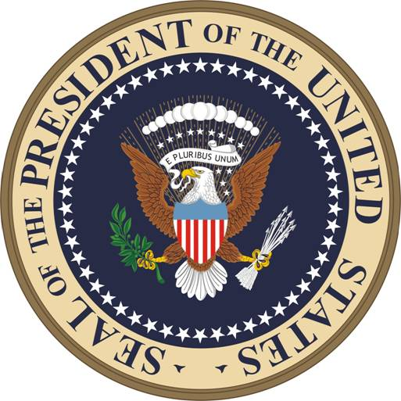
FORMAL QUALIFICATIONS
3.) “Have been fourteen years a resident within the United States”
This has been defined to mean 14 years or more not necessarily consecutive (Ex. Hoover(1928) and Eisenhower (1952) both spent time outside the USA)
More than 100 million people today meet the qualifications to be President

Slide 13
THE PRESIDENT’S TERM
Framers considered different lengths: 4 years with possible re-election; 6 or 7 years in 1 term only
Hamilton stated in the Federalist Papers #71 that four years was long enough to gain experience, demonstrate abilities, and establish stable choices
Until 1951 there was no limit to the number of terms

Slide 14
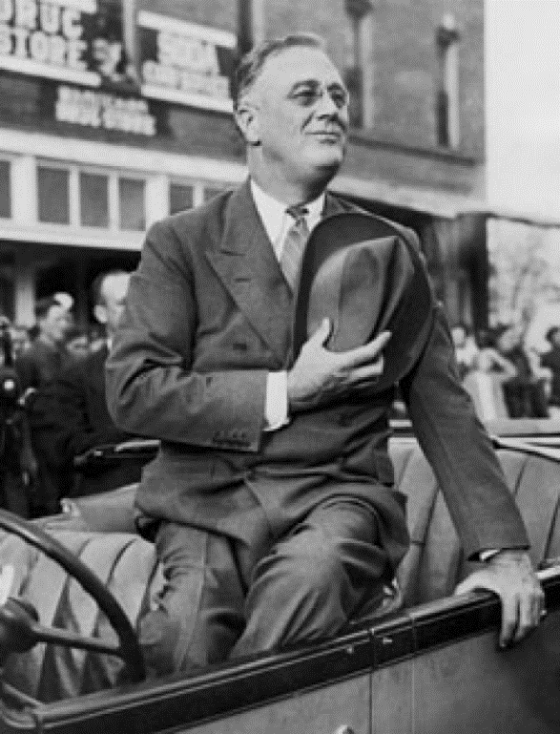
THE PRESIDENT’S TERM
Several Presidents refused more than 2 terms
FDR broke tradition by winning a third (1940) and a fourth (1944) term
22nd Amendment (1951) set a limit of 2 terms
A term is defined as 1 day past 2 years
Example: if a person assumed the office 1 day past the 2-year mark in the previous person’s term, the new person could complete that term and serve 2 more terms of their own (10-year max)

Slide 15
THE PRESIDENT’S TERM
Many people, including Truman, Eisenhower, and Reagan have called for repeal of the 22nd Amendment because they say it takes away the people’s ability to choose who is President
Several Presidents have called for a single 6-year term. This would free up the President from having to worry about getting re-elected

Slide 16
PAY AND BENEFITS
President’s salary determined by Congress
It can neither be increased nor decreased during his term (Article II, Section 1, Clause 7)
Salary:1789-$25,000; 2001-$400,000
$50,000 expense allowance was added to salary and subject to income tax
Constitution prohibits any other emolument (pay)

Slide 17
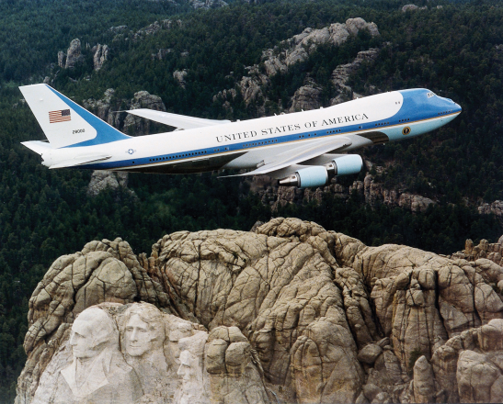
PAY AND BENEFITS
Non-pay benefits the president has access to:
The White House is a 132-room mansion
A sizable suite of offices and a large staff
A fleet of automobiles
Air Force 1, and other planes and helicopters
Camp David a resort hideaway in the Catoctin Mountains, MD
The finest medical, dental, and other health care
Generous travel and entertainment funds and much more

Slide 18
