Slide 1
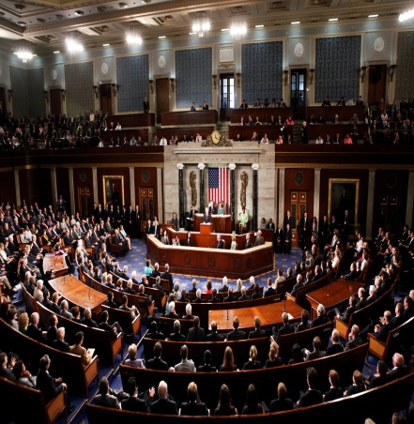
The House of Representatives and The Senate
Chapter 10-Section 2 and 3

Slide 2
Congressional Elections
The Constitution sets out that the States are responsible for running the national elections
Since 1872 Congress has required that national elections are held on the same day in all states with the exception of Alaska.
The Tuesday following the first Monday in the November of each even-numbered year.
Congress also calls that representatives be chosen by written or printed ballots.
Voting machines were approved in 1899.
Off-Year Elections-Congressional elections that occur in the non-presidential years, that is, between presidential elections known as Mid-term elections.
More often than not, the party in power that holds the presidency loses seats in the off-year elections.
Section 2

Slide 3
Congressional Districts
The 435 members of the House are chosen by the voters in 435 separate congressional districts.
7 states have only one representative.
There are 428 congressional districts in the other 43 States.
The Constitution makes no mention of Congressional districts, and until 1842 each state was allowed to decide how they would elect their own members to the House.
Section 2

Slide 4
Congressional Districts
Types of Congressional Districts-
I. Single-member District-
Voters in each district elect one of the State’s representatives from a field of candidates running for a seat in the House from that district.
II. At-Large Districts-
The state’s seats are filled by electing them as a whole, rather than from a particular district. Every voter could vote for a candidate for each one of the State’s seats in the House.
This proved to be unfair because a party with a very small plurality of voters statewide could win all of a state’s seats in the House.
Congress did away with this system with a 1842 law. Today all states have to use the single member districts to elect their House members. Only the 7 states with one member can use the at-large system.
Section 2

Slide 5
What is Gerrymandering?
Around the early 1800’s many States had began to draw Congressional districts in a way that would give an advantage to the political party that controls the state legislature.
The nickname for these odd looking districts was referred to as Gerrymandering named after Governor Elbridge Gerry’s redistricting of Massachusetts in 1812
Gerrymandering takes two main forms-
I. Packing-Which concentrates the opposition’s voters in one or a few districts leaving the others safe for the dominant party.
II. Cracking-Which spreads the opposition as thinly as possible among many districts limiting their ability to win anywhere.
Effects of Gerrymandering-
This produced districts that were different in size that failed to properly represent all of people living in them.
Section 2

Slide 6
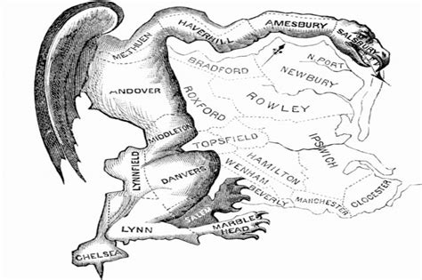

Slide 7
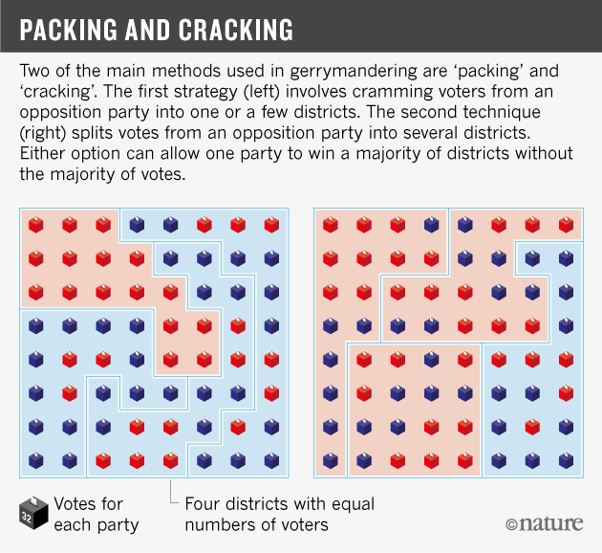

Slide 8
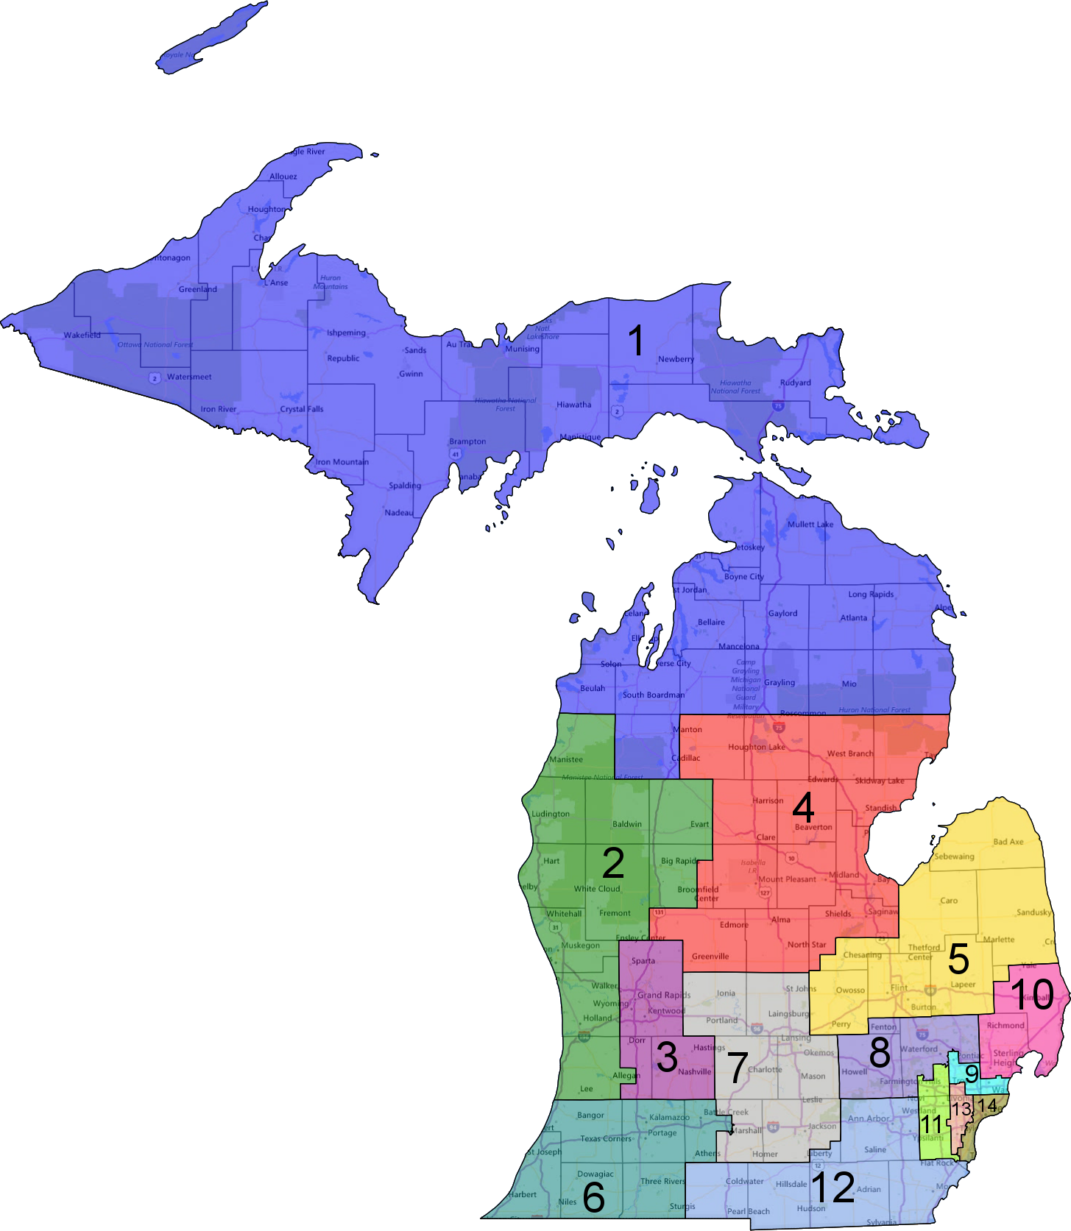
Michigan’s Congressional Districts

Slide 9
Limiting the Power of Gerrymandering
In 1964 the Supreme Court put limits on Gerrymandering
I. Wesberry v. Sanders (1964)-The population of each district had to be as close as possible to each other or it was a violation of the Constitutions call for “one man one vote”.
II. Gomillion v. Lightfoot (1996)-Could not gerrymander based on race or it would be a violation of the 15th Amendment
III. Bush v. Vera(1999)-Ruled that the drawing of districts could not be based on race
However, the Supreme Court more recently has held while race cannot be the controlling factor in drawing district lines, race can be one of the mix of factors that make those lines.
Section 2

Slide 10
Membership
HOUSE
435 members; each state’s delegation is determined by its population
SENATE
100 members (two per state)

Slide 11
What are the Qualifications?
HOUSE
Need to be at least 25 years old, U.S. citizen for 7 years, resident of the state represented
SENATE
Need to be at least 30 years old, U.S. citizen for 9 years, resident of the state represented

Slide 12
How Long Are the Terms?
HOUSE
2 years, entire House must be elected every two years
SENATE
6 years with staggered elections, 1/3 of the members elected every 2 years

Slide 13
How Are They Elected?
HOUSE
Directly chosen by the voters of a district
SENATE
Directly chosen by the voters of a state (17th amendment), originally, state legislature chose them

Slide 14
Who is the Presiding Officer?
HOUSE
Speaker of the House must be elected every two years
SENATE
Vice-President of the U.S. is assigned by the Constitution to be the “President of the Senate”

Slide 15
Do They Have Any Special Powers?
HOUSE
Brings impeachment charges
May choose the President if there is no majority in the electoral system
Must start all revenue bills
SENATE
Acts as jury in impeachment trials (2/3 vote needed)
May choose the Vice President if there is no majority in the electoral system
Must ratify treaties with foreign nations by 2/3 vote
Must approves Presidential appointments (majority needed)

