Slide 1
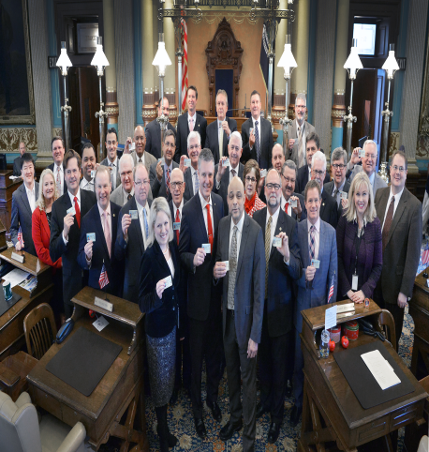
The Members of Congress
Chapter 10-Section 4

Slide 2
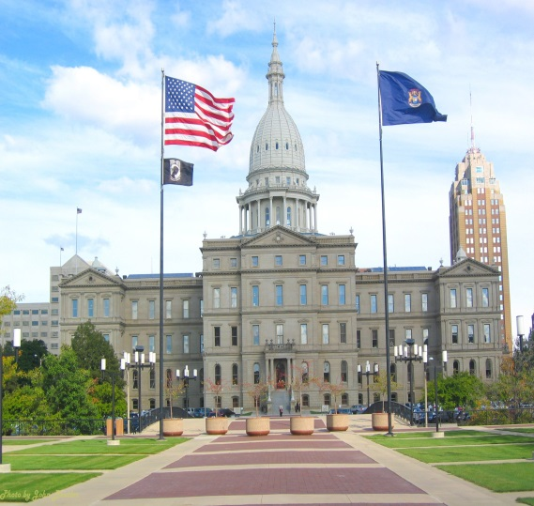
Key Terms
Delegate
Trustee
Partisan
Politico
Bills
Floor Consideration
Oversight Function
Franking Privilege

Slide 3
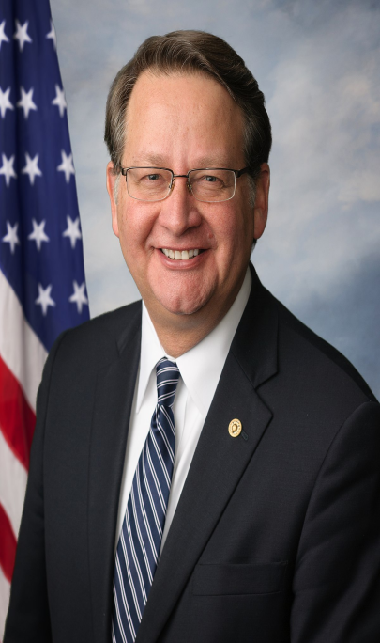
Roles & Functions
Members of Congress have five major roles in which they can fill:
    Legislators
    Representatives of their constituents
    Committee members
    Servants of their constituents
    Politicians
Michigan Senator-Gary Peters (D)

Slide 4
Overview of Members
Demographics of Congress-
  Most of the 535 members of Congress are married white men aged 50 or older who have college degrees and who identify themselves as Christians.
  Most tend to be upper-middle-class citizens
  Congress currently has 88 women, 42 African Americans, 24 Hispanics, eight Asian Americans, one Native American, and one Native Hawaiian.
  The typical Senator is serving a second term, while the average member of the House of Representative has served four terms.

Slide 5
Ways in Which Congress Represents their Constituents
There are four broad ways in which lawmakers choose to represent the people when they vote.
  Delegates-They believe they should vote however their constituents want them to, even if it means going against the delegate’s personal views or those of his or her party.
  Trustees-They are most often guided by their personal views on each specific issue, even if it may mean voting differently than their constituents might want
  Partisans-Place their loyalty to their political party first when deciding how to vote. They support the party platform and party leaders.
  Politicos-Try to balance the other three approaches—personal views, party loyalty, and the wishes of constituents—when deciding how to vote.
Any of these approaches can place a congressperson in a difficult situation because it’s hard to make everyone happy.

Slide 6
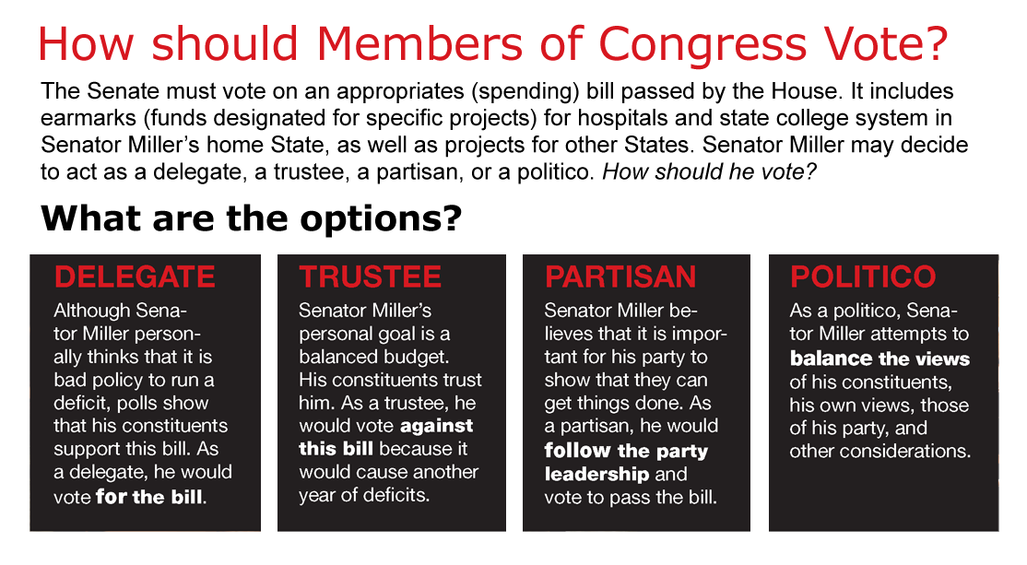
Ways in Which Congress Represents their Constituents

Slide 7
Committee Members
Members of Congress do much of their work in committees.
Committee members must decide which bills will die in committee and which ones will move ahead to be voted on.
Committee members also provide oversight of executive branch agencies, making sure that they carry out the public policies set
by law.

Slide 8
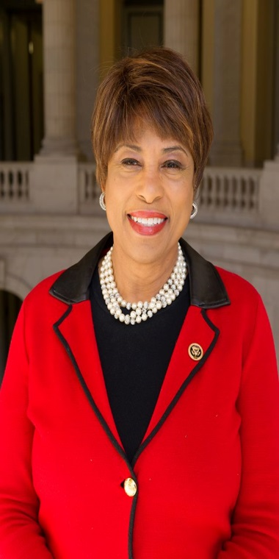
Serving the People
Members of Congress and their staffs help citizens of their districts and states deal with the federal bureaucracy.
  There are many kinds of request for aid from constituents. Some involve finding information or submitting it through proper channels, while many requests involve putting in a good word or recommendation on behalf of a constituent.
  Failing to fulfill such requests can cost members votes in the next election.
Michigan House of Representatives Member-Brenda Lawrence (D)

Slide 9
Fringe Benefits
“Fringe Benefits” for members of Congress often include:
  Access to inexpensive health care, fine dining, free parking, travel and generous retirement pensions.
  Members receive funds to hire staff and run their rent-free offices.
    They can mail letters and other materials without postage, print items for free, and produce radio or television tapes at low cost.

Slide 10
Privileges of Membership
Members of Congress cannot be arrested for civil crimes while taking part in congressional business.
Members of Congress cannot be charged with libel or slander for anything they say while conducting official business in Congress.
  This protects the freedom of discussion and debate in Congress.
  Members can still be punished for simply making false accusations against people verbally or in writing.

