Slide 1
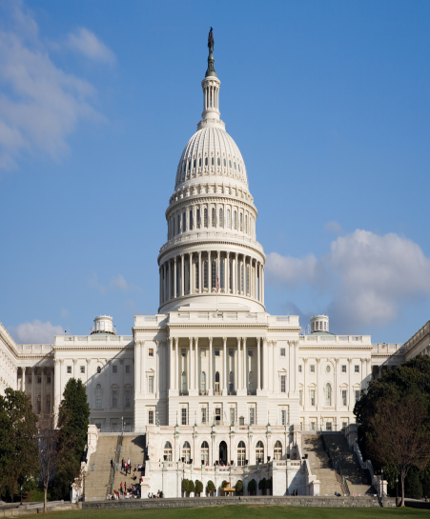
The National Legislature
Chapter 10-Section 1

Slide 2
The National Legislature
In theory we live in a democracy
What does this mean?
  In a democracy, the people rule
However, we more accurately live in a “Representative Democracy”
  This is because you do not personally make laws, conduct foreign policy, collect taxes or arrest criminals you elect people to do that for you
James Madison thought the legislature was the most important branch

Slide 3
A Bicameral Congress
Bicameral Legislature—Means we have two houses in Congress
  Senate and the House of Representatives
The founders of our Constitution created a bicameral legislature for three reasons:
1.) Historical Reasons:
  The British Parliament has consisted of two houses since the 1300’s
  Most colonial and state assemblies consisted of two houses
  Today forty-nine out of our fifty states have bicameral legislatures
    Only Nebraska has a unicameral legislature

Slide 4
A Bicameral Congress
2.) Practical Reasons:
Bicameralism is a reflection of federalism
Adopting a Bicameral legislature settled the conflict between the Virginia Plan and New Jersey Plan in 1787
  The Connecticut Plan created a Senate that was equal in representation and a House of Representatives based on proportional representation

Slide 5
A Bicameral Congress
3.) Theoretical Reasons:
The Framers favored a bicameral Congress in order that one house should act as a check on the other
  Ex. In the Senate even though California has 37 million residents it still has the same amount of representatives (two Senators) as Wyoming who has only 500,000 residents

Slide 6
Terms and Sessions
Terms of Congress
  Traditionally since 1789—Congress meets in two year terms
  Each term is numbered consecutively
  The first national Congress met on March 4, 1789 and ended two years later on March 4, 1791
  The 20th Amendment changed the start date for Congress which now starts on the 3rd day of January at 12:00 noon EST of every odd-numbered year
  115th Congress opened on January 3, 2017 at 12:00 EST
    116th Congress begin on January 3, 2019 at 12:00 EST

Slide 7
Terms and Sessions
Sessions
Session—A period of time during which, each year, Congress assembles and conducts business.
  Congress adjourns (ends) each session when finished
Session used to last four or five months but now it lasts all year with several short breaks scheduled
One house cannot adjourn for more than three days without the consent of the other.
President has the power to prorogue (end, discontinue) the session if the houses cannot agree on an ending date. (No President has used this power)

Slide 8
Terms and Sessions
Special Session
President may call a special session to deal with some emergency or special issue
  Each house can be called into special session separately.
Only twenty-six special sessions have been called in the history of our nation
  President Truman called the most recent one in 1948 to deal with anti-inflation and welfare after WWII.
The Senate has been called twenty-six times to consider treaties or presidential appointments
  The House has never been called separately

