Slide 1

Chapter 20-The New Frontier and the Great Society
Test Materials

Slide 2
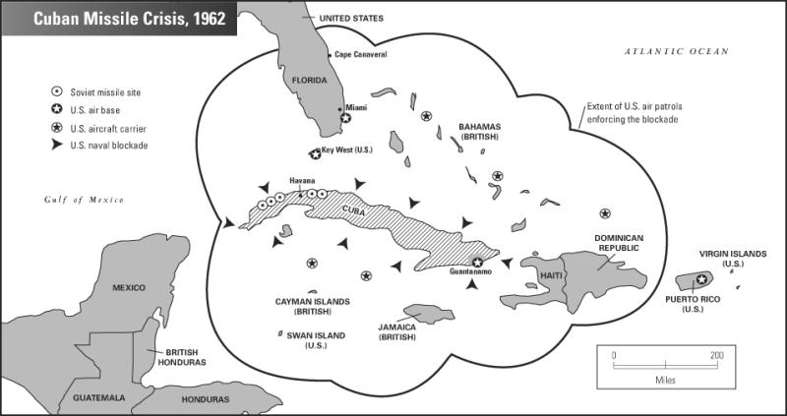

Slide 3
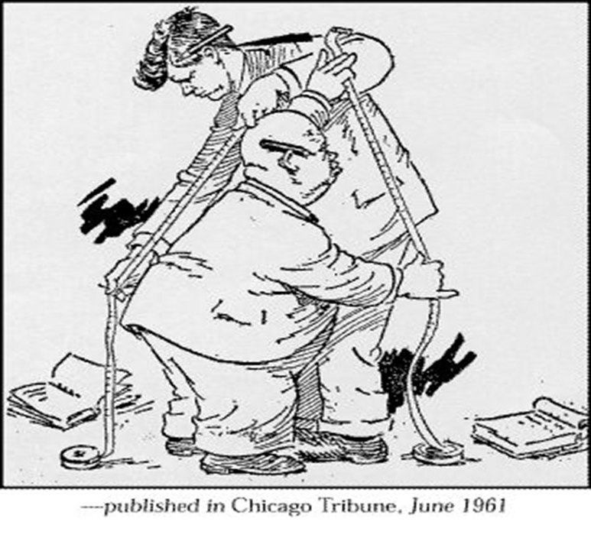

Slide 4
Primary Source #1

Slide 5
Primary Source #2

