Slide 1
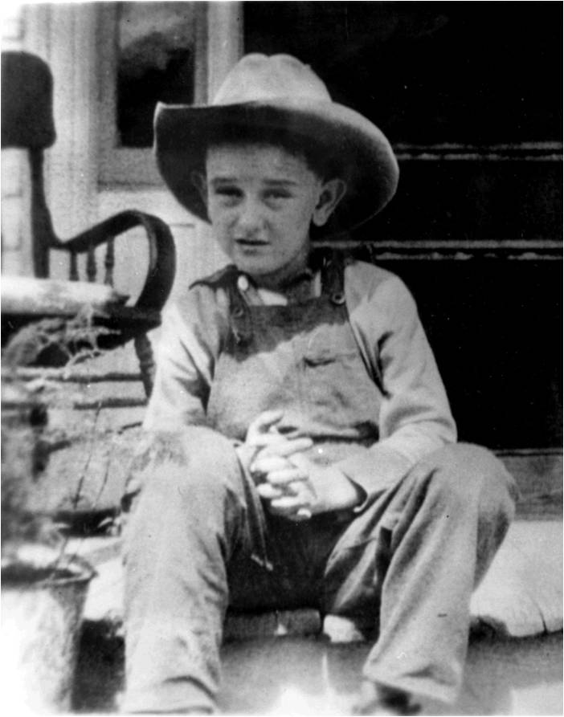
Chapter 20-Section 3- The Great Society

Slide 2
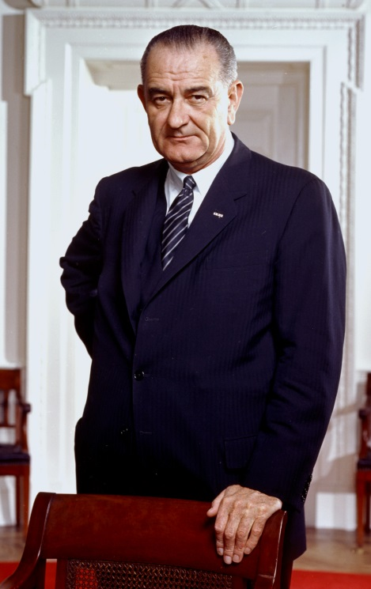
LBJ’s Path to Power
On November 22nd,1963 following the assignation of JFK his Vice President Lyndon Baines Johnson (LBJ) becomes the 36th President of the United States
LBJ had a very different background than Kennedy both in his personality and life experience
He was selected as a V.P. candidate to help even out ticket during the 1960 election
Kennedy Strong in North, LBJ strong in South
He was a long serving Senator from Texas, who supported social programs including the New Deal and was considered by many to be a master politician
Worked to pass help pass Civil Rights legislation like the Civil Rights Act of 1957 during his time in Congress

Slide 3
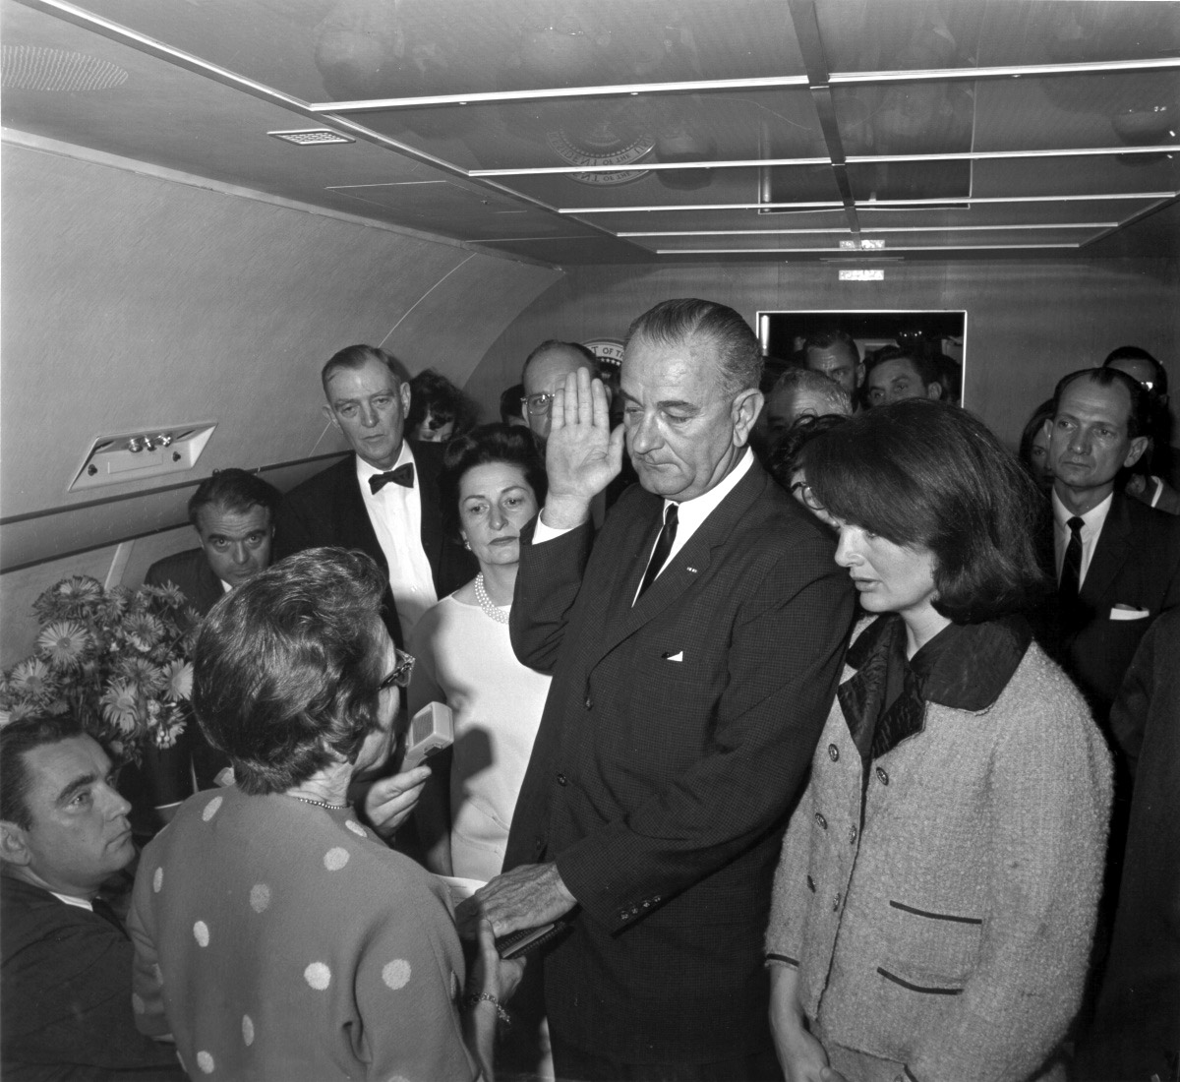

Slide 4
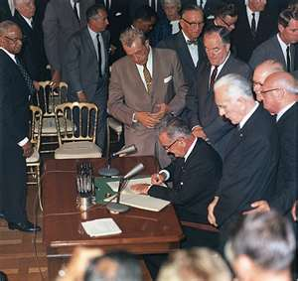
Johnson’s Domestic Agenda
Johnson looked to continue the plans and changes proposed by Kennedy through focusing on domestic issues
Civil Rights Act of 1964-
Discrimination due to race, religion, national origin, or sex is outlawed
Tax–cut bill (1964)-
Eventually decreased federal deficit from $6 billion (1964) to $4 billion (1966)
The War on Poverty-
Economic Opportunity Act
$1 billion allocated for youth programs, anti-poverty measures, small-business loans, job training and the head start program Volunteers to Service America (VISTA)

Slide 5
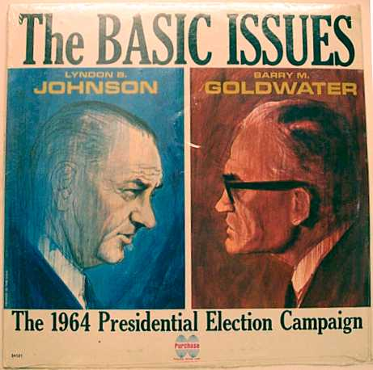
Johnson’s Domestic Agenda
The 1964 Election-
Democratic Candidate for President is Lyndon B. Johnson
Received public support for attempts to solve nation’s problems
He felt that more troops in Vietnam “would offer no solution at all to the real problem of Vietnam”
Republican Candidate for President is Barry Goldwater
An Arizona Senator who campaigned on the platform that:
There was way too much government intervention/spending going on in an attempt to help struggling Americans
The use of Social Security should be voluntary
He was also a huge proponent of States rights and suggested using nuclear power on Cuba and North Korea if their communist presence continues to grow

Slide 6
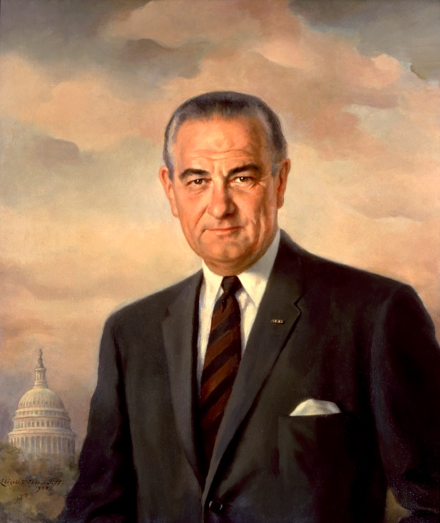
Johnson’s Domestic Agenda
LBJ wins the 1964 election by landslide by receiving 61% of the popular vote and 486 of a possible 538 electoral votes
The Great Society-
Phrase used to describe Johnson’s program to end poverty and racial injustice in the United States during his speech at the University of Michigan on May 22nd, 1964
It would create higher standard of living, equal opportunity, richer quality of life for all

Slide 7
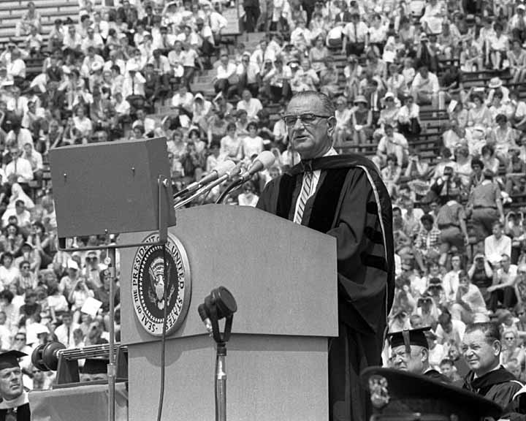
Johnson’s Domestic Agenda
Great Society Programs-
Education-
Elementary and Secondary Education Act of 1965 provides nearly $1 billion for textbooks and reading materials
Healthcare-
Medicare-
Government provides hospital insurance and low-cost medical insurance for 65 and older
Medicaid-
Health insurance provided for welfare recipients

Slide 8
Johnson’s Domestic Agenda
Great Society Programs-
Immigration-
Immigration Act of 1965 ended quotas based immigration policies established in 1924
Housing-
As more people began moving into the city there was an increased need to develop low cost housing
This resulted in the creation of the Department of Housing and Urban Development
Robert Weaver was the first appointment of an African American cabinet member in our nations history
Wholesome Meat Act of 1967-
Enacted in 1967 this act established a statute for federal meat inspection programs.
It requires that states have inspection programs "equal to" that of the federal government which are administered by the Food Safety and Inspection Service (FSIS) of the United States Department of Agriculture (USDA).

Slide 9
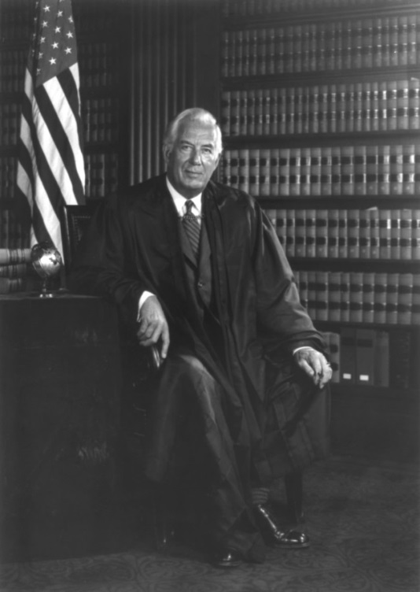
The Warren Commission
During the 1960’s the Supreme Court led by Chief Justice Earl Warren made many liberal reforms that aligned with ideas of the day which supported the rights of “The Individual”
Banned state-sanctioned prayer in public schools
Ruled that State required loyalty oaths were unconstitutional
Decisions in Congressional Reapportionment
Reapportionment-The way that states redraw election districts based on the changing population in them

Slide 10
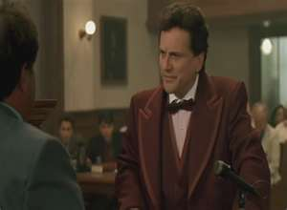
Reforms of Warren Court
The Warren court expanded the rights of people accused of crimes-
Mapp v. Ohio (1961)
Which ruled that illegally seized evidence could not be used in state courts
Gideon v. Wainwright (1963)
Ruled that the courts must provide representation for those who cannot afford it
Escobedo v. Illinois (1964)
Ruled that anyone accused of a crime has the right to have a lawyer present during questioning
Miranda v. Arizona (1966)
Suspects must be read rights before questioning

Slide 11
Miranda Rights
Miranda Rights-
You have the right to remain silent and refuse to answer questions.
Anything you say may be used against you in a court of law.
You have the right to consult an attorney before speaking to the police and to have an attorney present during questioning now or in the future.
If you cannot afford an attorney, one will be appointed for you before any questioning if you wish.
If you decide to answer questions now without an attorney present, you will still have the right to stop answering at any time until you talk to an attorney.
Waver of Rights-
Knowing and understanding your rights as I have explained them to you, are you willing to answer my questions without an attorney present?

Slide 12
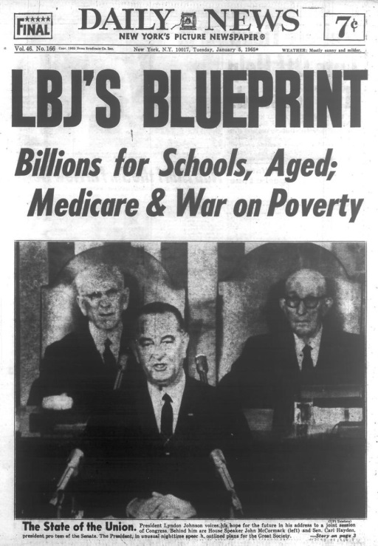
Impact of the Great Society
Debates and disagreements over benefits/detriments of the Great Society programs
No President since post-WWII had made such reaches of power of government
Results of Great Society-
Poverty levels decreased
Tax cuts spurred economy
Increased federal deficit
Issues overshadowing Great Society programs-
Cold War
Vietnam

