Slide 1
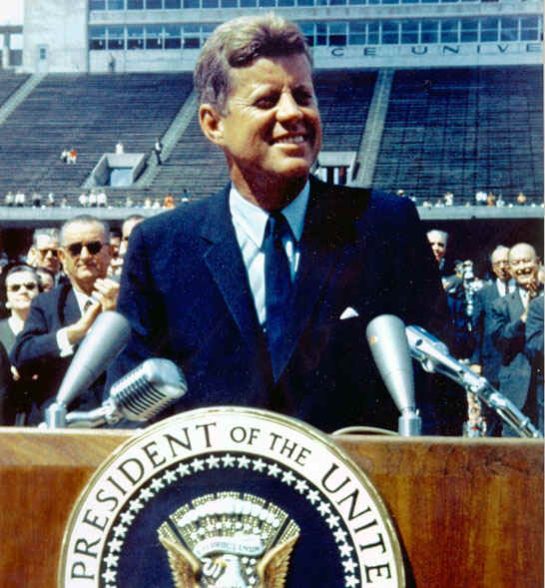
Chapter 20-Section 2- The New Frontier

Slide 2
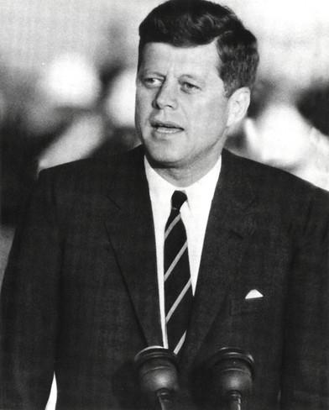
The Promise of Progress
Kennedy proposed many changes to Congress to address needs of Americans
  Medial care for the aged
  Rebuild run down urban areas
  Educational Aid
Conservative Republicans and Southern Democrats blocked passage of many proposals
  This was the same coalition that blocked Truman’s Fair Deal
  Kennedy lacked popular mandate (a clear indication that voters approved of his plans) due to his slim victory
The government eventually engaged in ‘deficit spending’ in attempts to stimulate the economy
  Increased defense spending
  Increased minimum wage to $1.25
  Extended unemployment benefits to Americans in need

Slide 3
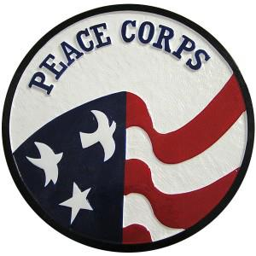
The Promise of Progress
Peace Corps-
  A program of volunteer assistance to developing nations of Asia, Africa, and Latin America
  Known as ‘Kennedy’s Kiddie Korps’
  Volunteers worked as:
    Agricultural advisers
    Teachers
    Health aides
Alliance for Progress-
  Offered economic and technical assistance to Latin American countries
  Goal: To deter these countries from picking up Fidel Castro’s revolutionary ideas

Slide 4
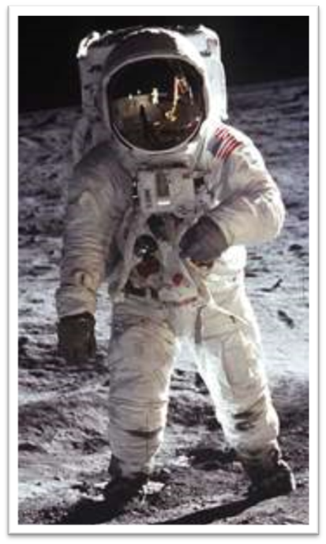
The Promise of Progress
April 12, 1961 – Soviet cosmonaut Yuri Gagarin becomes first human in space
  Kennedy vows to surpass the Soviets by sending an American to the moon
National Aeronautics and Space Administration (NASA)-
  Constructed facilities in Cape Canaveral, FL
  Mission Control Center in Houston, TX
  On July 20th, 1969 the United States achieved Kennedy’s dream of landing a man on the moon
Result of Space Program:
  Universities expanded science programs
  New industries and technologies to be used in business, industry, and producing consumer goods

Slide 5
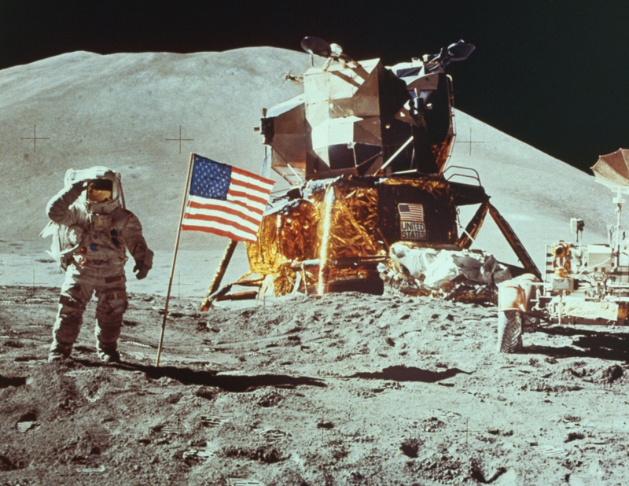

Slide 6
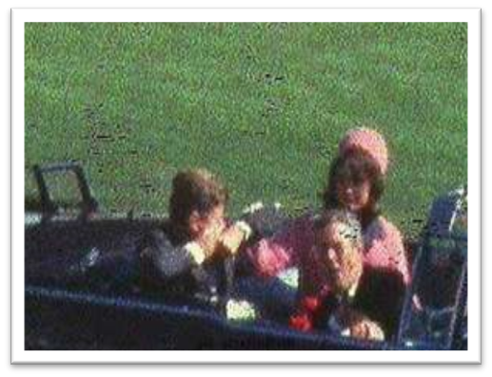
The Tragedy in Dallas
Kennedy traveled to Dallas, Texas on November 22, 1963 to mend problems in state’s Democratic party and begin his campaign for re-election
Kennedy traveled through Dallas in an open-air limousine with Texas Governor John Connally and his wife
Shortly after noon Kennedy was shot and killed as they turned into Dealey Plaza by Lee Harvey Oswald who shot the President from the sixth floor window of the Texas School Book Depository

Slide 7
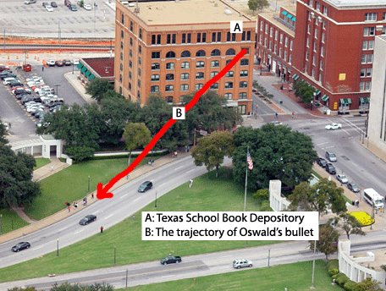

Slide 8
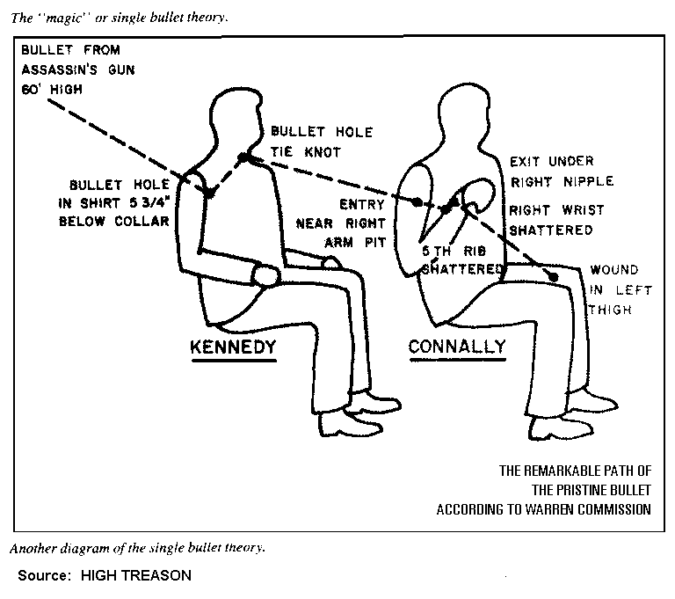

Slide 9
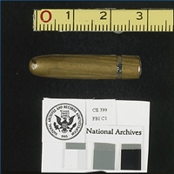
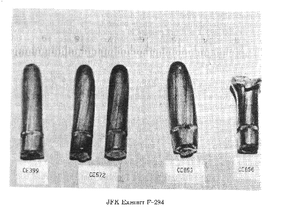
Magic Bullet Theory
What it looks like
What it should look like

Slide 10
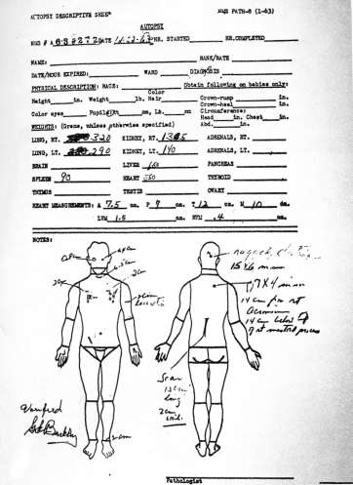
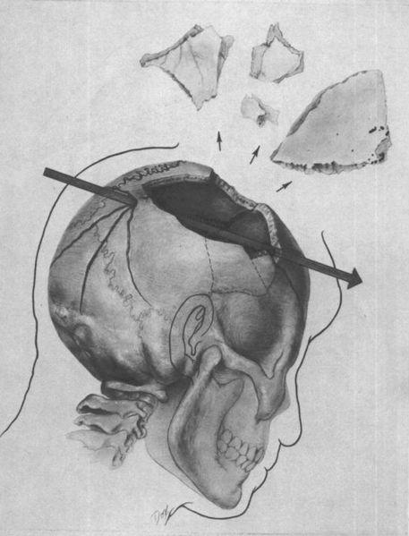
Kennedy’s Autopsy Report

Slide 11
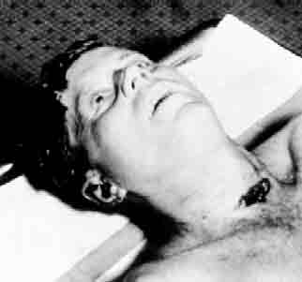
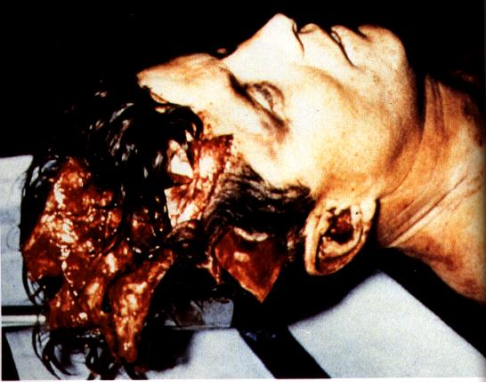
Kennedy’s Autopsy Photos

Slide 12
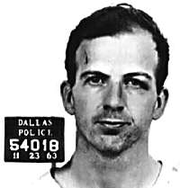
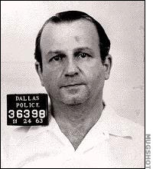
The Tragedy in Dallas
Dallas police charged Lee Harvey Oswald with the shooting
  Palm print was on rifle used to kill Kennedy
November 24, 1963, Lee Harvey Oswald was being transferred between jails as Americans watched on television when a local Nightclub owner names Jack Ruby jumped through security and killed Oswald
    Oswald never gets a chance to defend himself
    Ruby later died of a pulmonary embolism (blockage of an artery in the lungs) in 1967 leaving many questions unanswered
Lee Harvey Oswald
Jack Ruby

Slide 13
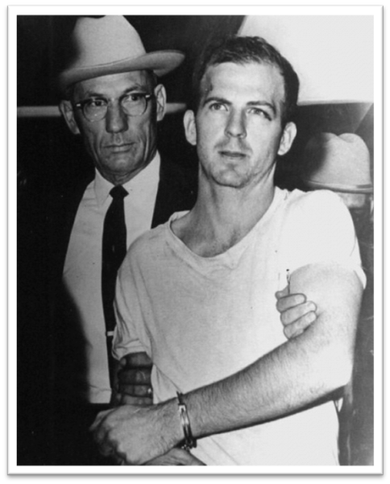
The Tragedy in Dallas
  The Warren Commission, was established by President Lyndon B. Johnson on November 29, 1963 to investigate the assassination of United States President John F. Kennedy
  Led by Supreme Court Justice Earl Warren they ultimately determined that Oswald acted as the lone shooter
    However, many still believe that there was a greater conspiracy surrounding JFK’s death believing that it could have been carried out by communists, revenge for the failed attempt at the Bay of Pigs or the work of the CIA

