Slide 1
The Power of Congress
Chapter 11

Slide 2
Taxes
Pair up with an elbow partner…you need pen and paper with both full names at the top. Title it “Taxes”
1.) In your words explain what you think the definition of a “tax” is, and what it is used for?
2.) Give as many examples of the different types of taxes as you can think of (you should know at least 3 types)
3.) Give as many examples as you can think of ways that tax money is spent (Remember we are talking about the Federal and State Government so choose things you think the they would pay for that private citizens don’t directly pay for)

Slide 3
Expressed Powers of Money and Commerce
Chapter 11-Section 1

Slide 4
Congressional Powers
Expressed Powers-Powers afforded to the government explicitly and in specific wording in the constitution
Implied Powers-Powers afforded to the government by reasonable deduction from the expressed powers
Inherent Powers-Powers afforded to the government because it created a national government
Commerce Power-The power of Congress to regulate interstate and foreign trade

Slide 5
Money
Congress has the power to tax
  Why?
    Under the Articles of Confederation the lack of the power to tax forced Congress to beg the states for money
      Unsurprisingly most states ignored this request from Congress
      This is one of the main reasons the Articles of Confederation were thrown out and the Constitution was created
The Purpose-
  To pay debts
  Provide for the common defense and general welfare…in other words, to meet public needs
  Protect domestic industry

Slide 6
Types of taxes
There are two general types of tax: Direct and Indirect
:Direct Tax: Paid directly to the government by the person on whom it is imposed
  Income
  FICA (payroll)
  Capital gains: (stocks and real estate)
  Estate (death): Exempt for first 5.4 million of value of estate
Indirect Tax: Paid to the government by someone else and then passed on to you as the consumer
  Fuel
  Alcohol
  Cigarettes
  Tariffs: A tax on foreign goods imported into country (cars, food, appliances, etc.)

Slide 7
Debt
Congress has the power to borrow money
How?
  Issues or creates debt in the form of: bonds, bills and notes
Public debt:
  All of the unpaid money borrowed by Congress
Deficit Financing: Also called Deficit Spending
  Government spends more than it earns each year
    To fix that they borrow money taking on more debt to make up the difference
  Results: Downturn in national economy, major tax cuts (less income to the government), the “War on Terrorism” and wars in Iraq and Afghanistan

Slide 8
Currency & bankruptcy
Congress has the power to coin money
Why?
  With independence, a stable system of currency (money) collapsed: each state issued its own currency and some people still used English and Spanish coins as well. Money without taxing power is worthless.
    Creating a stable uniform currency was beneficial to the nation
Legal Tender:
  Any kind of money that by law a creditor must accept as payment for debts
  First paper currency that was legal tender wasn’t printed until 1863!
Bankruptcy:
  When a Federal court determines that a person or company is insolvent which means that they are unable to pay their debts in full

Slide 9
commerce
Congress has the power to regulate interstate and foreign commerce (trade)
Why?
  The lack of the power to regulate commerce was a leading cause of the creation of the Constitution
Effect:
  This power is responsible for building a strong and United States
  Regulates commerce with foreign nations & between states
  Helps to prevent monopolies by corporations
  Has extended Federal authority into many areas of American life (the ban on discrimination based on race, color, religion, gender or national origin is an example)

Slide 10
The Other Expressed Powers
Chapter 11-Section 2

Slide 11
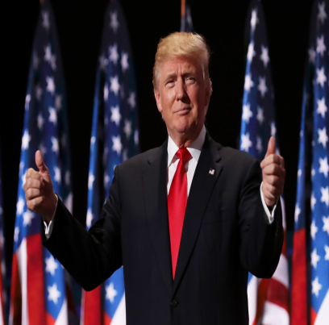
Foreign Relations
Foreign Relations Powers-
  Congress has the power to deal with foreign states and shares these powers with the President.
    The Constitution gives the President primary responsibility over the conduct of America foreign policy
Congress has two sources of authority when it comes to foreign affairs-
    1.) From expressed powers they have spending power and the power to regulate foreign commerce in addition to war powers
    2.) Sovereignty powers because the U.S. is a sovereign state with in the world community

Slide 12
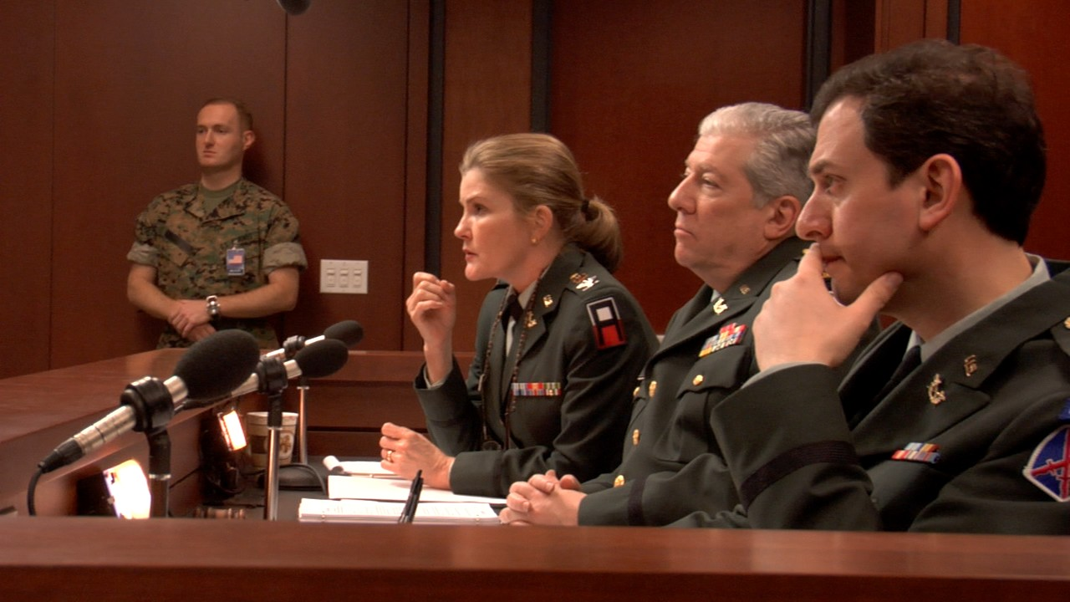
War Powers
War Powers-
  Six of the twenty-seven expressed powers deal with war which allows Congress to declare war (although the President is commander in chief), regulates the militia and armed services, creates military laws, military tribunals… etc.

Slide 13

Domestic Powers-Copyright
Copyrights-
  A copyright is the exclusive right of an author to reproduce, publish, and sell his or her creative work
  Copyrights must be registered in the Copyright Office of the Library of Congress
    They are good for 70 years beyond the life of the author

Slide 14
Domestic Powers-Patents
Patents-
  A patent grants an inventor the sole right to manufacture, use, or sell any new and useful art, machine, manufacture, or composition of matter, or any new and useful improvement on previous inventions
    They’re good for twenty years unless extended by Congress
    The Patent and Trademark Office of the Department of Commerce administers or transfers patent
    Private individuals, not the government, must enforce their rights

Slide 15
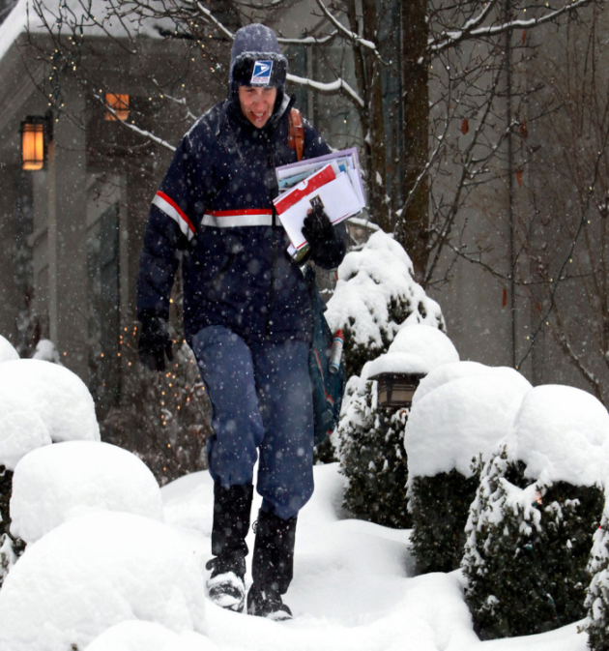
Domestic Powers-The Postal Powers
Postal Powers-
  Established in Article I, Section 8, Clause 7 Congress has the power to establish post offices and post roads.
      Postal roads include rail lines, roads, airways and water routes

Slide 16
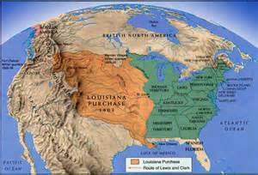
Domestic Powers-Territorial Powers
Territorial Powers-
  Congress has the power to acquire, manage, and dispose of land
  The government may acquire property through purchase, donation, or eminent domain
  Generally federal laws, rather than state laws, are enforced on federal properties, even if those properties lie within the boundaries of states

Slide 17
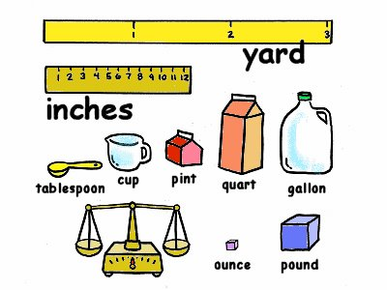
Domestic Powers-Weights and Measures
Weights and Measures-
  Congress guarantees uniform, accurate gauges of time, distance, area, weight, volume, etc.
    In 1838 Congress legalized the English system of pound, mile, etc.
    In 1866 Congress legalized the metric system of gram, meter, etc.
  Congress created the National Bureau of Standards in the Commerce Department, now known as the National Institute of Standards and Technology, in 1901

Slide 18
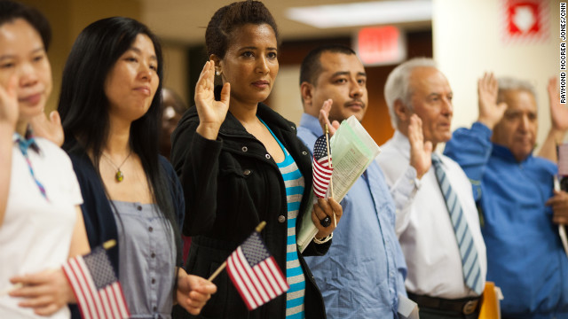
Domestic Powers-Naturalization
Naturalization-
  Naturalization is the legal process by which citizens of one country become citizens of another
    Article I, Section 8, Clause 4 makes this an exclusive power of the national government

Slide 19
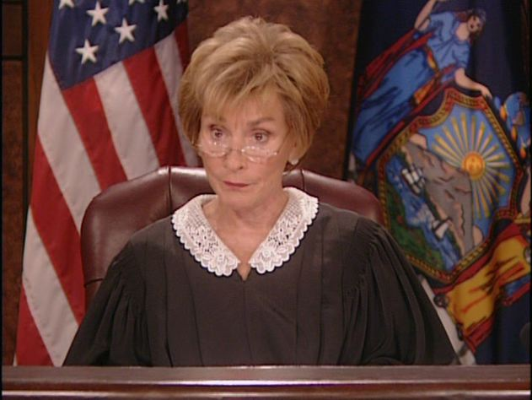
Domestic Powers-Judicial Powers
Judicial Powers-
  Congress has the power to create inferior courts beneath the Supreme Court and structure the federal judiciary
    This included establishing the number of Supreme Court justices who will serve

Slide 20
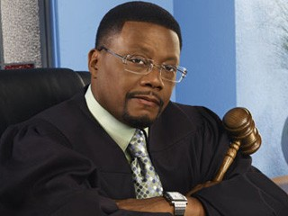
Domestic Powers-Judicial Powers
Judicial Powers (Continued)-
  Congress has the power to define federal crimes and set punishments for those crimes
    The Constitution mentions four federal crimes
      Counterfeiting, Crimes committed on the high seas (international waters), Offenses against international law or Treason
    Congress has since defined more than 100 additional federal crimes (bank robbing, kidnapping, etc.)

Slide 21
The Implied Powers
Chapter 11- Section 3

Slide 22
Key Terms
Necessary and Proper Clause
Strict Constructionists
Liberal Constructionists
Consensus
Appropriate

Slide 23
The Necessary and Proper Clause
It is the final clause in the lengthy Section 8 of Article I in the Constitution, give to Congress its expressed powers.
Known as the “Elastic Clause”
To make all Laws which shall be necessary and proper for carrying into Execution the forgoing Powers and all other Powers vested by this Constitution in the Government of the United States, or in any Department or Officer thereof.
  Clause 18 of the Constitution

Slide 24
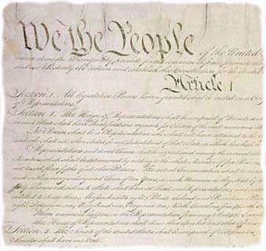
Necessary and Proper Clause
Much of the adaptability and vitality come from this
Allows Congress to choose the means “for carrying into execution”
  Powers given it by the Constitution
Along with supporting decisions from Supreme Court

Slide 25
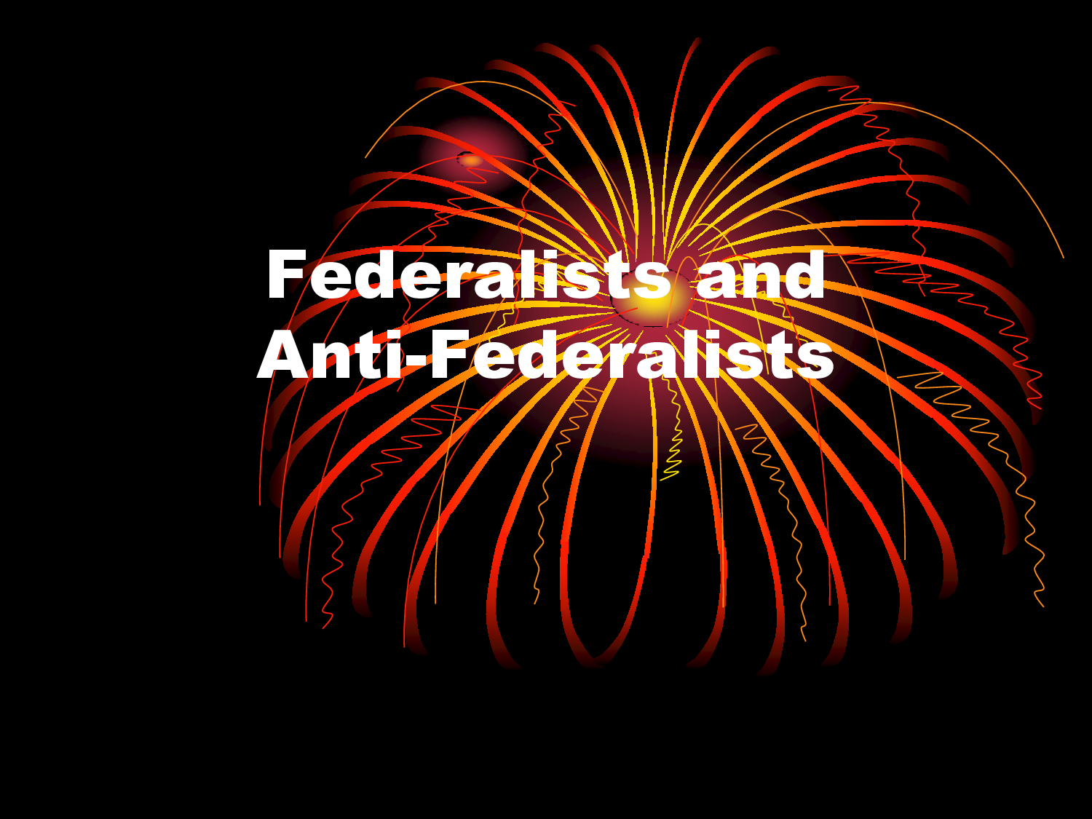
Strict Versus Liberal Construction
“Elastic Clause” subject to one of the most important disputes
Federalists and Anti-Federalists clashed over the meaning
Centered on the Powers of Congress

Slide 26
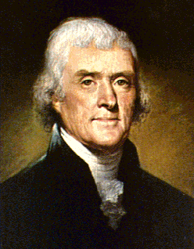
Strict Constructionists
Strict Constructionists led by Thomas Jefferson thought Congress could only exercise
  1. Its expressed powers
  2. Only those implied powers absolutely necessary to carry out its expressed powers
State should keep as much power as possible

Slide 27
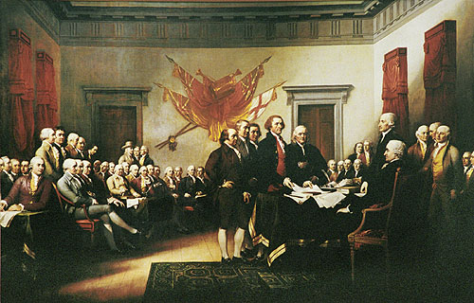
Strict Constructionists
They did want to protect interstate trade
Need for strong defense
Feared consequences of a strong government
Argued only states not the far off Government could protect-and preserve those differing interests

Slide 28
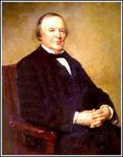
Liberal Constructionists
Implied power upheld by McCulloch v. Maryland in 1819
Factors in Growth:
  Wars
  Economic crisis's
  National Emergencies
  Advances in communication and transportation

Slide 29
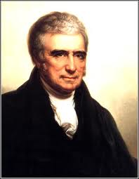
Liberal Constructionists
Demands of the people for more services
People like a broader Constitution not a narrow one
Consensus-A general agreement

Slide 30
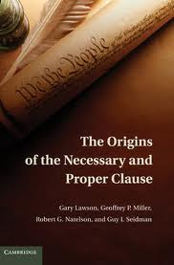
The Doctrine in Practice
Interpretation of the Necessary and proper Clause have let the government change with the times
Implied powers has made it possible for government to deal with many problems

Slide 31
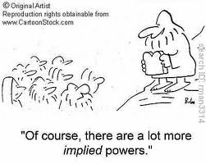
Basis of Implied powers
Every exercise of implied powers must be based on expressed powers
Basis for exercise of implied powers:
  1. The commerce power
  2. Its power to tax and spend
  3. The war powers

Slide 32

The Commerce Clause
Power to regulate foreign and interstate trade
Commerce includes-buying and selling of goods
As well as transportation of people and commodities

Slide 33
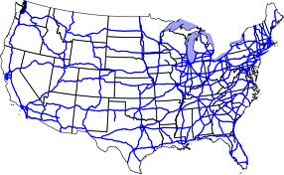
Commerce Clause
Under the Commerce Clause Congress Can:
  Regulate manufacturing
  Wages and hours
  Labor and Management relations
  Food and drugs
  Air travel
  Building interstate highways
  Consumer and environmental protection

Slide 34
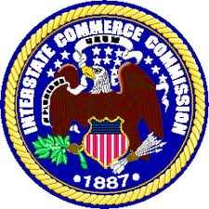
Limits on Commerce Power
Congress places four explicit limitations
Congress cannot pass a law solely on the grounds that a measure will somehow promote “the General Welfare of the United States”

Slide 35
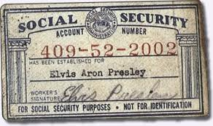
Limits on Commerce Power
It can levy taxes and provide spending money the General welfare
Appropriates- assigns a particular use
Tens of billions support education, unemployment, Social Security, Medicare

Slide 36
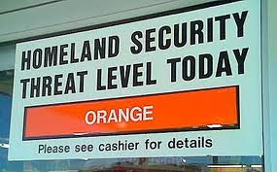
War Powers
National Government is responsible for protection
Congress can do what ever is necessary and proper when waging war
Congress has the power to order a draft

Slide 37
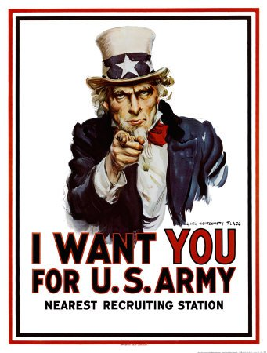
War Powers
War Powers
Article 1 section 8 gives expressed power to raise and support armies and to provide and maintain a navy
Supreme Court upheld the draft in cases challenging selective service in 1917

Slide 38
Section 4- The Non-legislative Powers
Chapter 11-Section 4

Slide 39
Constitutional Amendments and Electoral Duties
Constitutional Amendments
  Article V gives Congress the power to propose amendments by a two-thirds vote in each house.
Electoral Duties
  In certain circumstances, the Constitution gives Congress special electoral duties.
  If no candidate for President receives a majority in the electoral college, the House decides the election.
  If no candidate for Vice President receives a majority in the electoral college, the Senate decides the election.
  Also, if the vice presidency is vacated, the President selects a successor, who faces congressional approval by a majority vote in both houses.

Slide 40
Impeachment Power
The Constitution grants Congress the power of removing the President, Vice President, or other civil officers from their office through impeachment.
The House has the sole power to impeach, or bring charges against the individual.
There is then a trial in the Senate.
  A two-thirds vote of the senators present is needed for conviction.
The penalty for conviction is removal from office.

Slide 41
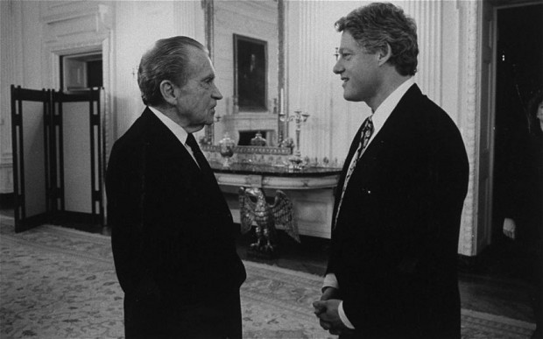
Impeachment Power
Andrew Johnson (1867)
  Violated the Tenure of Office Act
    He felt it was unconstitutional
  Acquitted by one vote
Richard Nixon (1974)
  Watergate Scandal
  Resigned before impeachment
Bill Clinton (1998)
  Clinton lied under oath and obstructed justice
  He lied about a relationship with White House intern
  Acquitted on both charges

Slide 42
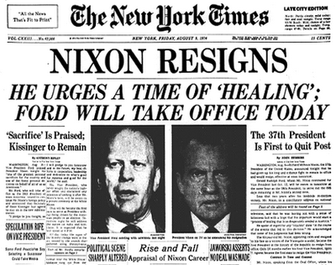

Slide 43
Executive Powers
Treaties
The President makes treaties “by and with the Advice and Consent of the Senate,... provided two thirds of the Senators present concur.”
Presently, the President often consults members of the Senate Foreign Relations Committee.
Appointments
All major appointments made by the President must be confirmed by the Senate by majority vote.
Only 12 of 600 Cabinet appointments to date have been declined.
“Senatorial courtesy” is the practice in which the Senate will turn down an appointment if it is opposed by a senator of the President’s party from the State involved.

Slide 44
Investigatory Power
Congress may choose to conduct investigations through its standing committees for several reasons:
To gather information useful to Congress in the making of some legislation
To oversee the operations of various executive branch agencies
To focus public attention on a particular subject
To expose the questionable activities of public officials or private persons
To promote the particular interests of some members of Congress.

Slide 45
Sources
Adapted from Mr. Rosenstock’s Presentation “Everything you wanted to know about the Expressed Powers of Money and Commerce”

