Slide 1
Chapters 3 & 4
Test Material
11th Grade Government

Slide 2
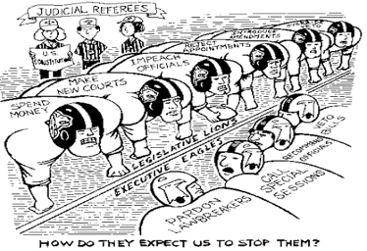

Slide 3
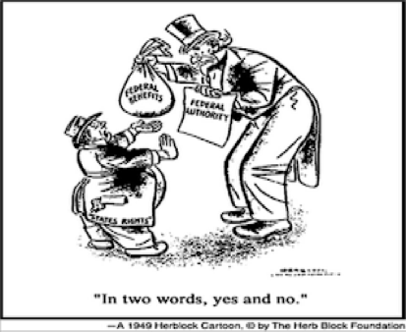

Slide 4
Document C
When all government, in little as in great things, shall be drawn to Washington as the Center of all power, it will render powerless the checks provided of one government on another and will become as venal [corruptible] and oppressive as the government from which we separated.
—Thomas Jefferson, 1821

Slide 5
Document D
It is emphatically the province and duty of the judicial department to say what the law is…If two laws conflict with each other, the courts must decide on the operation of each…This is of the very essence of judicial duty.
—John Marshall, quotes regarding Marbury vs. Madison

Slide 6
Document E
Article Six of the Constitution - Supreme Law of the Land
This Constitution and all laws and treaties of the United States Government created by it shall be the supreme (highest) law of the land. The judges of every state shall be bound by it (forced to obey it) regardless of the laws of any state to the contrary (that stand in conflict with it).

Slide 7

Homework Packet
Governmental Powers Activity
Chapter Four, Section One Guided Notes
Chapter Three Guided Notes (Sections 1, 2, and 3)
Create Your Own Amendment
Six Principles of the Constitution
Exit Ticket: Which amendment is the most important and why?

Slide 8
Study Guide
Question 4:
Be familiar with the Informal Amendment Process.

