Slide 1
Test Material
Chapter 17
10th Grade U.S. History

Slide 2
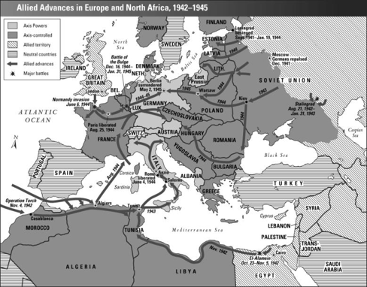

Slide 3
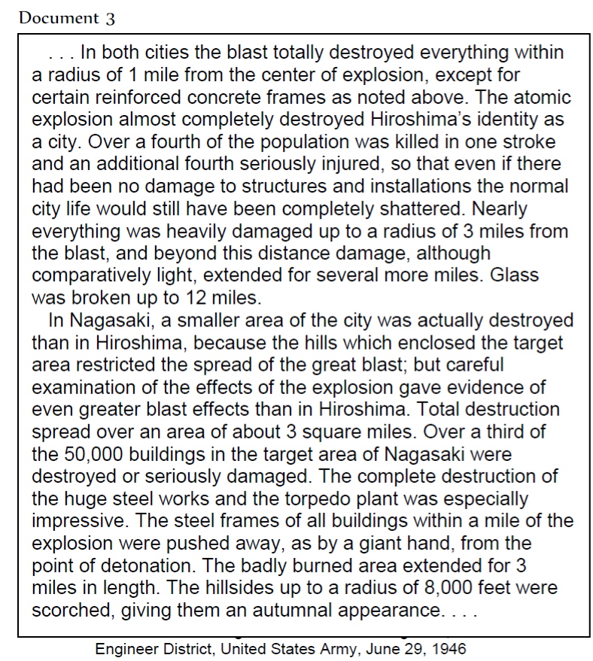

Slide 4
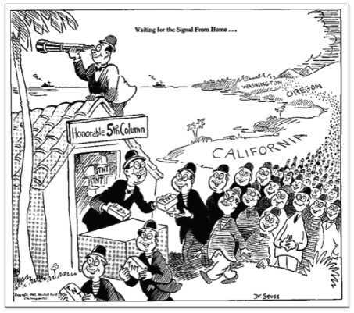

Slide 5

Homework Packet
The American Homefront Webquest
Video Reflection Questions
  Why I love a country that once betrayed me-George Takei
  Crash Course #36-The U.S. Homefront
Atomic Bomb Activity
Exit Tickets
  Was the U.S. justified in sending Japanese-Americans to interment camps?
  How do you think the war would have ended if the United States had not dropped the Atomic Bomb on Japan?
  How did government regulations impact civilians in the U.S?
Chapter Seventeen Guided Notes (Sections 2-3)
Thinking Map: The U.S. preparation for war

