Slide 1
Chapter 6: Section 2
Voter Qualifications
(Pg. 156-163)

Slide 2
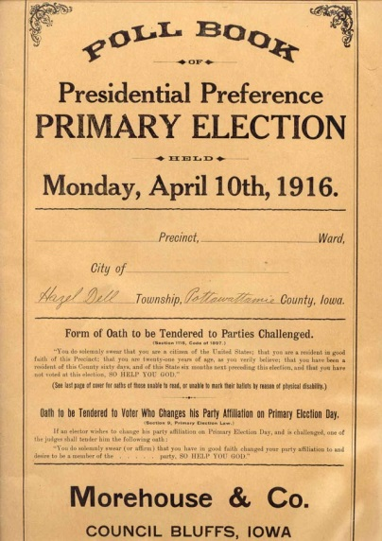
Vocabulary
Alien-Any person who is not a citizen of the country in which he or she lives.
Transients-A person who is staying or working in a place for only a short time.
Registration-The requirement in some democracies for citizens and residents to check in with some central registry specifically for the purpose of being allowed to vote in elections.
Purging-The process in which State and local officials regularly remove or “purge” citizens from voter rolls.
Poll Books-A database that allows elections officials to review and/or process voter information during an election but does not actually count votes.

Slide 3
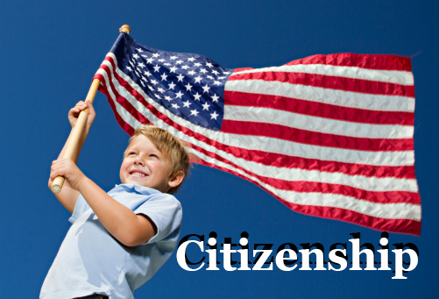
Universal Requirements
1. Citizenship
2. Residence
3. Age

Slide 4
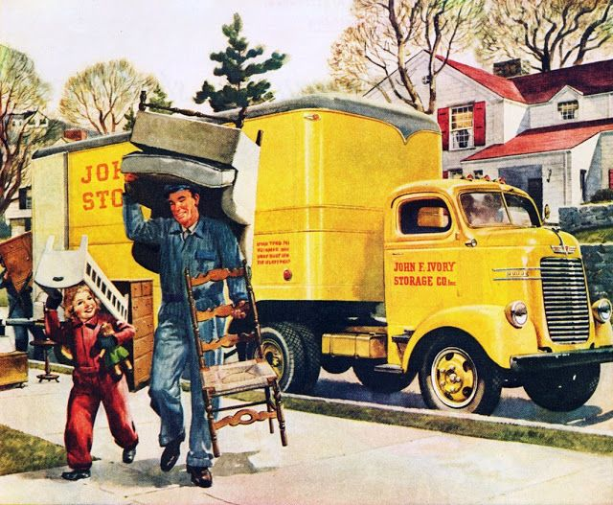
Citizenship
In most States, foreign-born residents who are not citizens cannot vote
Citizenship is determined by each State
States can also distinguish between native born and naturalized citizens, requiring that voters become citizens of that State for a minimum period of time before being allowed to vote
Ex: In most cases its 30 days

Slide 5
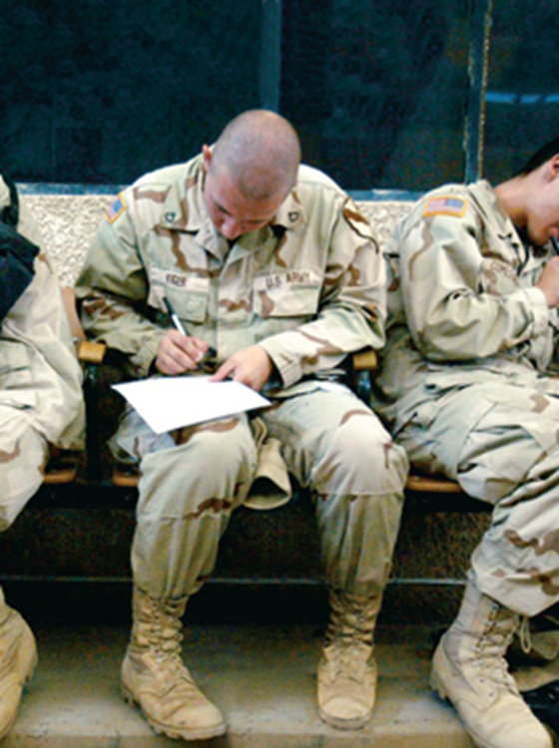
Residency
A person must be a legal resident of the State in which he or she votes
In the past, this meant a person had to be a State resident for at least a year to vote in that State
Dunn v. Blumstein (1972)
Transients cannot vote in the State where they are living temporarily
Registered voters living or working outside their State, such as soldiers, can cast absentee ballots

Slide 6
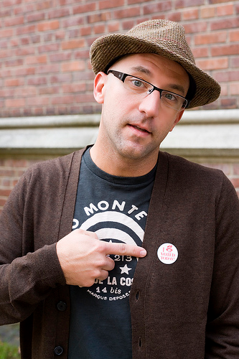
Age
Under the 26th Amendment, the minimum voting age cannot be older than 18
Before the passage of this amendment, the minimum age had been 21 in most States
Some States allow 17 year olds to vote in primary elections
Illinois
Historically, young voters have been less likely to vote than other age groups

Slide 7
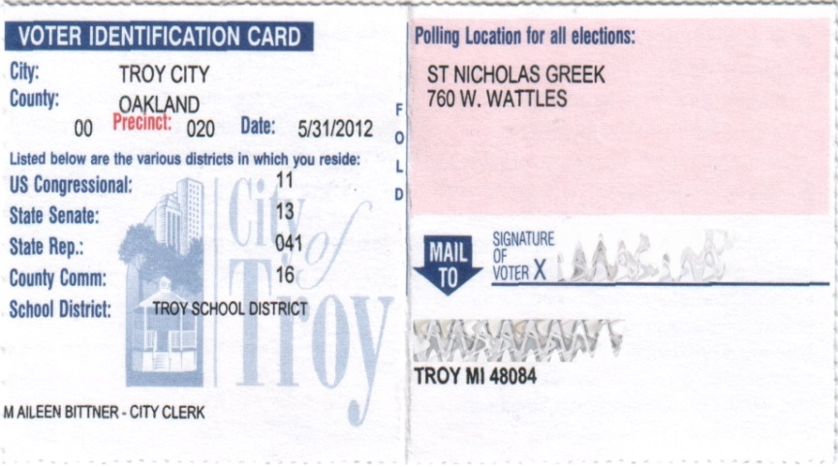
Voter Registration
In almost all States, one must be registered in order to vote
Usually this involves providing age, name, place of birth, address, length of residence
Registrar or county clerk typically keeps record of all eligible voters

Slide 8
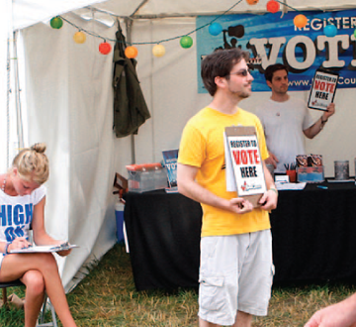
Voter Registration
Can take place at rallies, fairs, school campuses, and other public places
In other democracies, voters must be registered by law, in the United States it is voluntary

Slide 9
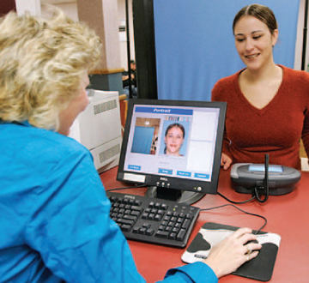
Voter Registration
The Motor Voter Act requires all States to:
Let eligible citizens register when they apply for or renew a driver’s license
Provide voter registration by mail
Make registration forms available at State offices

Slide 10
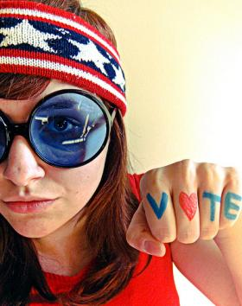
Voter Registration
To become a registered voter in Michigan you must:
Be a citizen of the United States
Be 18 years old by the next election
Be a resident of Michigan and at least a 30 day resident of your city or township by Election Day
You cannot be confined in a jail after or currently in the process of being convicted and sentenced for a crime

Slide 11
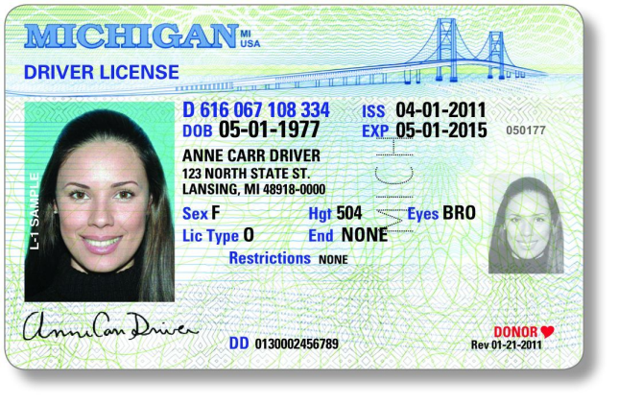
Voter ID Laws
In 2005, Indiana passed a law requiring voters to present photo ID to vote
In 2008, the Supreme Court ruled that the law was constitutional and did not create a barrier to voting
Why do you think that voter ID laws are controversial?
Does it create an impediment to voting?

Slide 12
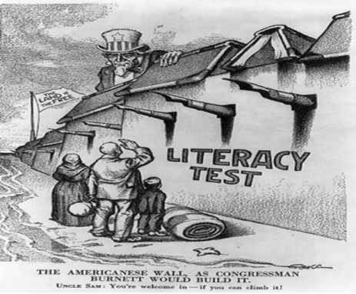
Tests and Taxes
Literacy tests for voting were once common, but are no longer used
These were often aimed at denying African Americans the ability to vote
Grandfather clauses kept many from voting despite the passage of the 15th Amendment
Some States, particularly in the South, also charged a poll tax to vote
Ex. In 1966 Mississippi charged a $2.00 poll tax which is the equivalent to 15.58 today (2018)
In 1966, the United States minimum wage was $1.25 which is equivalent to $9.69 in 2018 dollars.
24th Amendment eliminated all poll taxes

Slide 13
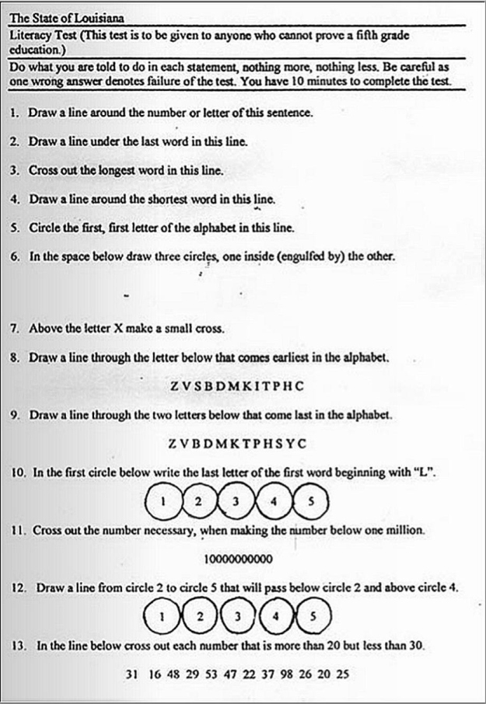

Slide 14
Persons Denied the Vote
Every State denies the vote to some people
Few States allow people found mentally incompetent to vote
Most States disqualify people convicted of serious crimes from voting (felons)
However, in many of these states, it is possible for felons to regain their voting rights
Only two states, Maine and Vermont, have no voting restrictions on felons
Virginia, Kentucky, Florida and Iowa that have the harshest restrictions.
Some States also ban those dishonorably discharged from the armed forces from voting

