Slide 1
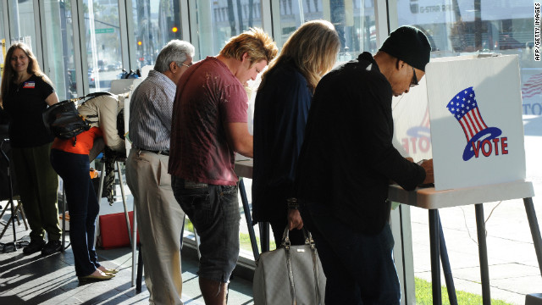
Chapter 6-Section 4 Voter Behavior

Slide 2
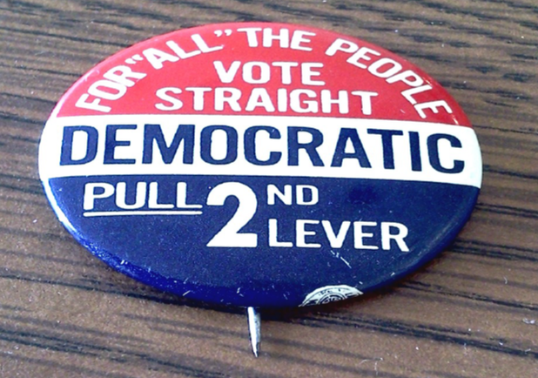
Key Terms
Off-year election
Ballot Fatigue
Political Efficacy
Political Socialization
Gender Gap
Party Identification
Straight-Ticket Voting
Split-Ticket Voting
Independent

Slide 3
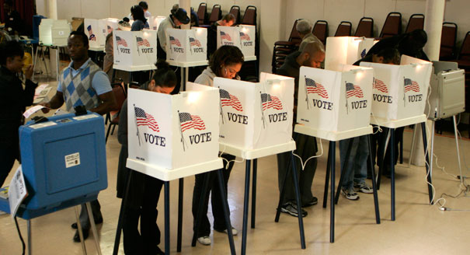
Introduction
What factors influence voter behavior?
Voters are influenced by sociological factors such as income, occupation, education, gender, age, religion, ethnic background, geography, and family.
Voters are also influenced by psychological factors such as political party identification, specific candidates, and key issues.

Slide 4
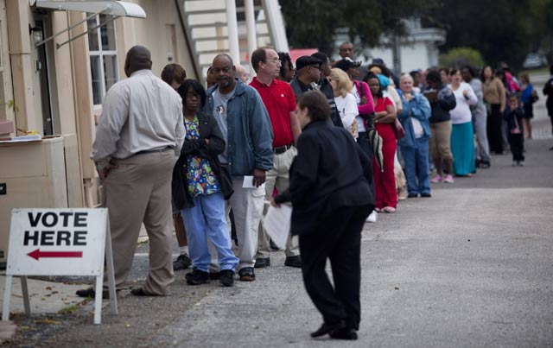
Voter Turnout
Voter turnout varies from election to election, but presidential elections always draw more voters than off-year elections

Slide 5
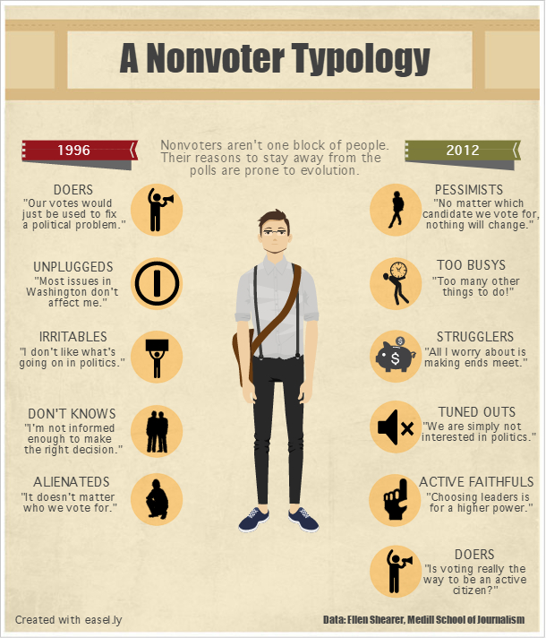
Non-voting
Millions of Americans do not vote.
Many people who do vote do not cast votes for every candidate on the ballot.
These people are called “nonvoting voters.”
Statewide offices and the presidency receive the most votes.
Voter turnout is highest in presidential election years.
More people vote in general state elections than in primaries or special elections.

Slide 6
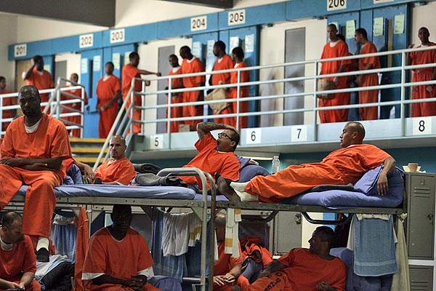
People Who Cannot Vote
Many people cannot legally vote.
This includes resident aliens, people with disabling mental conditions, and adults in prison.
Many others simply cannot vote.
Some 5-6 million people are too ill or disabled to vote.
Other people do not vote due to their religious beliefs or because they are traveling.

Slide 7
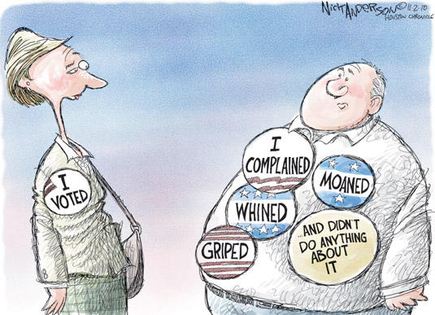
Non-voters
Why do people choose not to vote?
They may feel that their votes will not influence local or national government or they may not trust political institutions.
They may believe that conditions will remain fine even if they do not vote.
Western voters in presidential elections may feel that the election has been decided by eastern and central states before they can vote.

Slide 8
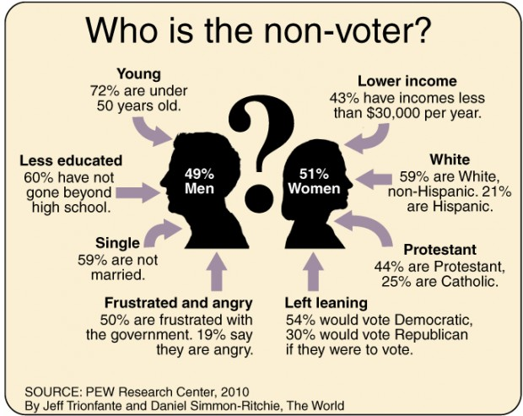

Slide 9
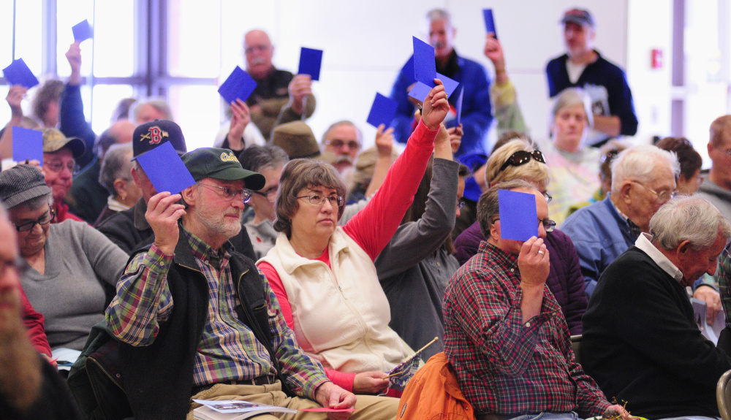
Voters vs. Nonvoters
Who are the people who are most likely to vote? (characteristics)
Have higher levels of income
Higher levels of education
Higher status
Older
Married
Long-time residents with strong party affiliation

Slide 10
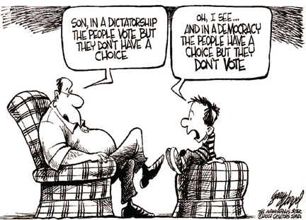

Slide 11
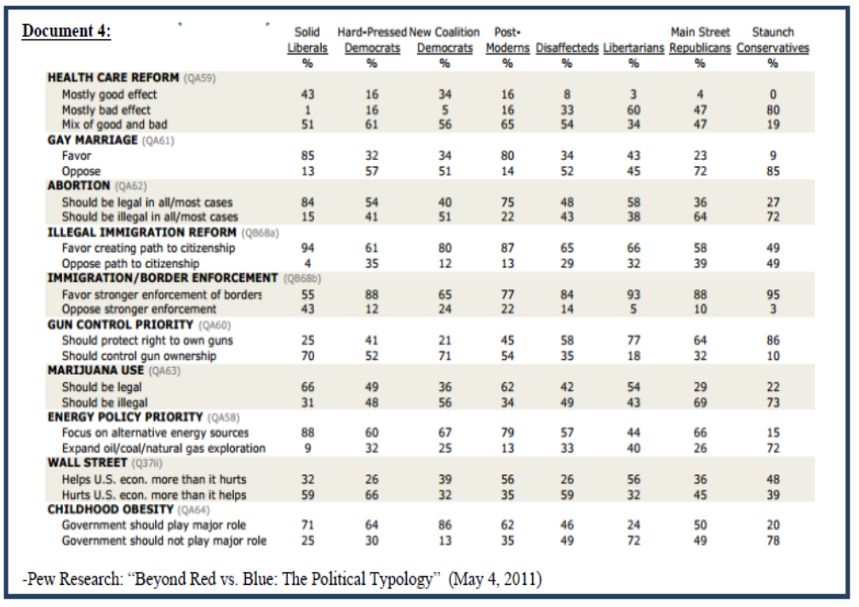
Studying Voter Behavior
Three sources that are used to gather voter behavior:
The results of specific elections
Scientific polls and surveys of public opinion
Studies of political socialization—how people gain political attitudes and opinions

Slide 12
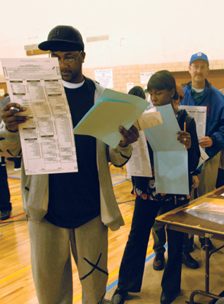
Studying Voter Behavior
Voters influenced by a combination of sociological and psychological factors
Sociology includes a voter’s personal qualities and their group affiliations.
Psychology includes how a voter sees politics.

Slide 13
Sociological Influences
Every voter has several qualities that combine to influence their votes.
A majority of the following groups tend to vote Republican:
Voters with higher incomes (such as professional and business people)
Voters with higher levels of education
Older voters (though this has varied in the past 30 years)
Protestants

Slide 14
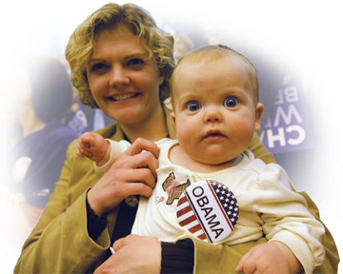
Sociological Influences
A majority of the following groups tend to vote for Democrats.
Women (by a 5-10 percent margin)
African Americans (by large margins since the 1930s)
Latinos (this varies among Latino groups)
Catholics

Slide 15
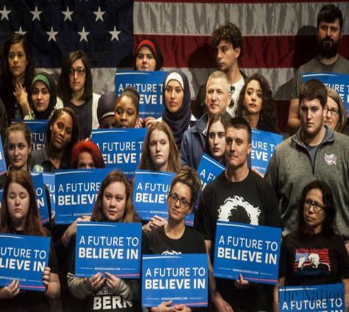
Sociological Influences
Geography affects voting:
Southerners once voted heavily Democratic, but now Republicans win many southern elections.
A majority of voters in big cities tend to vote for Democrats.
A majority of voters in the suburbs, small cities, and rural areas tend to vote Republican.
In general, family members tend to vote in similar ways.

Slide 16
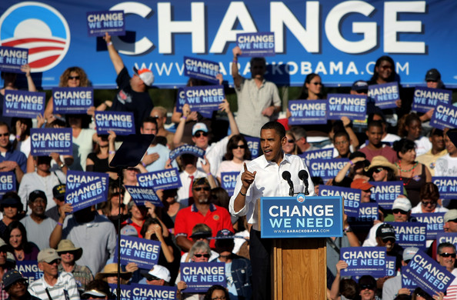
Party Affiliation
Party identification is the strongest predictor of how a person will vote.
Party loyalists are likely to vote for all of their party’s candidates in any election.
This tendency has decreased recently as more people identify themselves as independents with no party affiliation.
More people are also willing to vote for some candidates from the opposing party, “splitting” their ticket.

Slide 17
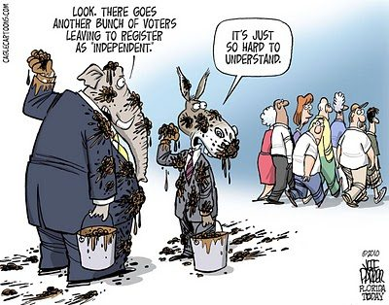
Independents
It is estimated that from one fourth to one third of all voters today are independents.
Independent voters once tended to be less concerned, less informed, and less active in politics than Democrats or Republicans.
In recent years, a rising number of independents are young people with above average levels of education, income, and job status.

Slide 18
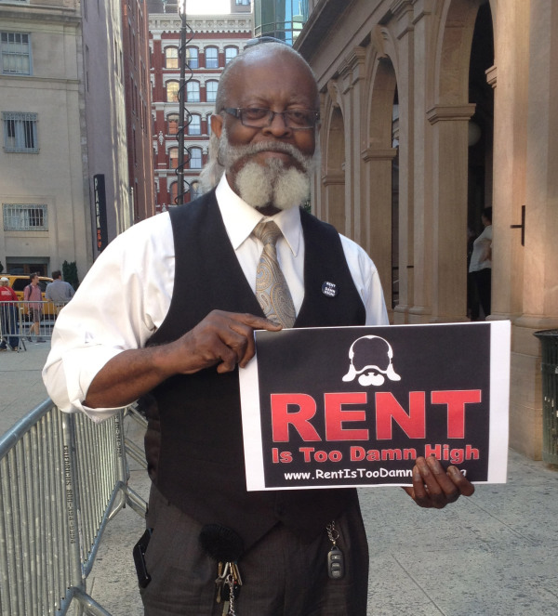
Candidates and Issues
Short-term factors such as particular candidates or key issues can swing voters in any specific election.
The image projected by a candidate—personality, style, character, appearance, and ability—influences voters.
Emotional, publicized issues such as civil rights, war, scandals, or the economy can also sway voters.

