Slide 1
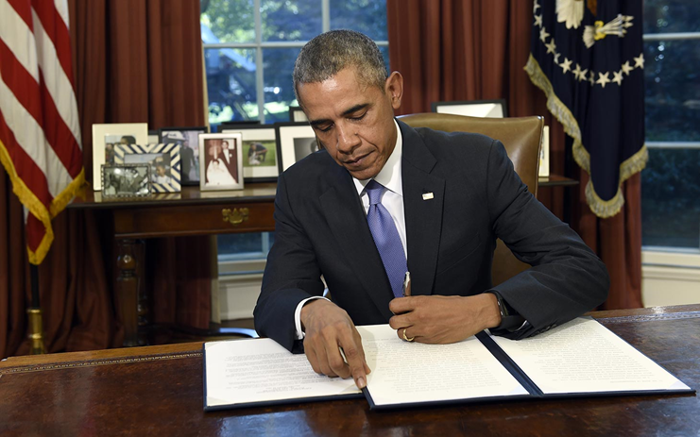
Chapter 3-Section 3-
Constitutional Change by Other Means

Slide 2
Informal Amendment Process
The Constitution is very skeletal in nature, it lays out a basic foundation, but many of the details are left open to change.
  Many changes have been made to the Constitution which do not involved any changes in its written words.
Informal Amendment-The process by which over time many changes have been made in the Constitution which have not involved any changes in its written word.
These changes are made in five basic ways:
  The Passage of Basic Legislation
  Executive Action taken by the President
  Key Supreme Court Decisions
  Political Party Practices
  Customs and Usages

Slide 3
I. Basic Legislation by Congress: Two Ways
1.) Passed laws that clarify several of the Constitution’s brief provisions
-Ex: Article III, Section I only talks about having a Supreme Court and “such inferior courts a the Congress may from time to time ordain and establish”…. Congress passed the Judiciary Act in 1789 and since then, has created all the federal courts….
2.) Congress has added to the Constitution by the way in which it has used many of its powers
-Ex: Constitution says that Congress has the power to “regulate foreign and interstate commerce.”…Congress has passed thousands of laws about this so that they expanded the words of the Constitution

Slide 4
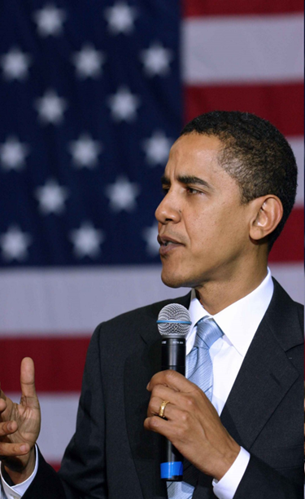
II. Executive Action
The way that presidents have used their powers has helped the Constitution to grow.
  Presidential actions such as the use of the military under the power of commander in chief.
Presidents add on to “executive power” based on what they think it means…. Thomas Jefferson took it to mean he can buy more land for the U.S. with the Louisiana Purchase in 1803, even though the Constitution doesn’t say he could
An executive agreement is a pact made by the President directly with the head of a foreign state and they do not need to be approved by Senate…
A treaty is a formal agreement between two or more sovereign states that needs to be approved by Senate

Slide 5
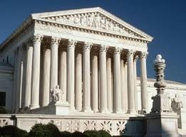
III. Court Decisions
The nation’s courts, most importantly the United States Supreme Court, interpret and apply the Constitution in many cases they hear.
  Basically it decides what can and cannot be done under the law.
    Ex. Marbury vs. Madison-
      Court decision claims the right of the Supreme Court to rule something unconstitutional, also affirmed the authority of federal power over States in the constitution

Slide 6
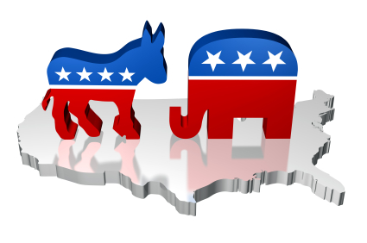
IV. Party Practices
There is no mention of political parties in the U.S. Constitution
Ex: There is no defined method for nominating a person for the presidency
  Since 1830s, parties have held national conventions to do that
  Changed the purpose of the electoral college
  Congress conducts its business on the basis of parties
  President makes appointments to office based on parties

Slide 7
V. Custom and Usage
Often an unwritten custom can be just as strong as written law.
  I. Cabinet-
    Custom says that the heads of the fifteen executive departments make up the “cabinet” (not the Constitution). The cabinet is a custom itself, not in the constitution
  II. Presidential Term Limits-
    The “no third-term rule” for presidents, was a custom that was followed for almost 150 years. Franklin Delano Roosevelt broke this custom in 1940.
    The passage of the 22nd Amendment (1951) officially set the Presidential term limit at two terms
  III. Presidential Succession-
    There have been eight Vice Presidents that have stepped into the role of President due to the previous President dying in office
    Not actually written in constitution until 1967 (25th Amendment)
      VP was to take the responsibilities, not the office itself
  IV. Senatorial Courtesy-
    Senate will not approve a presidential appointment opposed by a majority party Senator from the State in which the appointee would serve. (Federal judge, US Marshall, etc)

