Slide 1
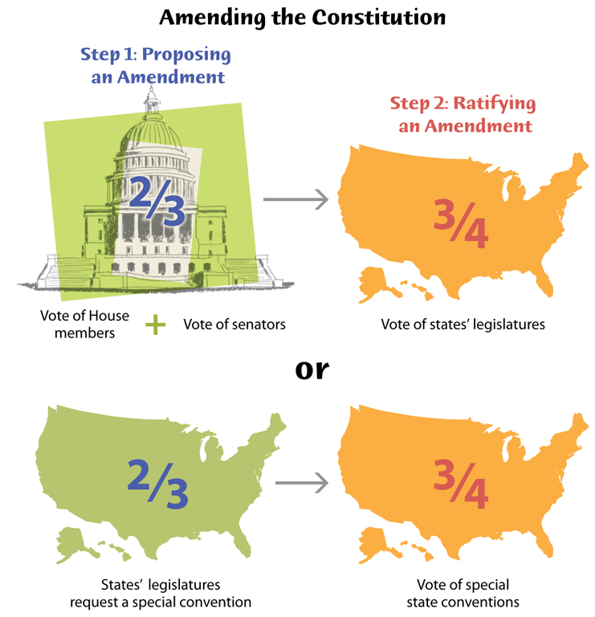
Section 2-Formal Amendments

Slide 2
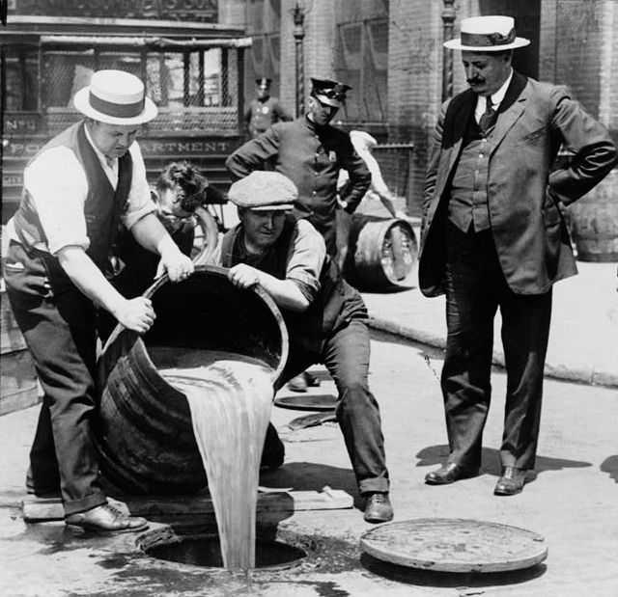
Amending the Constitution
The Constitution has stood as our fundamental document for over 200 years-in most ways, it has remained exactly the same, but several changes have been made throughout the years.

Slide 3
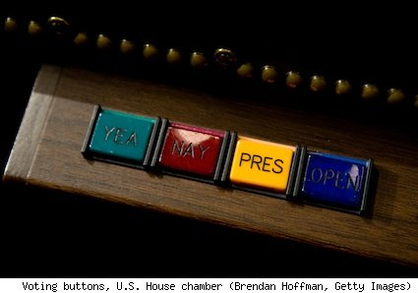
The Formal Amendment Process
The Constitution itself provides for its own “amendment”: changes in its written words. There are 2 methods of proposal and 2 methods of ratification (there are 4 total methods).
Two Methods of Proposal
  By Congress (2/3 approval in each House)
  Proposed at a national convention called by congress, when requested by 2/3 of state legislatures.
Two Methods of Ratification
  Ratified by the state legislatures of ¾ of the states.
  Ratified by conventions held in ¾ of the states.

Slide 4
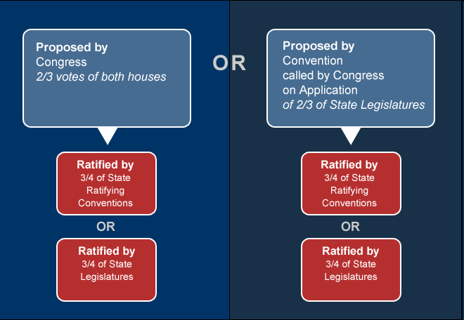
Amendment Process Options

Slide 5

Proposed Amendments
*The most common way is to be proposed by 2/3 vote in each house and ratified by ¾ of state legislatures–26 of the 27 amendments have been passed this way.
*15,000 joint resolutions calling for amendments have been proposed in Congress since 1789–33 have been sent to the states–only 27 have been passed.

Slide 6
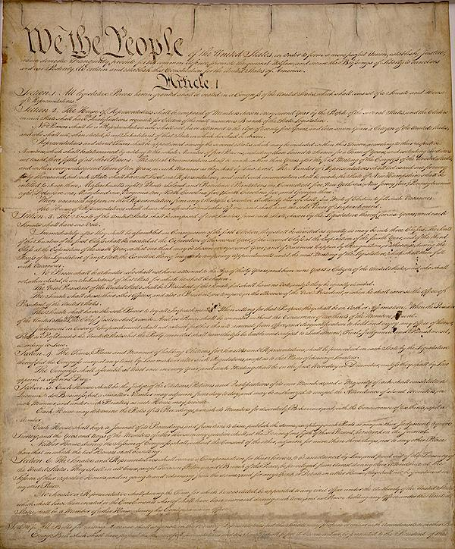
The Twenty-Seven Amendments:
“Bill of Rights”: The first ten amendments to the Constitution. These were added less than three years after ratification.
  These amendments ensure our personal freedoms (expression, speech, security, equality before the law).

Slide 7
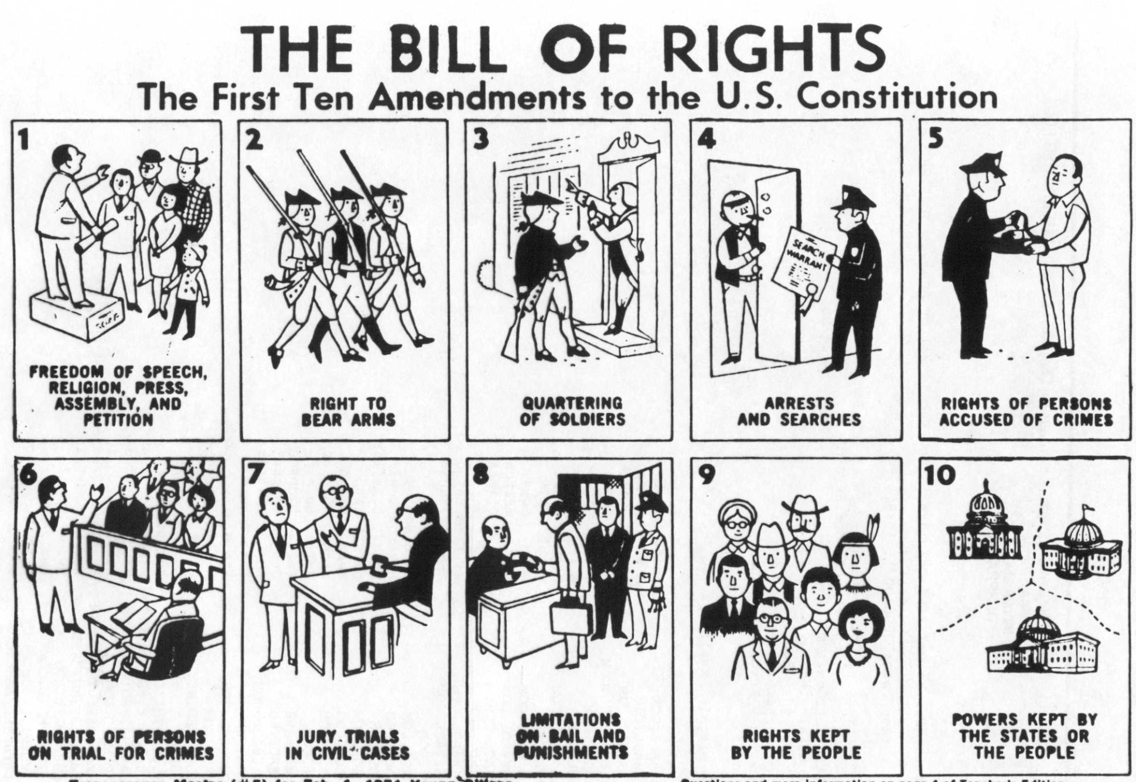

Slide 8
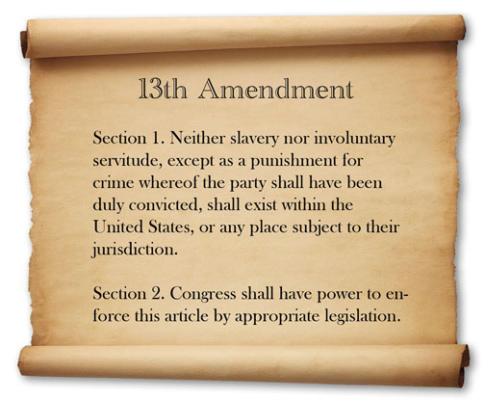
The Twenty-Seven Amendments
The Later Amendments
The next 17 amendments have been added throughout the past 200 years. Many were passed, and symbolized, historic changes (13th abolished slavery, 18th banned alcohol, 21st brought alcohol back).
*All of the amendments are intended to improve upon the existing governmental structure-they are well thought out, and viewed as necessary by the vast majority.

