Slide 1
Chapter 18
Cold War Conflicts
Test Materials

Slide 5
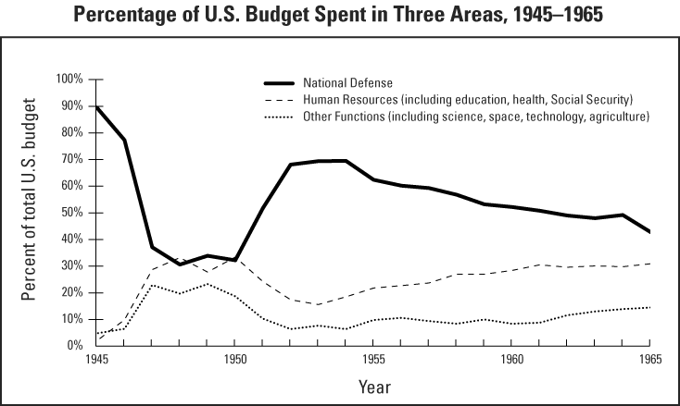

Slide 7
Document 1
“From Stettin in the Baltic to Trieste in the Adriatic, an iron curtain has descended across the continent. Behind that line lie all the capitals of the ancient states of Central and Eastern Europe… All the famous cities and the populations around them lie in the Soviet sphere and all are subject in one form or another, not only to Soviet influence, but to a very high and increasing measure of control from Russia.”
This is an excerpt from Winston Churchill’s “Iron Curtain” speech, March 5, 1946:

Slide 8
Homework packet
Ted-ED: McCarthyism Reflection Question
Chapter 18, Section 2 Notes
Cold War Trading Card Activity
Crash Course #37 Reflection Question
Cold War Webquest

