Slide 1
Cold War
Chapter 18
U.S. History

Slide 2
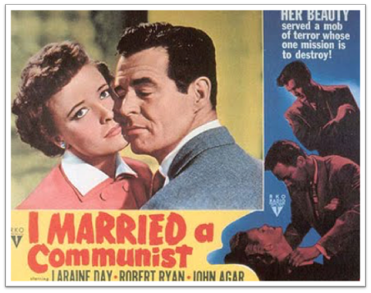
The Cold War at Home

Slide 3
Fear of a Communist Influence
People feared Communists would influence our government and we would lose civil rights
Some people said Truman was not strict enough
In response, Truman created the Loyalty Review Board is created to make sure all government employees are loyal
As a result 212 government employees are dismissed
Fear of communism grew out of control

Slide 4
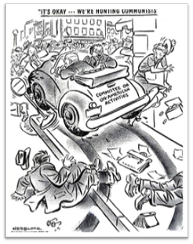
House Un-American Activities Committee:
Investigated other parts of country: Movies
Hollywood Ten-This group was arrested for not giving names of people who the government accused of being guilty
Hollywood Blacklist was also created: 500 people thought to be guilty couldn’t get work

Slide 5
McCarran Act-
Unlawful to create a dictatorship in U.S.: Took away freedom of thought and speech
Congress voted to override Truman’s veto

Slide 6
Spy Cases stun the Nation
Alger Hiss-
Charged with espionage but sent to jail for perjury
Richard Nixon made name for himself in prosecution

Slide 7
Ethel and Julius Rosenberg-
Soviets explode A bomb 1949
Secrets from U.S. scientists
Rosenberg’s were accused of leaking nuclear secrets
They were convicted and sentenced to death in electric chair

Slide 8
McCarthyism
Senator Joseph McCarthy-
Exploited people’s fear for his own gain
Claimed to have 57 names then 81 names and untimely 205 names of Communists
However he never produced a single name
He ruined lives, and scared people
When he accused the army he lost it all

