Slide 1
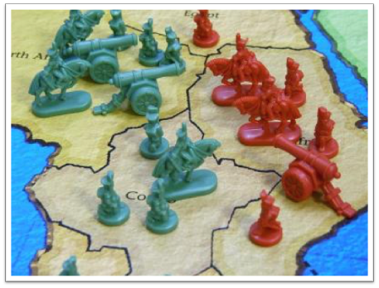
The Cold War Heats Up

Slide 2
China Becomes a Communist Country
The U.S. begins sending aid (3 billion) to the Chinese Nationalist government led by Chiang Kai-shek
The U.S. government saw the government corrupt and inefficient
U.S citizens admired the nationalists for resisting Japan during the war
Soon a new Communist party led by Mao Zedong began to gain support in China
Supported by peasants because the Communist were providing them with food and education

Slide 4
Renewed Civil War
Communist versus Nationalists
Between 1944 and 47 the U.S. continued to send military and monetary (2 billion) aid to Nationalists to oppose communism
The U.S failed to negate decease even though they were playing peacemakers
In 1949, Chinese Nationalists flee to island of Taiwan
Communists establish People’s Republic of China in mainland
With the support of the Red Army (U.S.S.R)

Slide 5
Due to their disagreement with Communist ideals the U.S. does not formally recognize the newly established Communist Chinese government
The United States public was stunned and out of fear many began blaming Truman for not opposing troops enough aid
State Departments blames the rise of communism in China on internal forces
Some believed that this was simply an excuse and that the government is filled with Communist
U.S. felt that their policy of containment failed
Lead to an increased fear of communism spreading abroad and throughout the country

Slide 6
The Korean War
Japan had annexed and ruled Korea from 1910-1945
Post WWII-Korea was Deeply Divided-
In the North, Communist forces controlled the region (after Japan had surrendered to the Soviets at the end of WWII) while the U.S. supported the efforts of the south Koreans
Similar to Germany

Slide 7
In 1950, North Korea attacked South Korea
This was after America had withdrawn most of their troops, so the Soviet Union pushed North Korea to attack by preparing them with tanks, airplanes, and money
Following this attack South Korea asks for help from the United Nations and United States
Sixteen other nations join in but the U.S. ultimately provides ninety percent of the troops (520,000 troops total)
Under the leadership of Macarthur and the might of U.S. forces North Korea was finally pushed back into their own territory
This saved his army from almost certain defeat
Seemed as if Korea would be a single country again

Slide 8
Then the Chinese aided the North Koreans, and pushed back to 38th parallel (38º N latitude)
Chinese felt threatened by the American fleet near their coast
The Korean War had escalated into a war where the main opponents were Chinese Communist versus Americans
In 1951, MacArthur suggests attacking Chinan with nuclear weapons but Truman disagrees saying that attacking China would bring Russia into the conflict and potentially start WWIII
MacArthur calls Truman “weak” and tries to go behind his back, but gets removed from his post
Wrote to newspapers, magazines and to Republican leaders
U.S people were upset by the removal of MacArthur

Slide 10
In 1951 the Soviets suggest peace talks that could end the war
Two points for peace are agreed upon:
38th parallel (38º N latitude) becomes the dividing line in Korea
The U.S.S.R. controls the area north of 38th parallel and the United States will help guide the area south of the 38th parallel
Republic of Korea (South), Democratic People’s Republic of Korea (North) were founded
A demilitarized zone (known as the DMZ) is created along this dividing line in hopes of preventing future conflicts
This was finalized in July 1953

Slide 11
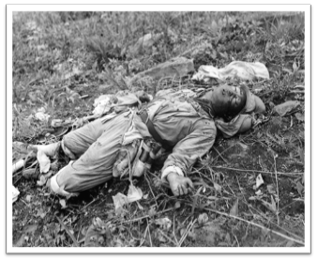
The war was a stalemate: No winner
54,000 dead Americans, cost nearly 67 billion
North Korean invaders had been pushed back and communism had been contained without the use of atomic weapons
Korea was still 2 nations, not 1
Unsuccessful war that increased the fear of communist aggression and prompted a hunt for Americans who could be blamed for the communist gains
1952-Election the country wants a new political party to lead us
Eisenhower: Republican party

