Slide 1
Cold War
Chapter 18
U.S. History

Slide 2

Former Allies Clash
•The U.S. and U.S.S.R. have different plans for their vision of Europe
•Russia-Believed in communism where the government had total control over property and economy
  No political parties, no real voting rights
•America-Believed in capitalism. A system where private citizens controlled the economy, property and held free voting right

Slide 3
•The events of the war made both the United States and Russia suspicious one another
•Harry S. Truman succeeds FDR as President
  As vice-president, Truman was not included in policy decisions and was not even aware the atomic bomb existed until he became President
•Joseph Stalin continued to lead Russia
  However, he resented that U.S. delayed attacking Germany and hid atom bomb from him

Slide 4
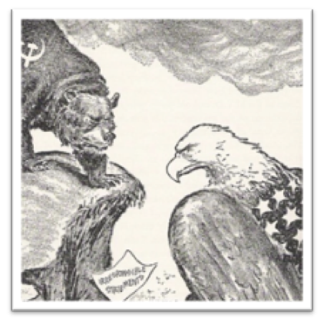
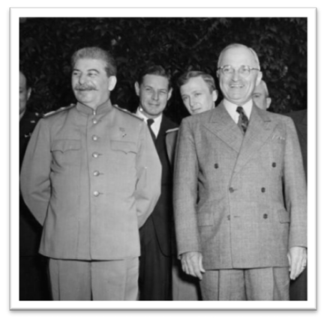

Slide 5
The United Nations
•In June of 1945 fifty nations came together to establish the United Nations established as new peacekeeping body
•UN becomes the arena where U.S. and U.S.S.R. would attempt to spread their influence
•Many hoped a lasting peace could be achieved

Slide 6
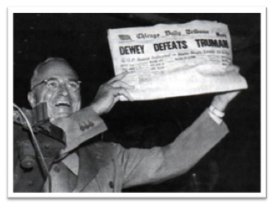
Truman Becomes President (Again)
•Truman’s Role:
–Had been kept out of main decisions during war
–Forced to jump in without background knowledge

Slide 7
Potsdam Conference
•In July 1945 a conference led by Harry Truman of the U.S., Clement Atlee of Great Britain and Joseph Stalin of the Soviet Union met to lay the foundations for a post war world
•Stalin had gone back on promises for free elections
  Democracy wasn’t allowed in the Soviet controlled territories
    The U.S. wanted this to help open trade doors fearing that the more communist countries that existed the stronger the Soviet economy would become

Slide 8
Bargaining at Potsdam
•Truman becomes convinced that U.S., Soviet aims deeply at odds
•Soviets want reparations from Germany due to the fact that they lost over twenty million men
  Truman objects to this request
•The U.S.S.R agrees to take reparations mainly from own occupation zones known as satellite nations
•U.S. emerges from war as great economic power and wants Eastern European raw materials, markets

Slide 9
Potsdam Conference
•As a response the U.S. established the policy of containment which aimed to prevent the spread of communism
•Europe Became Divided-The eastern block of Europe was Communist controlled while the west became a non-communist area
•Churchill described the division by saying that “an Iron Curtain had fallen across Europe”

Slide 10
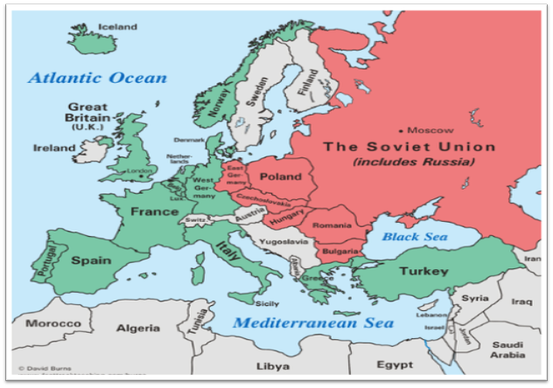

Slide 11
The Cold War in Europe
•The Cold War was a state of geopolitical tension after World War II that lasted from 1945 until the collapse of communism in 1991.
  This ideological conflict was mainly between powers in the Russian controlled Eastern Bloc and powers in the U.S. influenced Western Bloc.

Slide 12
•Truman Doctrine-Believed in containment by giving money to countries in jeopardy of being taken over by Communism
  U.S. replaces British aid to Greece and Turkey in order to reduce communist threat
•The Marshall Plan-In 1947, Secretary of State George Marshall proposes giving aid to any nation in need who is fighting off the advance of communism
    Under this plan sixteen nations receive over thirteen billion dollars in aid

Slide 13
Germany
•Following the Potsdam Conference Germany is divided into four zones
  A British, French, Russian and United States led zone
    However, Great Britain and France were still recovering from war so control ultimately fell to the U.S. and Russia
  Later it was split into an eastern and western block
    Berlin was shared but technically in Soviet territory. So it was divided and the Soviets agreed to keep road open

Slide 14
•Berlin Airlift-
  The United States and Great Britain conducted 227,000 flights over a period of 327 Days
  During the Berlin Airlift nearly 2.3 million tons of supplies were dropped into the city of Berlin

Slide 15
North Atlantic Treaty Organization
After seeing what happened in Germany people got nervous
So twelve countries (Belgium, the Netherlands, Luxembourg, France, and the United Kingdom, United States, Canada, Portugal, Italy, Norway, Denmark and Iceland) came together to form NATO for protection
Own military

