Slide 1
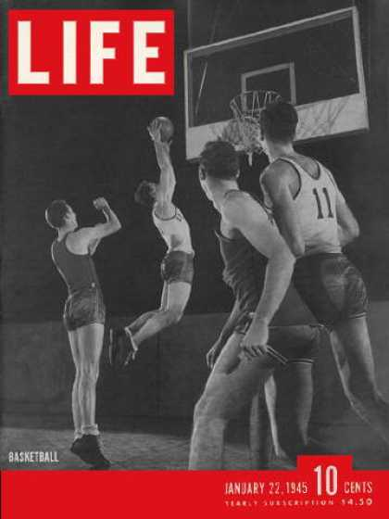
Section 4-The Home Front

Slide 2
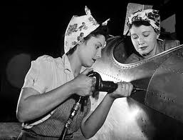
Opportunity and Adjustment
Economic Gains-
The war provided Americans with new economic opportunities
The U.S. will emerge from WWII as a dominant economic and military power
During the war many new jobs become available and defense rapidly spending increases
Unemployment falls to 1.2% in 1944
Roughly six million women entered the work force during WWII
Increasing the percentage of women working to 35%
The average American income increases by 10%

Slide 3
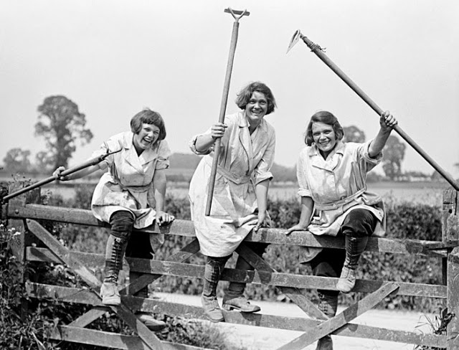
Opportunity and Adjustment
Farmers prosper from rising crop prices and the increased need for food during the war
This increase in food production allowed many farmers to pay off the mortgages on their homes and truly prosper for the first time since the beginning of the Great Depression
This isn’t the case for everyone as the war does triggers mass migrations away from rural areas to towns where were producing defense goods

Slide 4
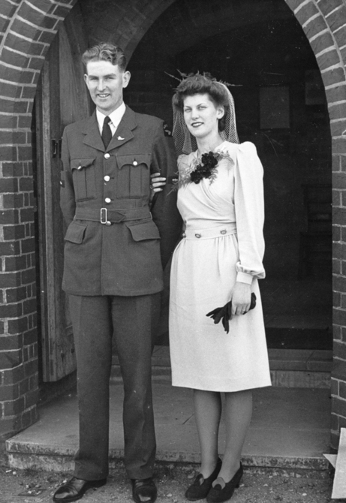
Opportunity and Adjustment
Social Adjustments-
Families adjust to mothers being left to raise the children alone while their fathers are away from home serving in the military
This creates a situation where families must get to know each other again and readjust their roles after the war
Many young couples rush to marry before these “boys” head overseas
In 1944 the G.I. Bill of Rights or Servicemen’s Readjustment Act is passed offering returning soldiers paid education, affordable loan guarantees for homes and loans to start new businesses

Slide 5
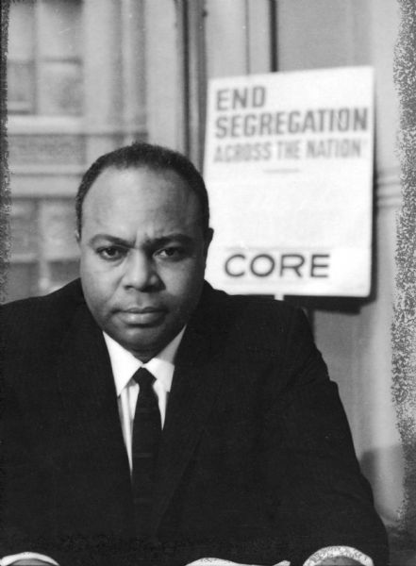
Discrimination and Reaction
Civil Rights Protests-
Racial tensions begin to rise in overcrowded Midwestern and Northern cities where many African Americans moved to find work
African-Americans rallied together to protect their rights by joining organizations such as CORE (Congress for Racial Inequality) headed by James Farmer
Their goal was to try and end racial segregation in the North and in 1942 first sit ins occurred in Chicago, Illinois

Slide 6
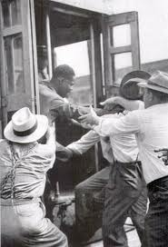
Discrimination and Reaction
In 1943 racial violence sweept across country
The Detroit riots in June of 1943 were amongst the worst.
The conflict began on Belle Isle between a group of blacks and whites. Soon a group of white sailors jumped in and a full out riot raged
FDR had to call in military troops.
In the end nine whites and twenty five African-Americans died in the conflict

Slide 7
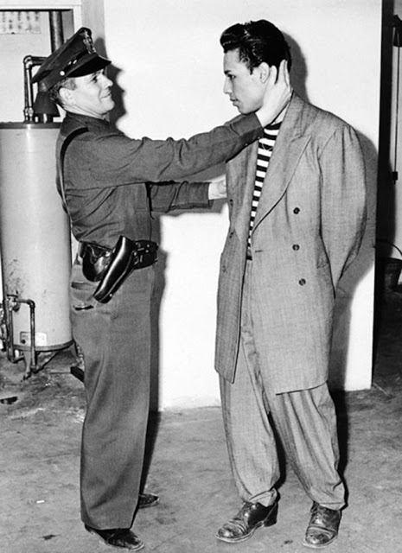
Discrimination and Reaction
Across the country in Los Angeles a group of U.S. sailors claimed that they were attacked by Mexican-Americans wearing “zoot suits”
This led to thousands of angry servicemen going into Mexican neighborhoods attacking anyone dressed in Zoot suits and beat them
These “Zoot Suit Riots” were an embarrassing example of racial predigest and uncontrolled anger

Slide 8
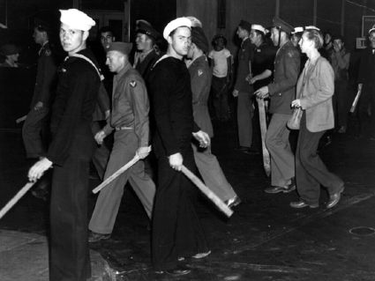

Slide 9
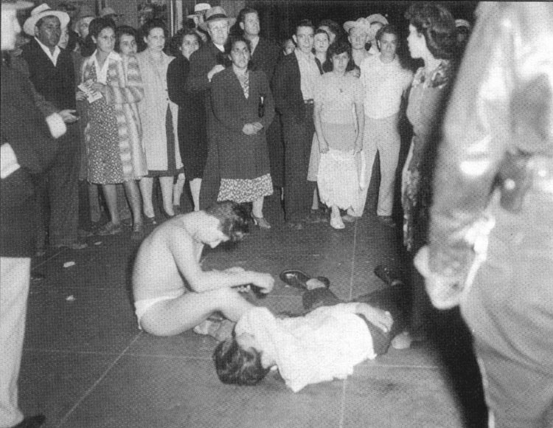

Slide 10
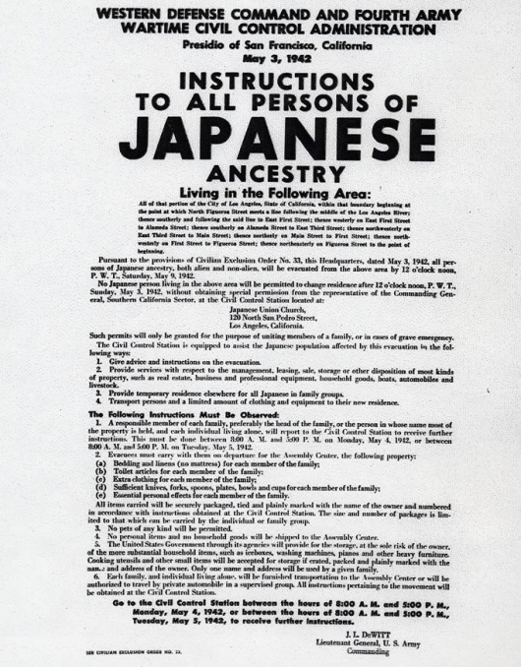
Discrimination and Reaction
Japanese Americans Placed in Internment Camps-
Hawaii governor forced to order internment (confinement) of Japanese
1942 FDR signs Executive Order 9066 which removes nearly 110, 000 Japanese Americans in four states
Oregon, Washington, California and Arizona
U.S. Army forces 110,000 Japanese Americans into prison camps
1944 Korematsu v. United States—Court rules in favor of internment

Slide 11
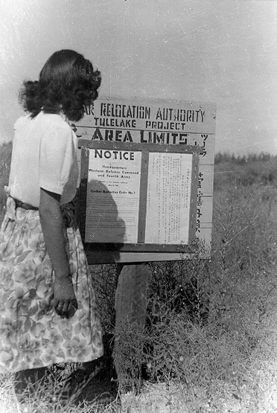
Discrimination and Reaction
Ironically in California only 1% of population was comprised of Japanese Americans yet many feared if Japan invaded the U.S. these Japanese Americans would turn against us and aid Japan in their efforts

Slide 12
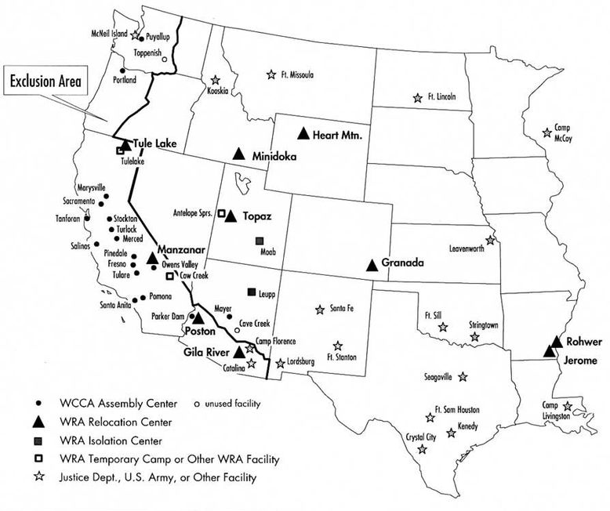

Slide 13
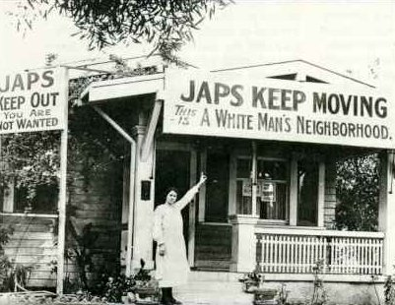

Slide 14
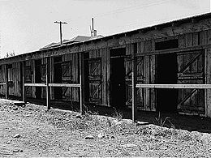

Slide 15
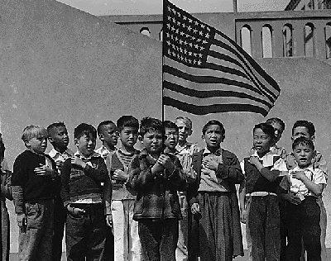

Slide 16
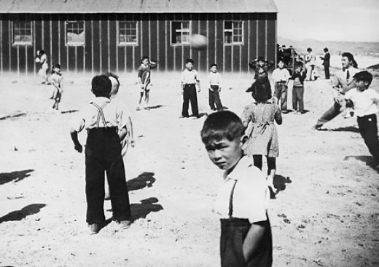

Slide 17
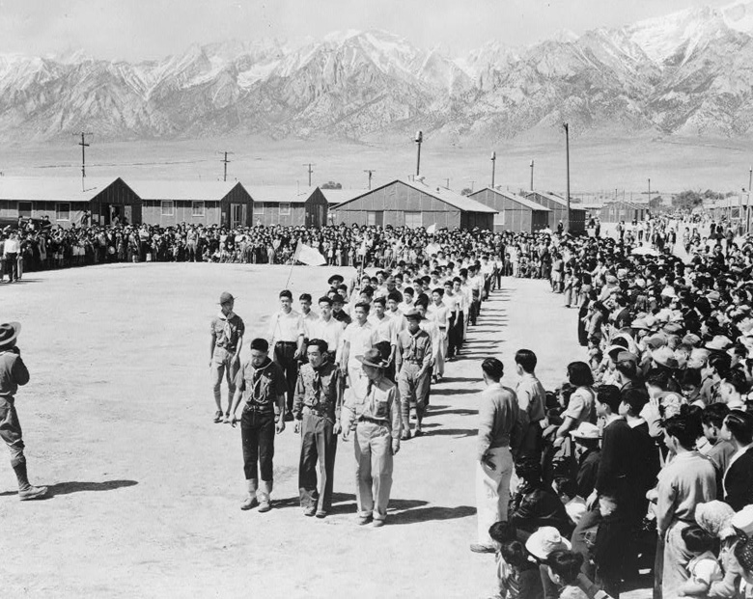

Slide 18
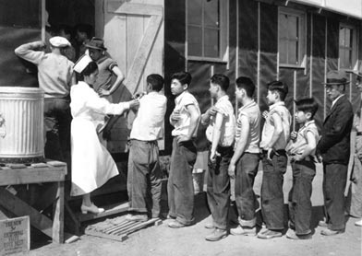

Slide 19
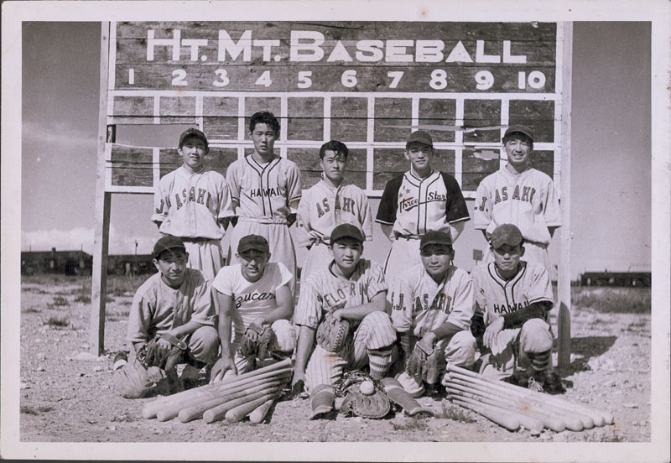

Slide 20
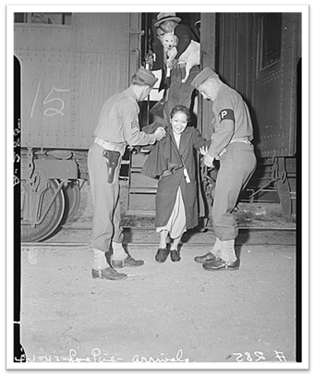
Discrimination and Reaction
On January 2, 1945, the exclusion order was rescinded
The freed internees were given $25 and a train ticket home
After war, Japanese American Citizens League pushes for compensation but nothing is done until 1988 when Congress grants reparations of $20,000 to everyone sent to relocation camp

