Slide 1
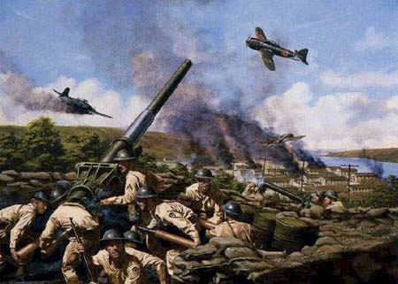
Chapter 17-Section 3-The War in the Pacific

Slide 2
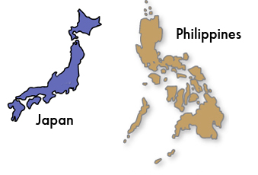
The Pacific Theater
Japan victorious at first
  Took Hong Kong, Indochina, Asia and most of Pacific
Japan took the Philippines from America
  Forced Macarthur to flee to Australia
    He reluctantly flees but vows to return before the war is over

Slide 3
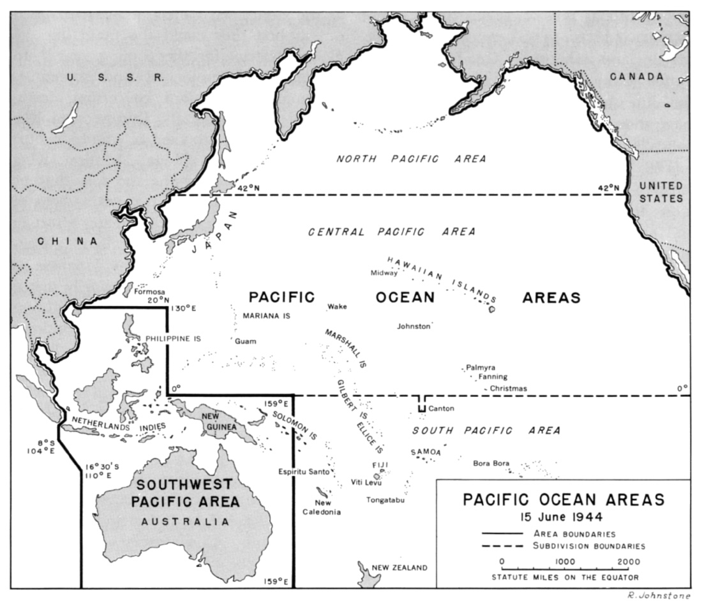

Slide 4
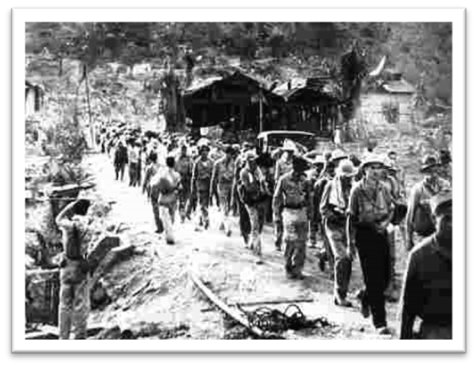
The Pacific Theater
The Bataan Death March-
  The forced march of American and Filipino prisoners of war by the Japanese during World War II.
    The 63-mile march where an estimated 60,000–80,000 prisoners from the southern end of the Bataan Peninsula in the Philippines on April 9, 1942.
      Its estimated that somewhere between 5,000 to 18,000 Filipinos and 500 to 650 Americans died during the march

Slide 5
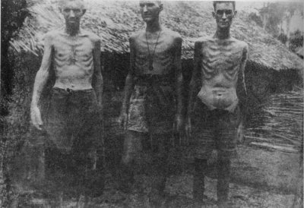

Slide 6
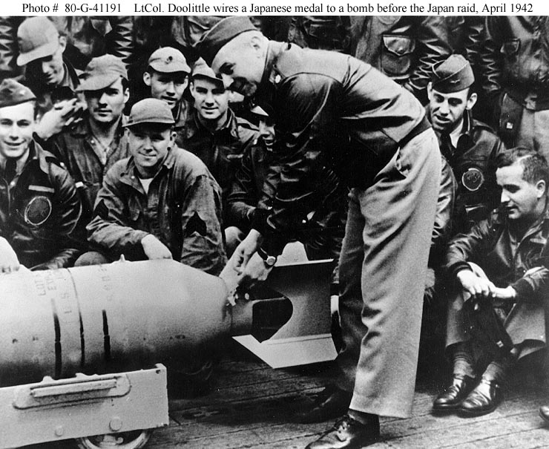
U.S. Needed a Victory
Doolittle’s Raid-
  American Lt. Col. Jimmy Doolittle led 16 bombers in an attack on Tokyo and other cities in April 1942
  Attack did little damage to the city of Tokyo and was strategically pointless but it boosted America’s morale by showing Japan we would fight back

Slide 7
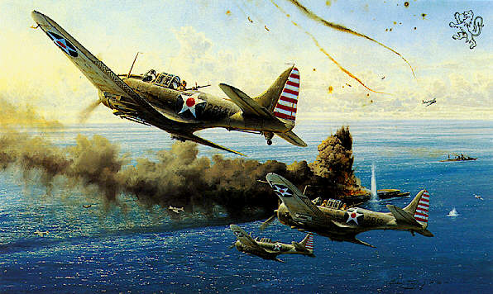
U.S. Needed a Victory
The Battle of the Coral Sea-
  This battle took place off the cost of Australia
    Americans and Australians pilots stopped Japanese forces during a five day battle
Completely aerial battle between planes launched from carriers
  First time in history a battle was fought without land or naval forces
No clear winner in the battle but the Allies were able to turn Japan back and block the invasion of Australia

Slide 8
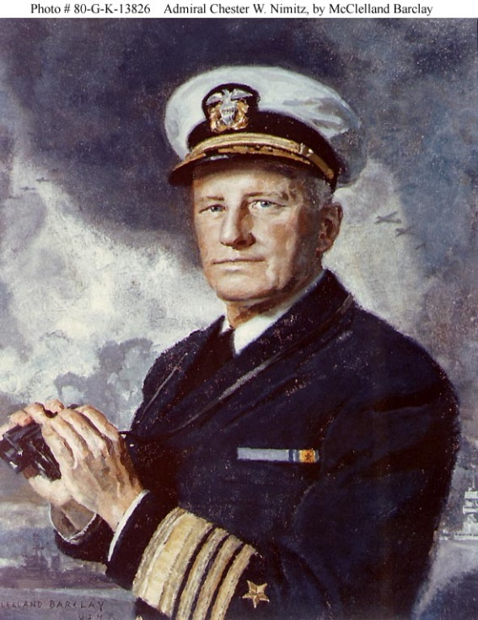
U.S. Needed a Victory
Battle of Midway-
  Naval battle around Midway Island located in the Central Pacific Ocean
    Admiral Chester W. Nimitz was placed in charge
  The U.S. destroyed four Japanese carriers and two hundred fifty airplanes
This decisive win was the turning point in the war
  We broke Japanese code
  Finally found fleet with our scout planes

Slide 9
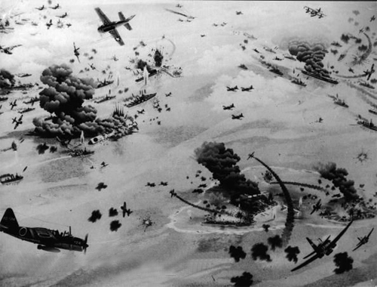

Slide 10
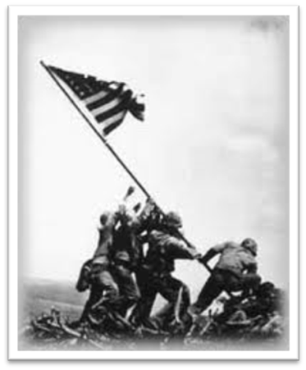
U.S. On the Offensive
The Americans used the strategy of Island Hopping–They would capture lightly-defended islands throughout the Pacific, one by one, until they had “HOPPED” their way towards Japan
The Pacific Ocean was so BIG that the U.S. needed a way to get closer to Japan This would get the U.S. within striking distance of Japan & allow the U.S. to set up bases to refuel/resupply at all of the conquered islands along the way
One of the most famous conflicts too place on Iwo Jima in 1944. An island needed for bomber attacks on Japan
  21,000 Japanese soldiers attempted to defend the island
    Only two hundred of these soldiers survived
  6,000 U.S. Marines died

Slide 11
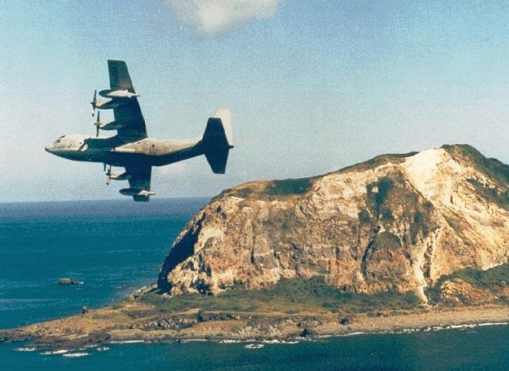

Slide 12
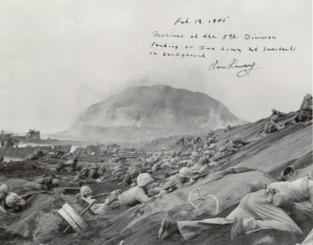

Slide 13
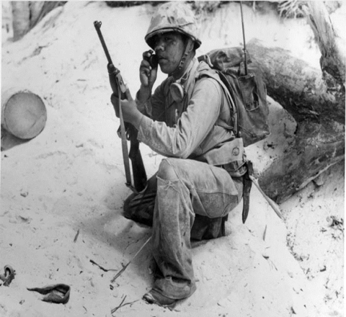
U.S. On the Offensive
Battle of Guadalcanal-
  Took place in August 1942
    Americans win first major land victory on the island of Guadalcanal
The U.S. military also started using Navajo Indians as “Code-talkers”
  Helped the U.S. communicate safely without the Japanese translating our messages or breaking our codes
    Only about 25 non-Navajo people in the entire world could speak the language
    Made up words for terms that didn’t exist in their language (names of birds meant “airplanes” and the word “egg” actually meant “bomb”)

Slide 14
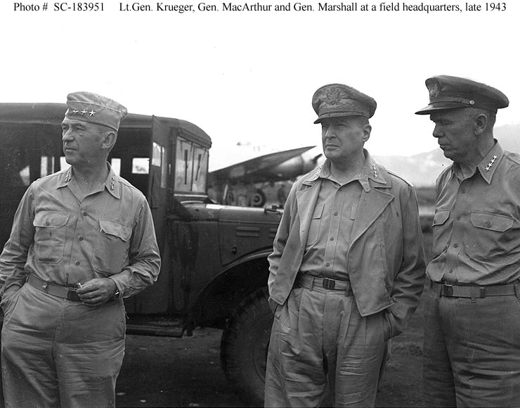
U.S. On the Offensive
The Philippine Islands-American returned to the Philippines in October 1944 after “Island Hopping” our way there
  General MacArthur made good on his promise to “return” to the Philippines

Slide 15
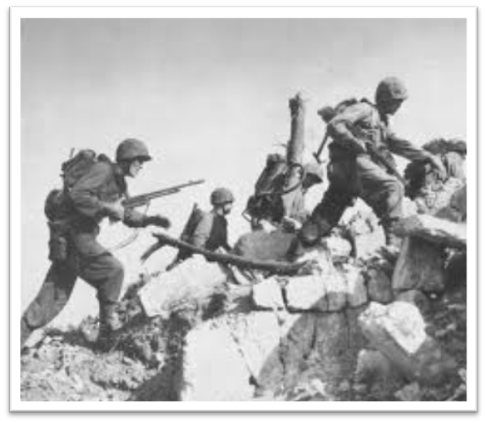
U.S. On the Offensive
The Battle of Okinawa took place in 1945
  Japanese defend this island fiercely
  110,000 Japanese Soldiers die during the battle
    There were 1,900 kamikaze attacks
    Japanese suicide pilots who flew planes loaded full of explosives
      Their goal was to crash their planes into enemy ships
      Often were inexperienced pilots with outdated equipment
    Japanese Generals commit the Japanese ritual suicide known as hari kari rather then surrender
Last hurdle before U.S. would invade Japan
  7,600 U.S. soldiers died as well

Slide 16
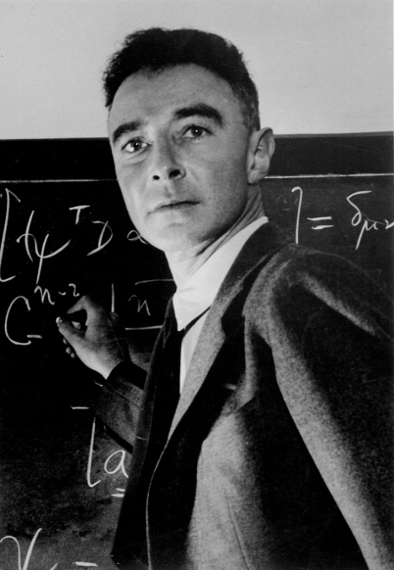
The Manhattan Project
U.S. feared that an invasion of Japan would result in 200,000 American casualties and perhaps as many as one to two million Japanese casualties
U.S. considers using an “Atomic Bomb” to end the war quickly
  Bomb had been developed as part of the “Manhattan Project” led by J. Robert Oppenheimer in 1942
  First tested in New Mexico in 1945
    It was a success but no one realized the long term effects it could have on those exposed

Slide 17
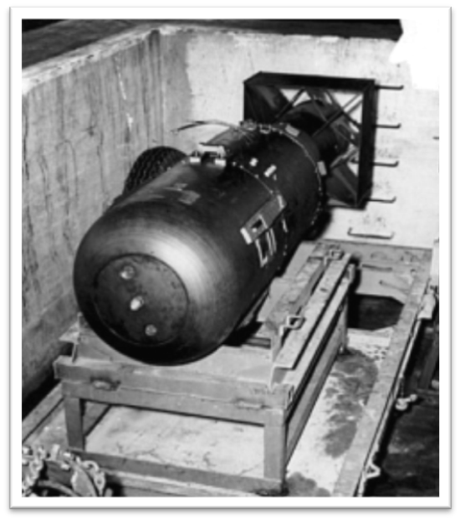
The Manhattan Project
President Truman had no knowledge of the device prior to becoming president.
  However, once he decided to use it he warned Japan to either surrender or else face “complete destruction”
  Japan refused so the U.S. dropped two bombs.
    One on Hiroshima named “Little Boy”(70,000 killed) and one on Nagasaki named “Fat Man”(40,000 killed)
Japan surrenders five days later on September 2nd, 1945

Slide 18
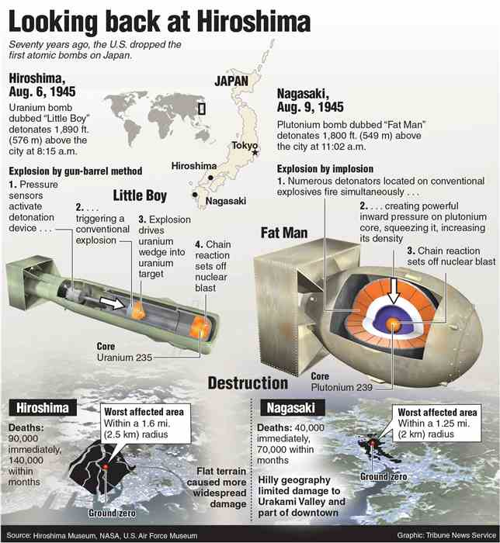

Slide 19
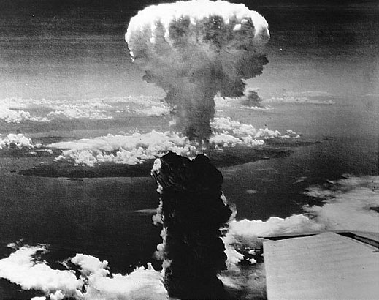

Slide 20
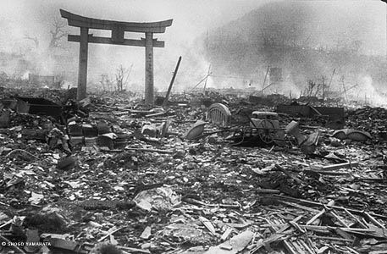

Slide 21
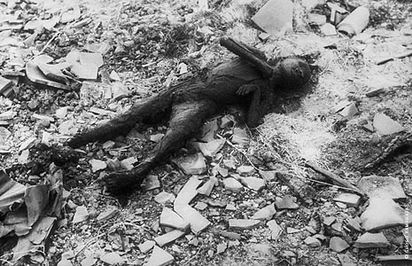

Slide 22
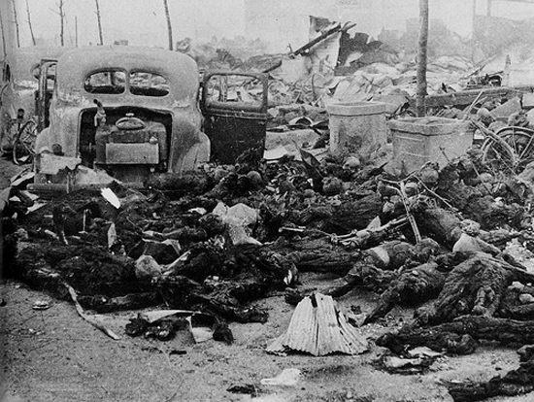

Slide 23
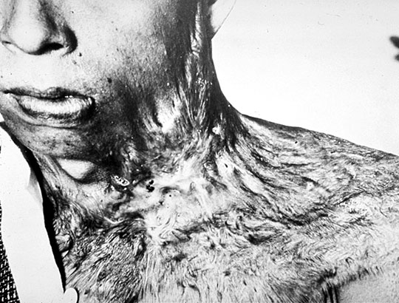

Slide 24
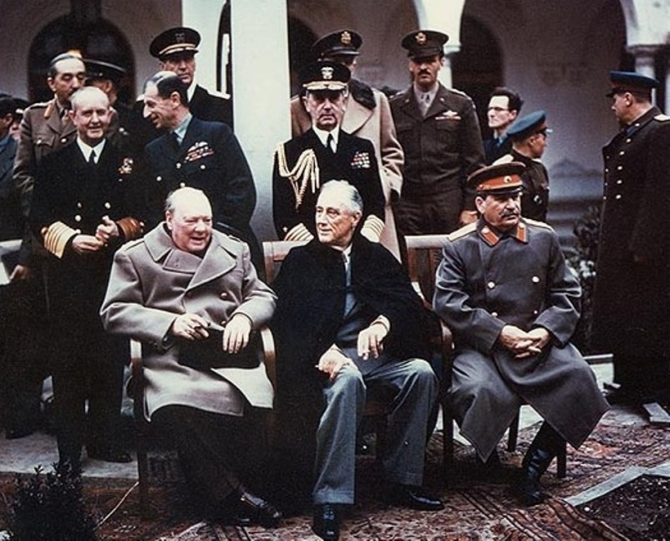
Rebuilding
The Yalta Conference was held from February 4th to 11th, 1945.
  FDR, Churchill and Stalin met to discuss Europe's postwar re-organization.
  The Soviets wanted to punish Germany for their actions.
    However, after reflecting on the damage the Treaty of Versailles inflicted on Germany following WWI Britain suggested leniency

Slide 25
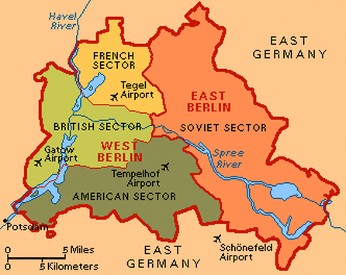
Rebuilding
In the end Germany would undergo denazification and demilitarization before it was divided into four zones controlled by the U.S., Britain, France and The USSR
  With a goal to create a free Germany
Russia agreed to free elections in Poland and Eastern Europe
Stalin would join in war against Japan
  Also agreed to hear plans for U.N.
It was also agreed to prosecute any Nazi war criminals they discovered

Slide 26
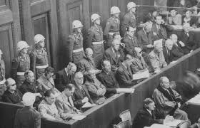
Nuremberg Trials
The Nuremberg Trials-Following WWII two sets of trials took place for Nazis involved in crimes committed during the Holocaust.
  The first, and most famous, began on November 20, 1945.
  Someone had to be responsible for Death Camps so many military leaders and industrialists on trial
Two hundred people were found guilty of committing war crimes
  Twelve of the twenty-four convicted were sentenced to death

Slide 27
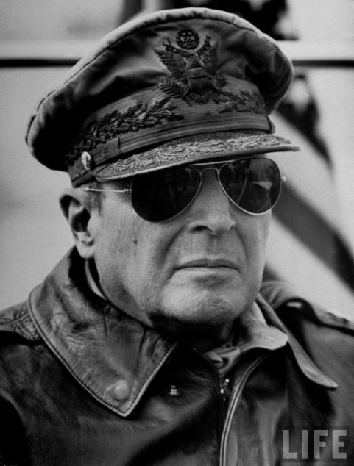
Japans Future
Following the bombings the U.S. maintained a positive presence in Japan helping them rebuild
  This effort was led by General McArthur who helped institute a new constitution
    Nicknamed the “McArthur Constitution” included an introduction of capitalist and free market ideas as well as for the first time in Japan’s history a guarantee of women's suffrage
  Japanese officials who had committed war atrocities were put on trial

